Slide 1


Slide 2
Protection of nature in Germany

Slide 3

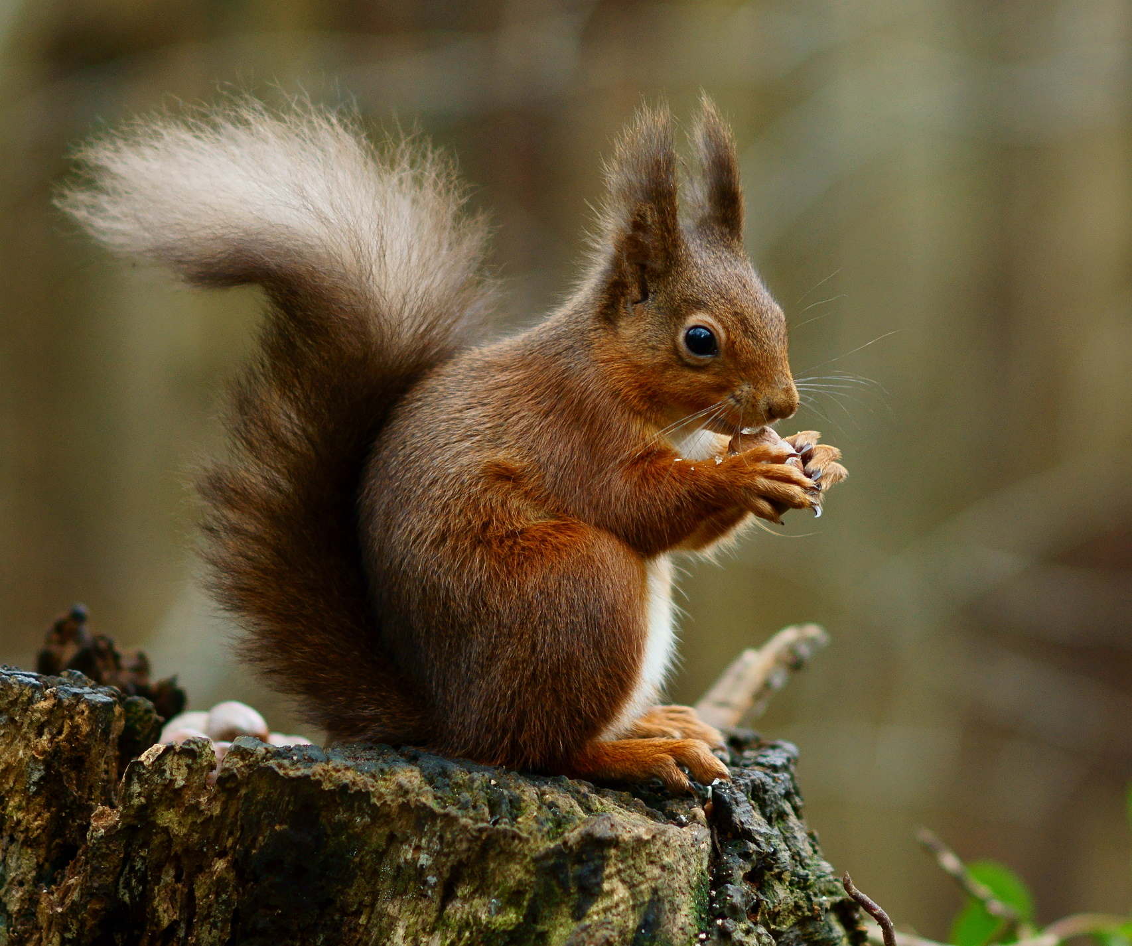
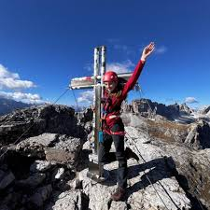
Introduction
nature protection is about making sure people do not ruin the nature
the main purpose is to protect animals and plants
keeping the rivers and forests clean
reducing pollution and the destruction of natural areas

Slide 4
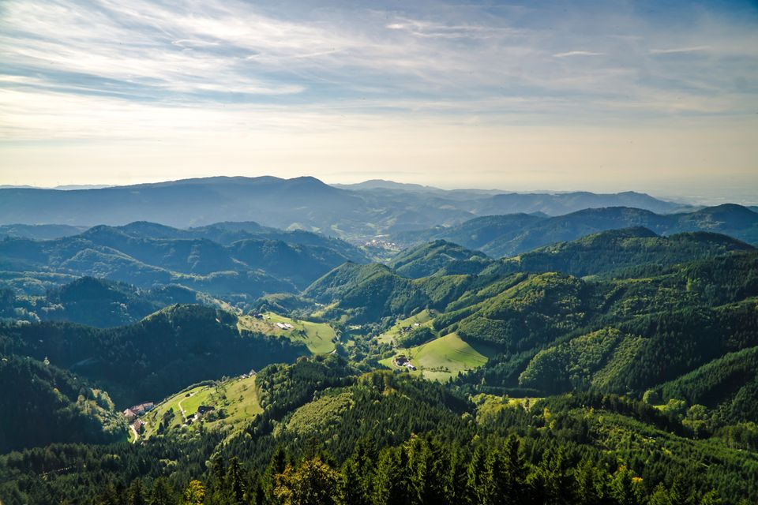

Types of protected areas
National parks
Biosphere reserves
LSG (Landschaftsschutzgebiete) - CHKO
Nature parks

Slide 5

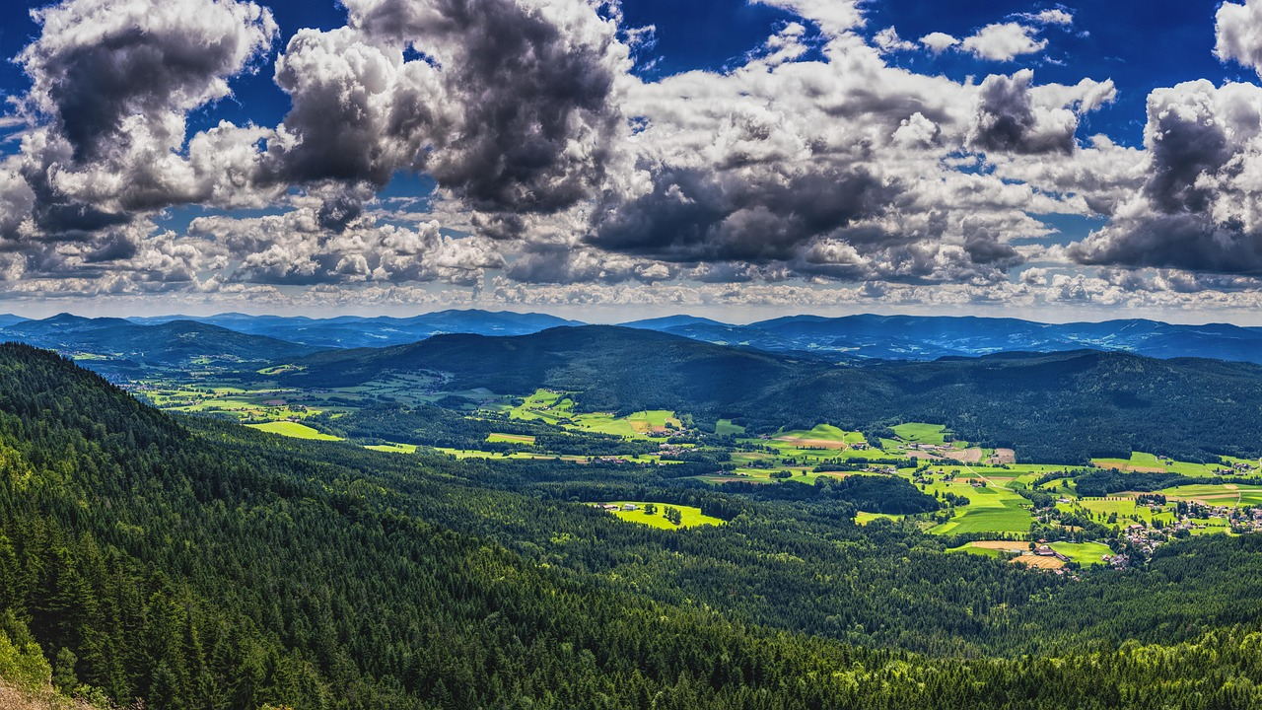
National parks
16 national parks in all of Germany
total area of 1 050 442 hectares
Bavarian forest is the oldest NP (1970)
Schleswig-Holstein Wadden Sea is the biggest (441 500 hectares)

Slide 6


Protection of NP
it is forbidden to harvest wood, pick up plants and hunt animals
banned to camp and make fires
hiking is allowed only on special routes
villages in NP are not included in the NP

Slide 7
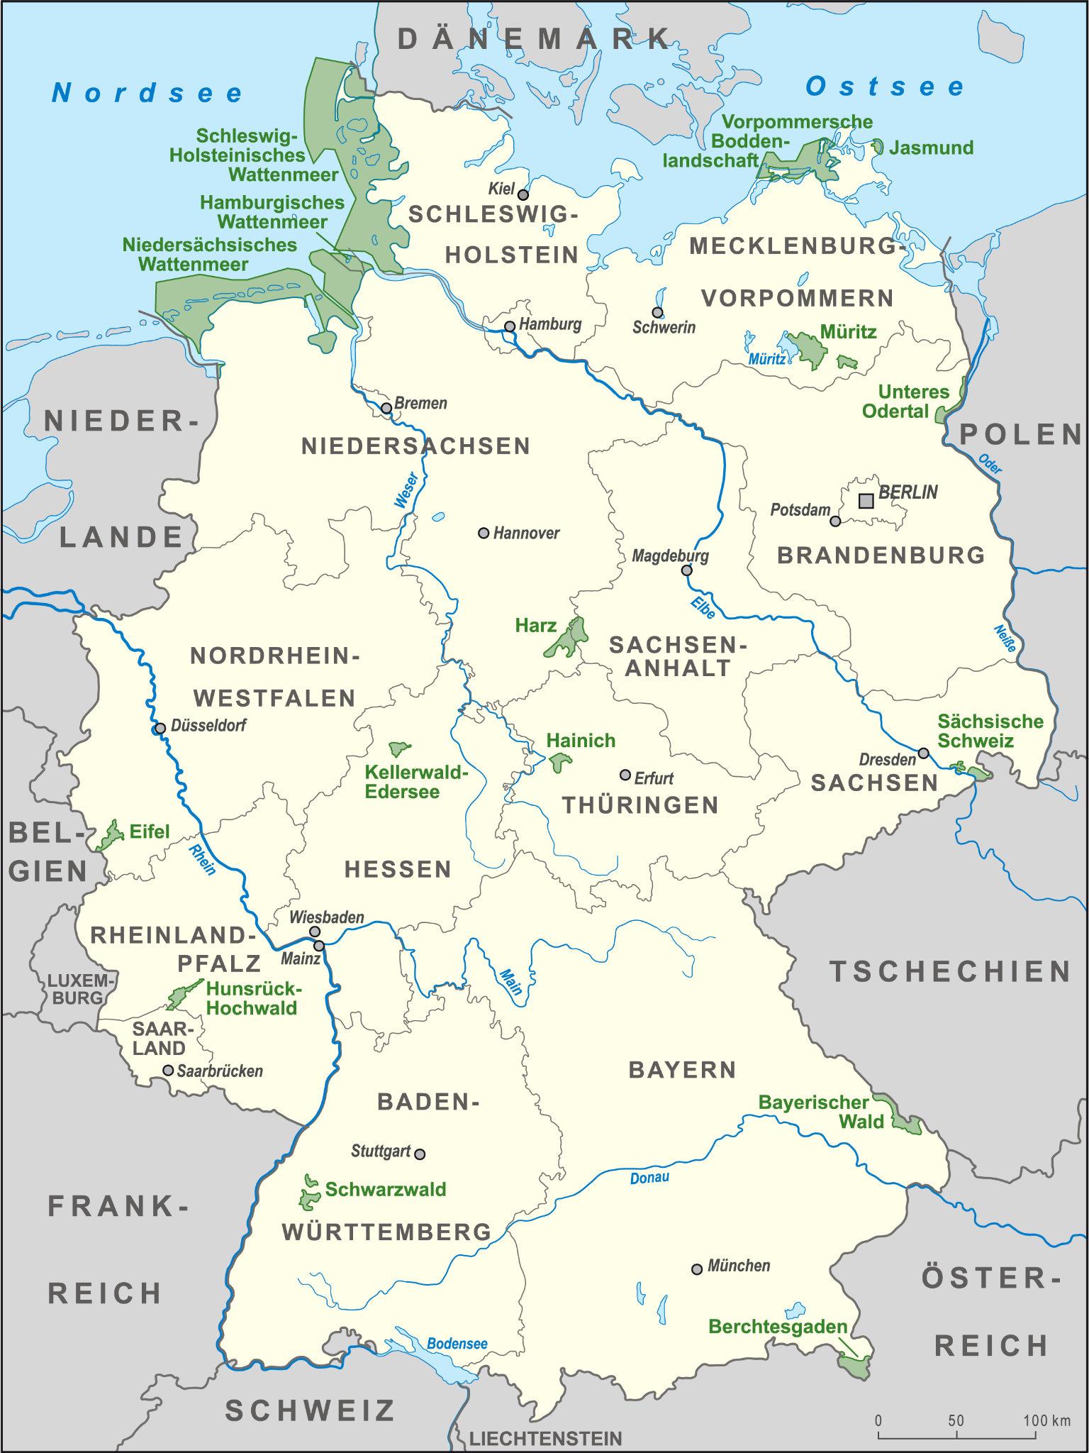
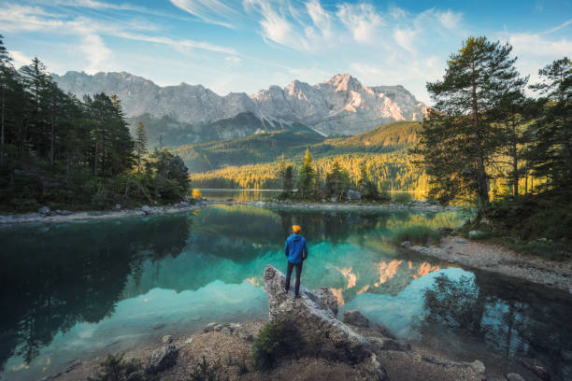
German national parks

Slide 8
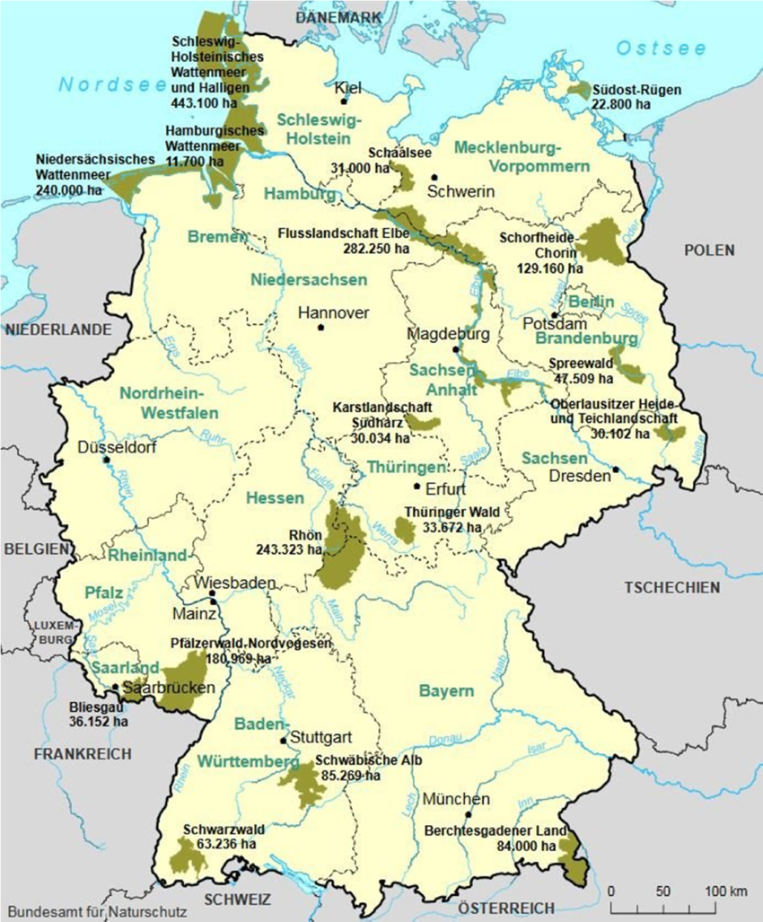
Biosphere reserves
they are part of the UNESCO program
17 BR in Germany
some NP are part of the Biosphere
reserves

Slide 9
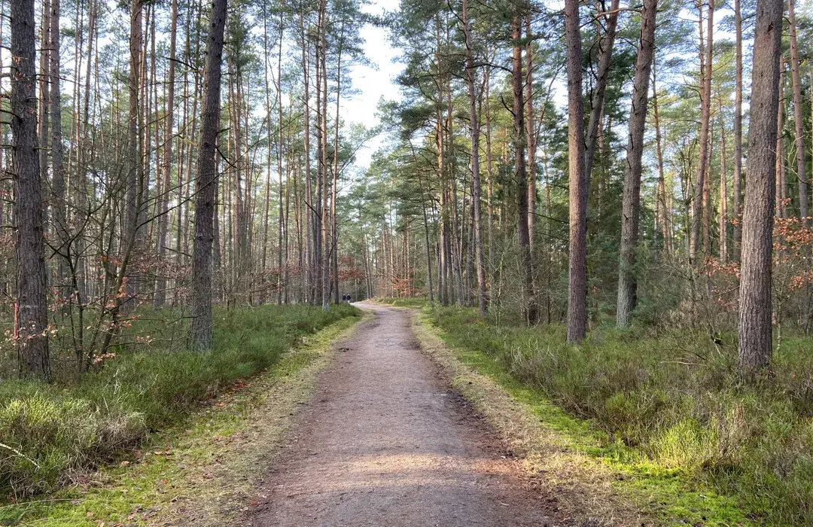
LSG
the rules are less strict than in NP
they are basic parts of german nature
agriculture and forestry are allowed
throwing out trash and building houses
is forbidden

Slide 10
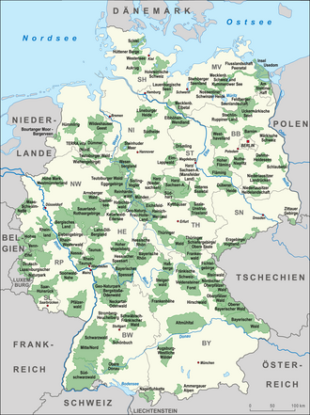
Nature parks
big protected areas similar to NP but less
strict
agriculture, forestry and tourism are allowed
buildings, pollution or industrial impact are
prohibited

Slide 11
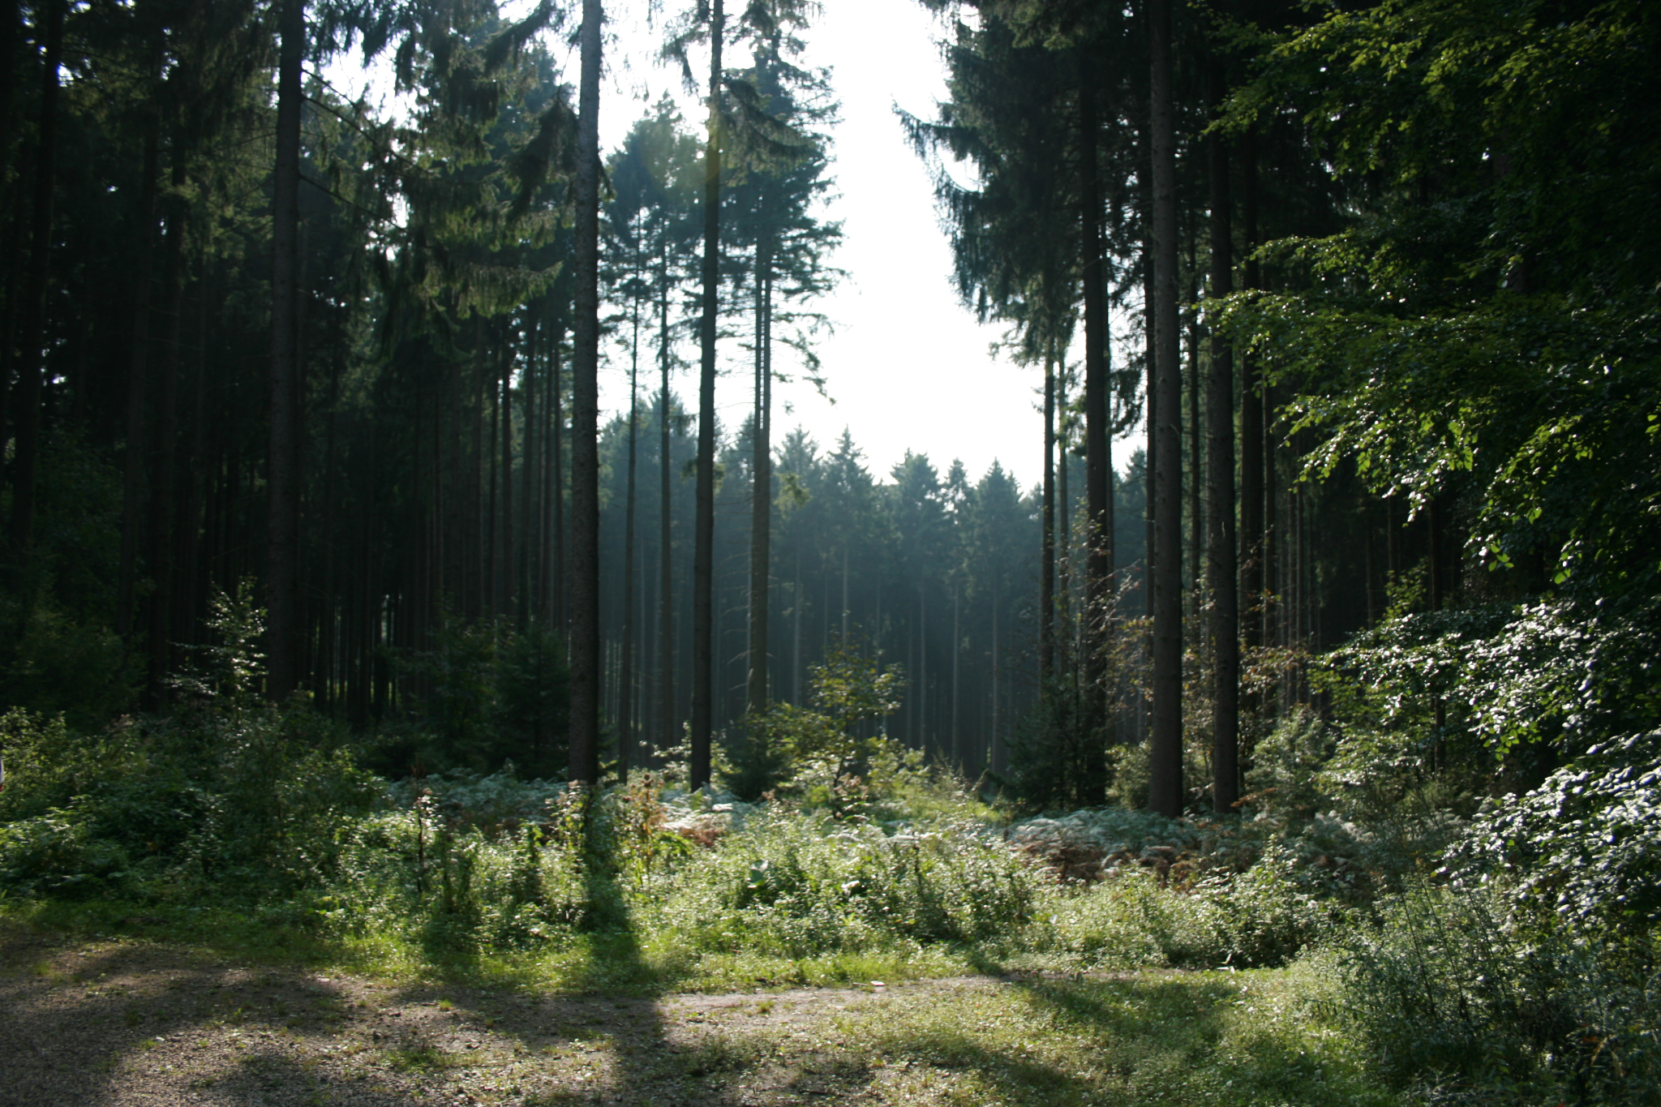
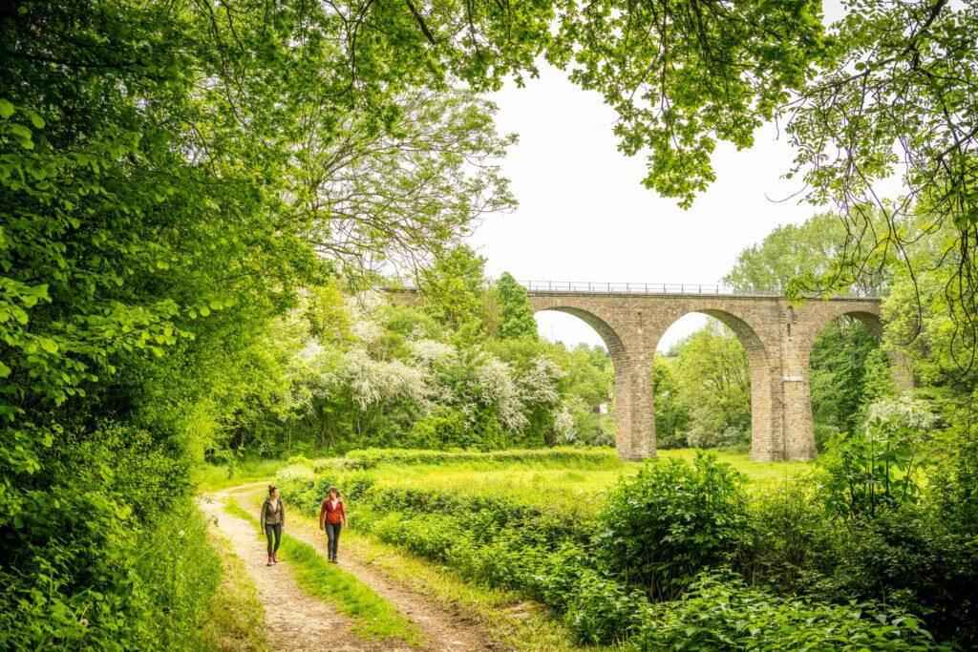
Protection of nature in Aachen
Aachener Wald - right next to Aachen (some small LSG zones)
Naturpark Hohes Venn-Eifel - closest big protected area
15-30 minutes from Aachen

Slide 12



Thank you for your attention
Danke!!!

