Slide 1


Slide 2

Invasive species
Dospivová, Dvořák, Kaňák, Mettler

Slide 3

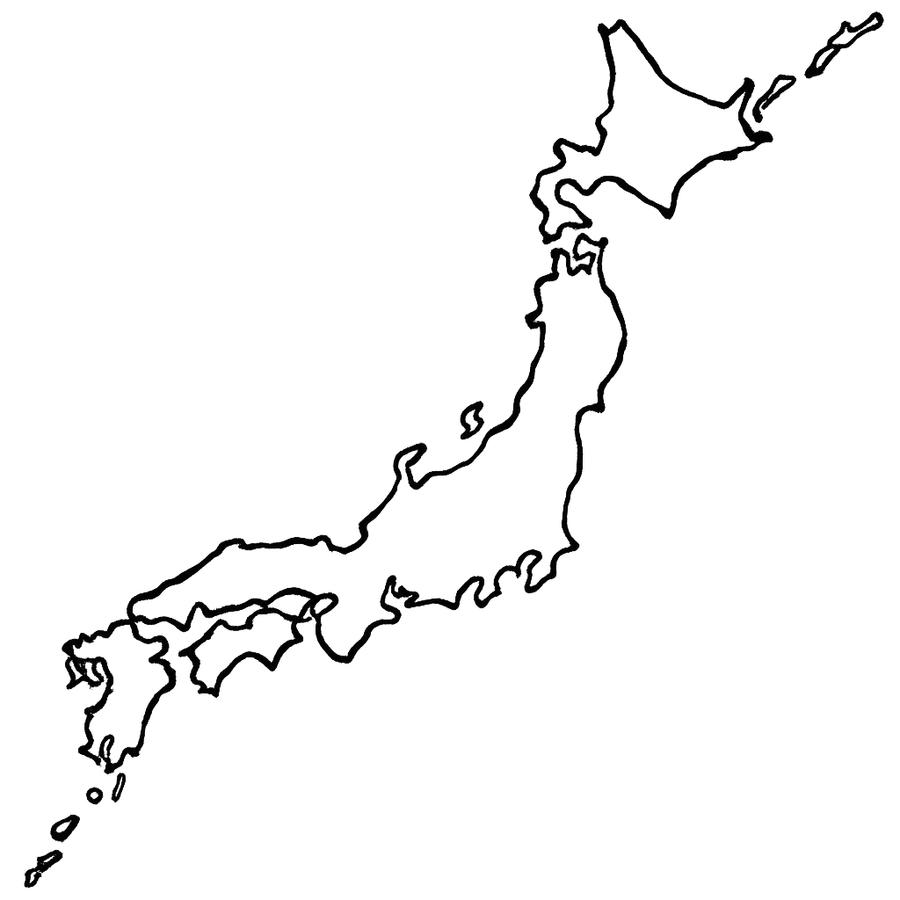
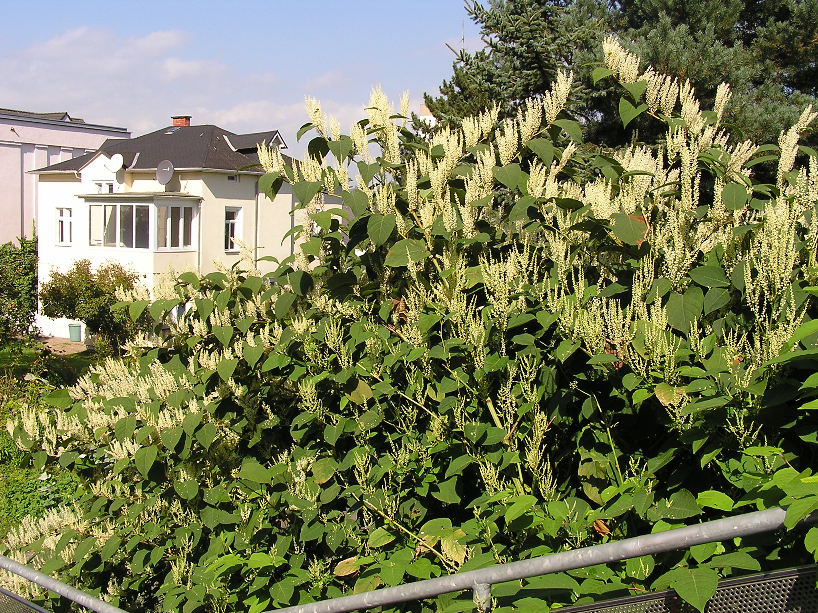
křídlatka japonská
Height about 2 meters or less
It has a habit of growing in large packs
Its origins trace back to North eastern Asia
It was used as a flower for parks
Even a small piece can grow into a full plant
It has a large root system makes it very difficult to get rid of

Slide 4
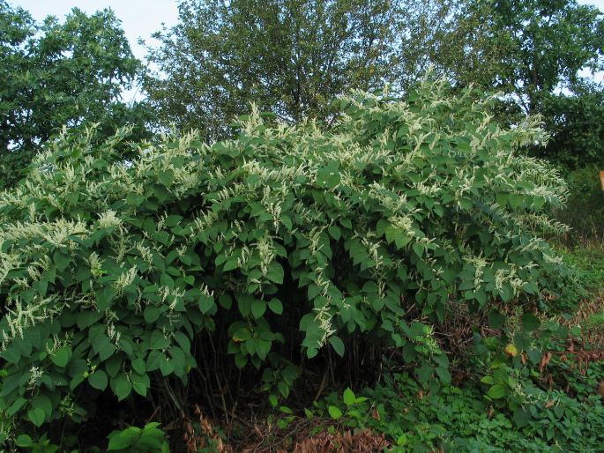
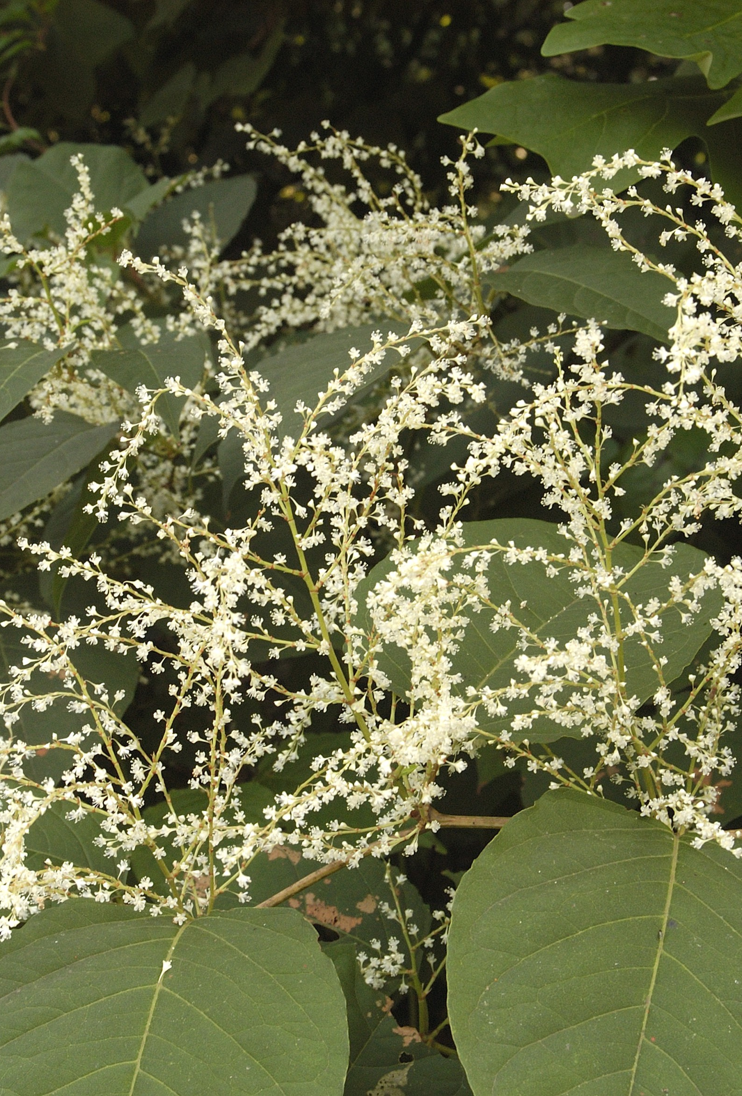
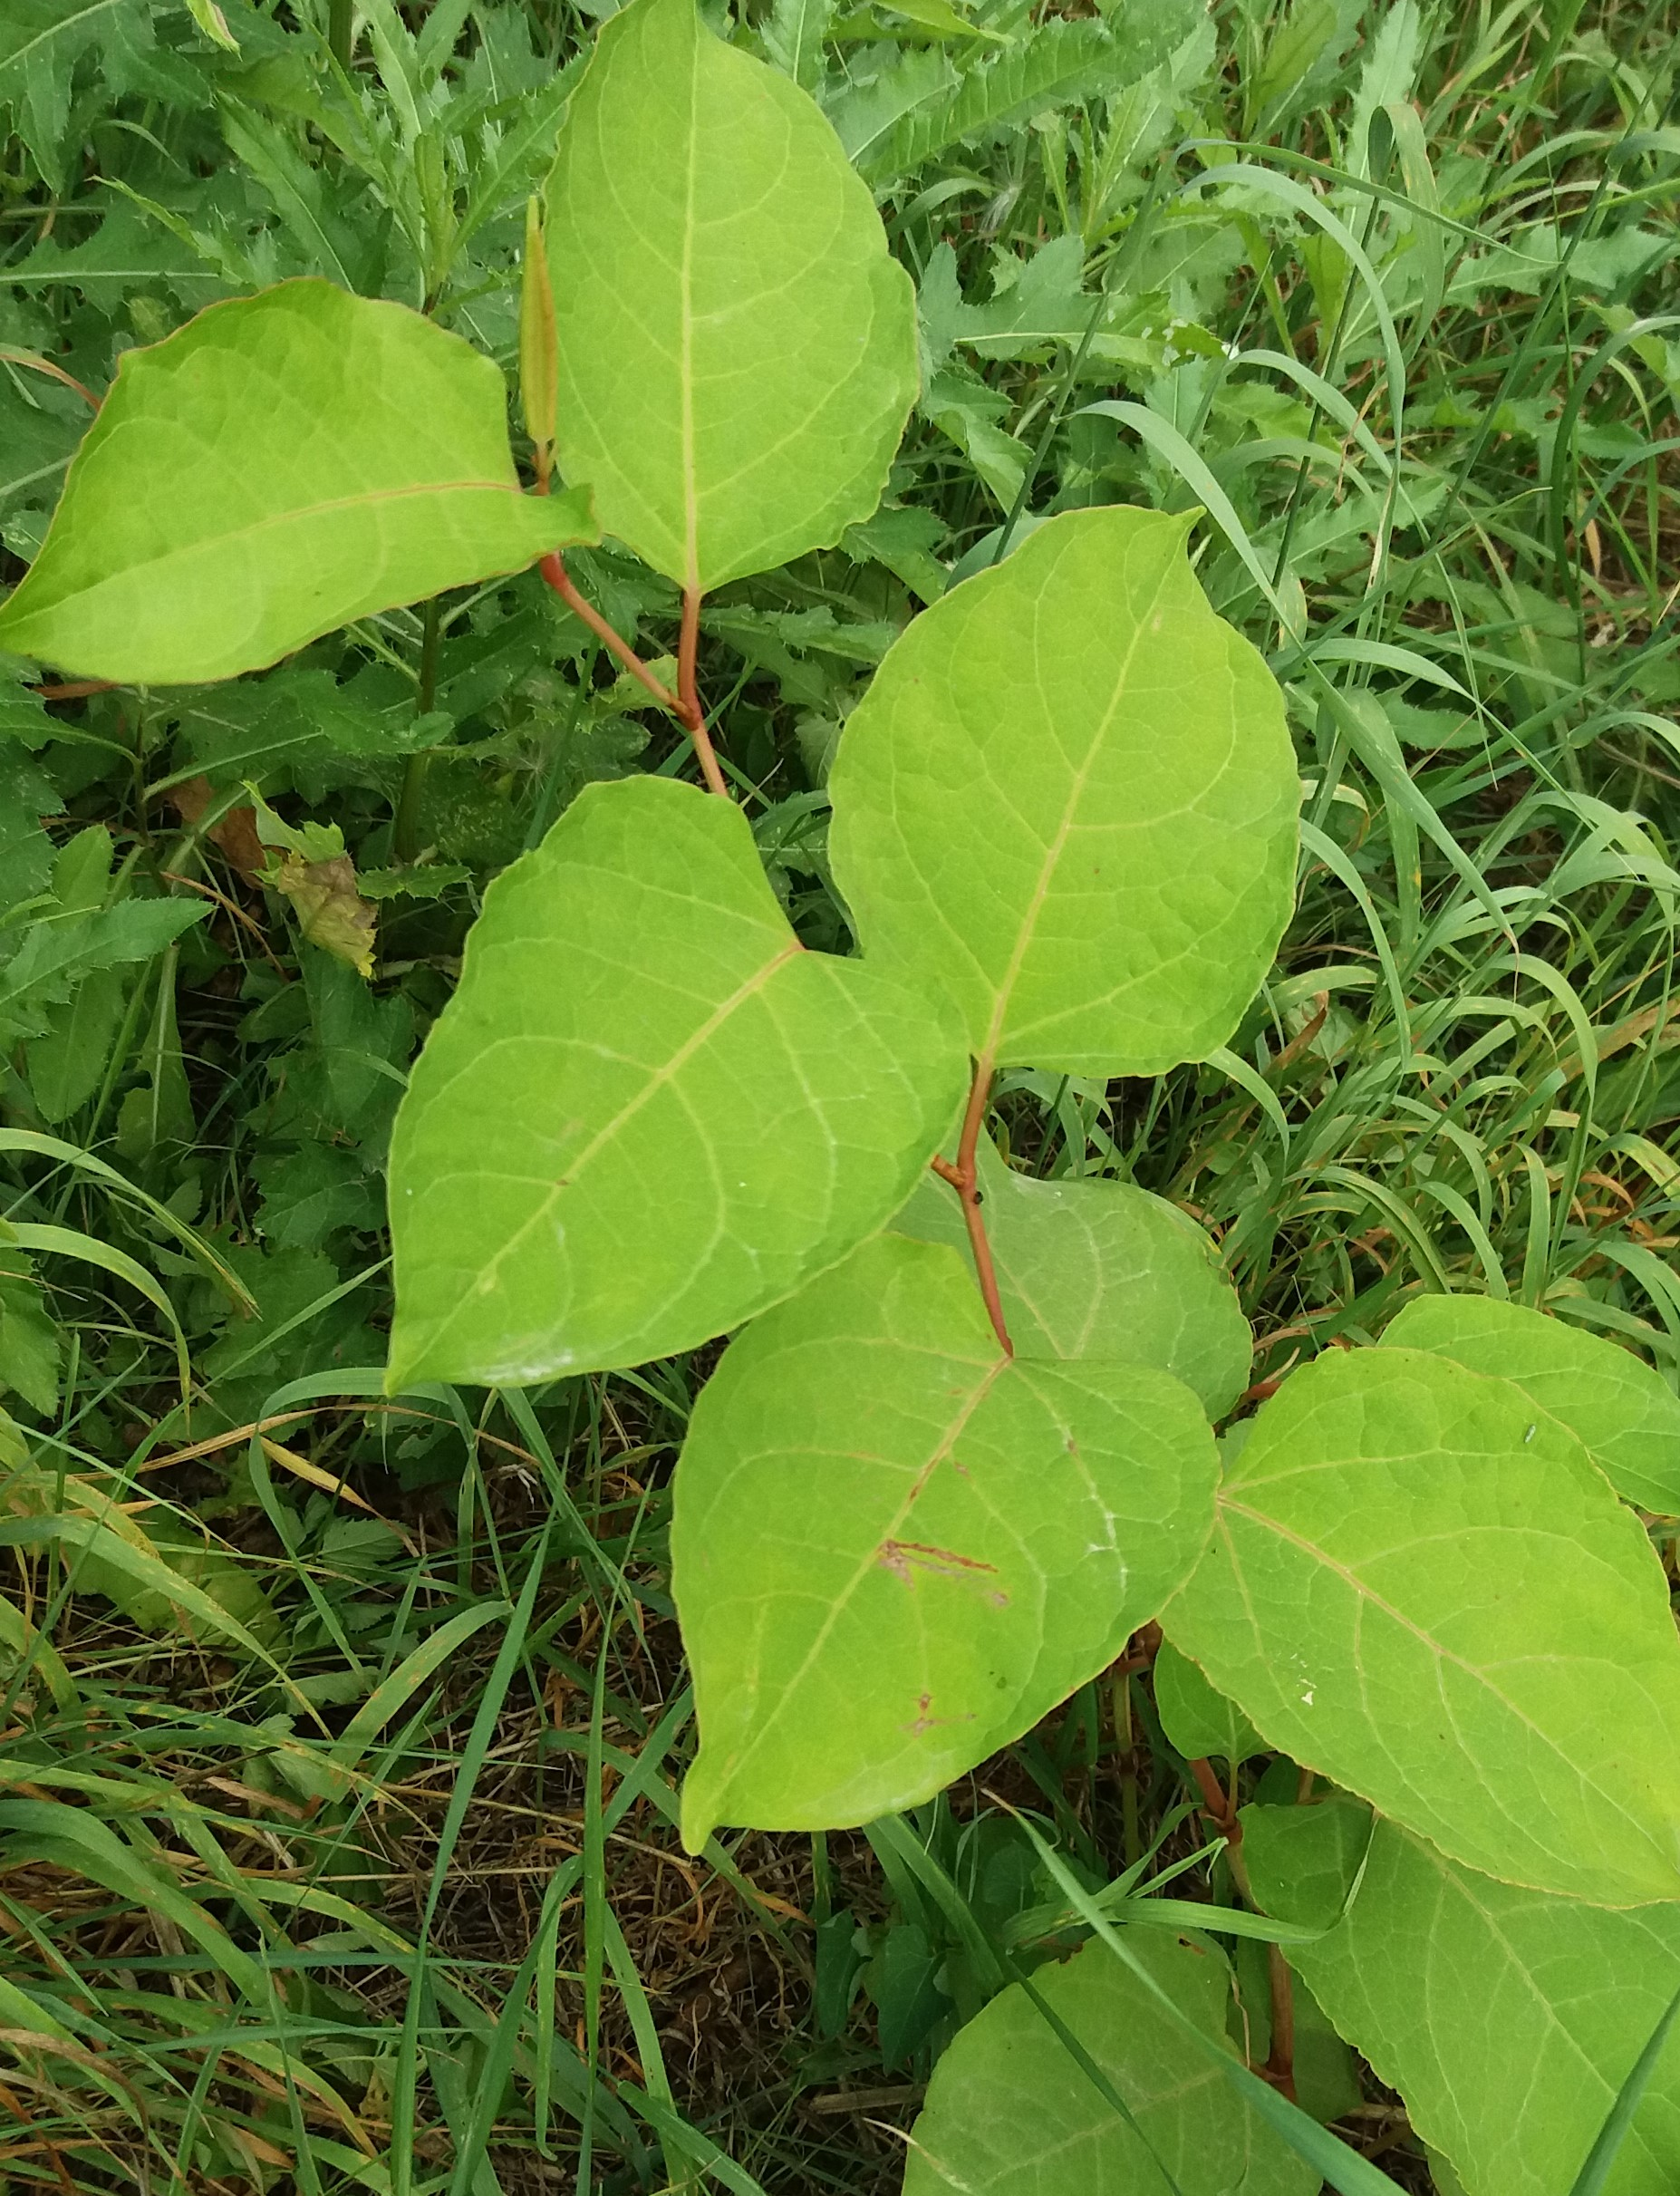
Photos

Slide 5
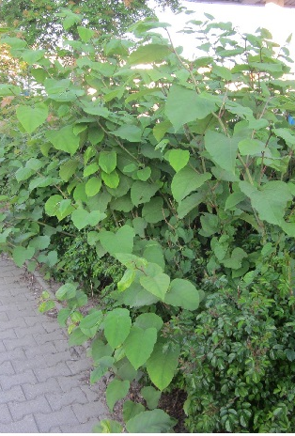
křídlatka česká
Height about 3-4 meters
It has a habit of growing in large packs
It is a hybrid of two species - křídlatka japonská a krídlatka sachalinská
It has mostly the same traits as it's parents but:
It has noticably smaller leaves
It is much more durable
And it is spreading even quicker

Slide 6
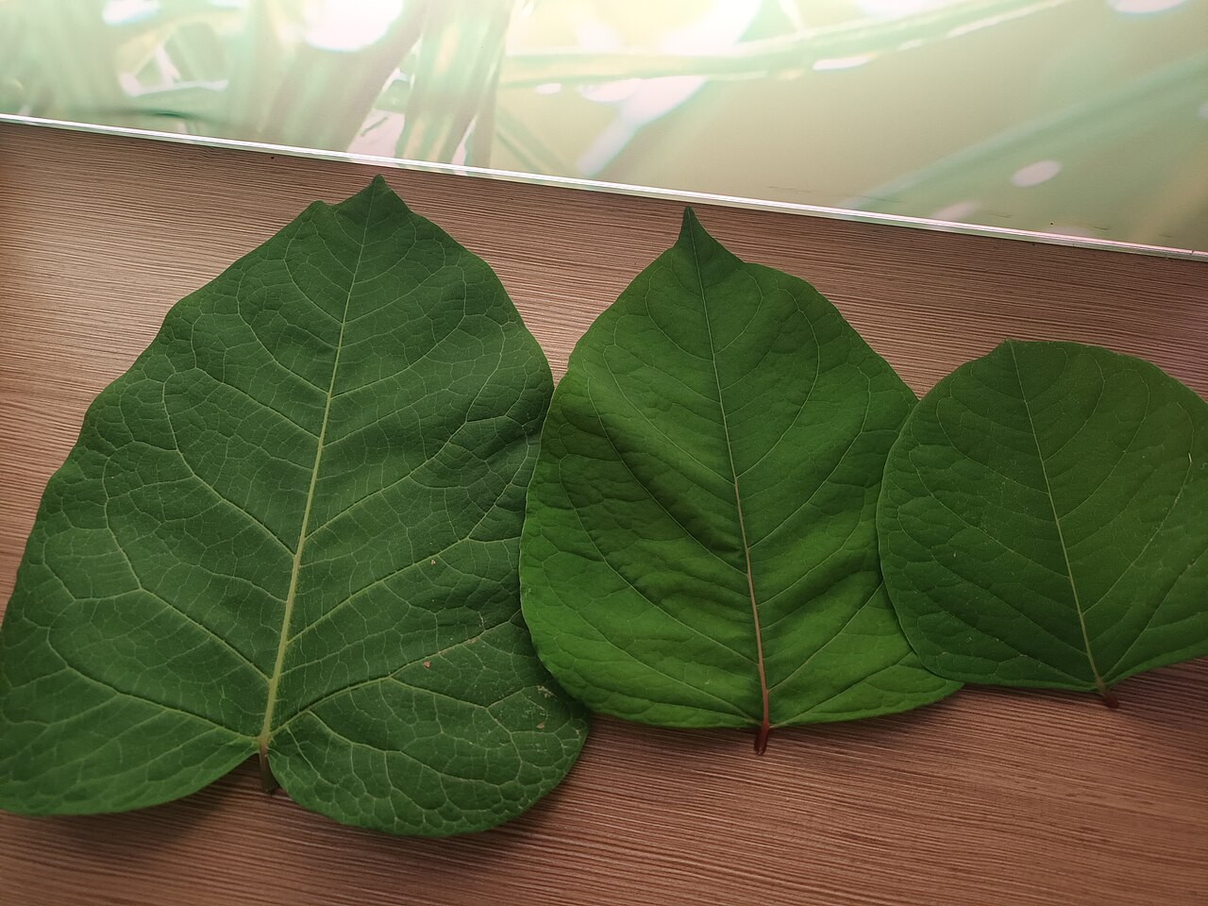
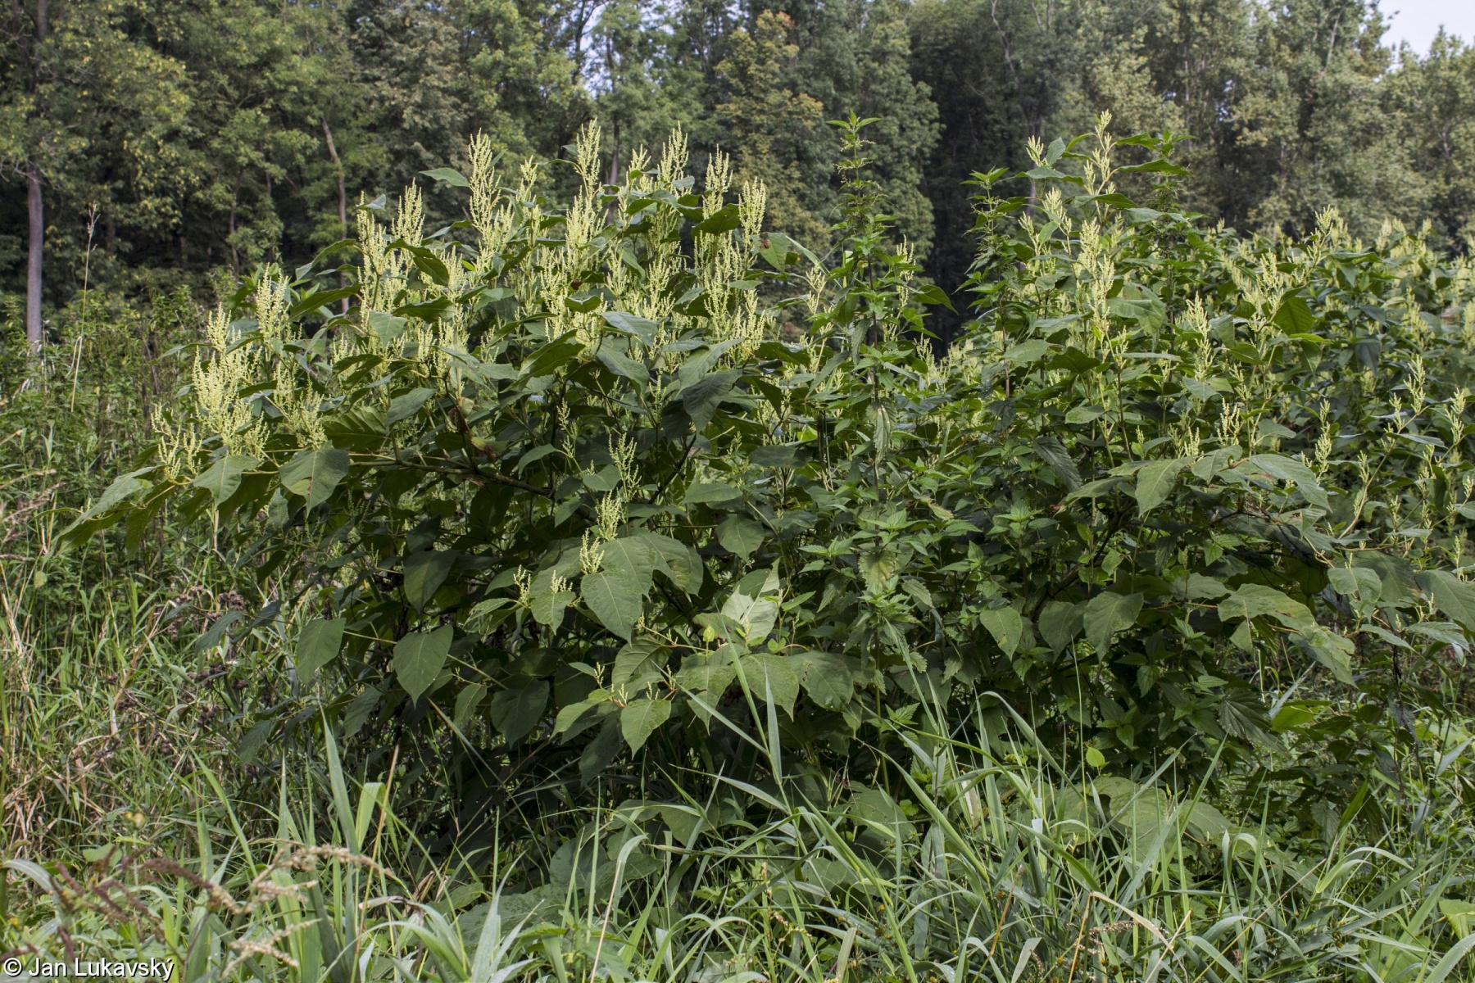
Photos
Comparison of leaves from křídlatka - leftmost is křídlatka česká

Slide 7
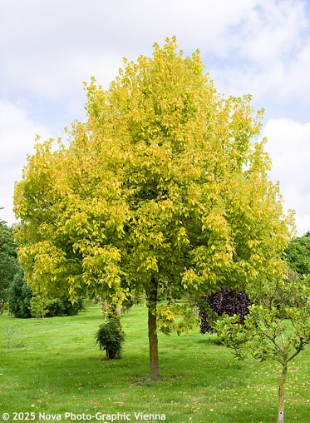
Javor jasanolistý
Bush or small tree
height around 15-20 meters
Very fast growing
Originates from North America
It is quite common around parks or water flows
It has quite the durability, notably around roots
It is fast spreading and aggressive towards native species of trees

Slide 8
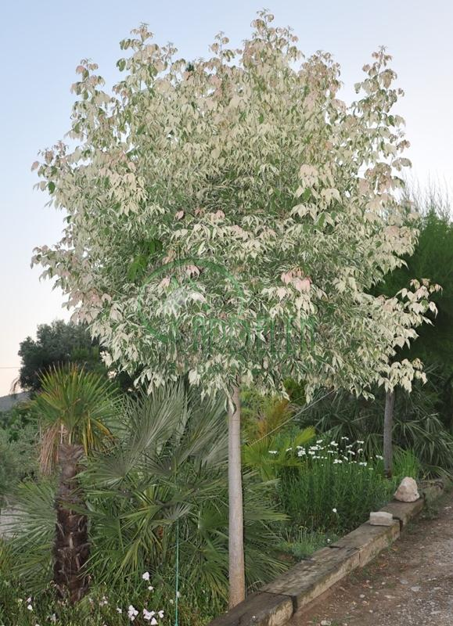
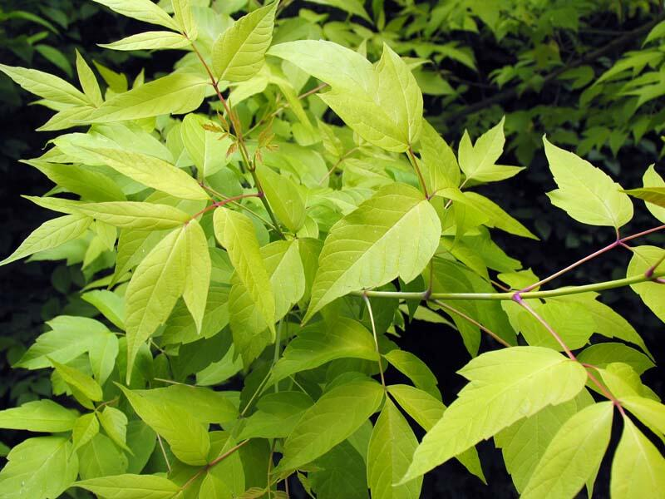
Photos

Slide 9

Topinambur hlíznatý
Height about 2 meters
Describes as fuzzy
Blooming part is about 8 cm
Common at the edge of forest
Originated from northh America
Potato of the Jews
Used as food for animals

Slide 10
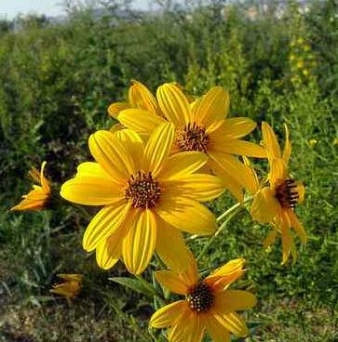
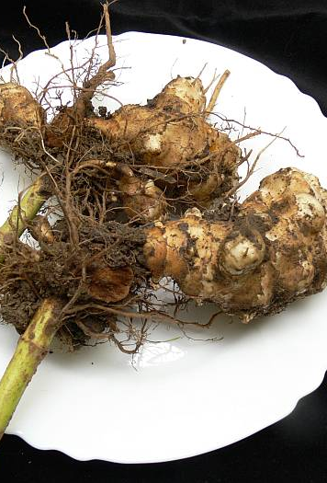
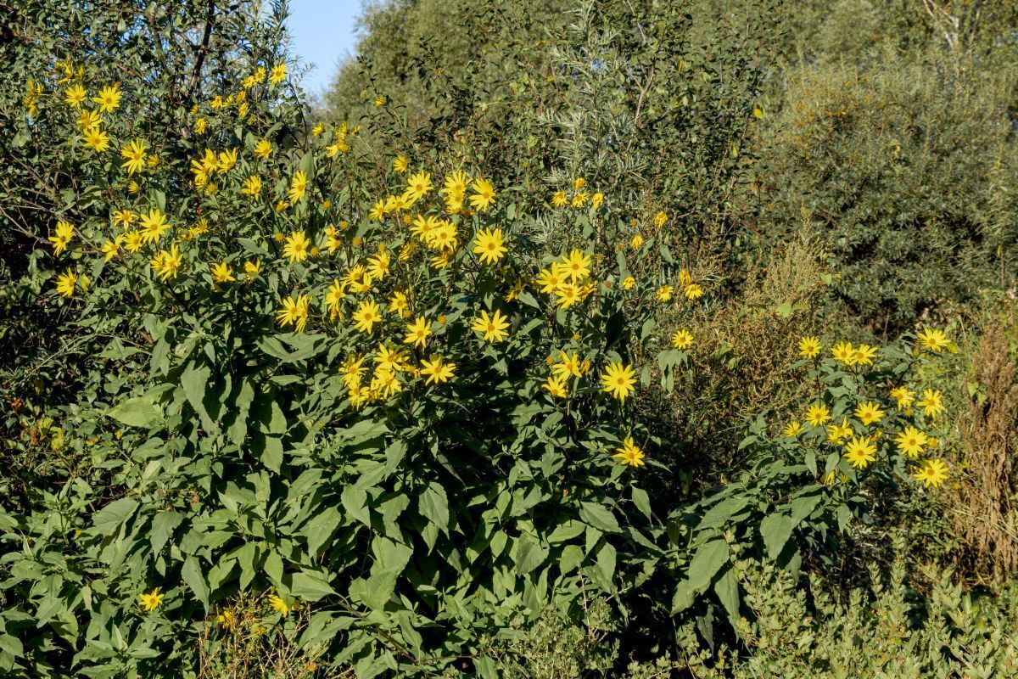
Photos

Slide 11
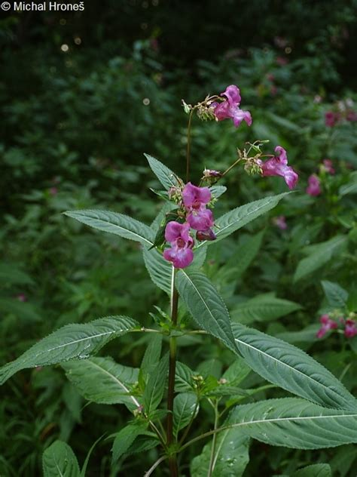
Netýkavka žláznatá
Height about 2 meters
Originated from Nepal
Got here for as honey producing flower
Spreads greatly around water and in damp surroundings
Nearly impossible to get rid of thanks to its seeds system
Seeds are edible and taste like nuts

Slide 12
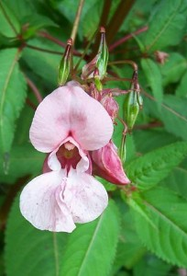
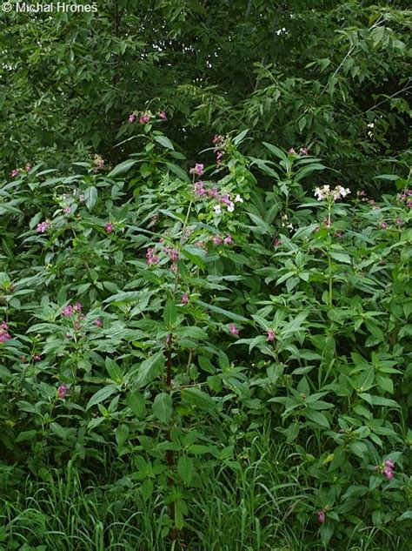
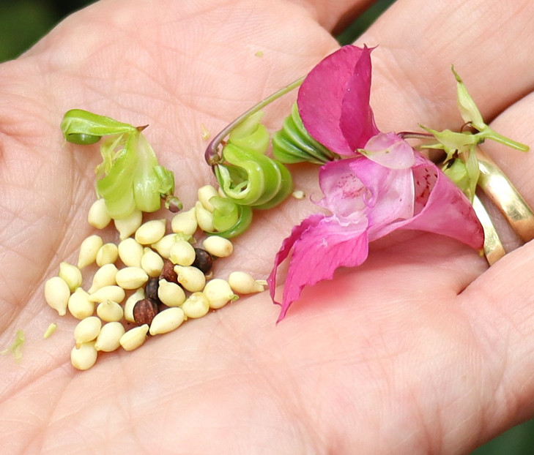
Photos

Slide 13
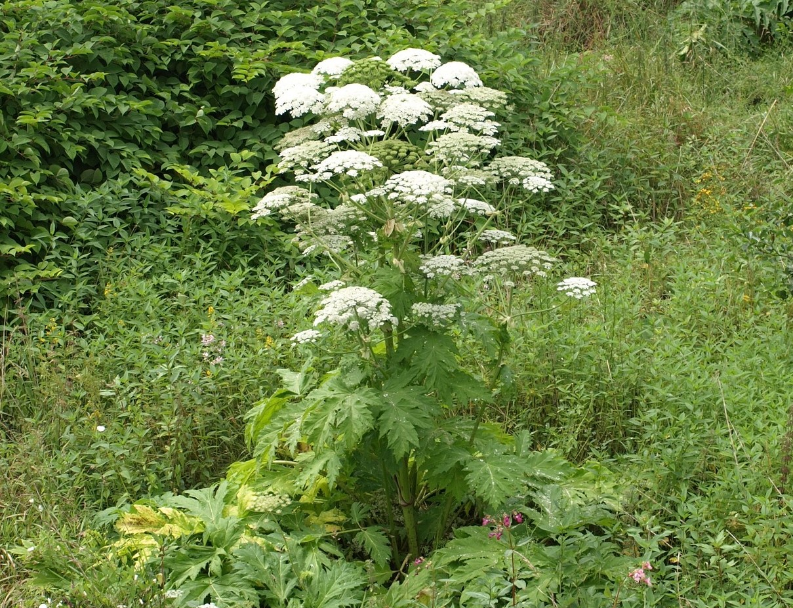
Bolševník velkolepý
Height about 3 meters
Originated from Kazakhstan
Top blooming part is about 50 cm
Summer flower (June to August)
Can cause blisters
Really difficult to take down
  Seeds need to be burn down
  Flower alone needs to be spray down by strong concentrate ofhebricid

Slide 14
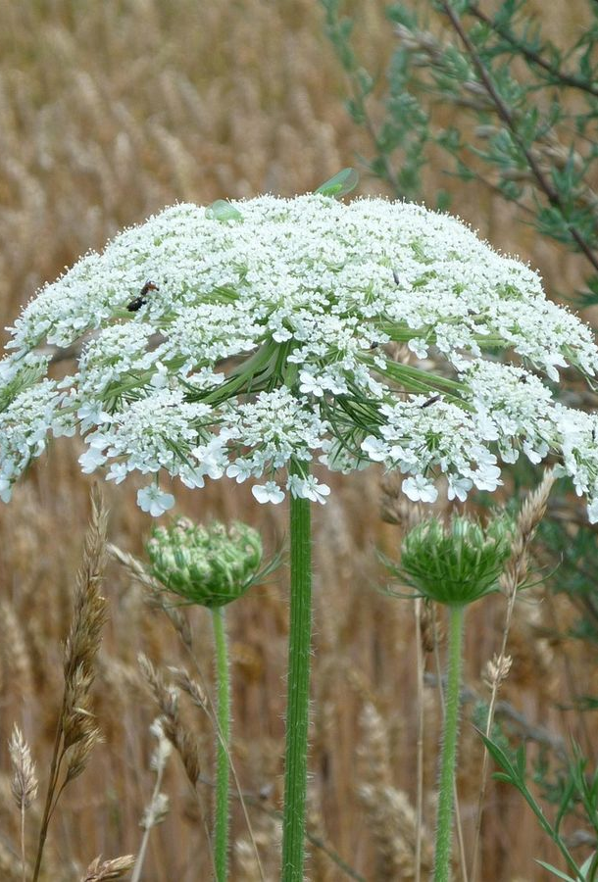

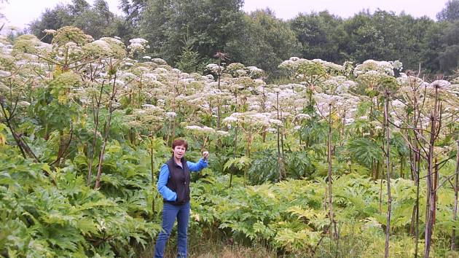
Photos

Slide 15
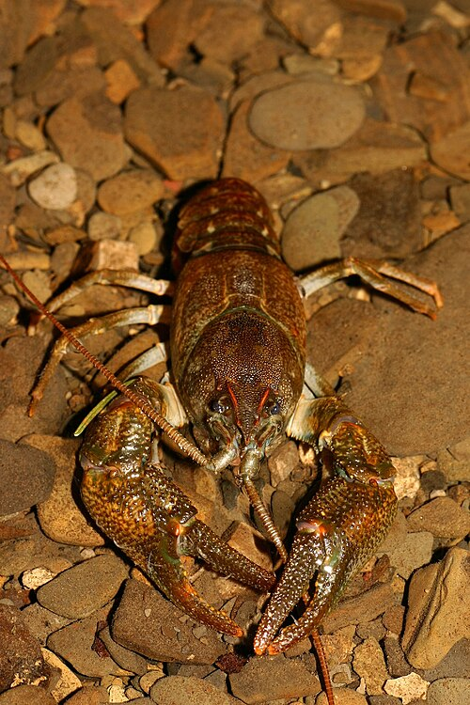
Rak mramorovaný (Marbled Crayfish)
Invasive Nature: Due to its rapid reproduction and adaptability, it has become a significant invasive species in many European countries (including Czechia)
They usually grow to a size of 8–12 cm in length some can even reach 15 cm
On average, they live for 2 to 3 years.
They are famous for being able to survive in water with very low oxygen levels and can even endure periods of drought by burrowing into moist soil.

Slide 16
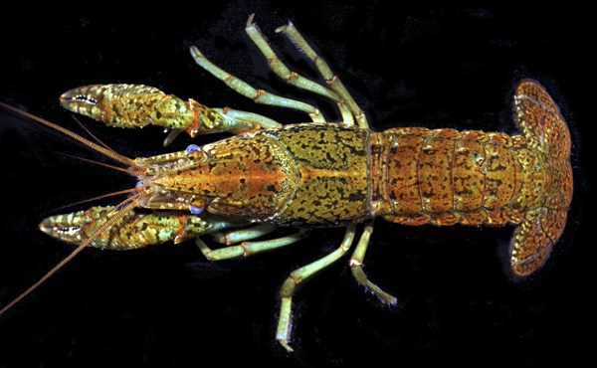
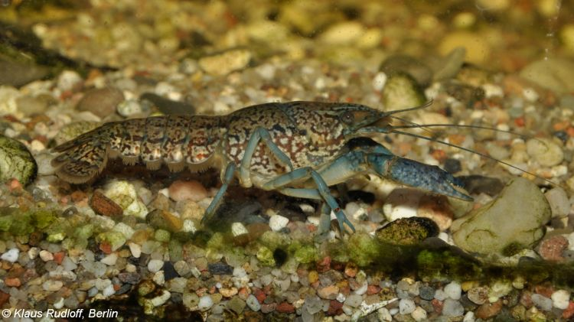
Photos

Slide 17
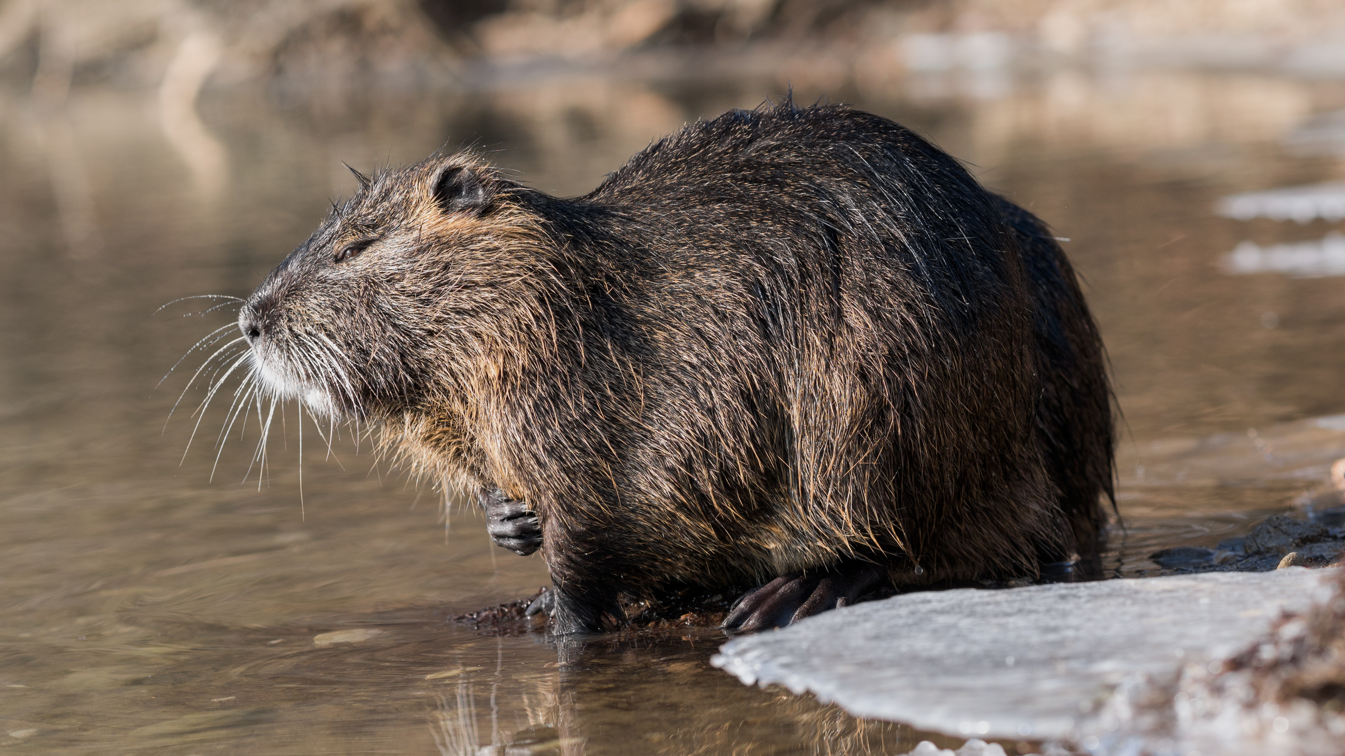
Nutrie říční
They typically grow to 40–60 cm in body length, with a tail adding another 30–45 cm.
An average adult weighs between 5–9 kg, though large males can reach up to 12 kg.
Originally from South America, they were brought to Europe and North America for their fur.
In the wild, they usually live 3 to 6 years.

Slide 18
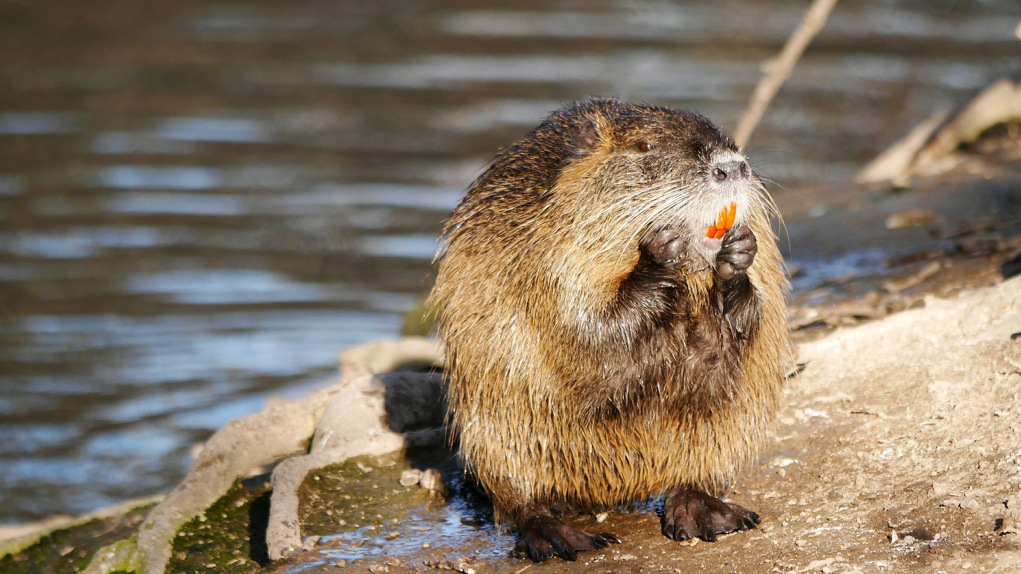
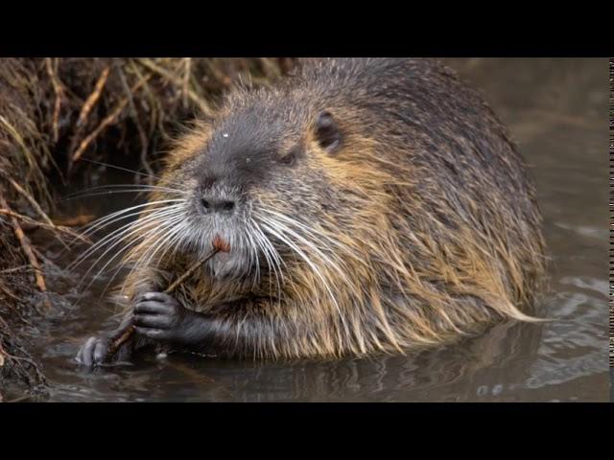
Photos

Slide 19
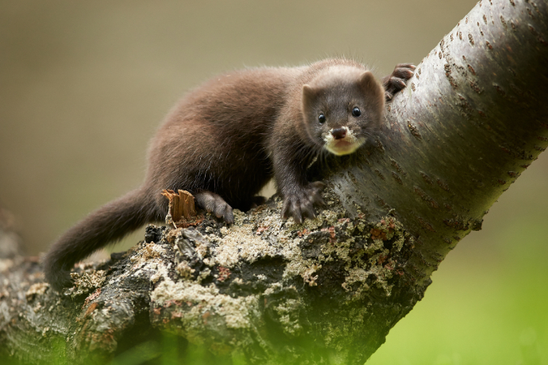
Norek americký (American mink)
They have a long, slender body typical of the weasel family. Males are larger than females, usually measuring 30–50 cm in length, with a tail of about 15–20 cm.
The American mink is a problematic invasive species. It is much stronger and more aggressive than the native European Mink, which it has almost entirely driven to extinction in many areas.
In the wild, they typically live 3 to 4 years, though they can live longer in captivity.

Slide 20
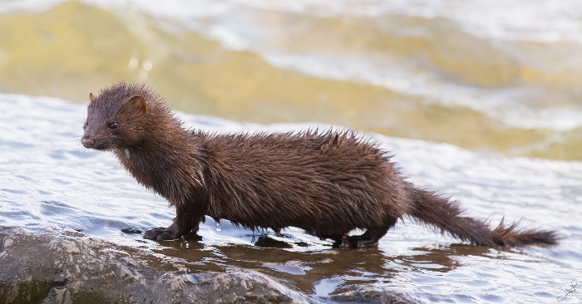
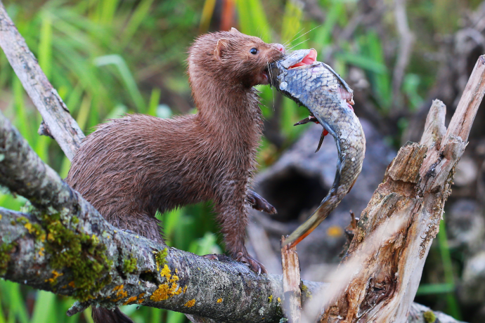
Photos

Slide 21
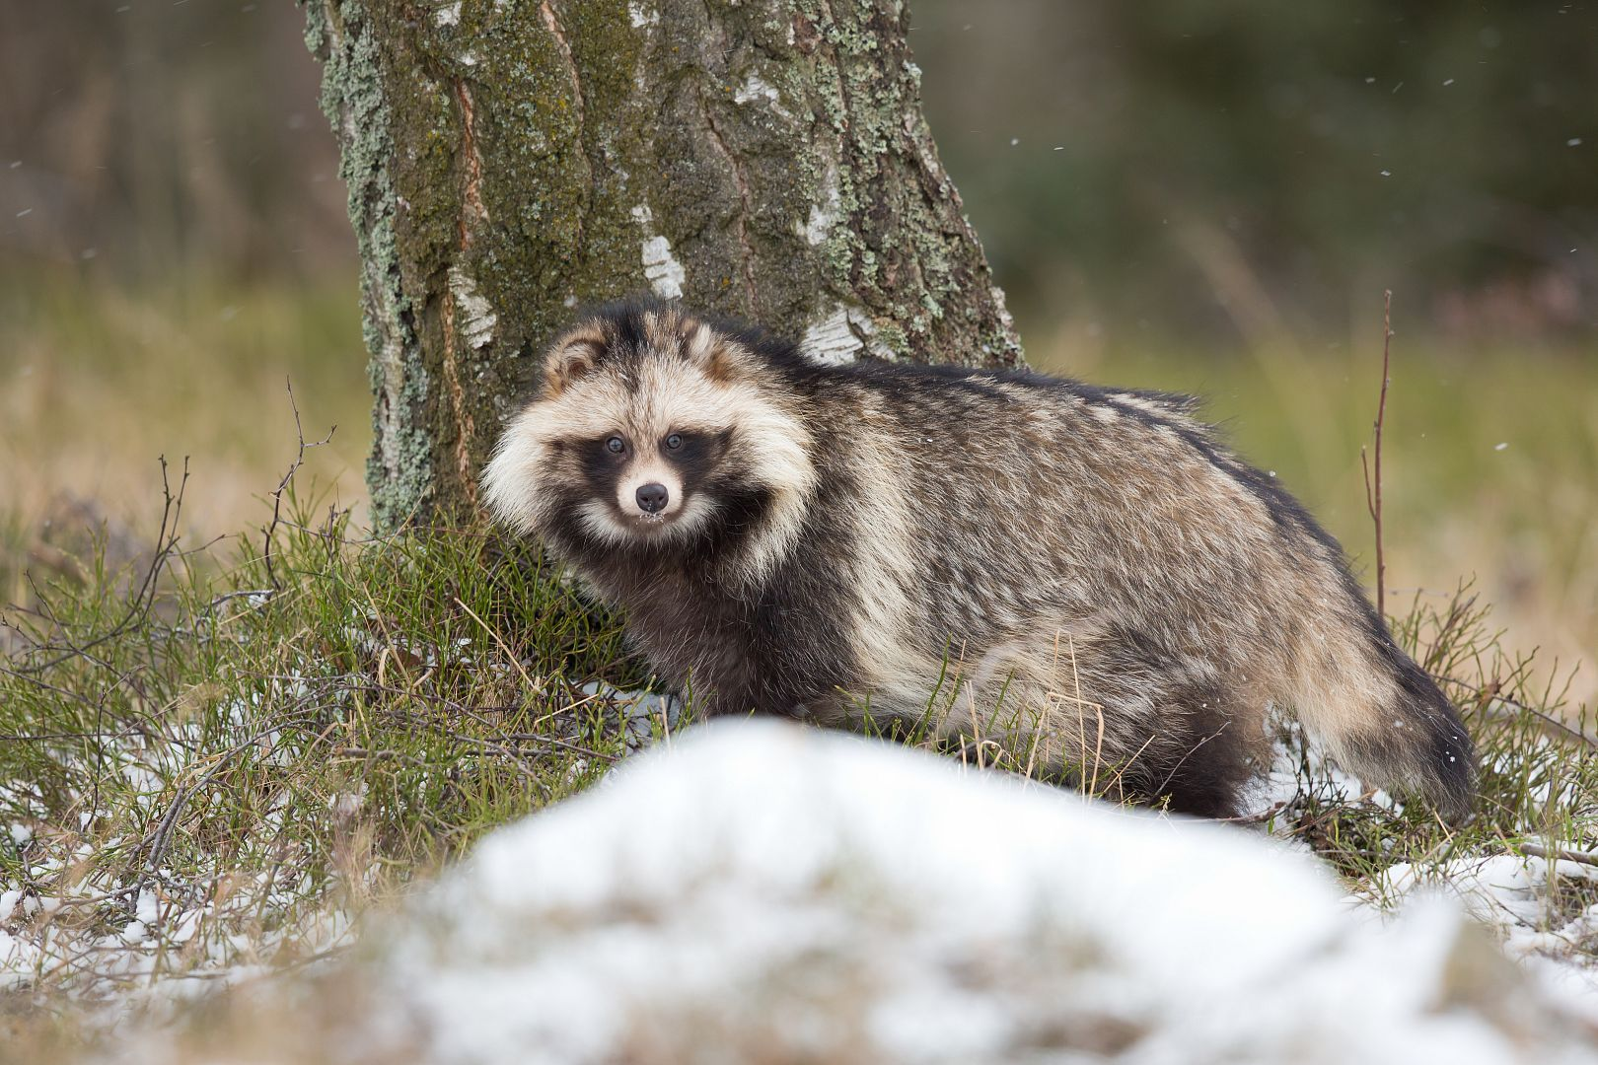
Psík mývalovitý (Common raccoon dog)
It has a stocky body, short legs, and thick fur. Its most distinctive feature is the dark “mask” around its eyes, which gives it a raccoon-like face. Its fur is usually grayish-brown and becomes much thicker in winter. They also hibernate.
In Europe it hasn’t got any natural predators, and it eats anything, so it poses danger for ground nesting birds and so on.

Slide 22
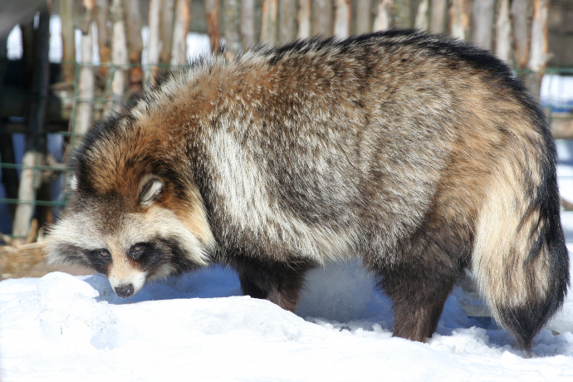
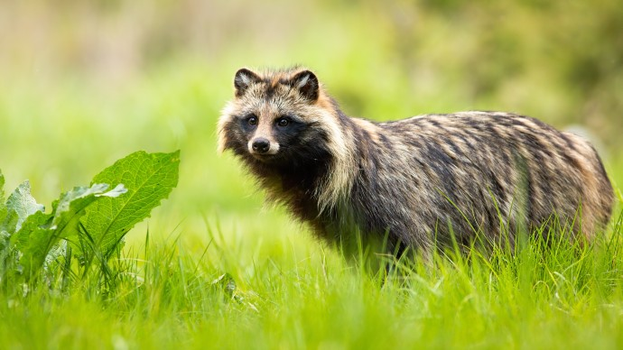
Photos

Slide 23
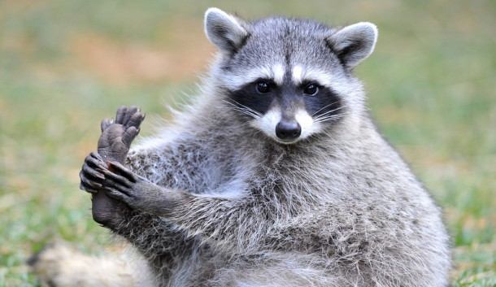
Mýval severní (Northern Raccoon)
It has grey-brown fur, a bushy tail with black rings, and a distinctive black “mask” across its eyes. This mask helps reduce glare and improves night vision.
It is dangerous for the same reasons as the raccoon dog, but it is also extremely intelligent, being able to open bins containers and even simple locks.

Slide 24
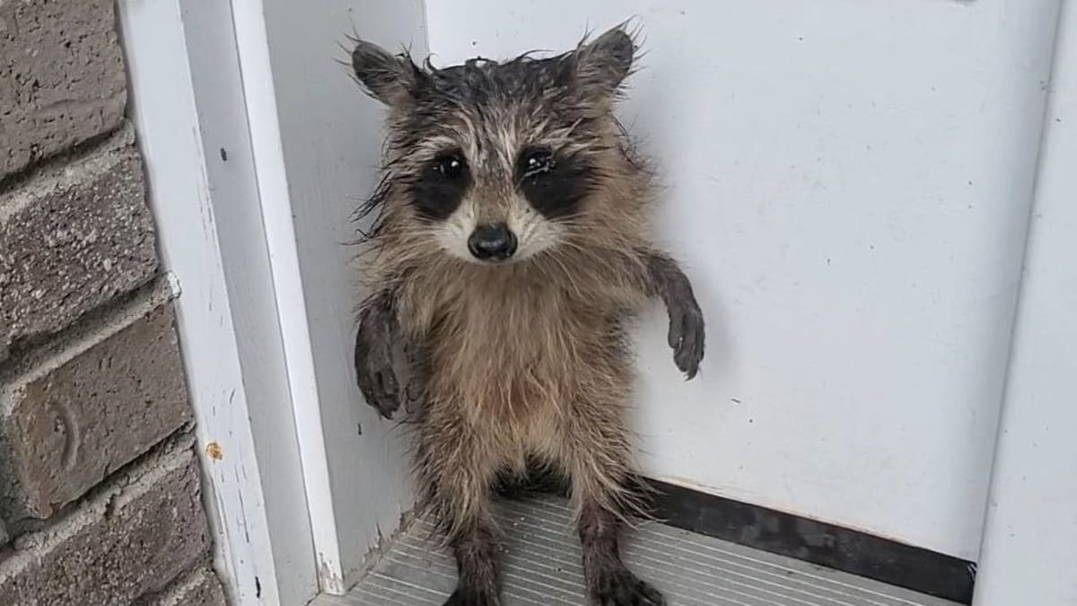
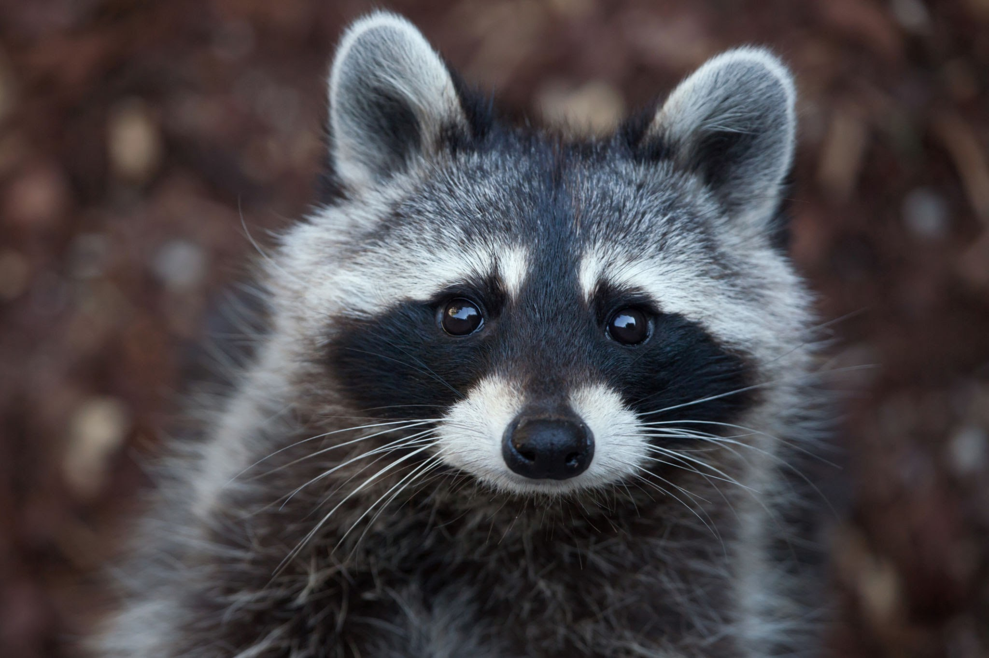
Photos

Slide 25
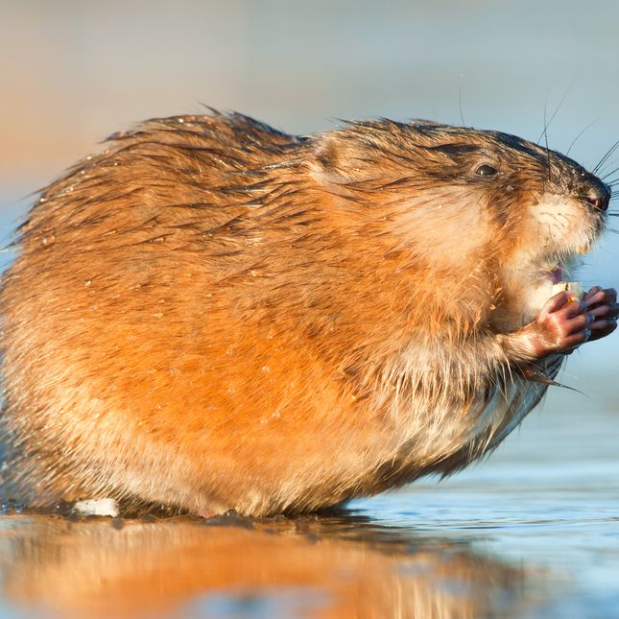
Ondatra pižmová (Muskrat)
It has dense brown fur, a long laterally flattened tail, and small ears. It is well adapted to life in water.
By digging burrows, it weakens riverbanks, pond edges, and dikes, which can even lead to structural damage or flooding.

Slide 26
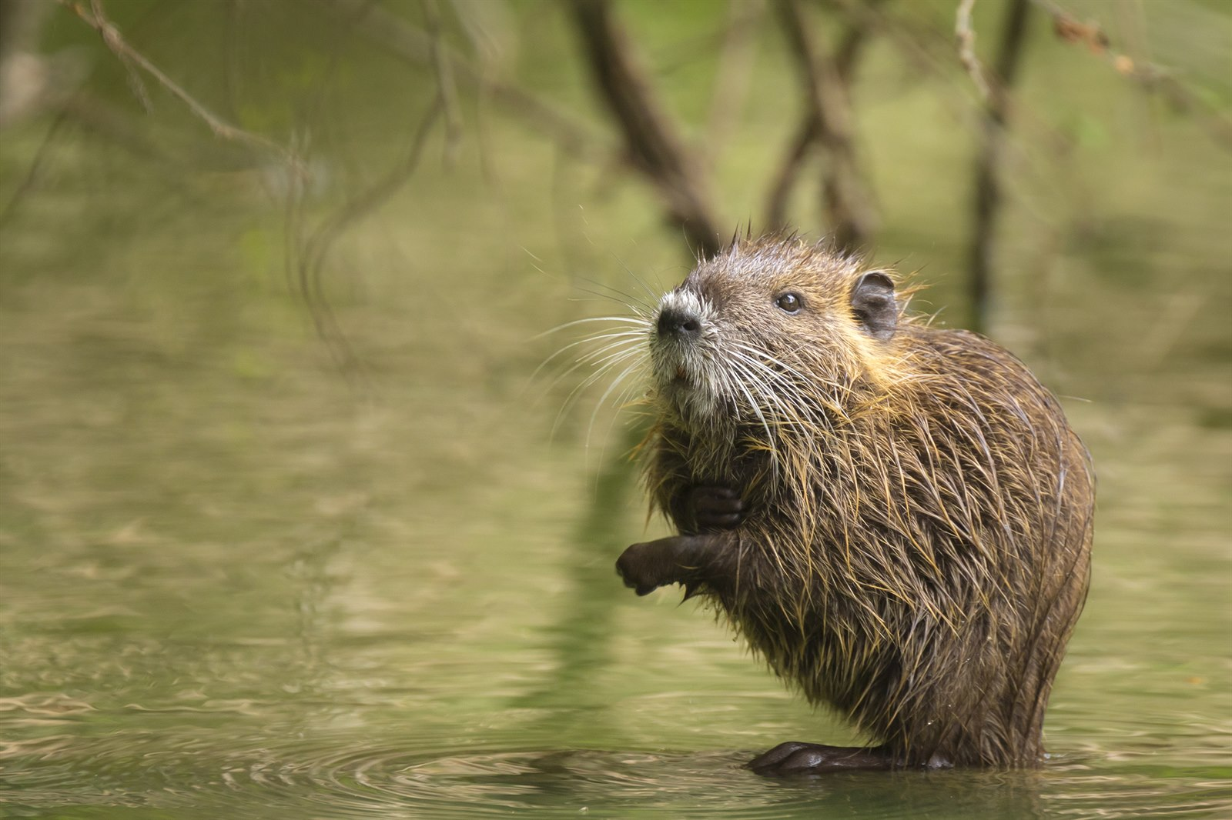
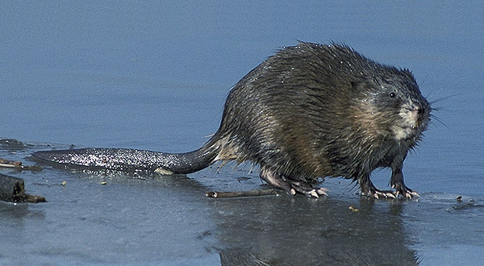
Photos

Slide 27
Thank you for your time :D

Slide 28
sources
http://www.sagittaria.cz/cs/prehled-druhu
https://invaznidruhy.aopk.gov.cz/invazni-zivocichove
https://www.dumprirody.cz/dum-prirody-litovelskeho-pomoravi/novinky/stopovani-chlupatych-vetrelcu/

