Slide 1


Slide 2
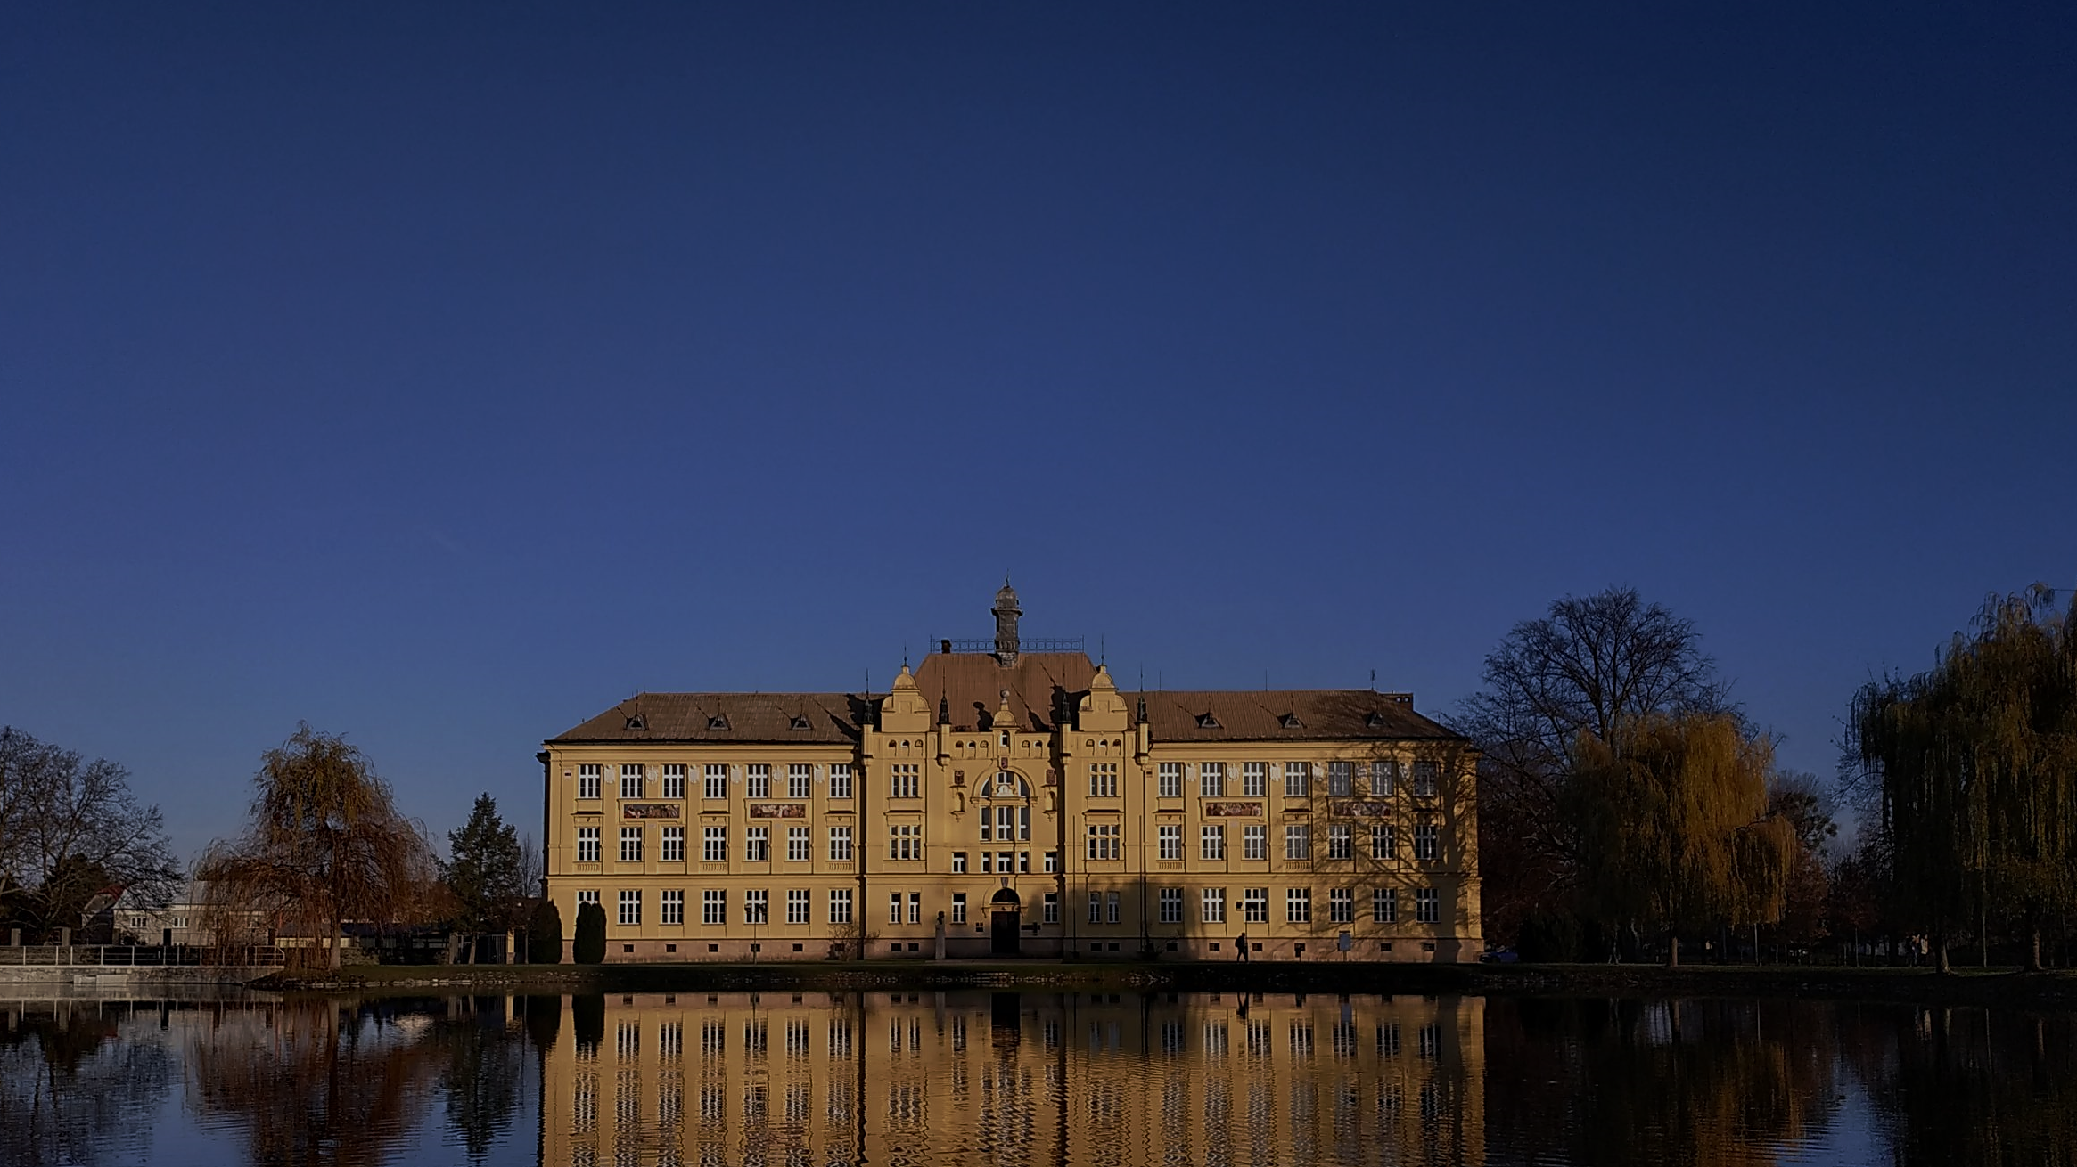
GYMNAZIUM JANA OPLETALA
Our school in the heart of the "Venice of Haná"

Slide 3
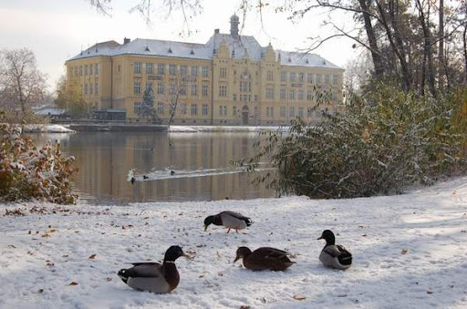
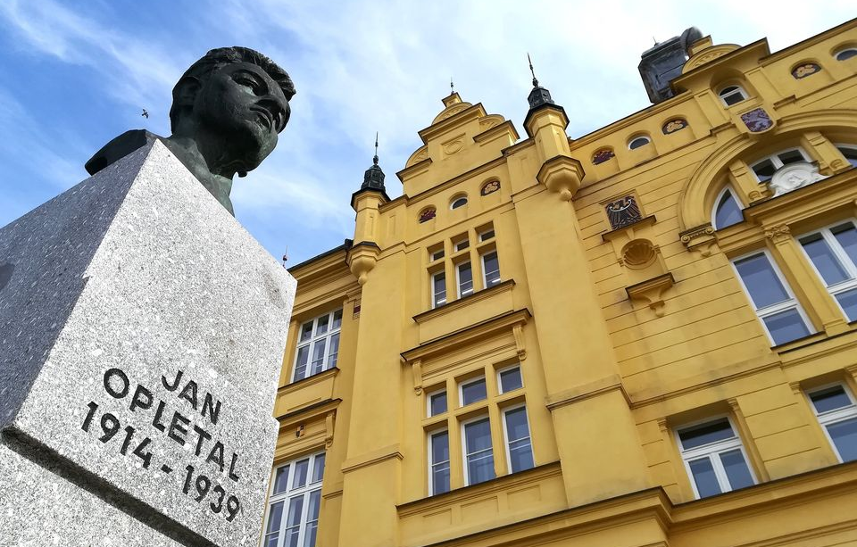

General information about school
our gymnasium is a secondary school located in Litovel, Czech republic
it prepares students students mainly for university studies
we have both four-year and eight-year study programs
student´s can develop their knowledge, skills and interests at our school

Slide 4
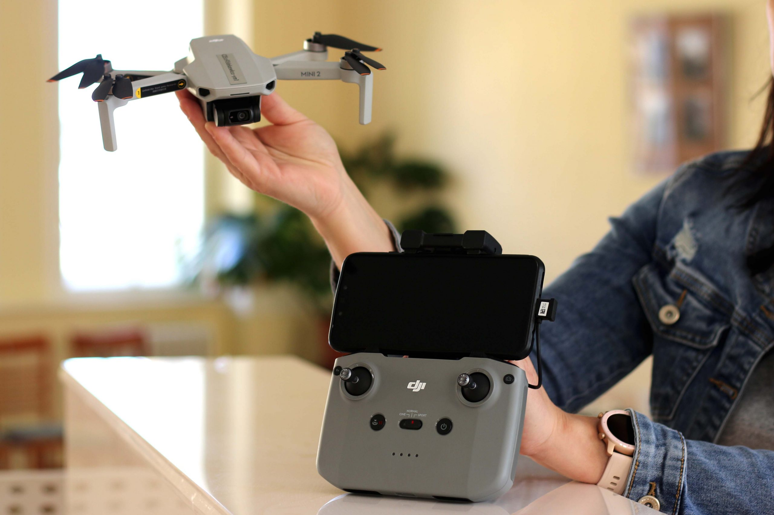
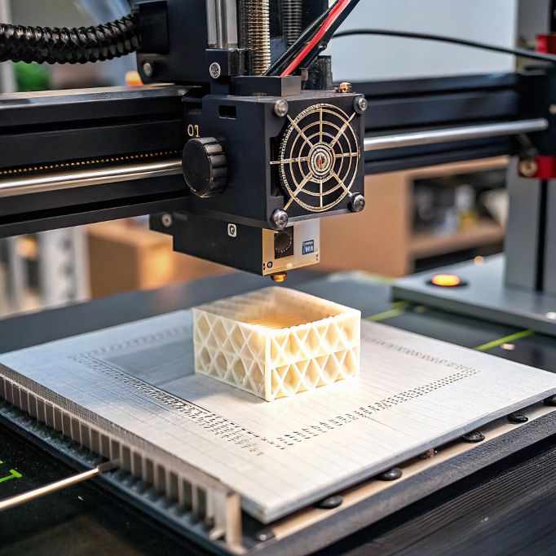




Academics & Modern Technology
we study subjects like languages, science, humanities, etc.
Education: general academic focus, preparing students for all types of universities
Modern GJO: we use cutting-edge tech like 3D printers and robots (Sphero Bolt,
DJI Robomaster)
University Partner: we are a "Faculty School" of Palacký University Olomouc

Slide 5
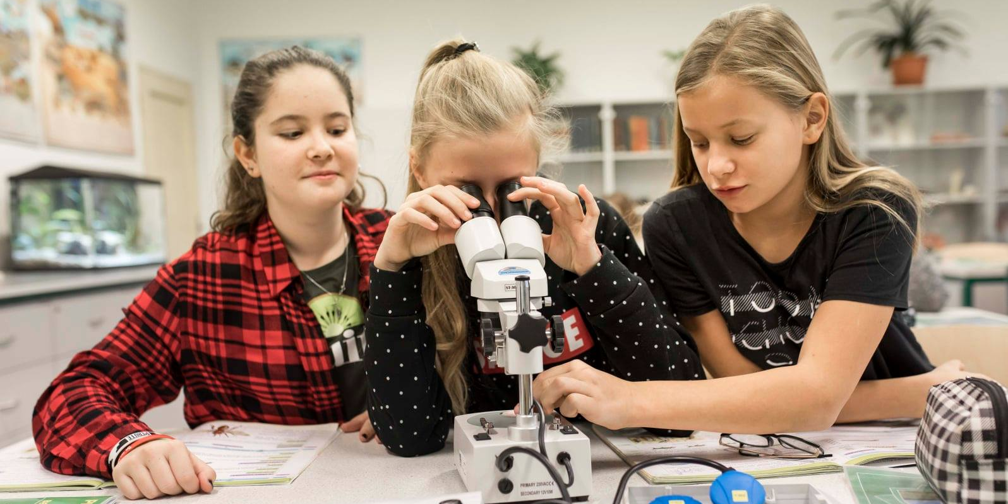
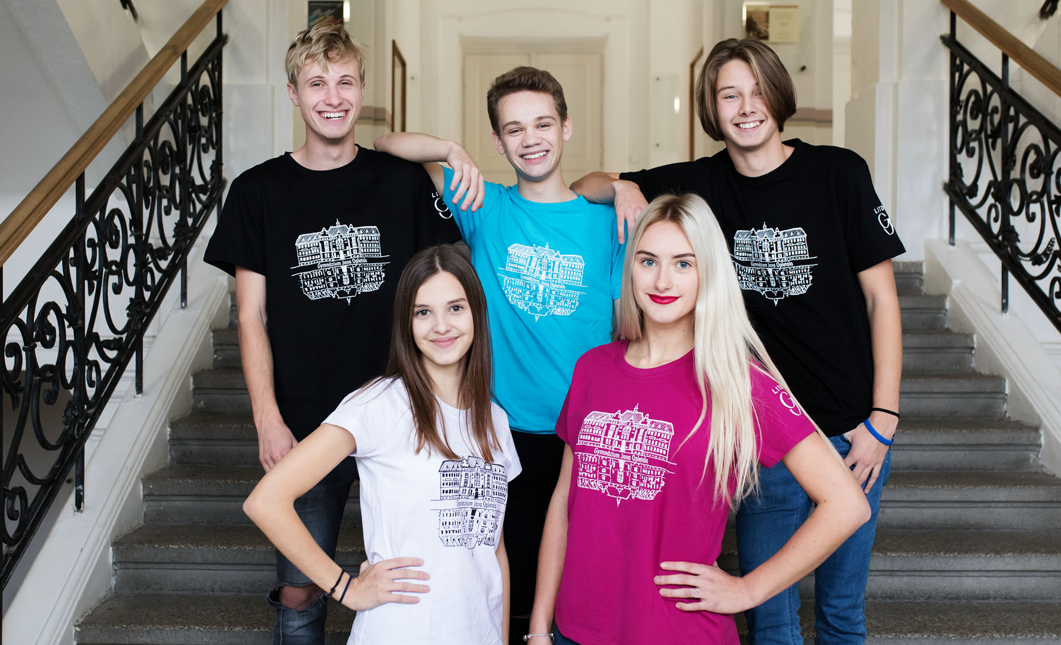
School day, holidays
school starts at 8:05 AM
we have about 6-8 lessons per day
each lesson lasts 45 minutes
there are short breaks between lessons, usually 5 or 10 minutes
we also have a longer break (15 minutes)
the lunch break is either after the 4th or 5th period
during the school year we have several holidays
the longest break is on summer holidays (lasts 2 months)

Slide 6
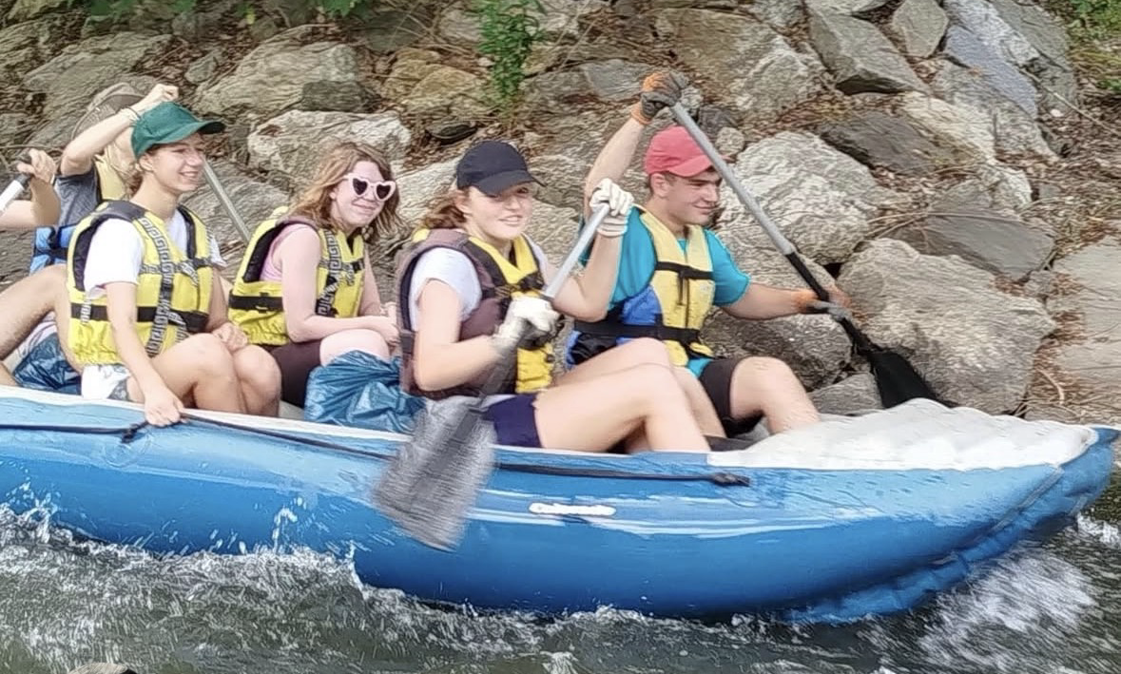
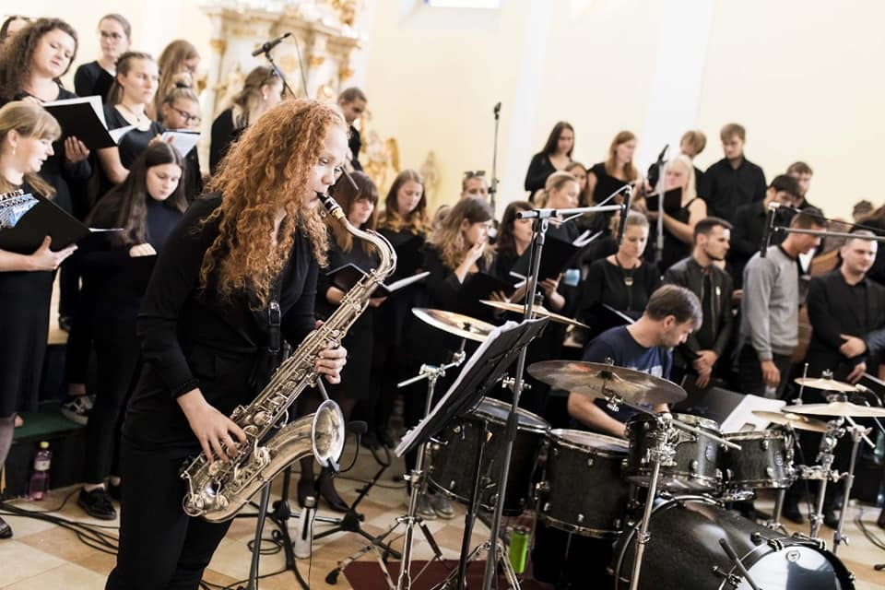
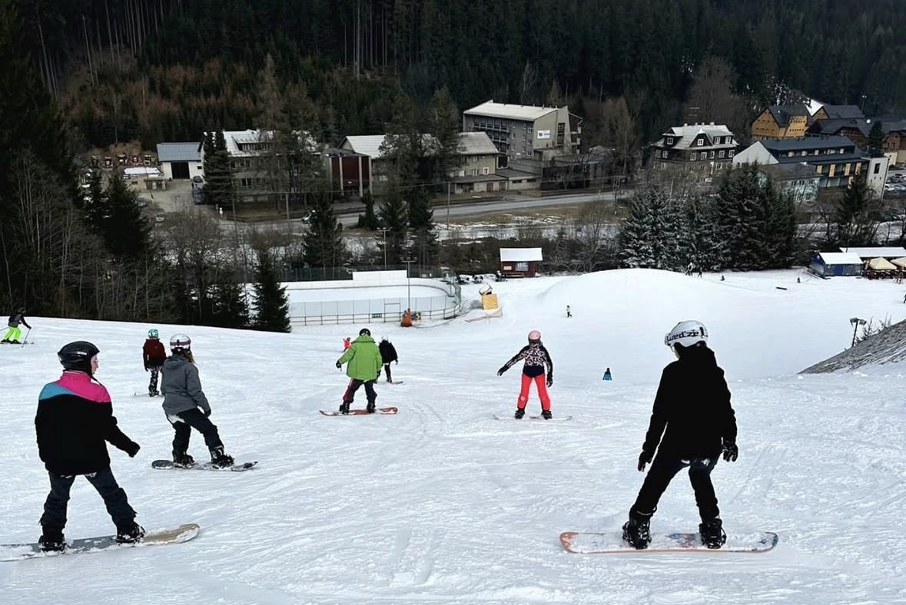
School Life (Beyond the Classroom)
Culture: the PALORA mixed choir (active since 2000) is a key part of our social life
Sports & Trips: canoeing on the Morava River, ski courses, and hiking
Projects: Erasmus+, UNESCO school and the Duke of Edinburgh’s Award (DofE)
Atmosphere: a smaller school (approx. 330 students) with a friendly, family-like
environment

Slide 7
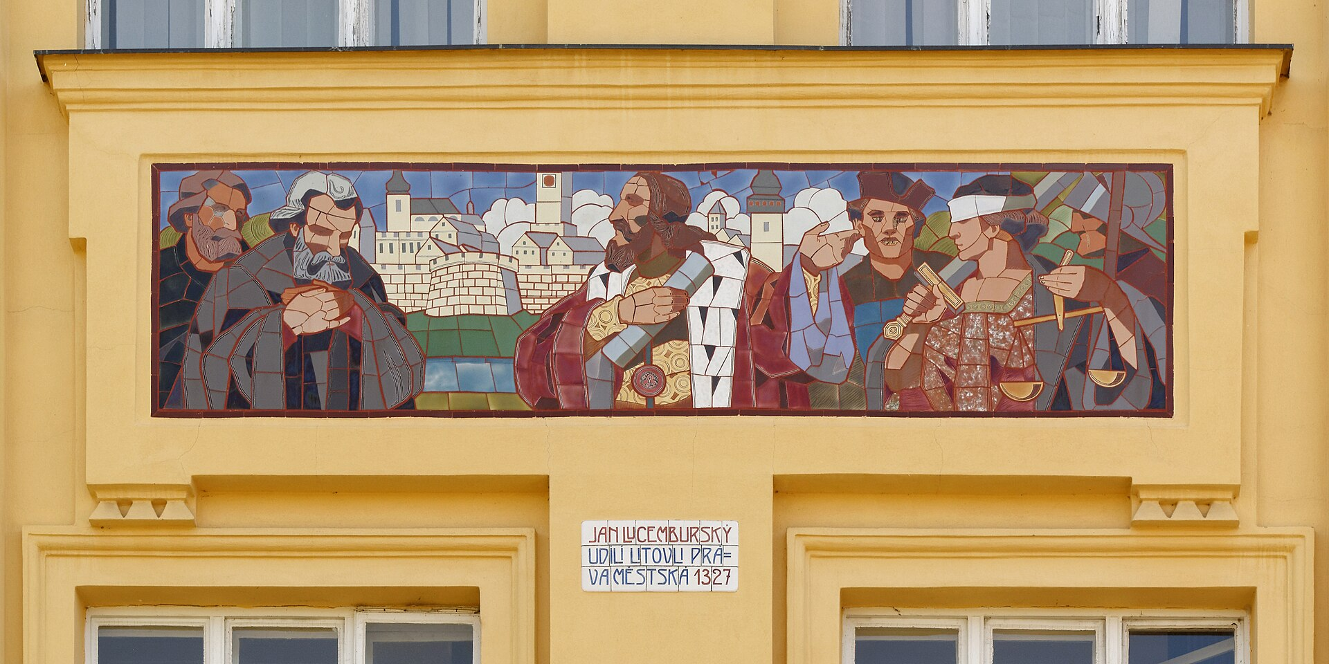
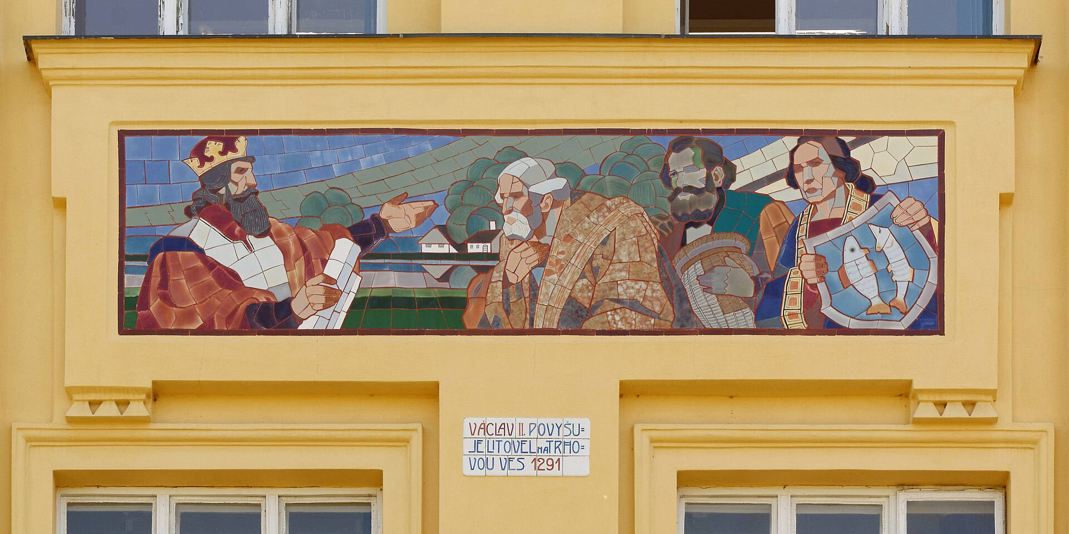
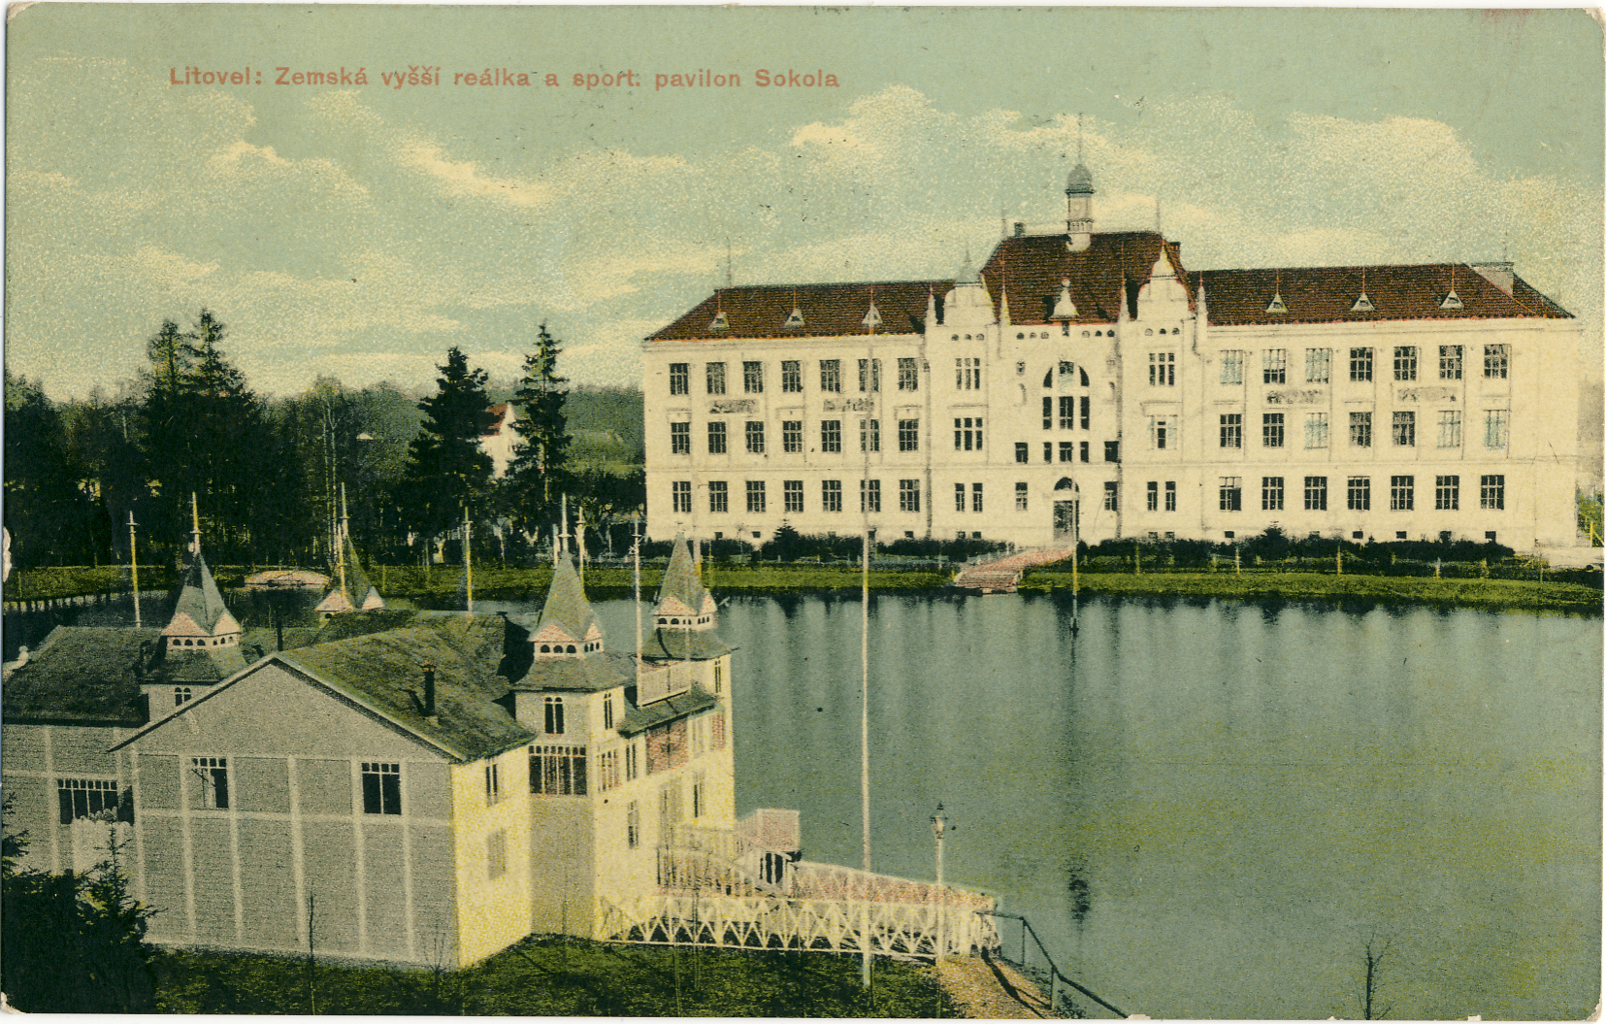
History & building
The Building: a stunning Neo-Renaissance building completed in 1904 (designed by architect Josef Bertl)
Art on Walls: the front of the building has mosaics made by Jan Köhler (they show the town's royal history)
The Motto: in our main hall, there is an inscription: "To Czech sons, the hope of the fatherland, from Czech Litovel" (a symbol of national pride from the time of the Austro-Hungarian Empire)

Slide 8
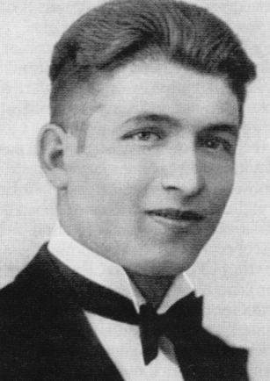
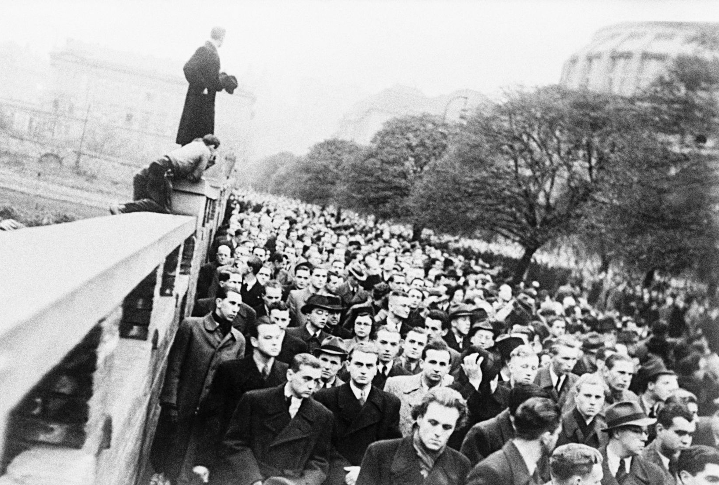
Jan Opletal – our heroic student
he was a famous graduate of our school (class of 1934)
he took part in protests against the Nazi occupation in 1939
during one of these protests, he was shot, died few days later
he became the first student victim of the Nazi occupation
due to the events following his funeral, November 17th was
declared International Students' Day
Memorial: A bronze bust of Jan Opletal stands proudely in front of our school entrance

Slide 9
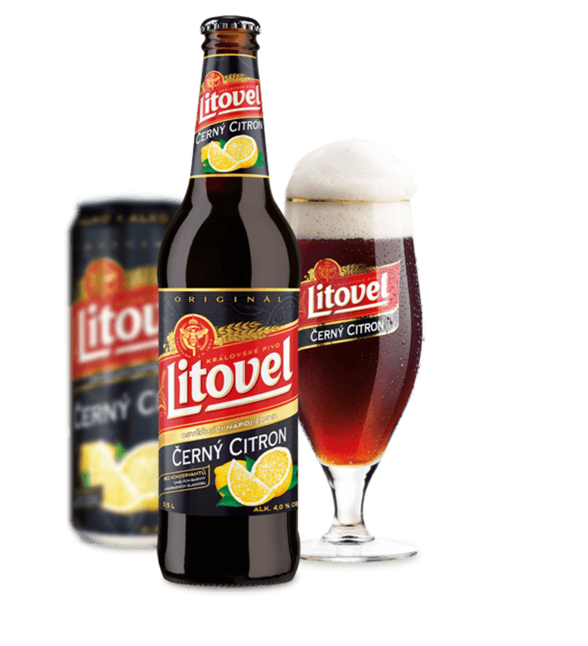
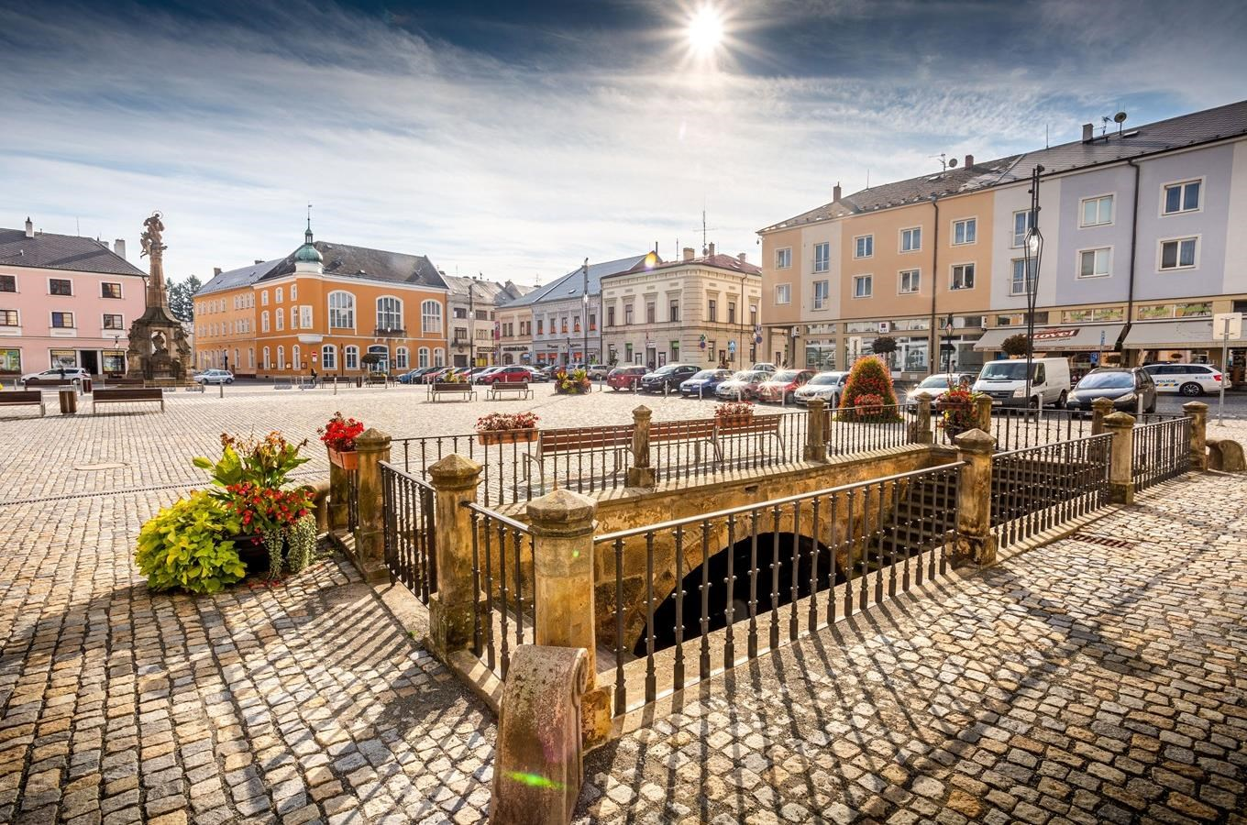
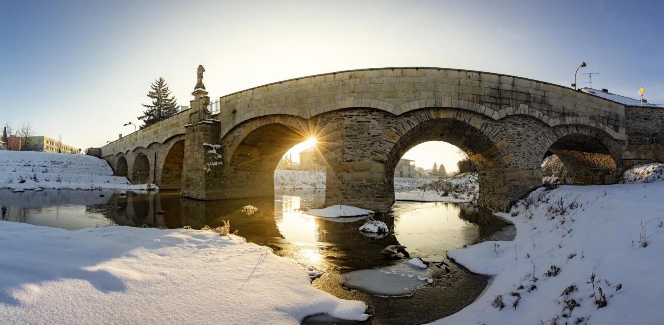
Litovel – The Venice of Haná
"Venice of Haná" because the town is built on six branches of the Morava River
Location: located in the Haná region, near the historic city of Olomouc and about 3
hours from Prague
Nature: Surrounded by the Litovelské Pomoraví (Protected Landscape Area)
the city has a long brewing tradition

