Slide 1


Slide 2
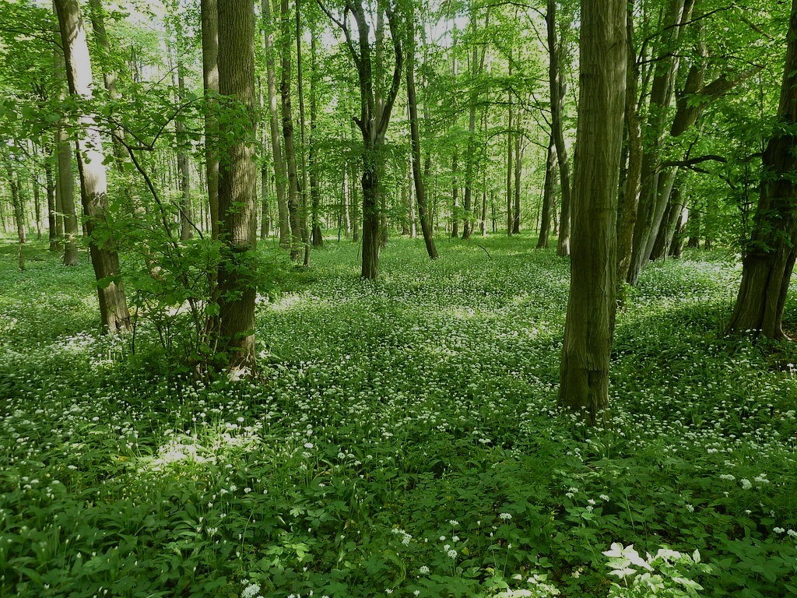
The
LITOVELSKÉ POMORAVÍ Protected
Landscape
Area

Slide 3
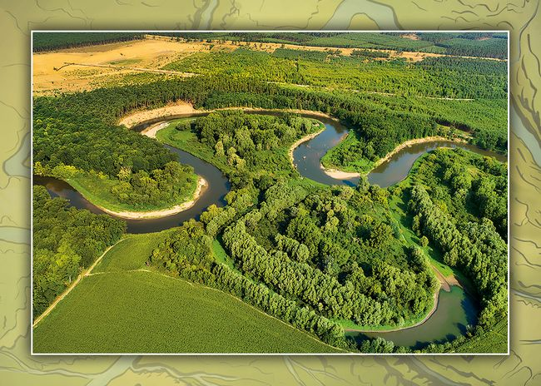

CHKO – The protected landscape area
CHKO Litovelské Pomoraví is a complex of extensive floodplain forests and meadows
It is located around the Morava River, which forms a unique inland delta that is unique in Europe

Slide 4
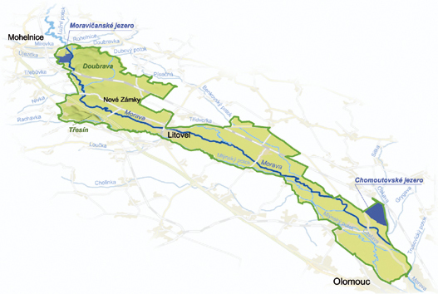

The Litovel Morava Riverlands PNA was established in 1990
It covers an area of 96 km²
It is a swath of land along the branches of the Morava River between 2 towns – Olomouc and Mohelnice

Slide 5
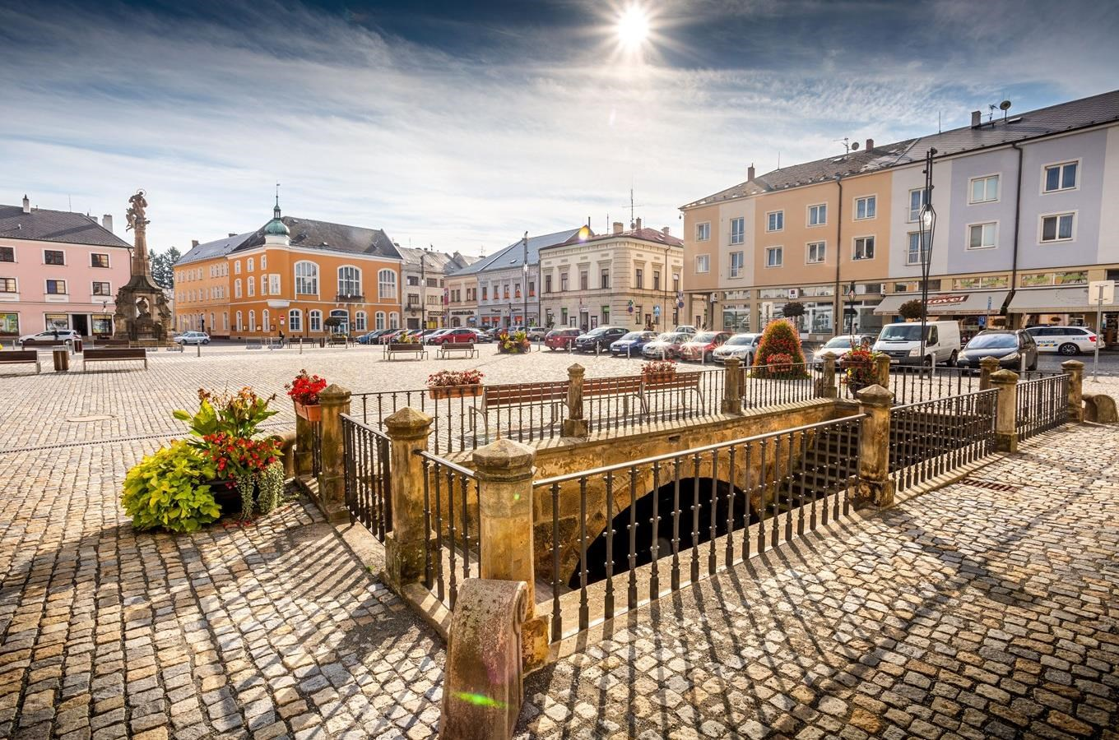
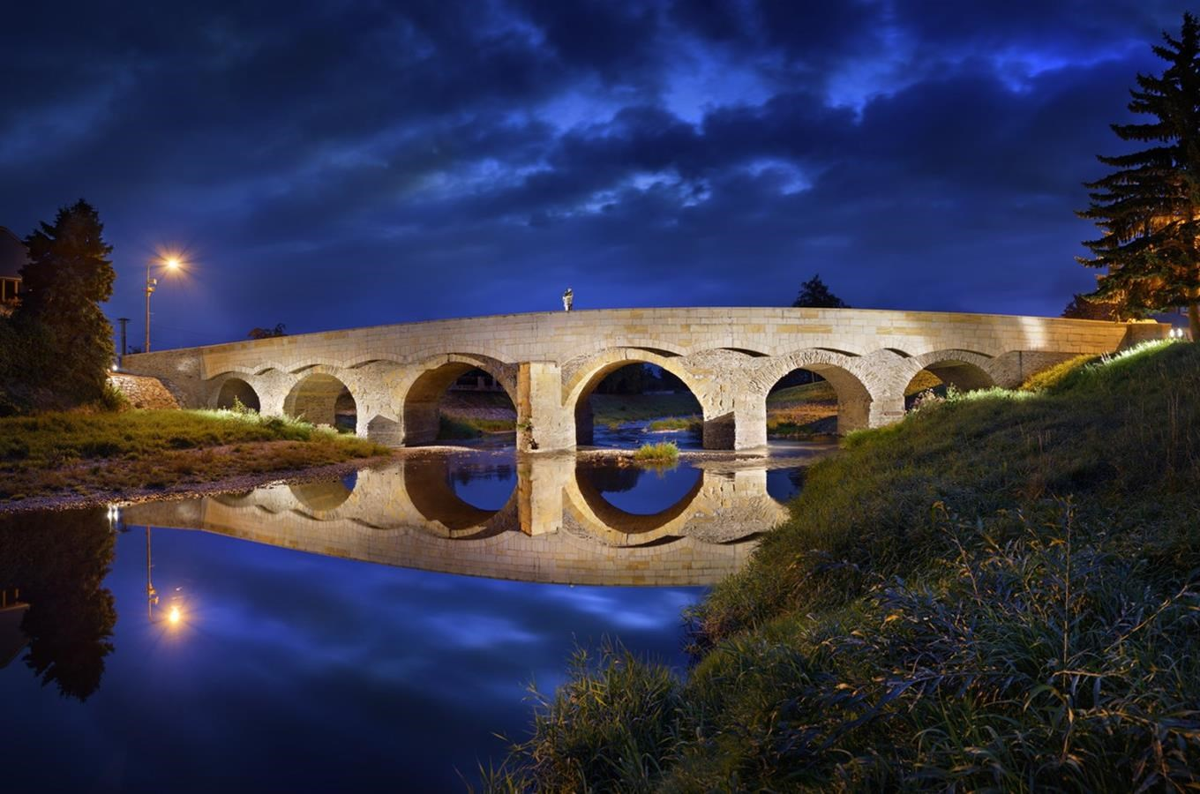
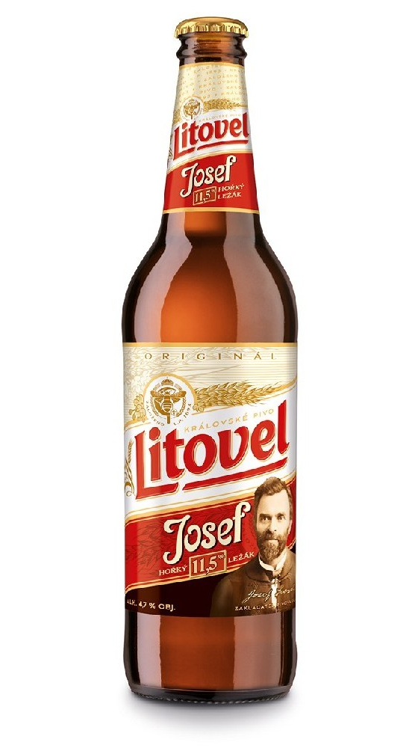
In the middle of this UNIQUE nature system is the royal town Litovel, from which the area takes the name (unexpectedly)
This is the best thing in the town and the bottles are ECOLOGICAL (cs its glass ofc)

Slide 6
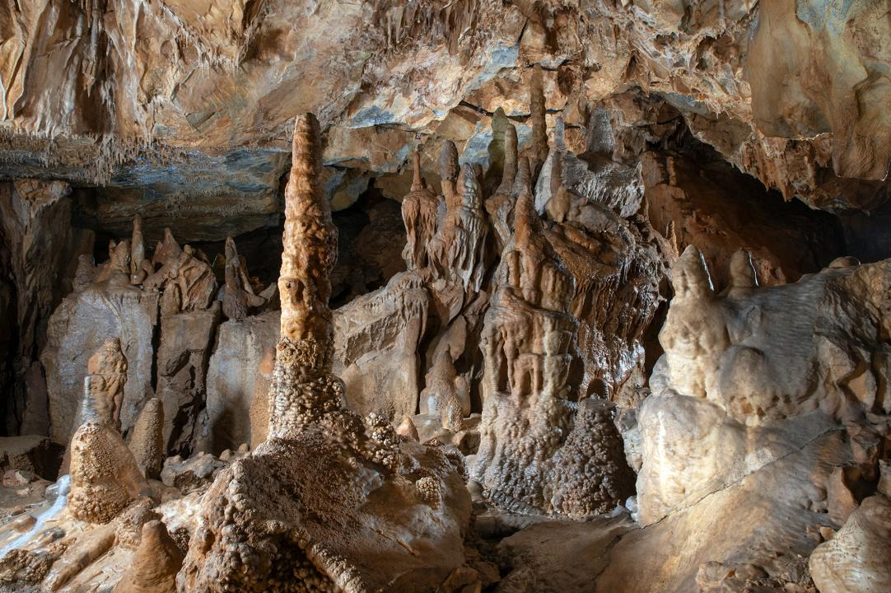
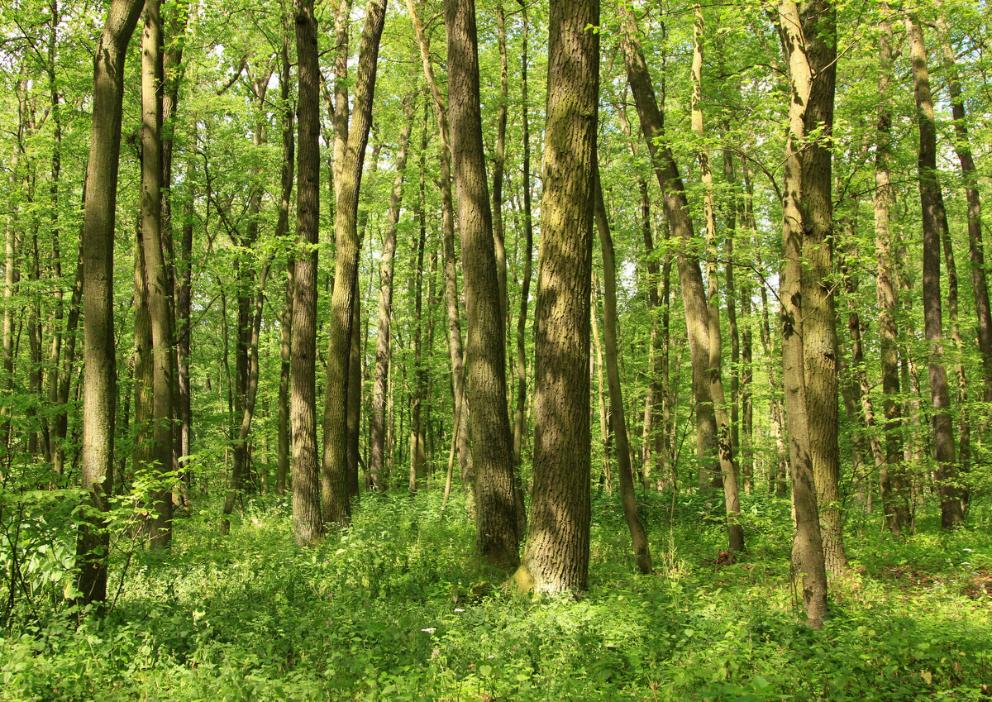
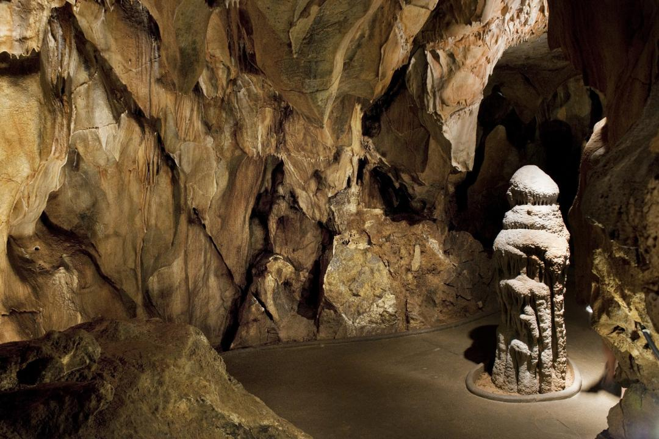
The PLA includes a karst area with well-known caves open to the public (Mladečské caves) and the area of twig deciduous forests Doubrava

Slide 7
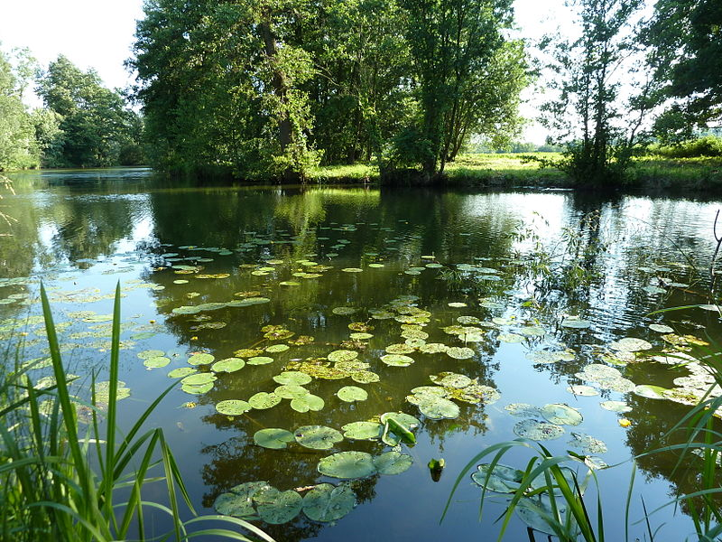
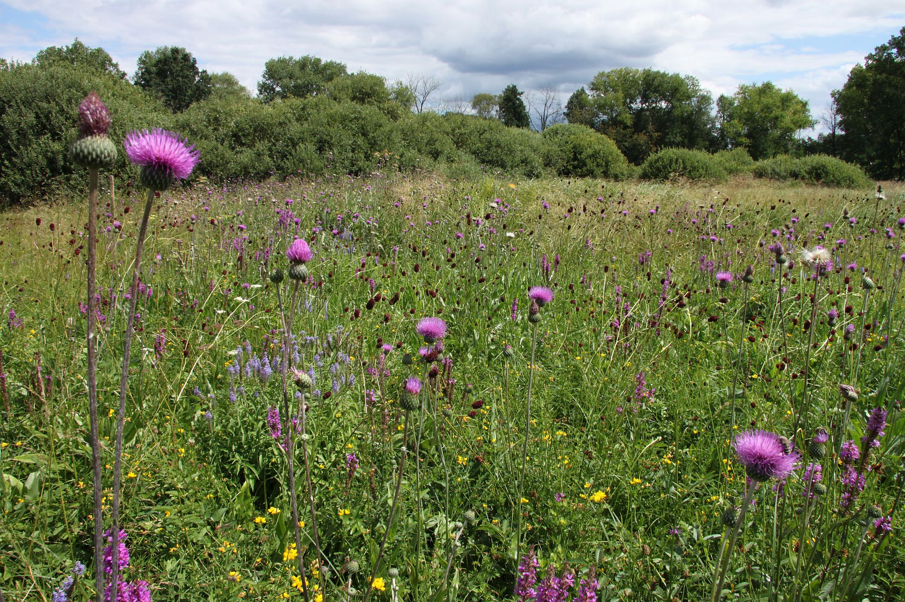

The Morava River flows into the Black Sea
Litovel Morava Riverlands is unique and special in several ways. These unusually well preserved and uniterrupted alluvial forests, flood plain meadows and bogs are home to a large number of rare plants and animals

Slide 8
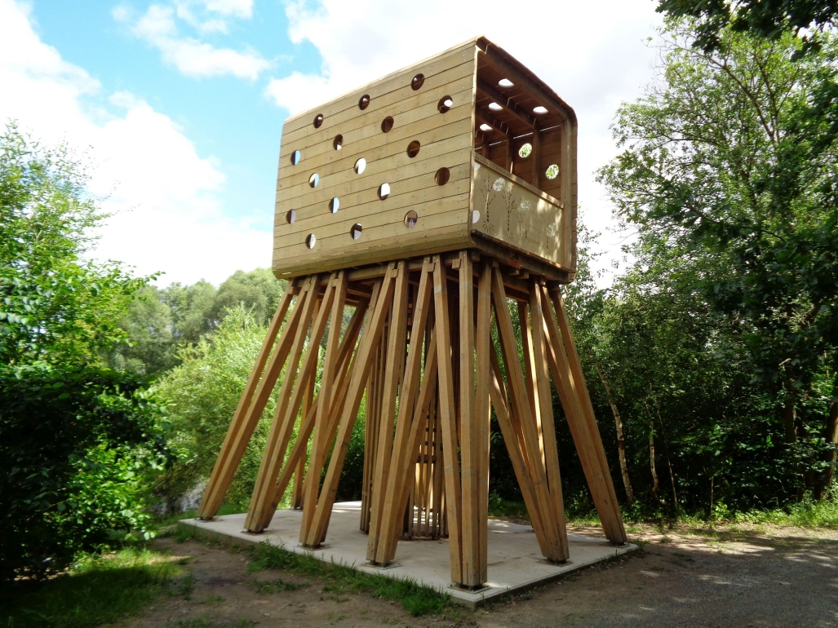
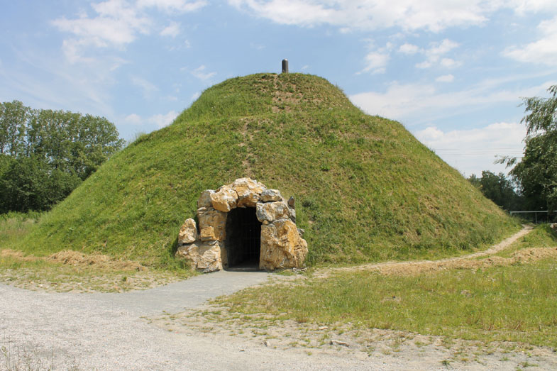
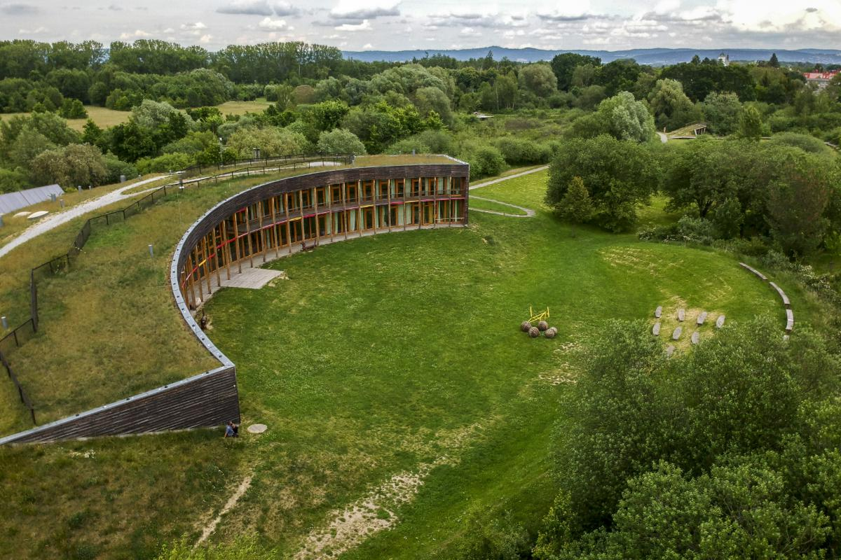
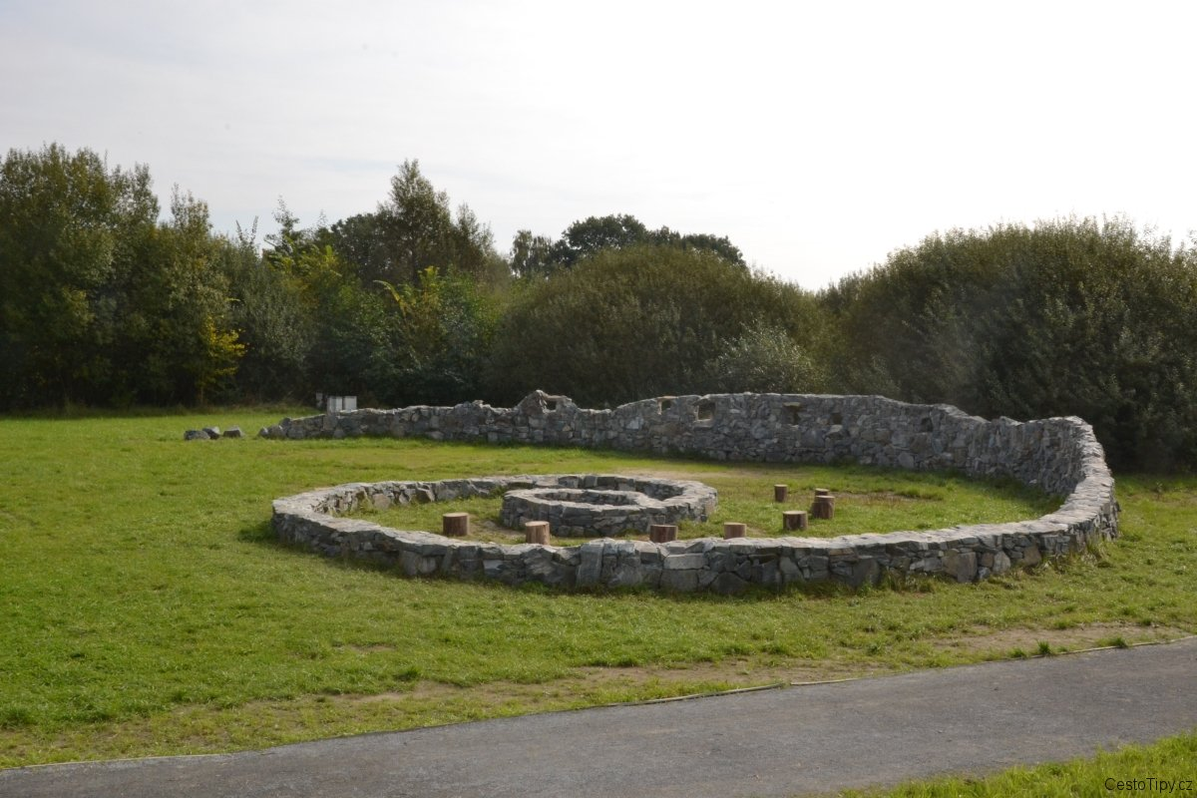
Sluňákov - Ecological Activities Center

Slide 9

Rare species in CHKO Litovelské pomoraví
Rare as this Pokemon card which was sold for about 16 million US dollars btw

Slide 10
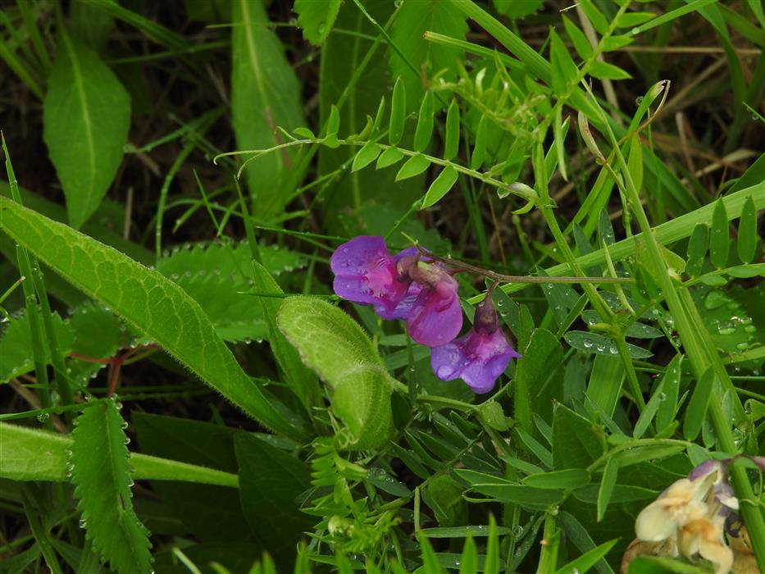
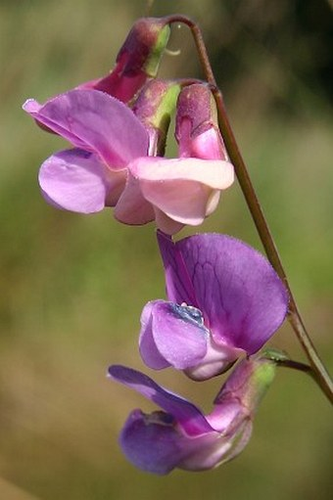
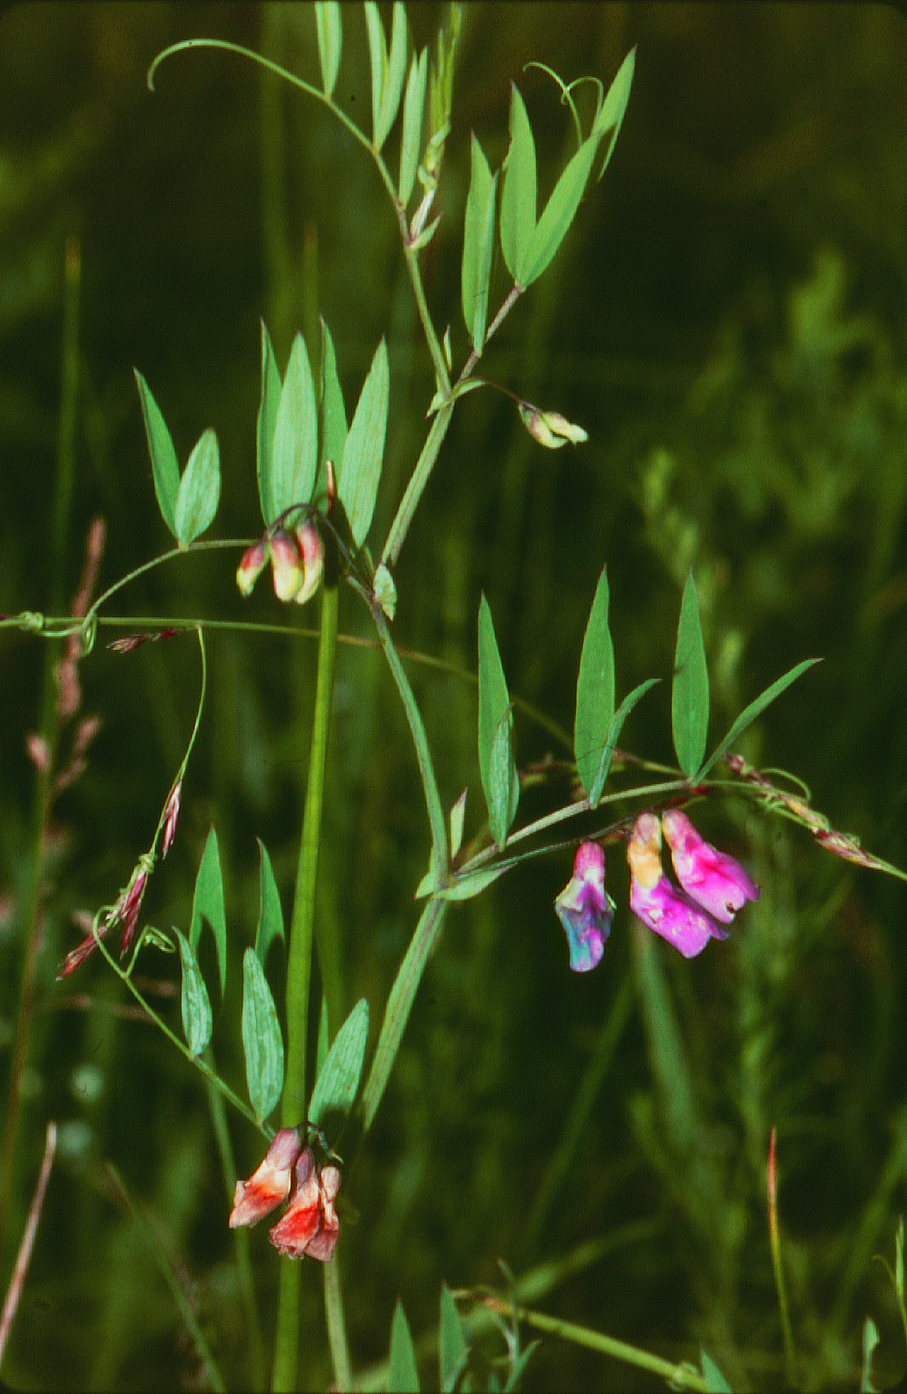
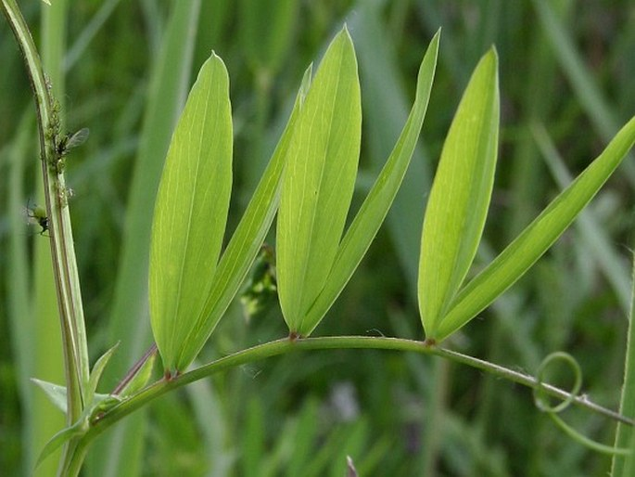
Hrachor bahenní (Lathyrus palustris)
Marsch Pea, Sumpf-Platterbse

Slide 11
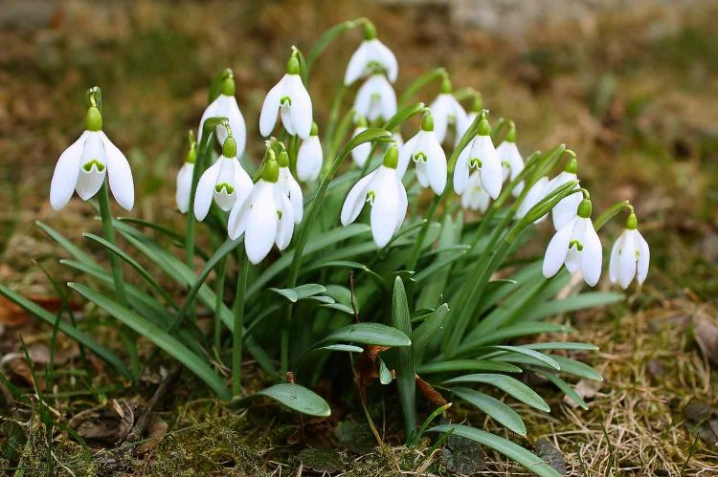
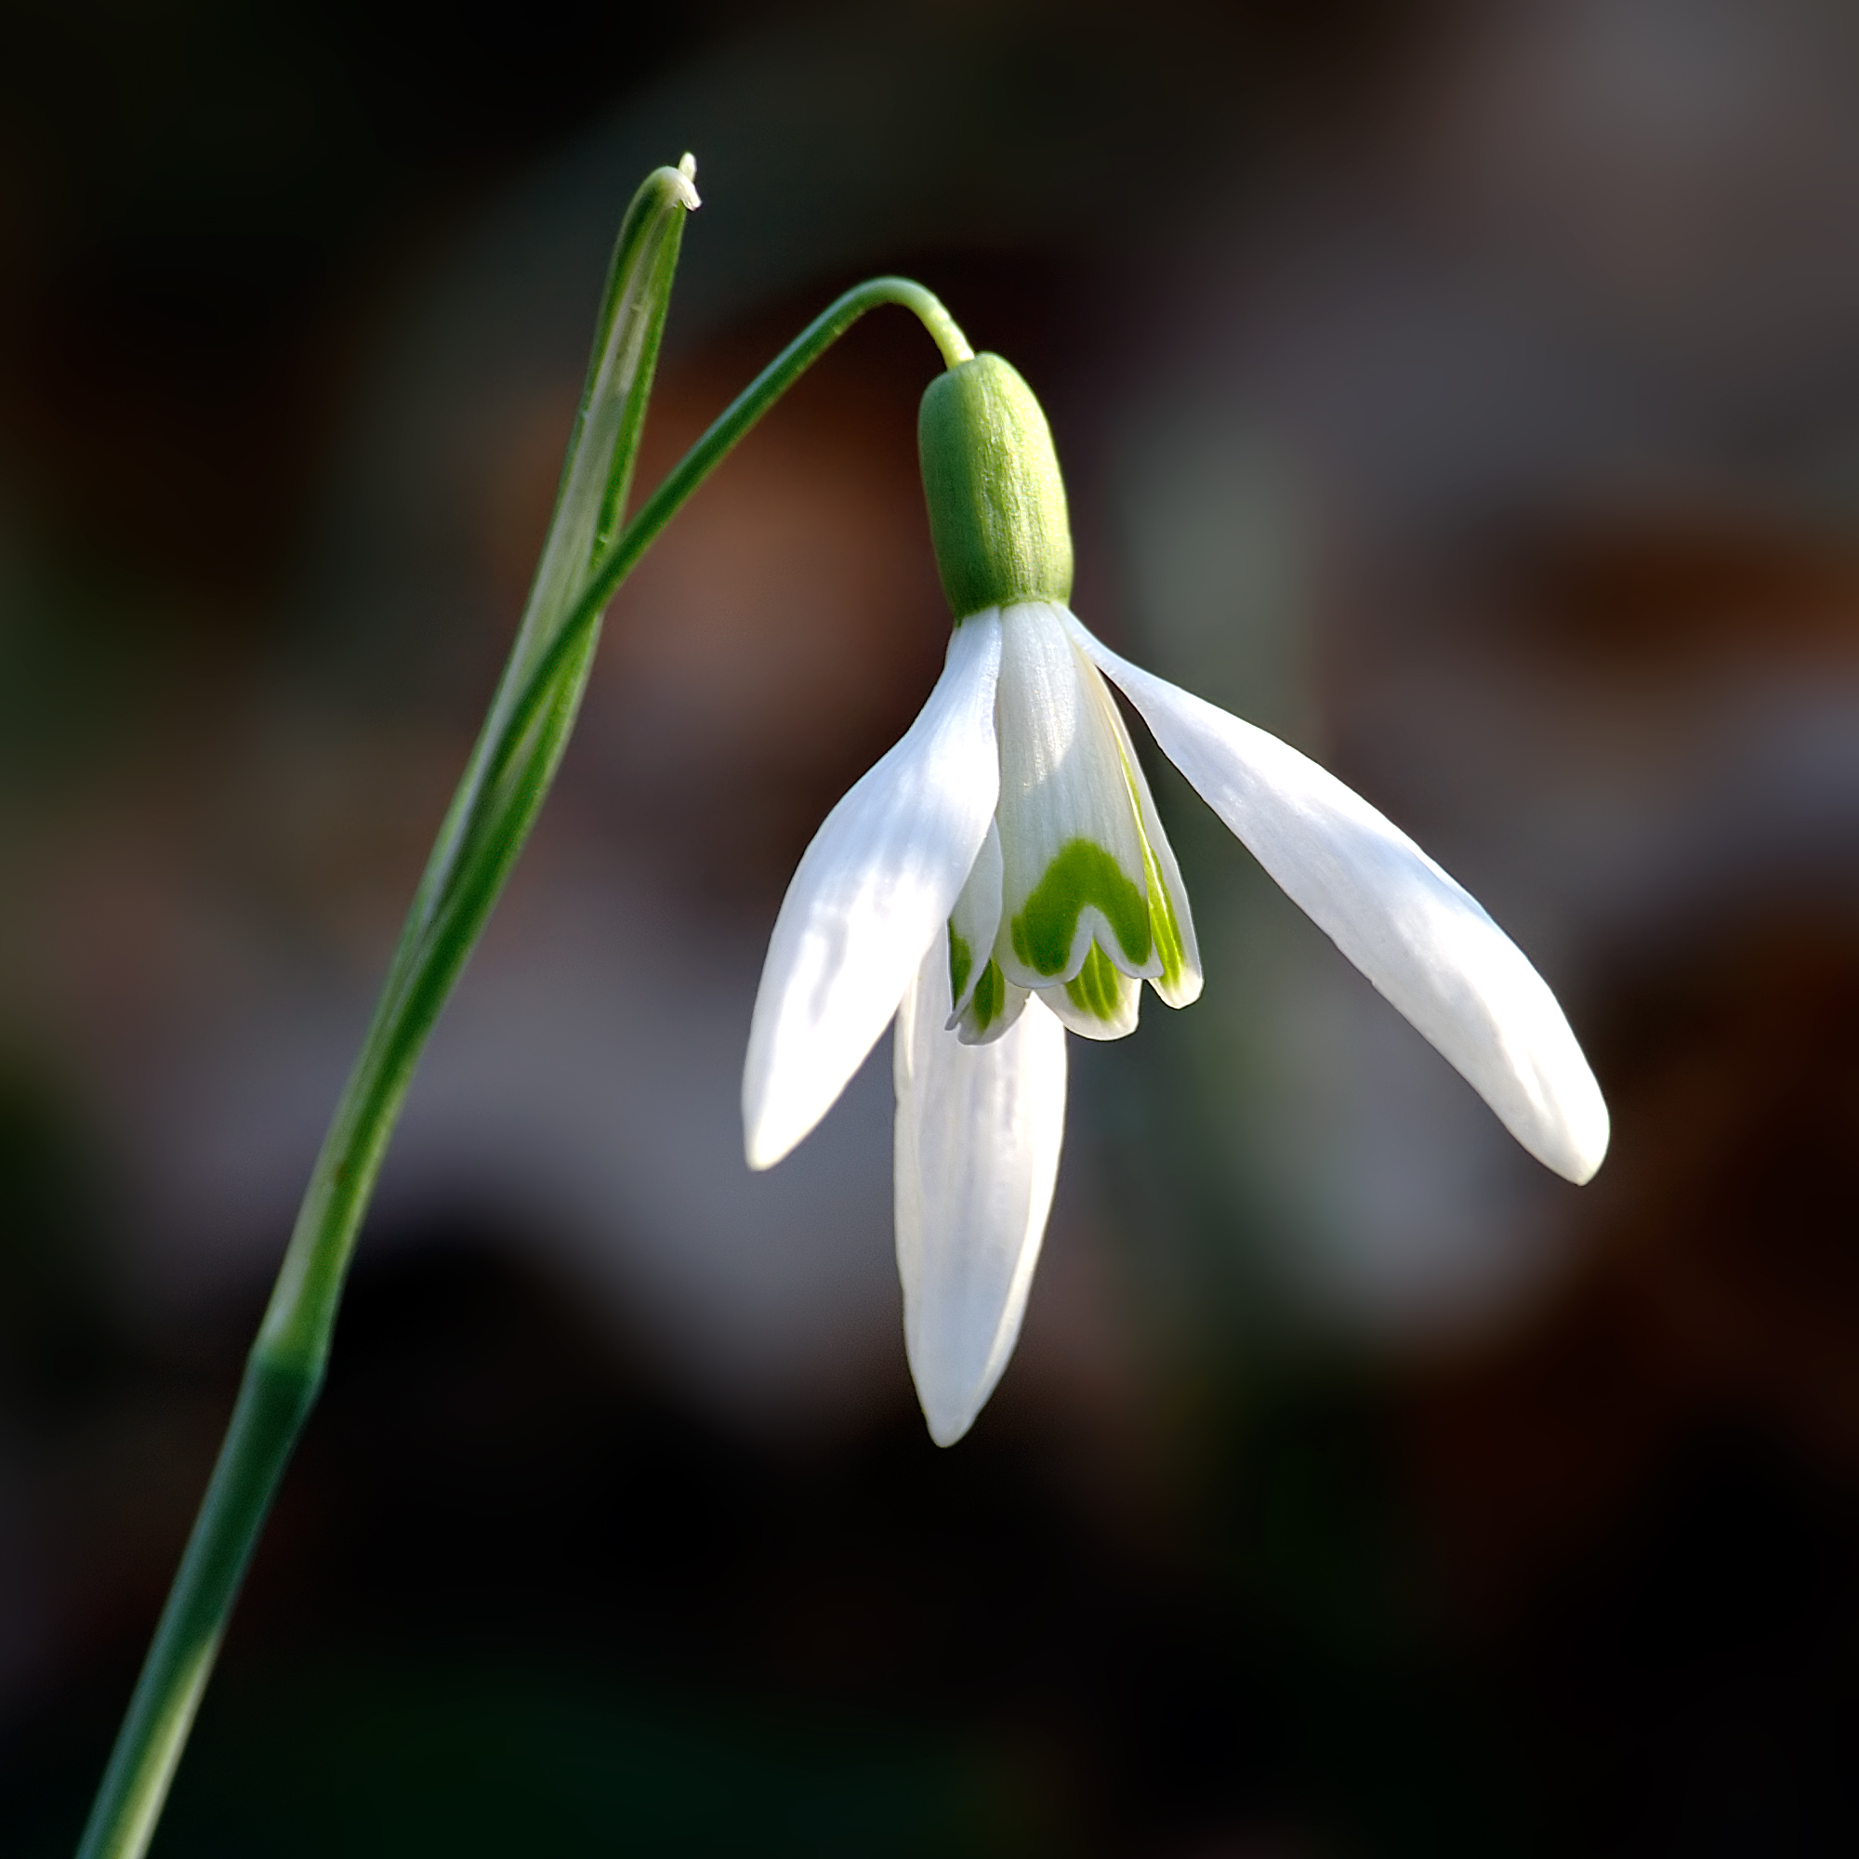

Sněženka podsněžník (Galanthus nivalis)
Snowdrop, Schneeglöckchen
Why the plants look so sad?

Slide 12
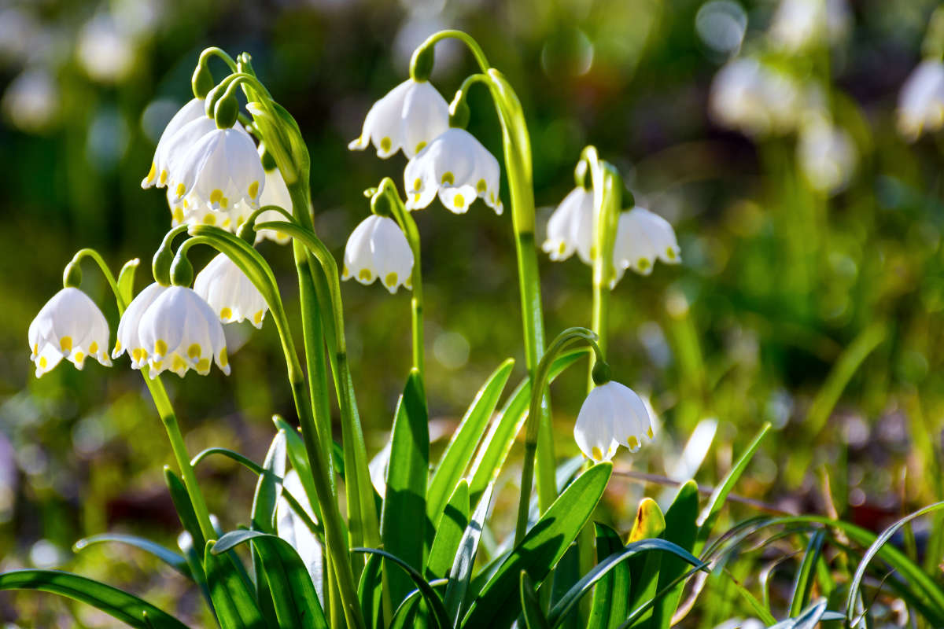
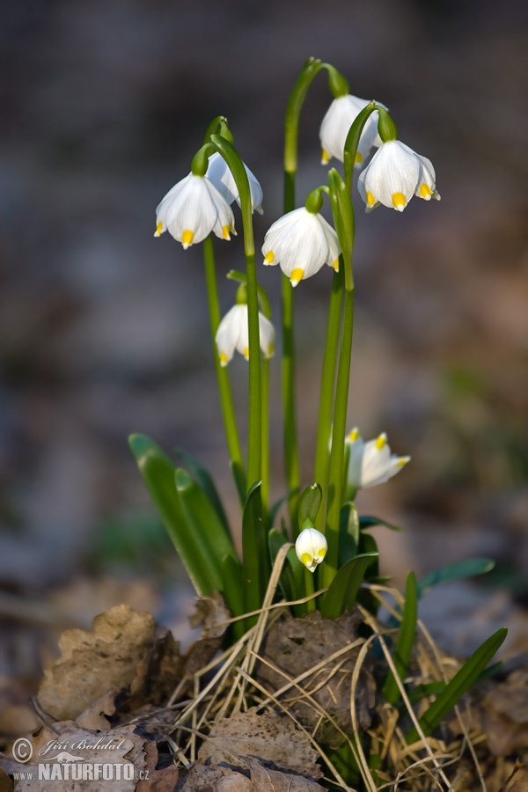
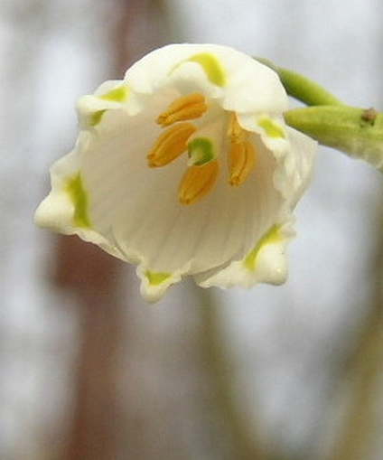
Bledule jarní (Leucojum vernum)
Spring snowflake, Märzenbecher

Slide 13
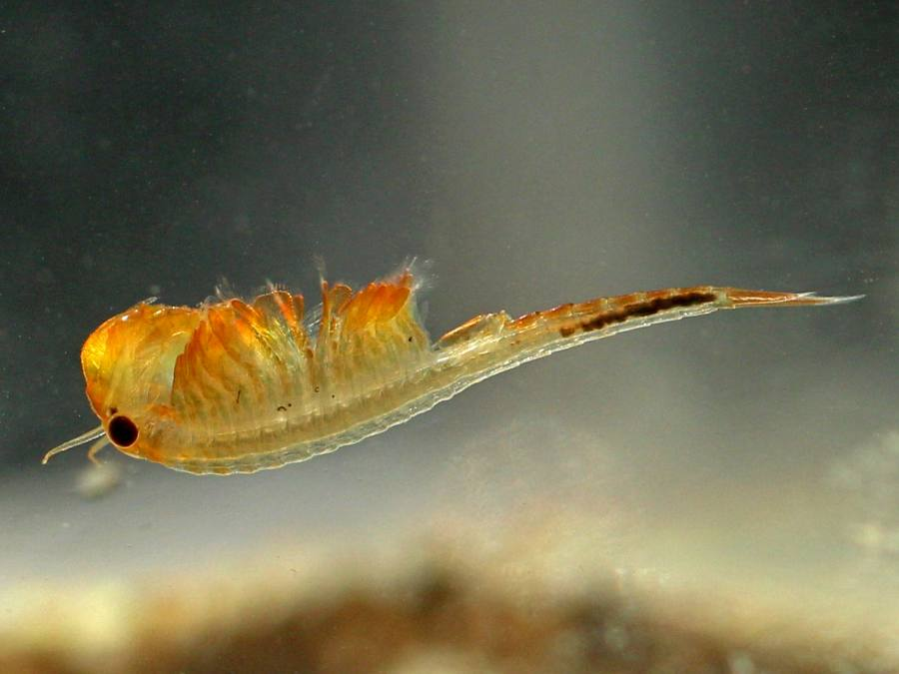
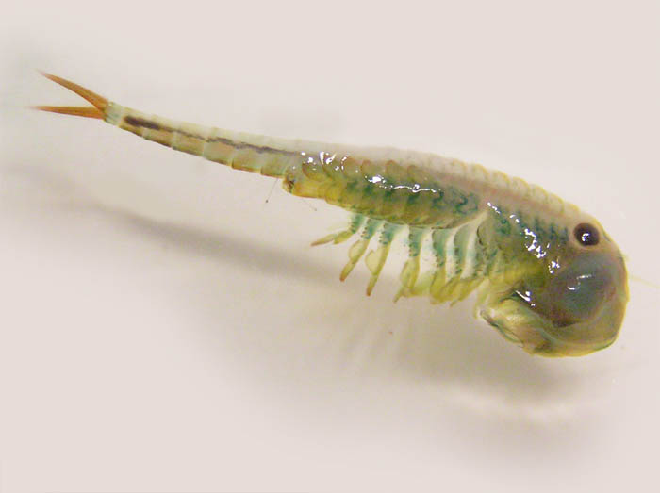
Žábronožka sněžní (Siphonophanes grubii)
Spring Fairy Shrimp, Frühlings-Feenkrebschen

Slide 14
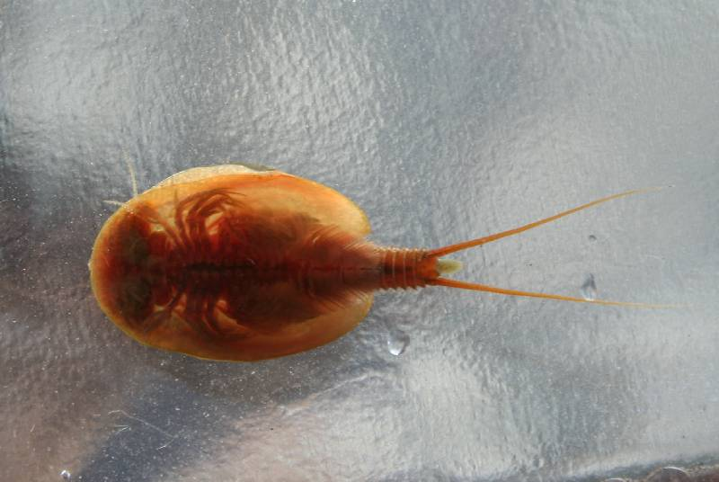
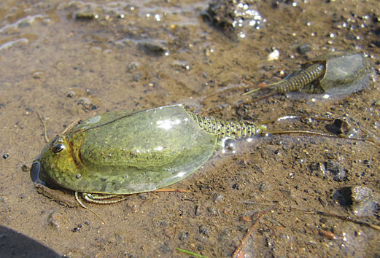
Listonoh jarní (Lepidurus apus)
Spring Fairy Shrimp, Frühlings-Schildkrebs

Slide 15
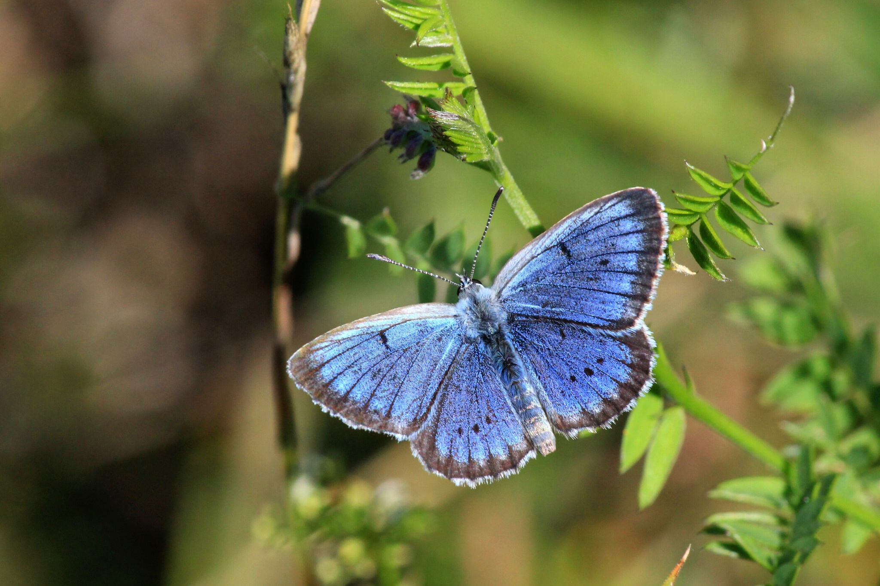
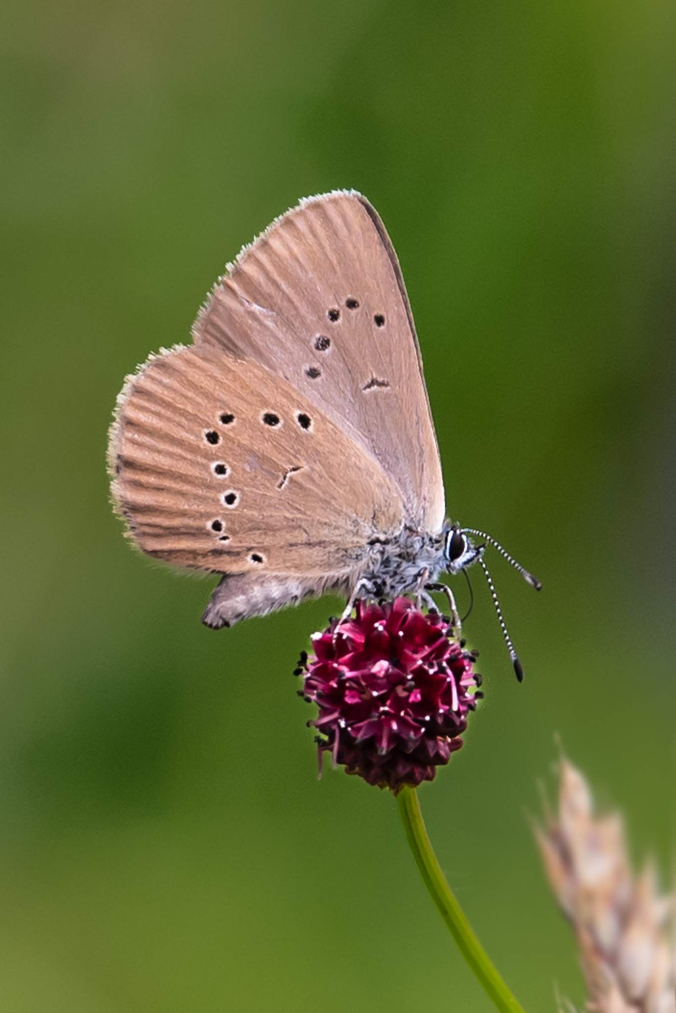
Modrásek bahenní (Phengaris nausithous)
Dusky Large Blue, Dunkler Wiesenknopf-Ameisenbläuling

Slide 16
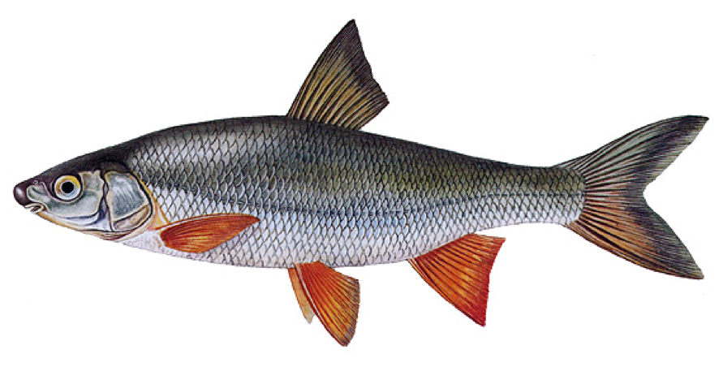
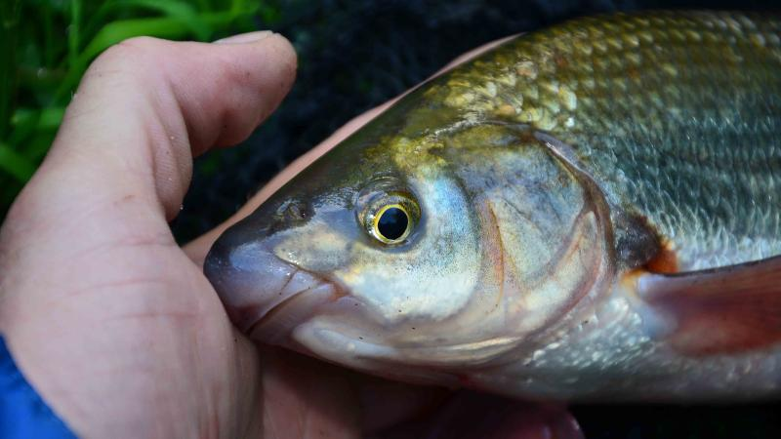
Ostroretka stěhovavá (Chrondrostoma nasus)
Common Nase, Nase
Oh man, it is smiling 🤗

Slide 17
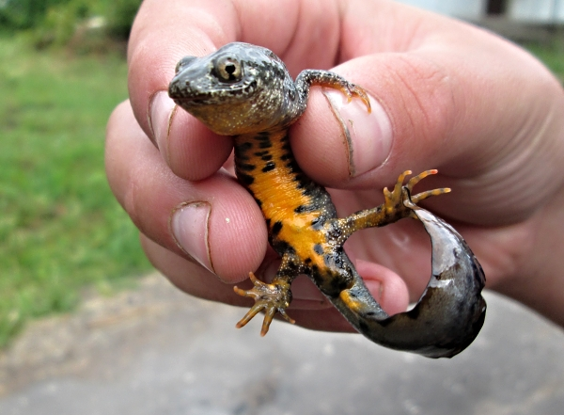
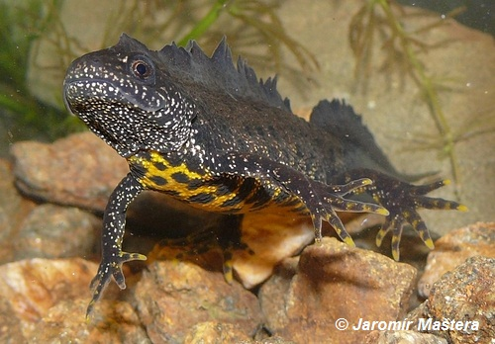
Čolek velký (Triturus cristatus)
Great Crested Newt, Nördlicher Kammmolch

Slide 18
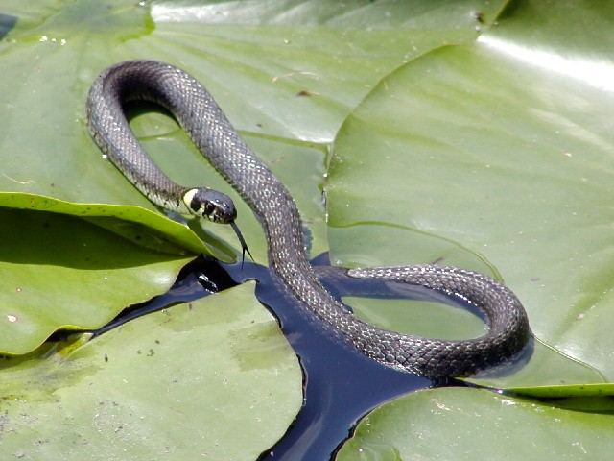
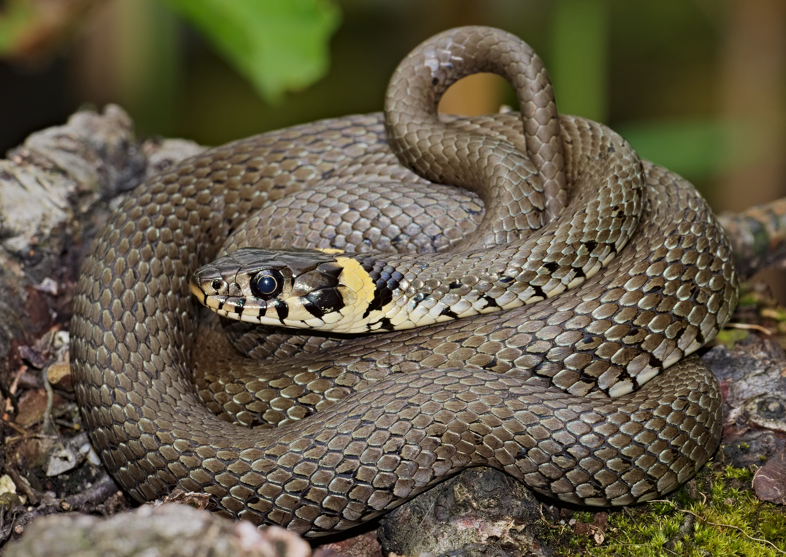
Užovka obojková (Natrix natrix)
Grass snake, Ringelnatter

Slide 19
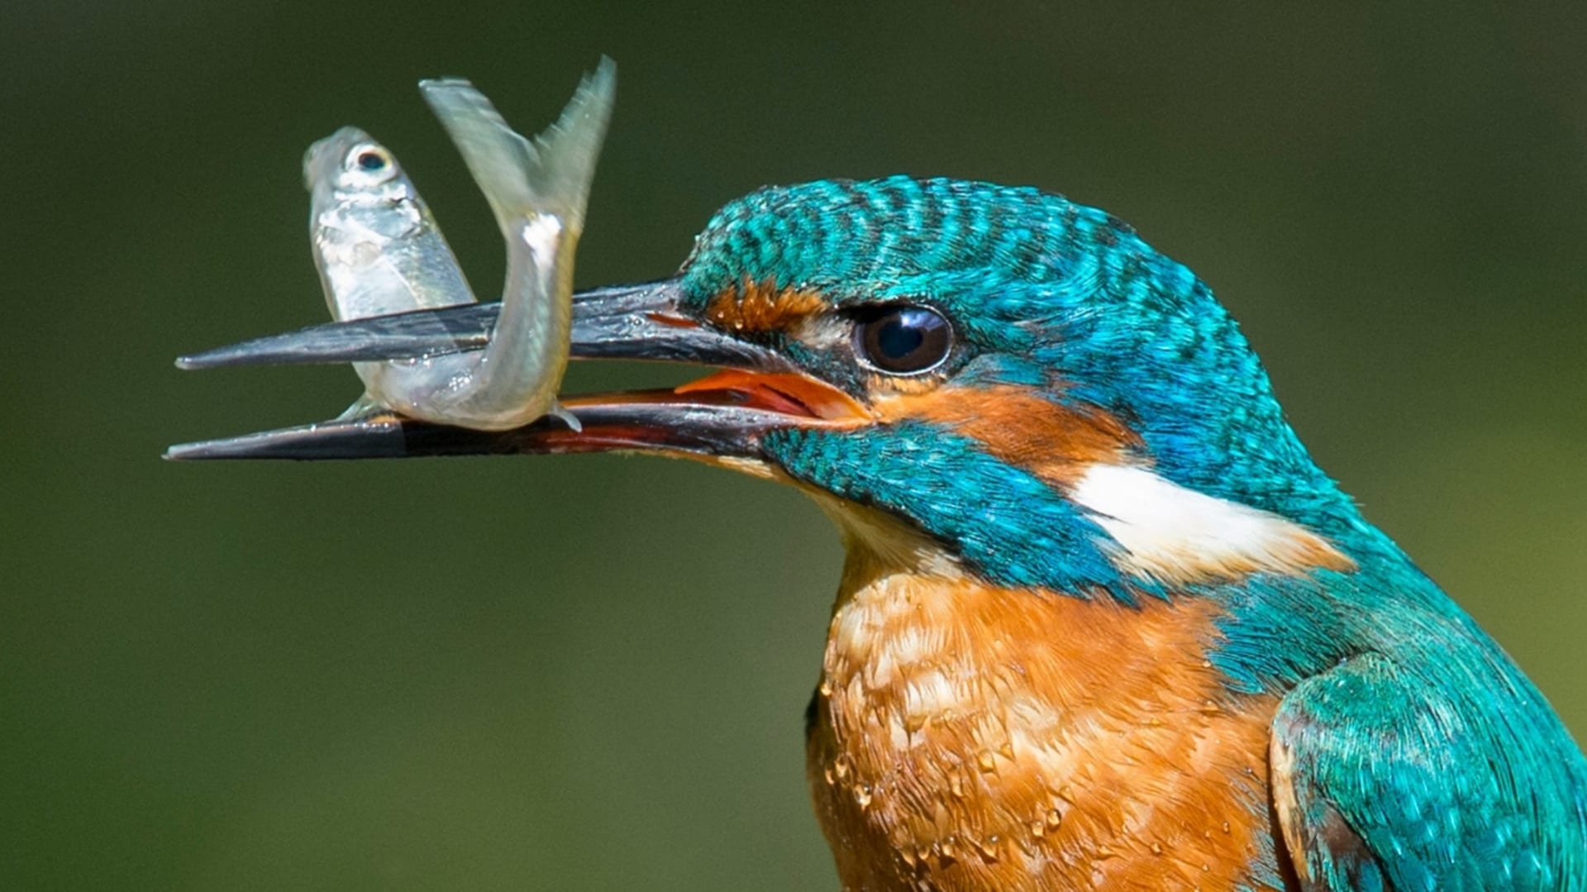
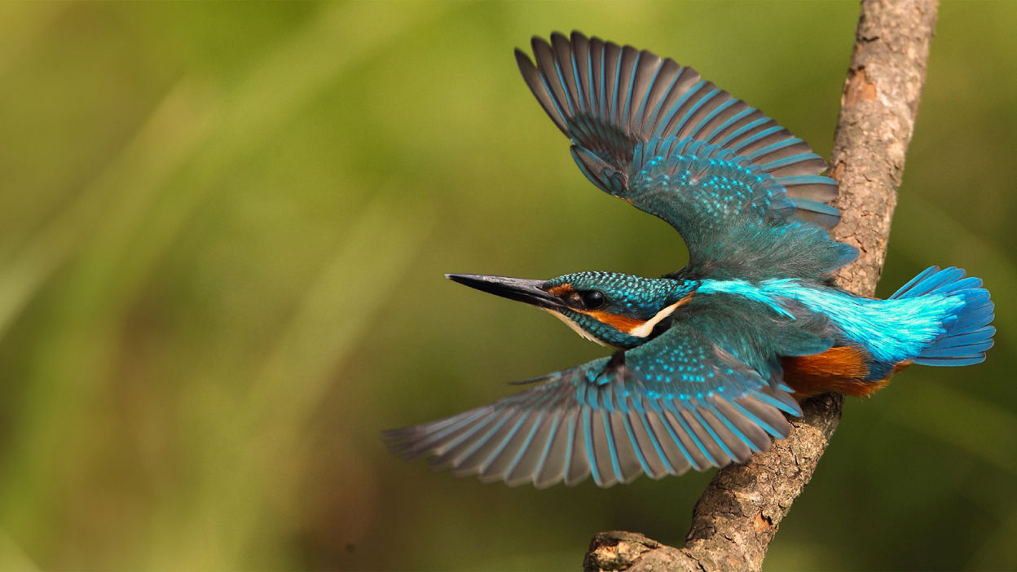
Ledňáček říční (Alcedo atthis)
Common Kingfisher, Eisvogel

Slide 20
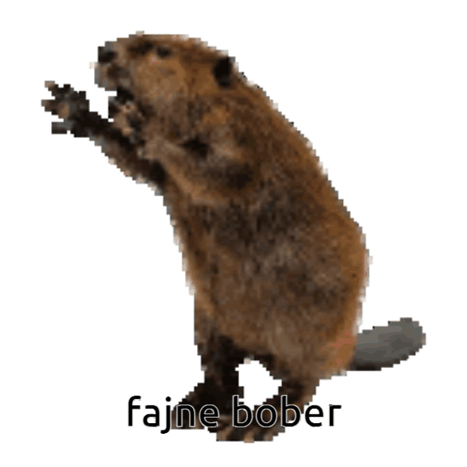
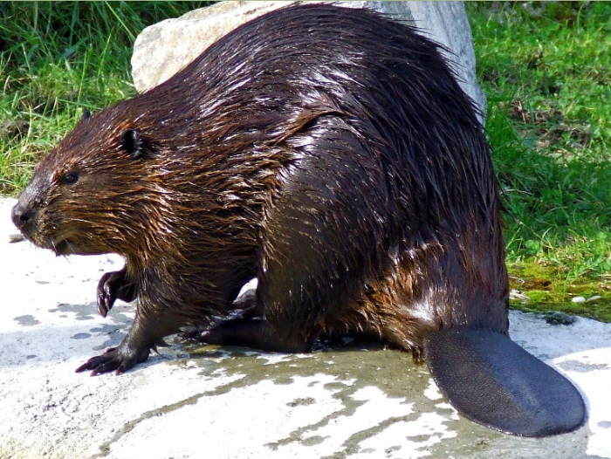
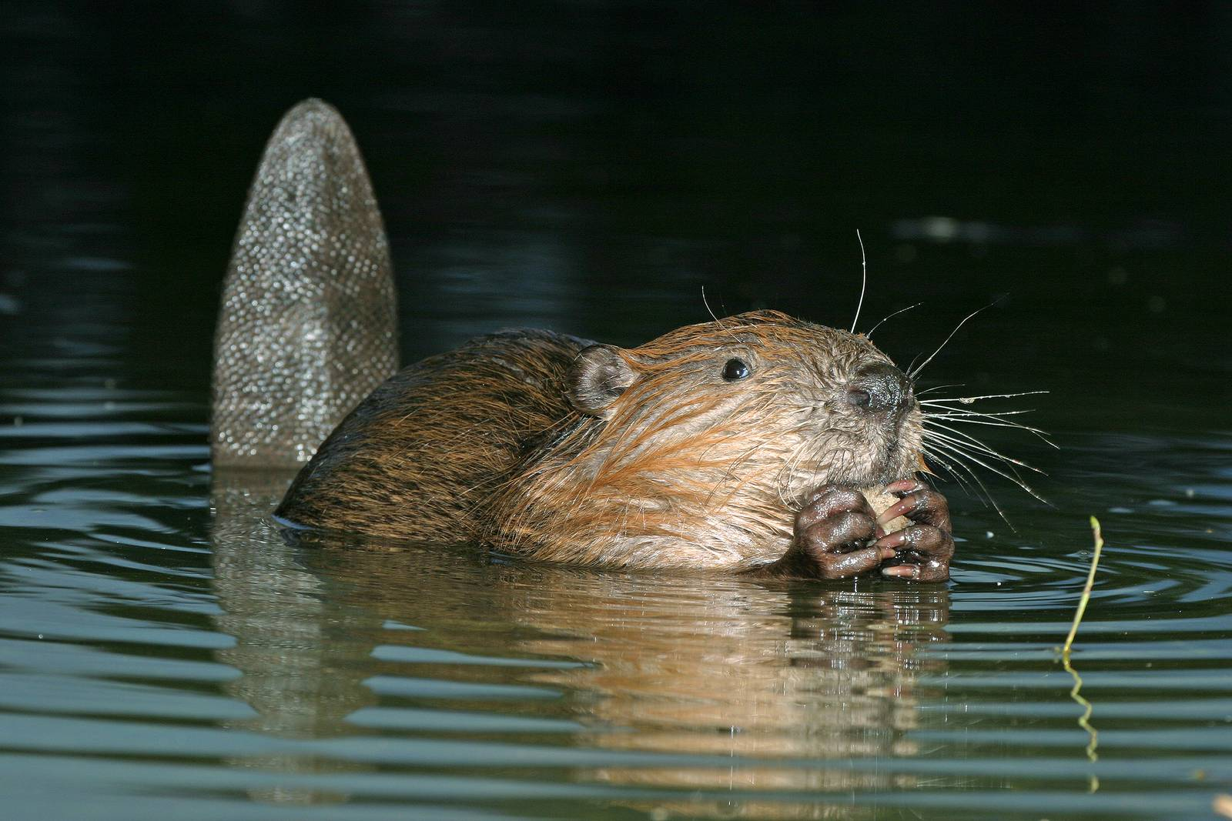
Bobr evropský (Castor fiber)
Eurasian Beaver, Europäischer Biber

Slide 21
Sources:
https://litovelskepomoravi.aopk.gov.cz/
https://www.ok-tourism.cz/en/tourist-attractions/nature/natural-attractions-1/
https://www.ok-tourism.cz/de
https://www.casopis.ochranaprirody.cz/z-nasi-prirody/chranena-krajinna-oblast-litovelske-pomoravi/
https://cs.wikipedia.org/wiki
https://www.pokemon-guru.cz/rubriky/jak-zacit/pro-zacatecniky/top10-nejdrazsich-pokemon-karet-na-svete_14050.html
https://www.seznamzpravy.cz/clanek/ekonomika-byznys-pokemon-trhl-novy-rekord-karticka-pikachu-se-prodala-za-340-milionu-299028
https://www.naucne-stezky.cz/naucna-stezka-luhy-litovelskeho-pomoravi/
https://slunakov.cz/areal-domu-prirody/

Slide 22


