Slide 1

DiscoverEU
Karger, Kořenek, Pospíšil, Stodůlka

Slide 2

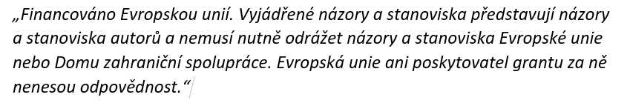

Slide 3
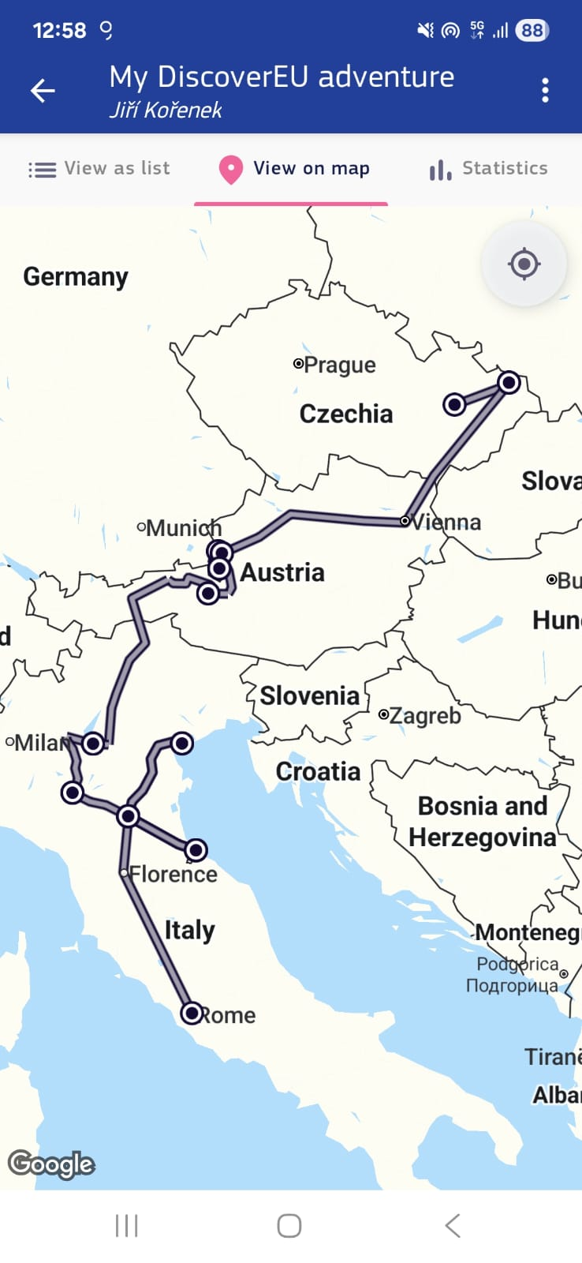

What is discoverEU?
- institution helping students to visit other countries
- experience real english
- alone or with school
- your own program
- 10 days paid

Slide 4
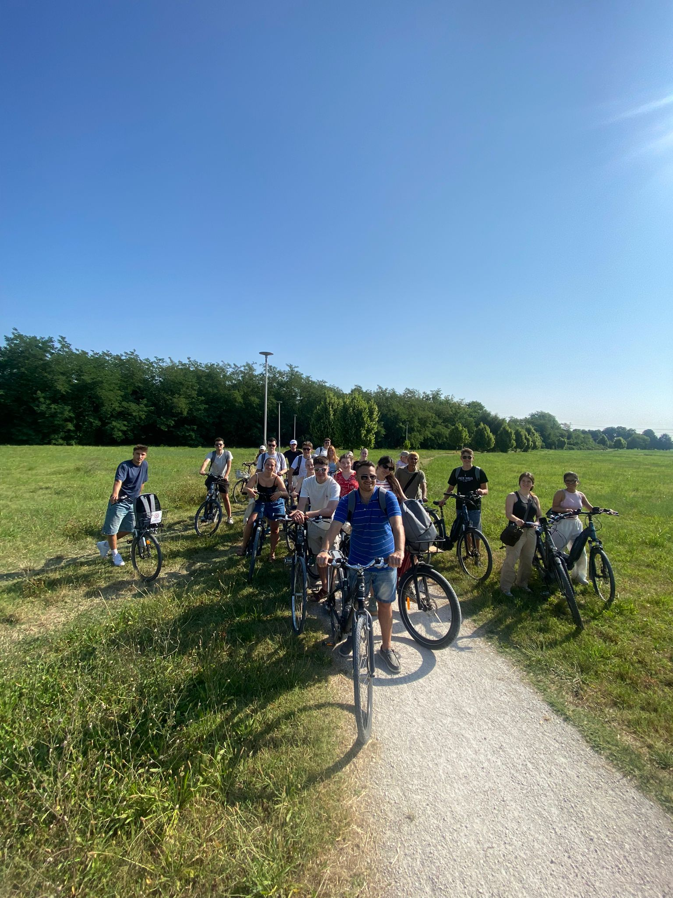
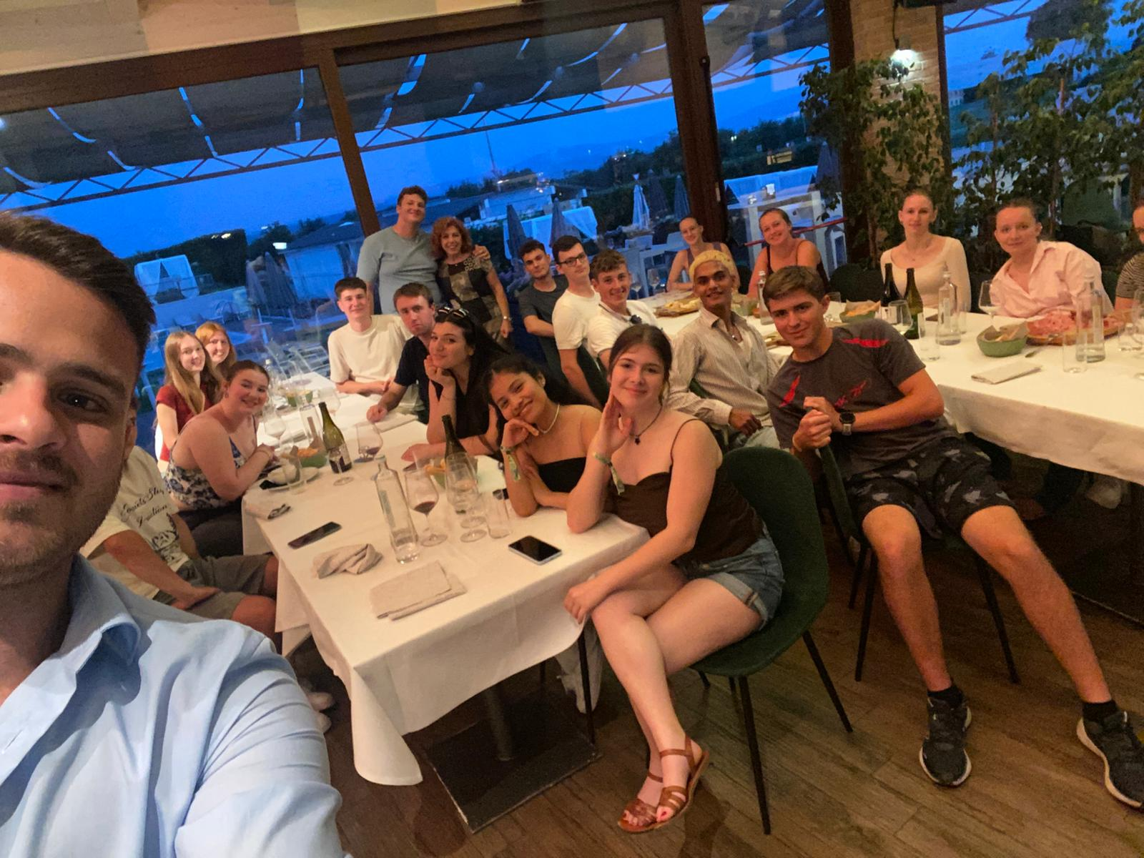
Meetup
- meet new other people
- discover local culture together
- with guides

Slide 5
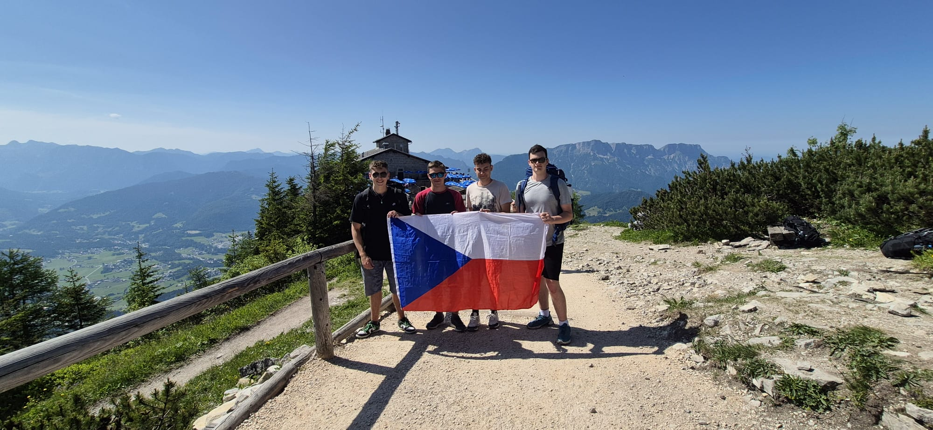
Our journey
- Austria
- Germany
- Italy

Slide 6
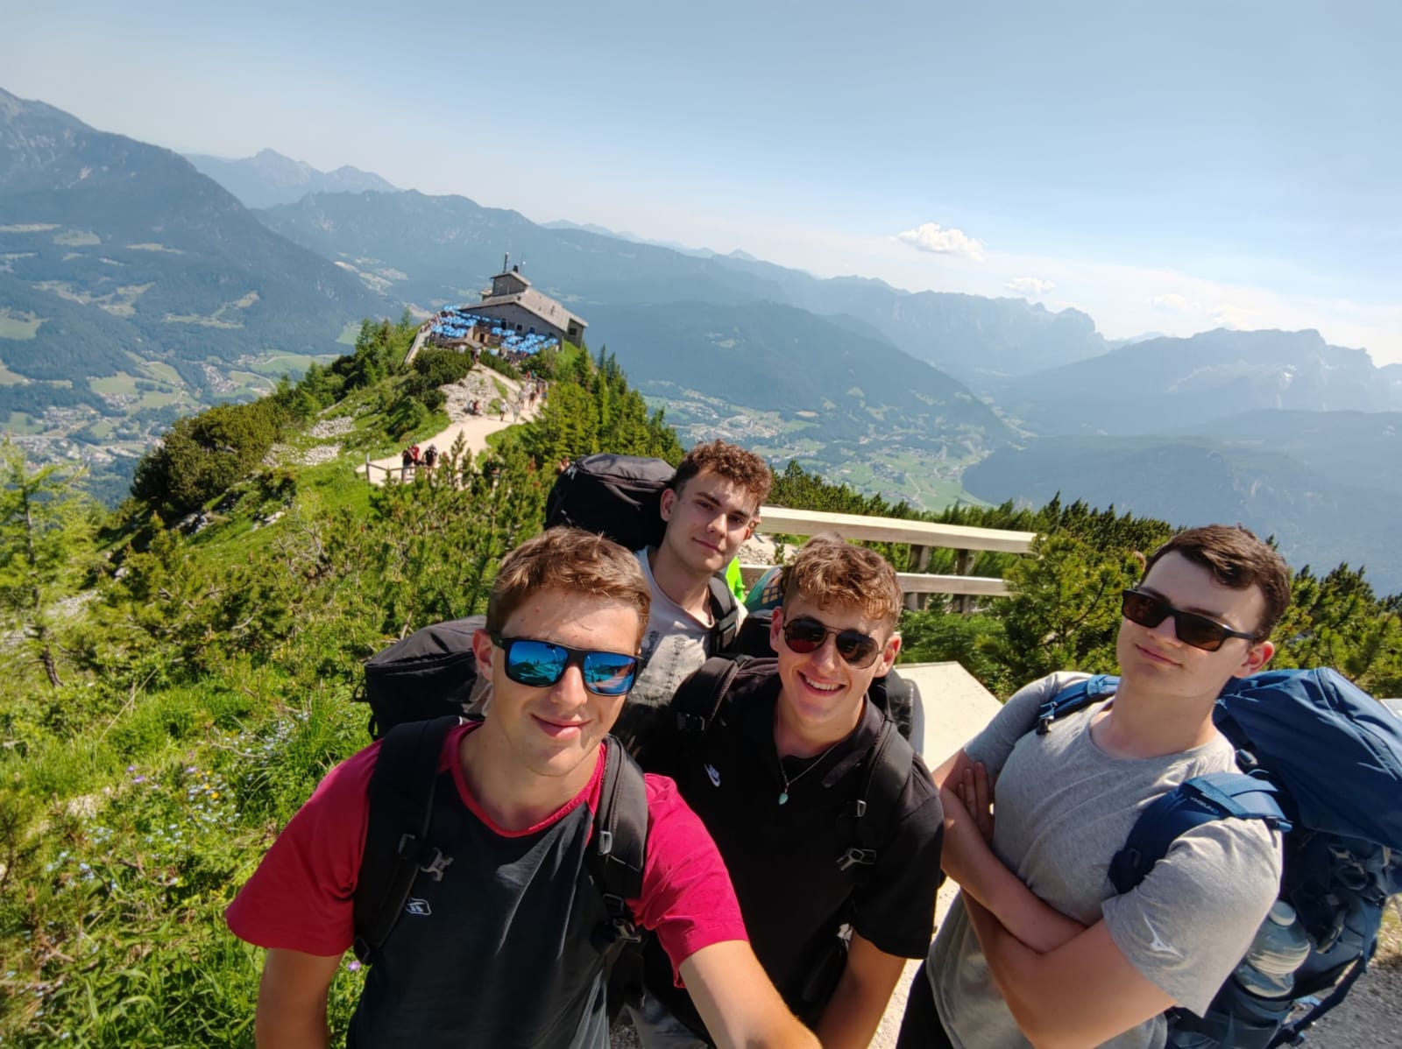
Germany
- Eagel’s nest
- historical museum
- Königssee

Slide 7
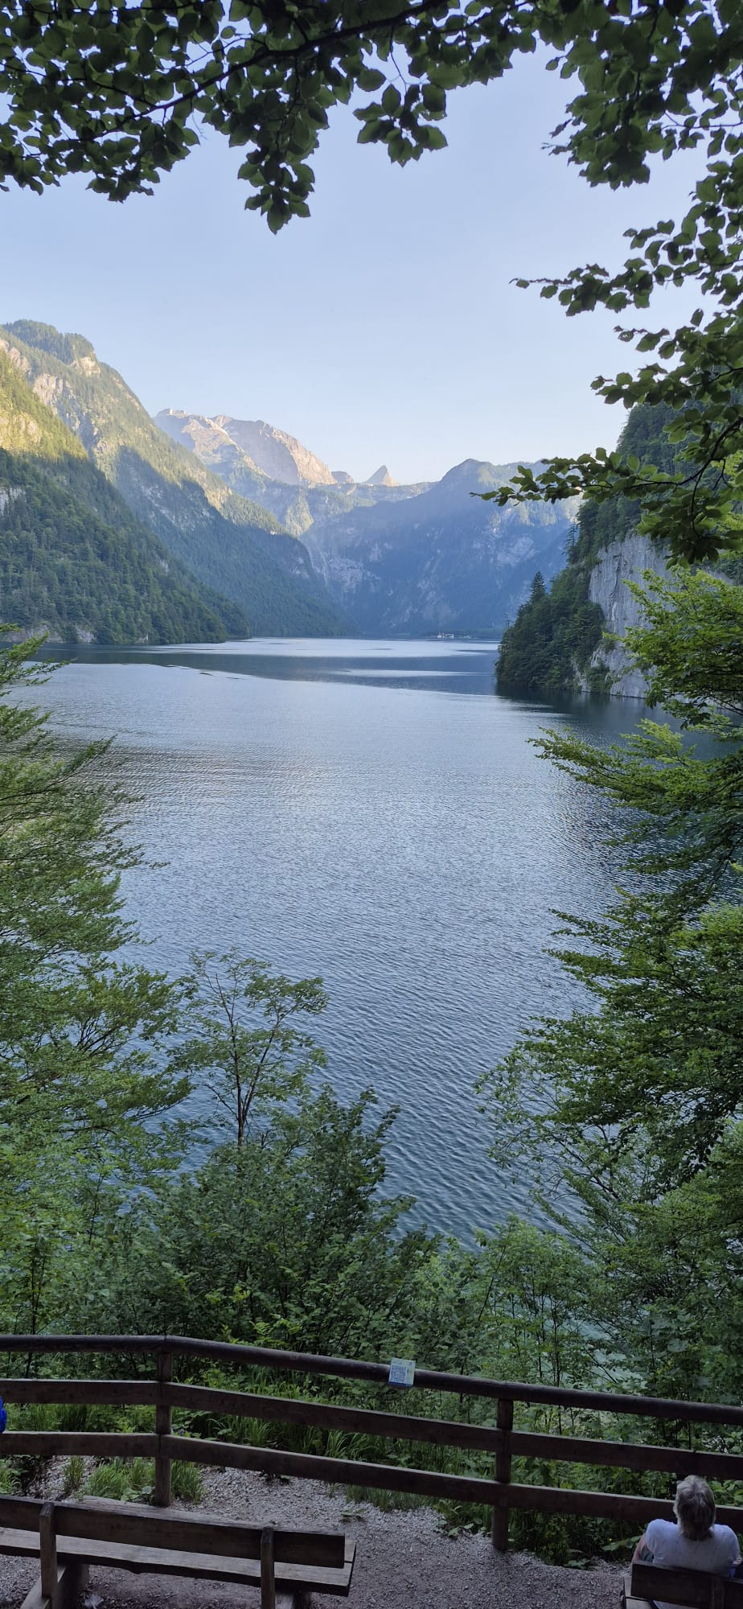
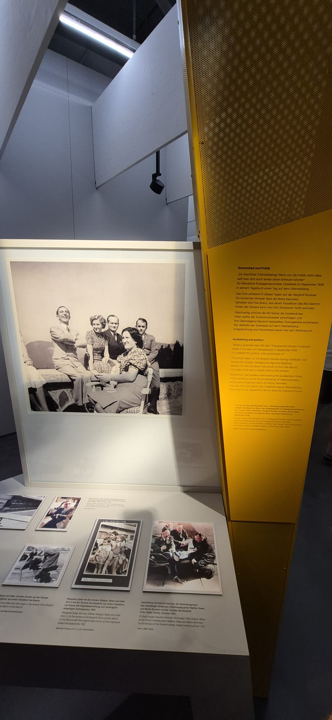
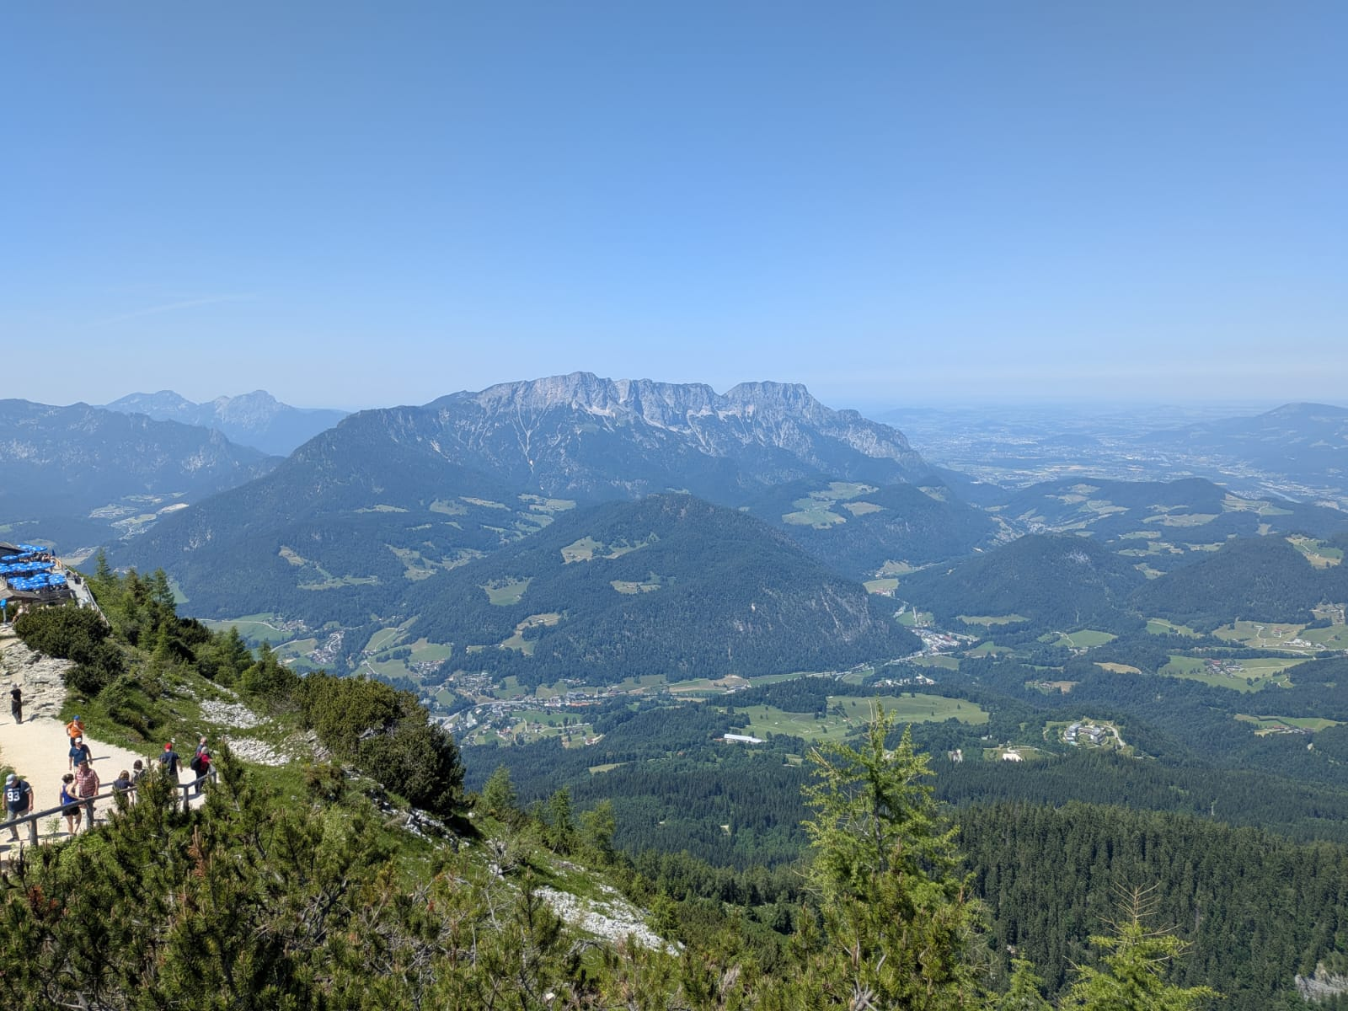

Slide 8
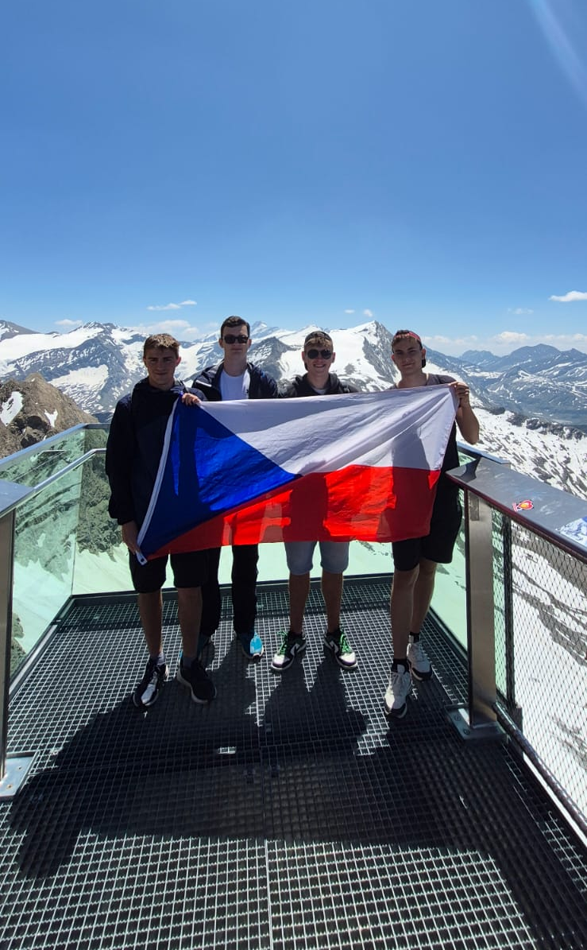
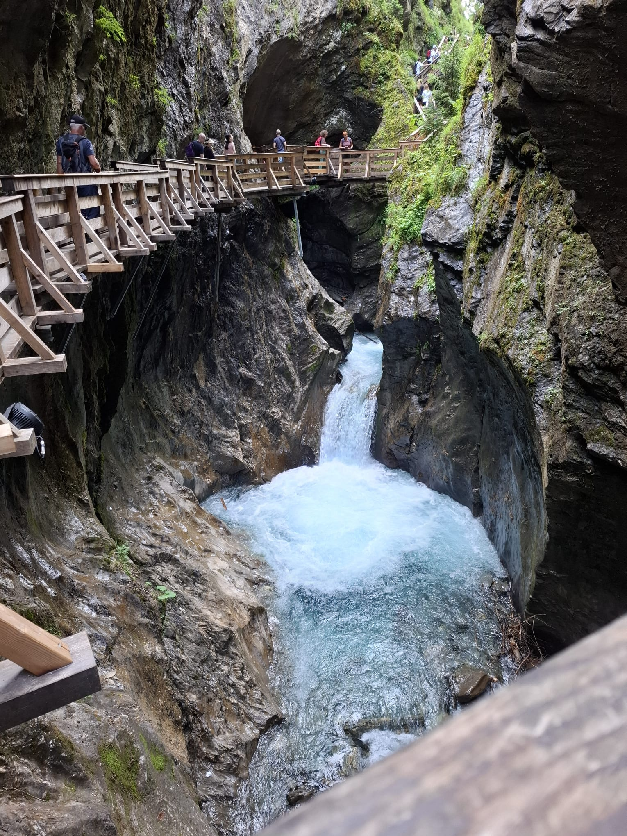
Austria
- Zell am See
- Kitzenhorn
- Sigmund Thun ravine

Slide 9
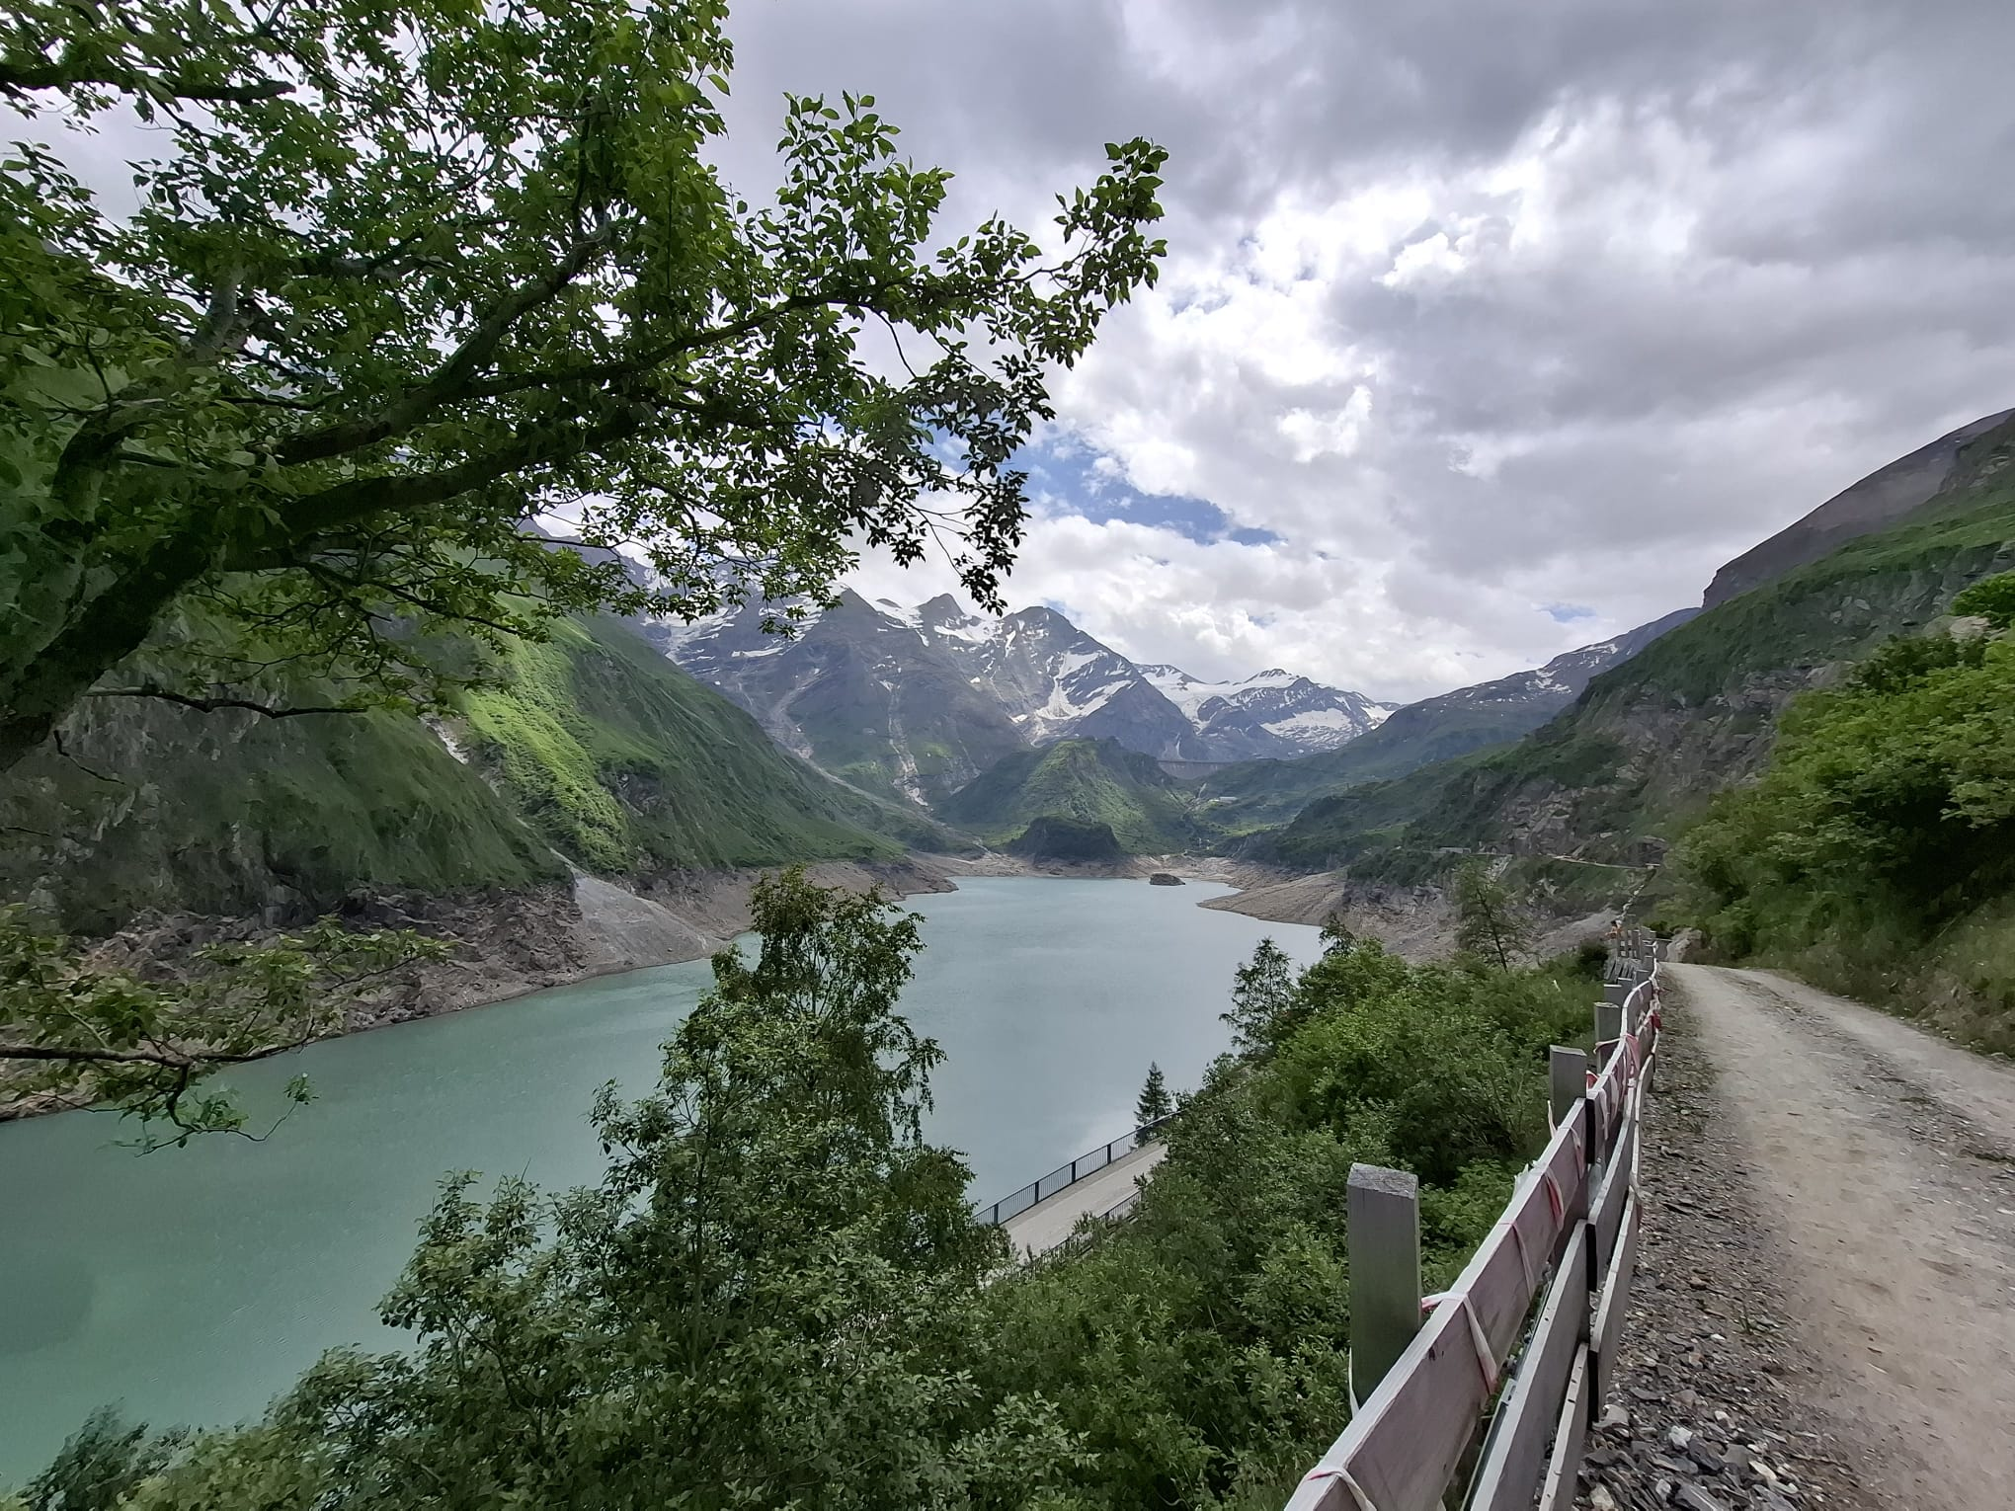
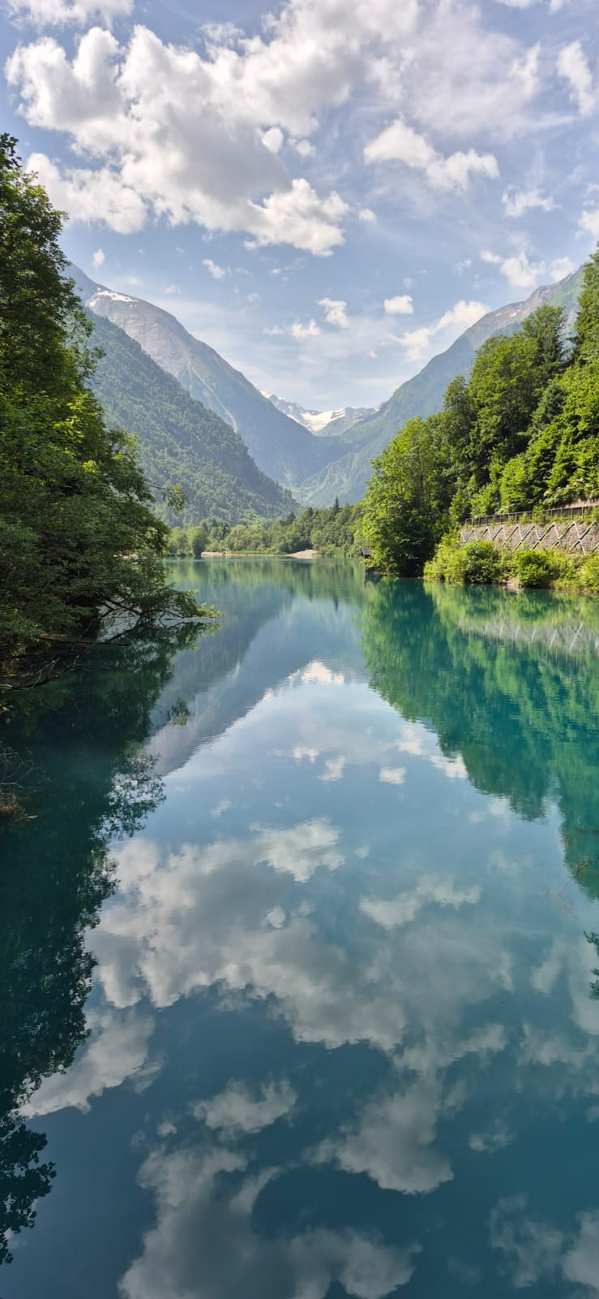
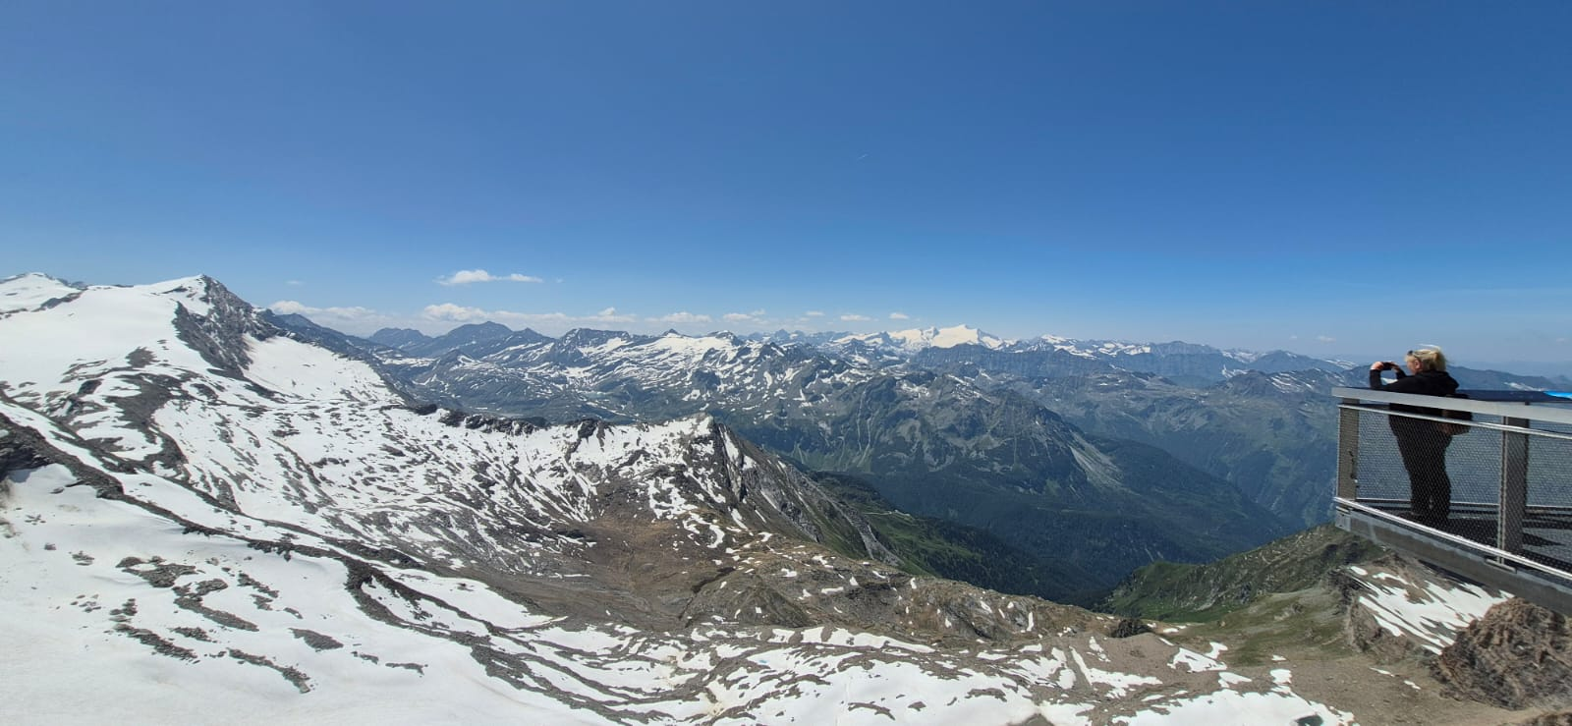

Slide 10
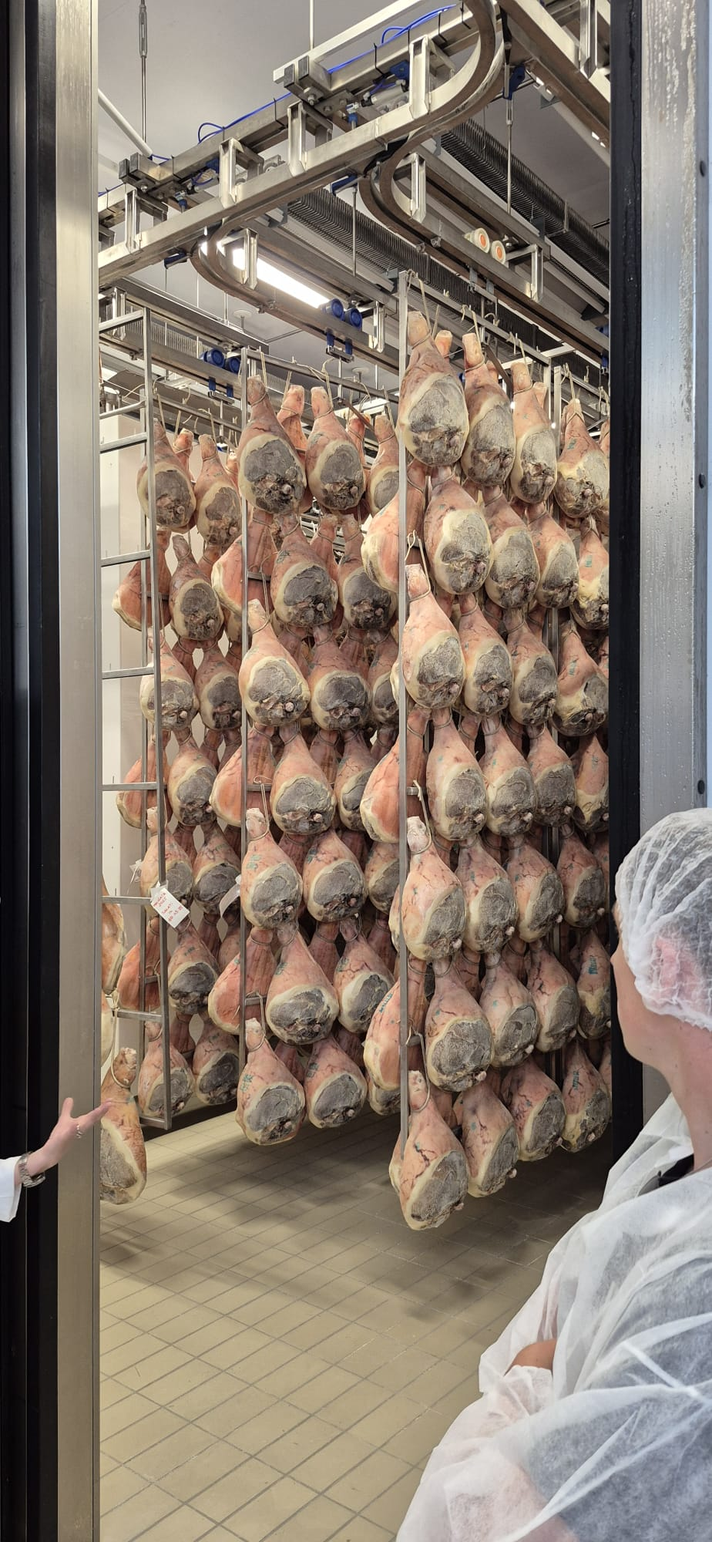
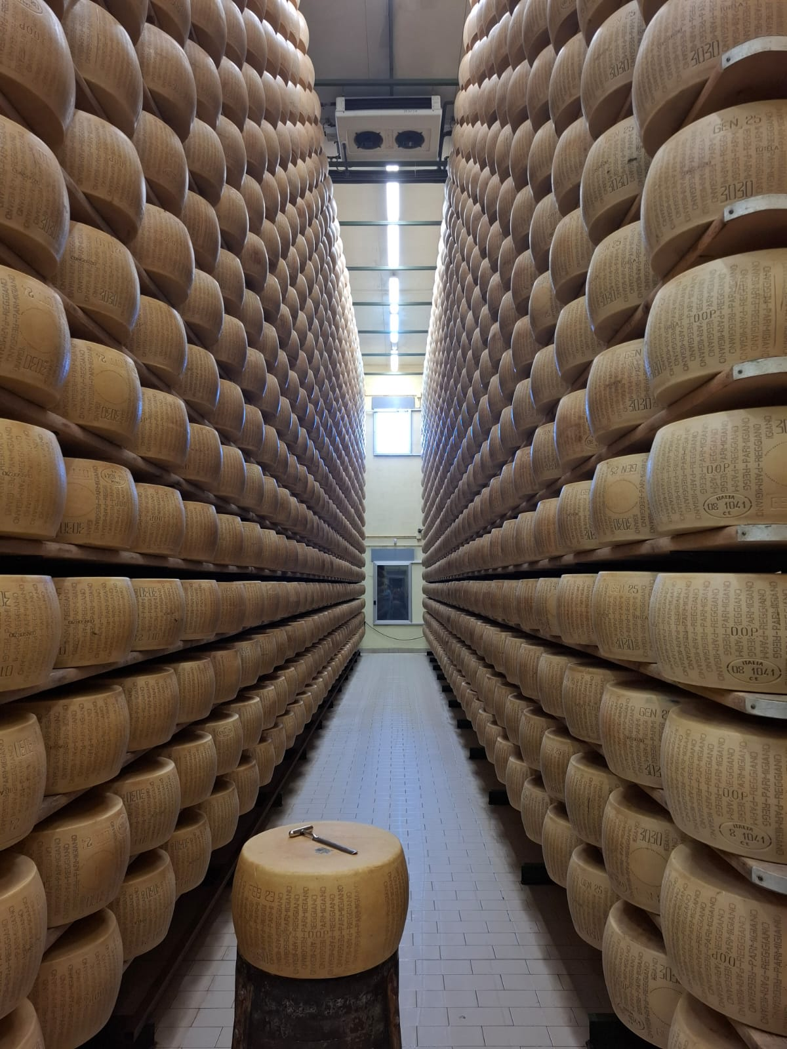
Italy
- Lago di garda
- Parma - meetup
- cheese factory + farm
- prosciutto factory
- venigar oil vineyard

Slide 11
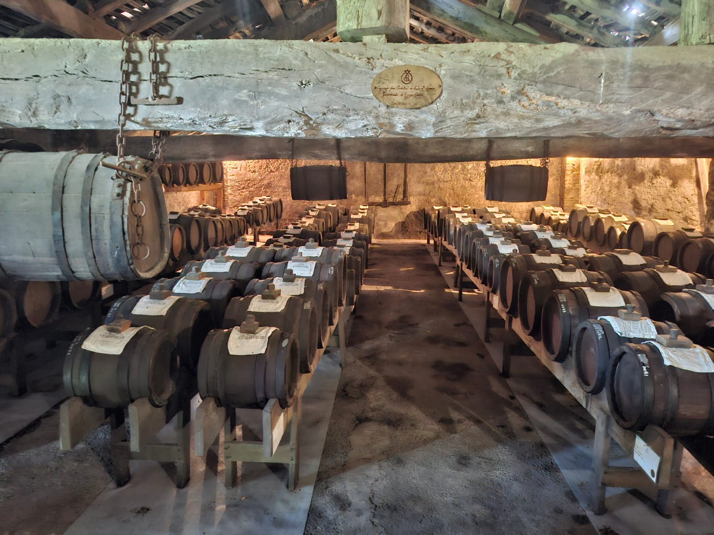
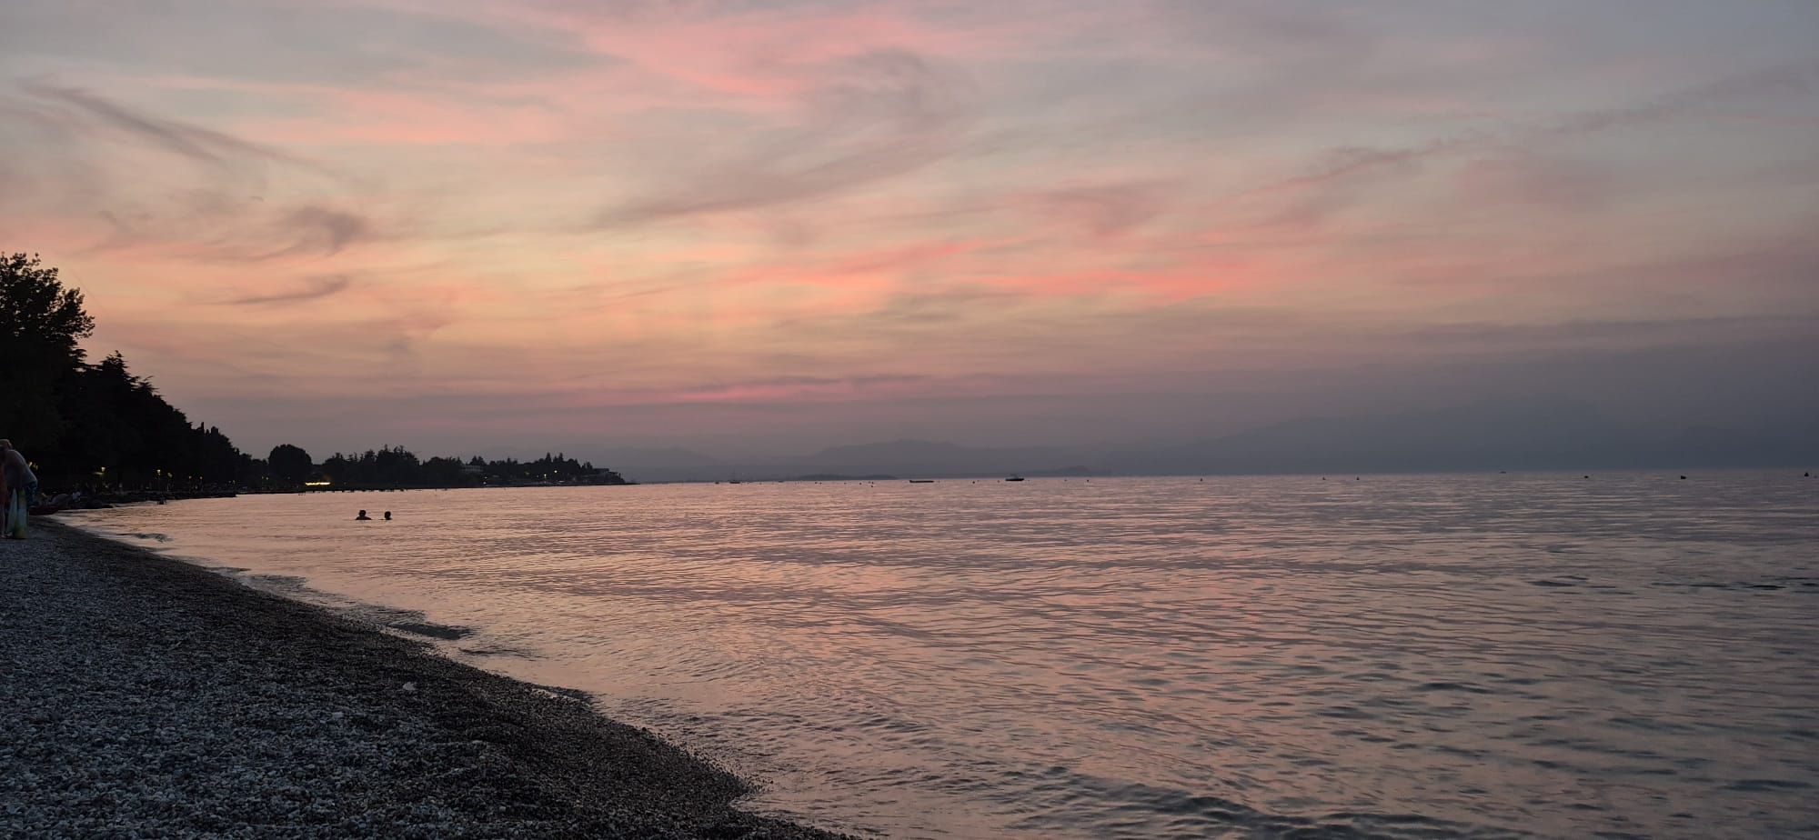

Slide 12
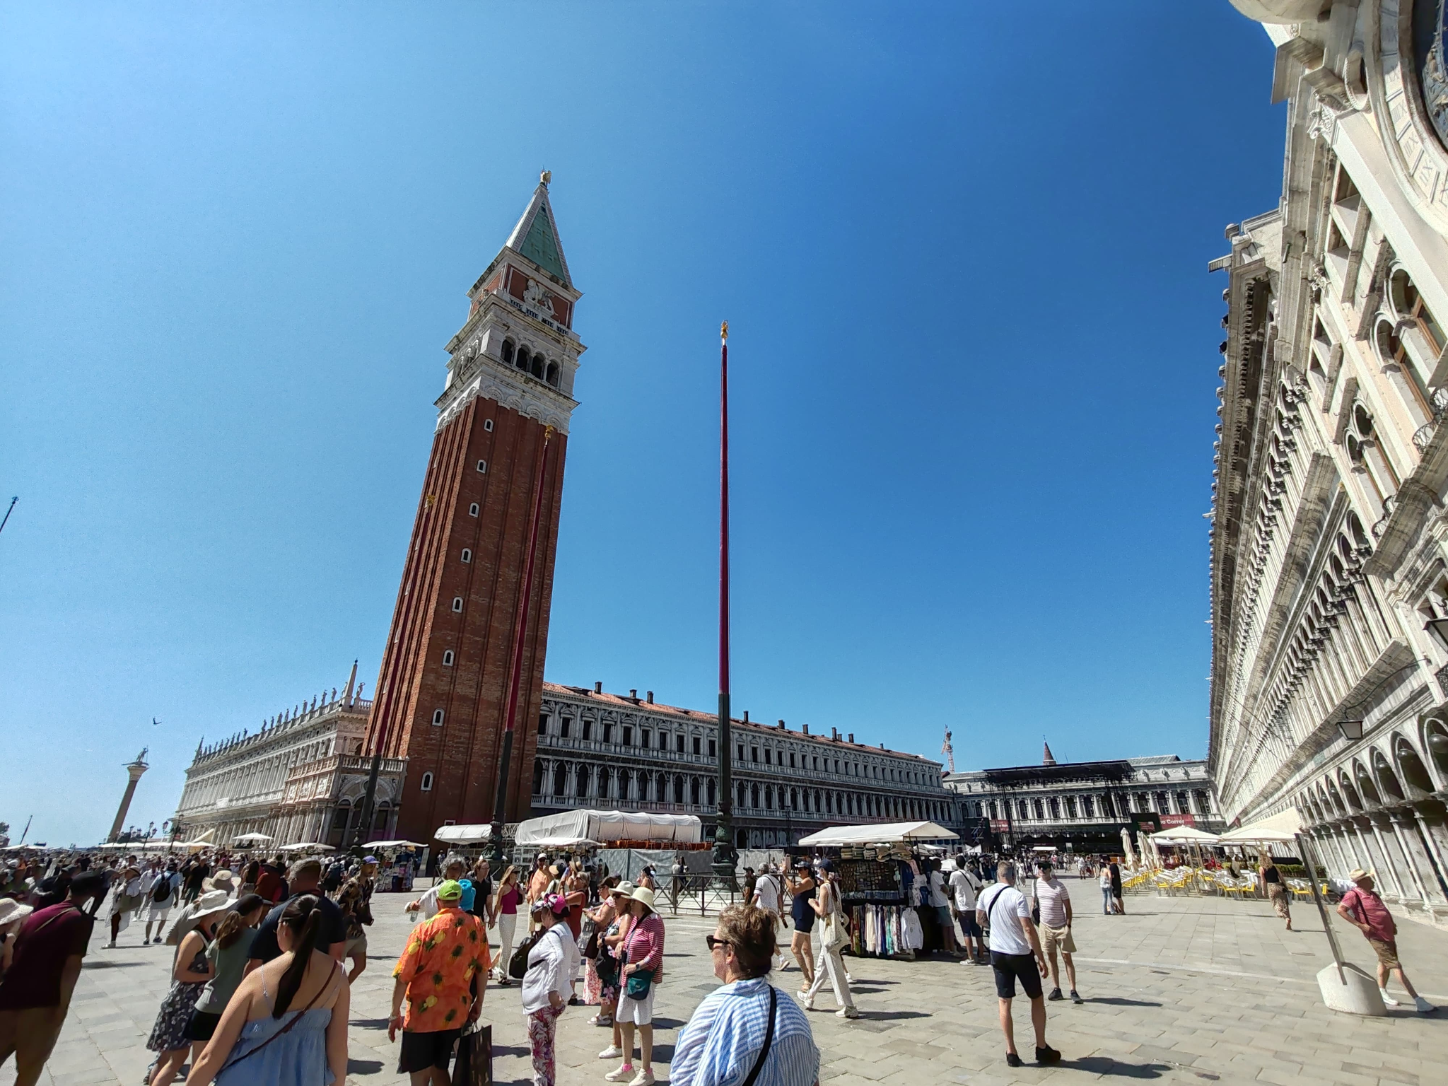
Italy
- Venice - Rialto bridge
- island Murano
- St Marco square
+ St Marco basilica

Slide 13
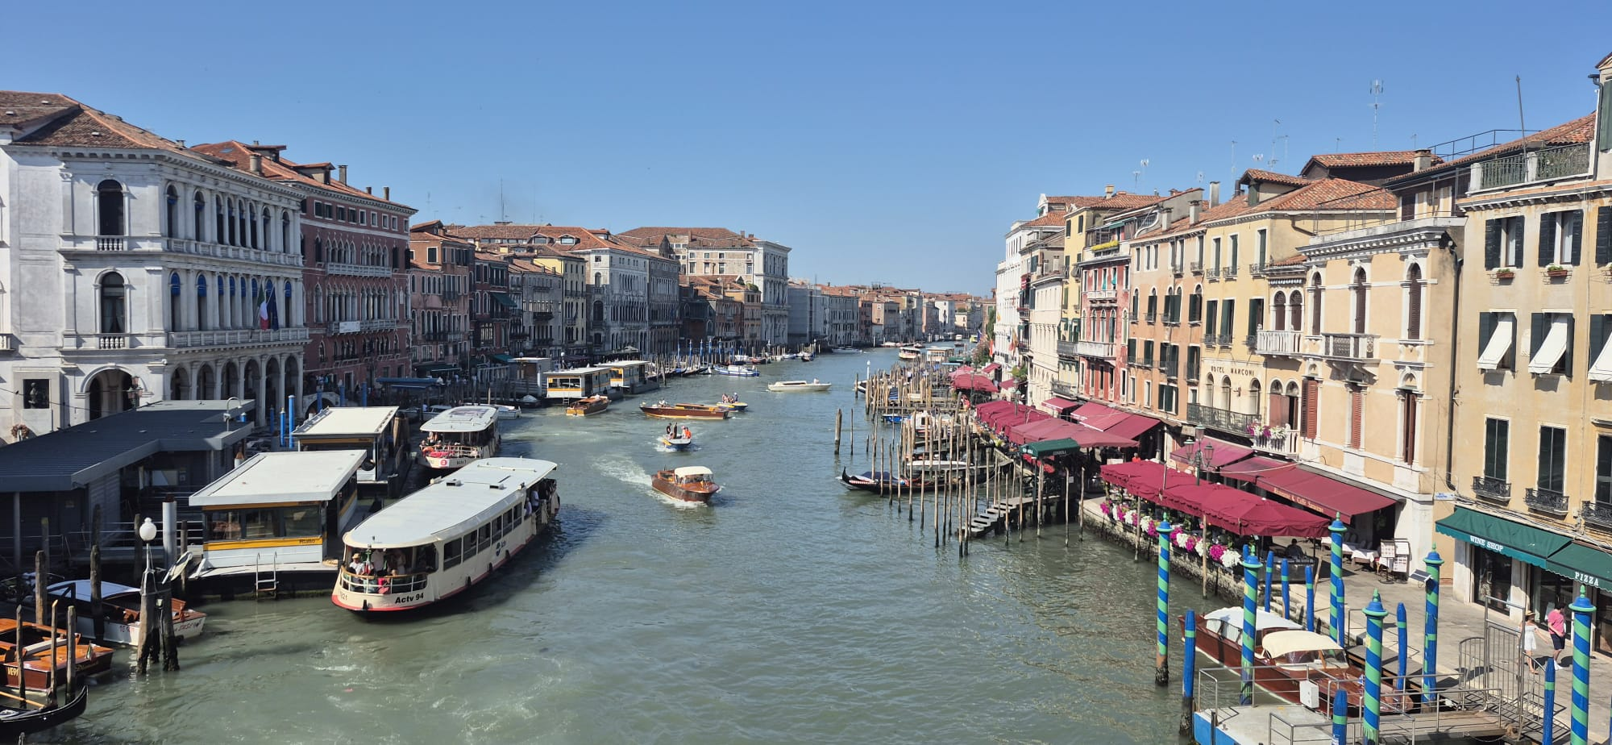

Slide 14
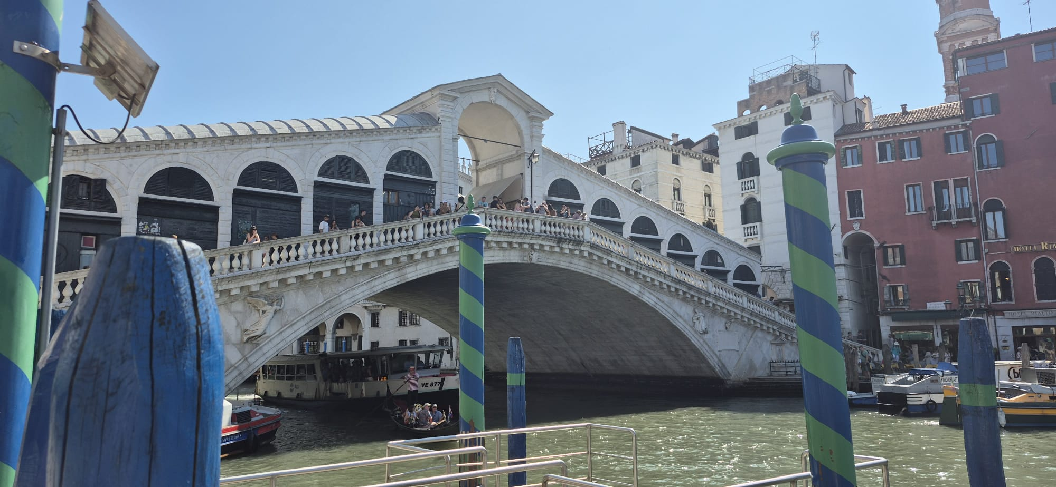

Slide 15
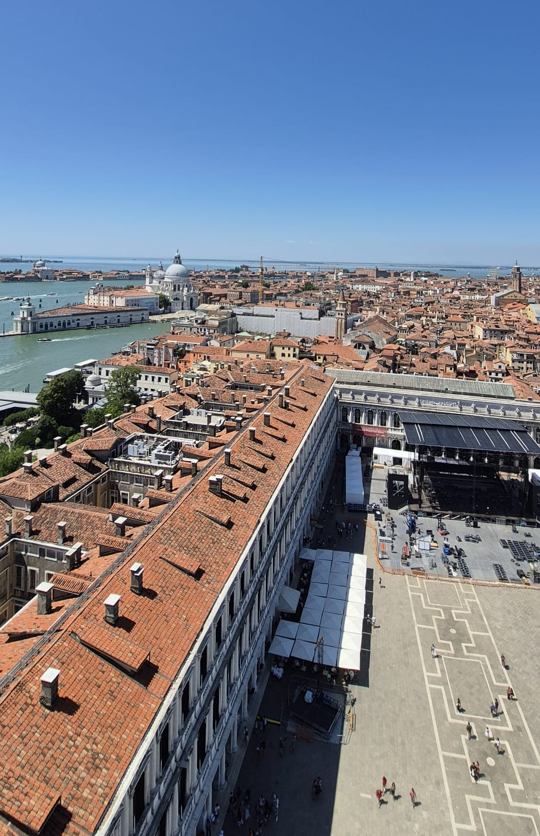
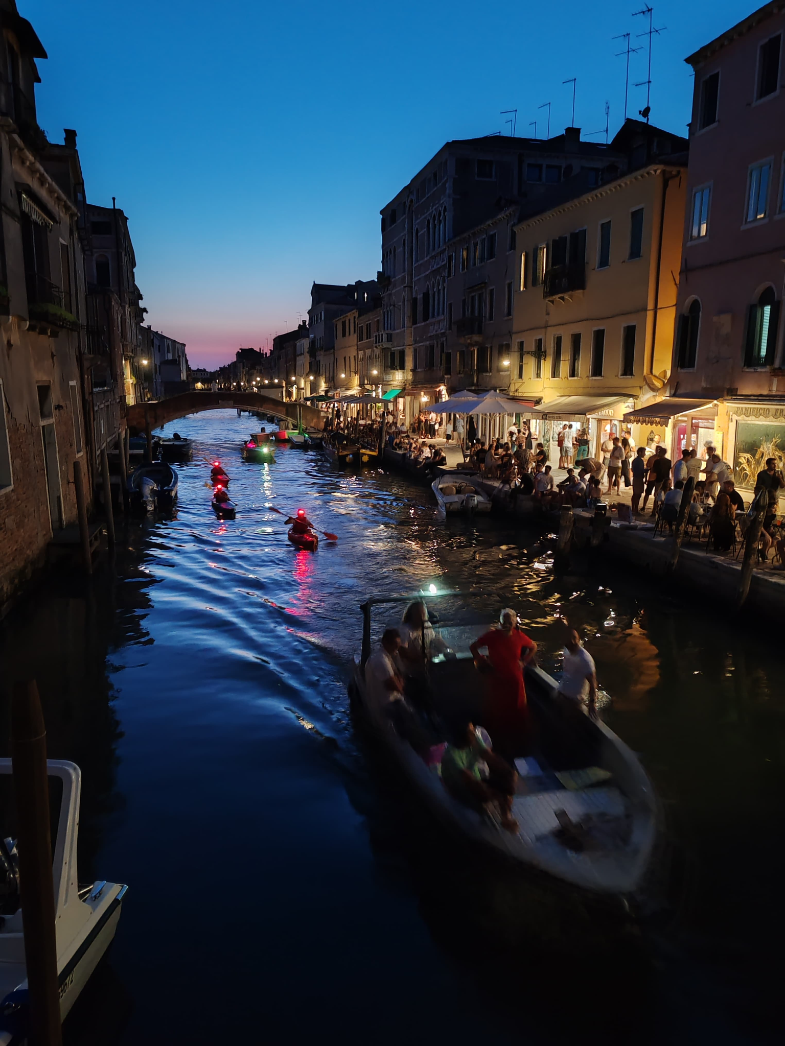

Slide 16
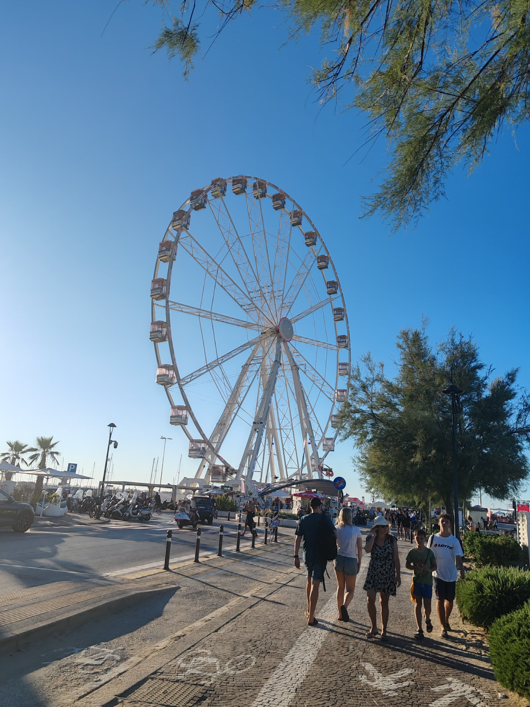
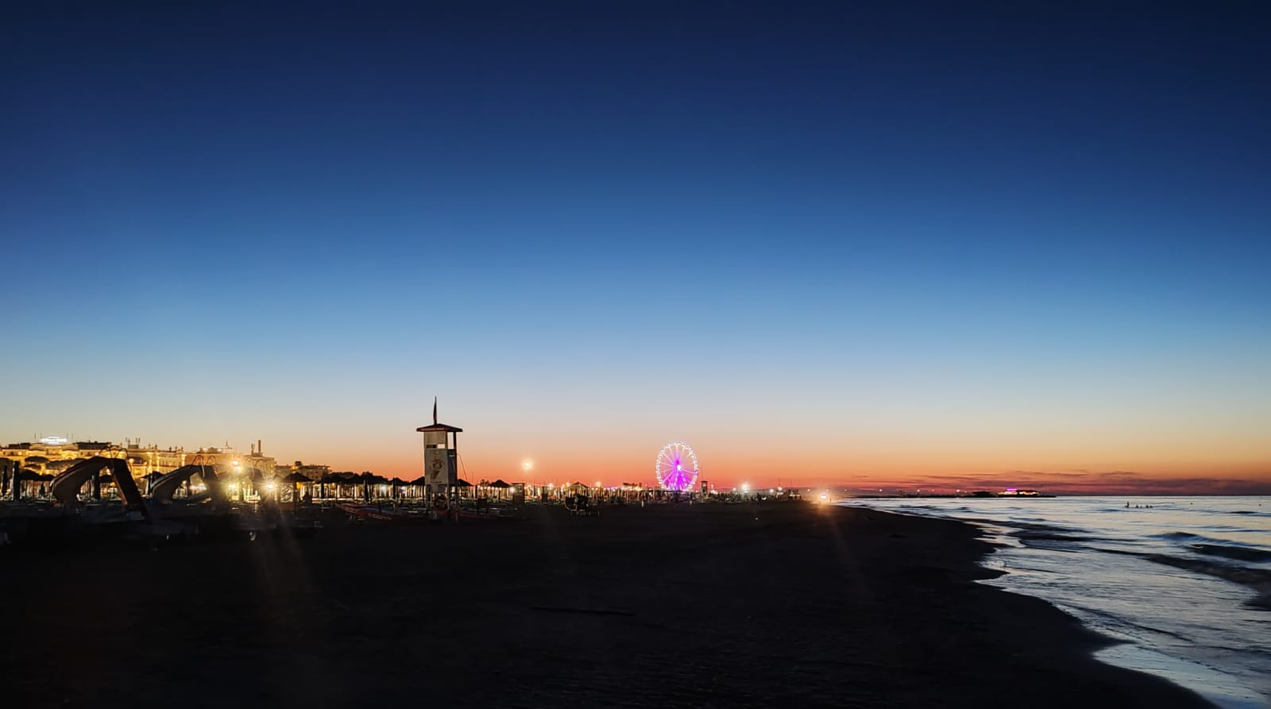
Italy
- Rimini - beach

