Slide 1
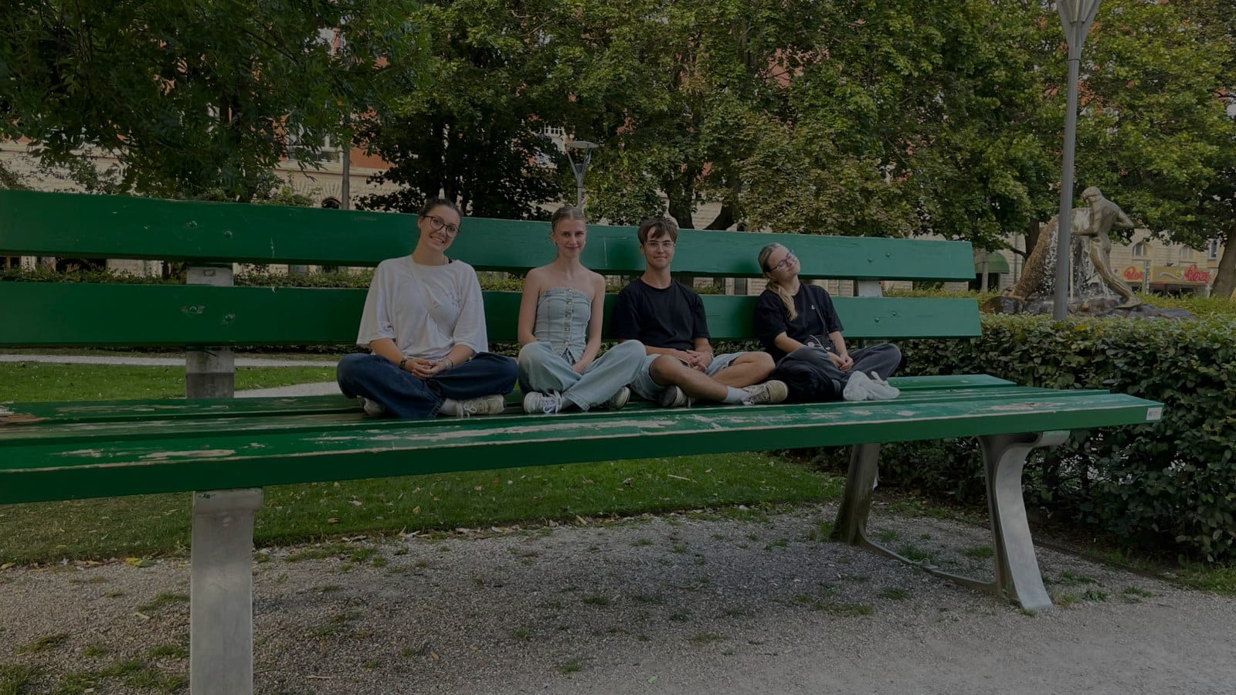
DiscoverEU
Erasmus+

Slide 2

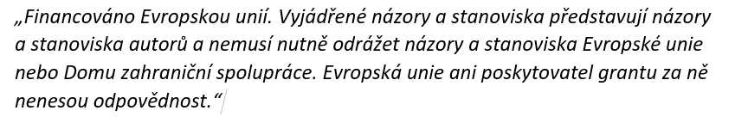

Slide 3
What is discovereu?
DiscoverEU is a program by the European Union that gives 18-year-old EU citizens the chance to travel around Europe for free by giving you a travel pass
The goal is to help young people discover Europe’s culture, diversity, and shared values
We were part of a project called DiscoverEU Inclusion Action, that means we had 10 days that were funded by the EU

Slide 4

How does the travel pass work?
If you get chosen you get a travel pass that let's you travel around europe by train for freeI
You get a mobile pass in the Interrail Rail Planner app.
You activate it before your trip.
The pass includes a QR code, which is checked by train conductors.
The pass gives you 7 days of traveling by the train

Slide 5
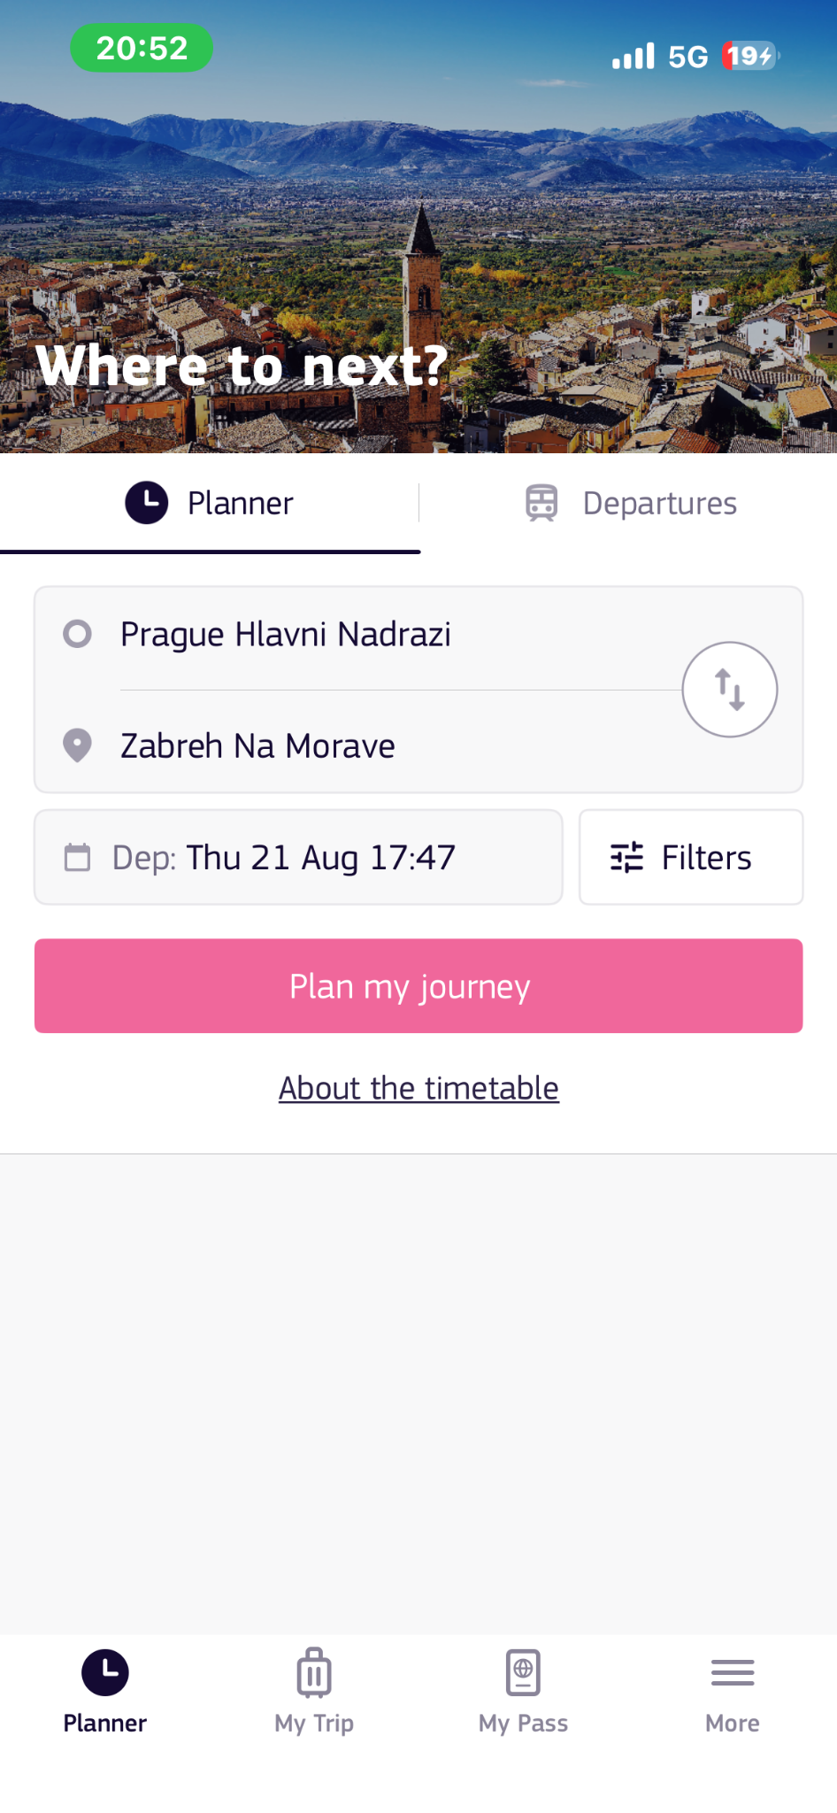
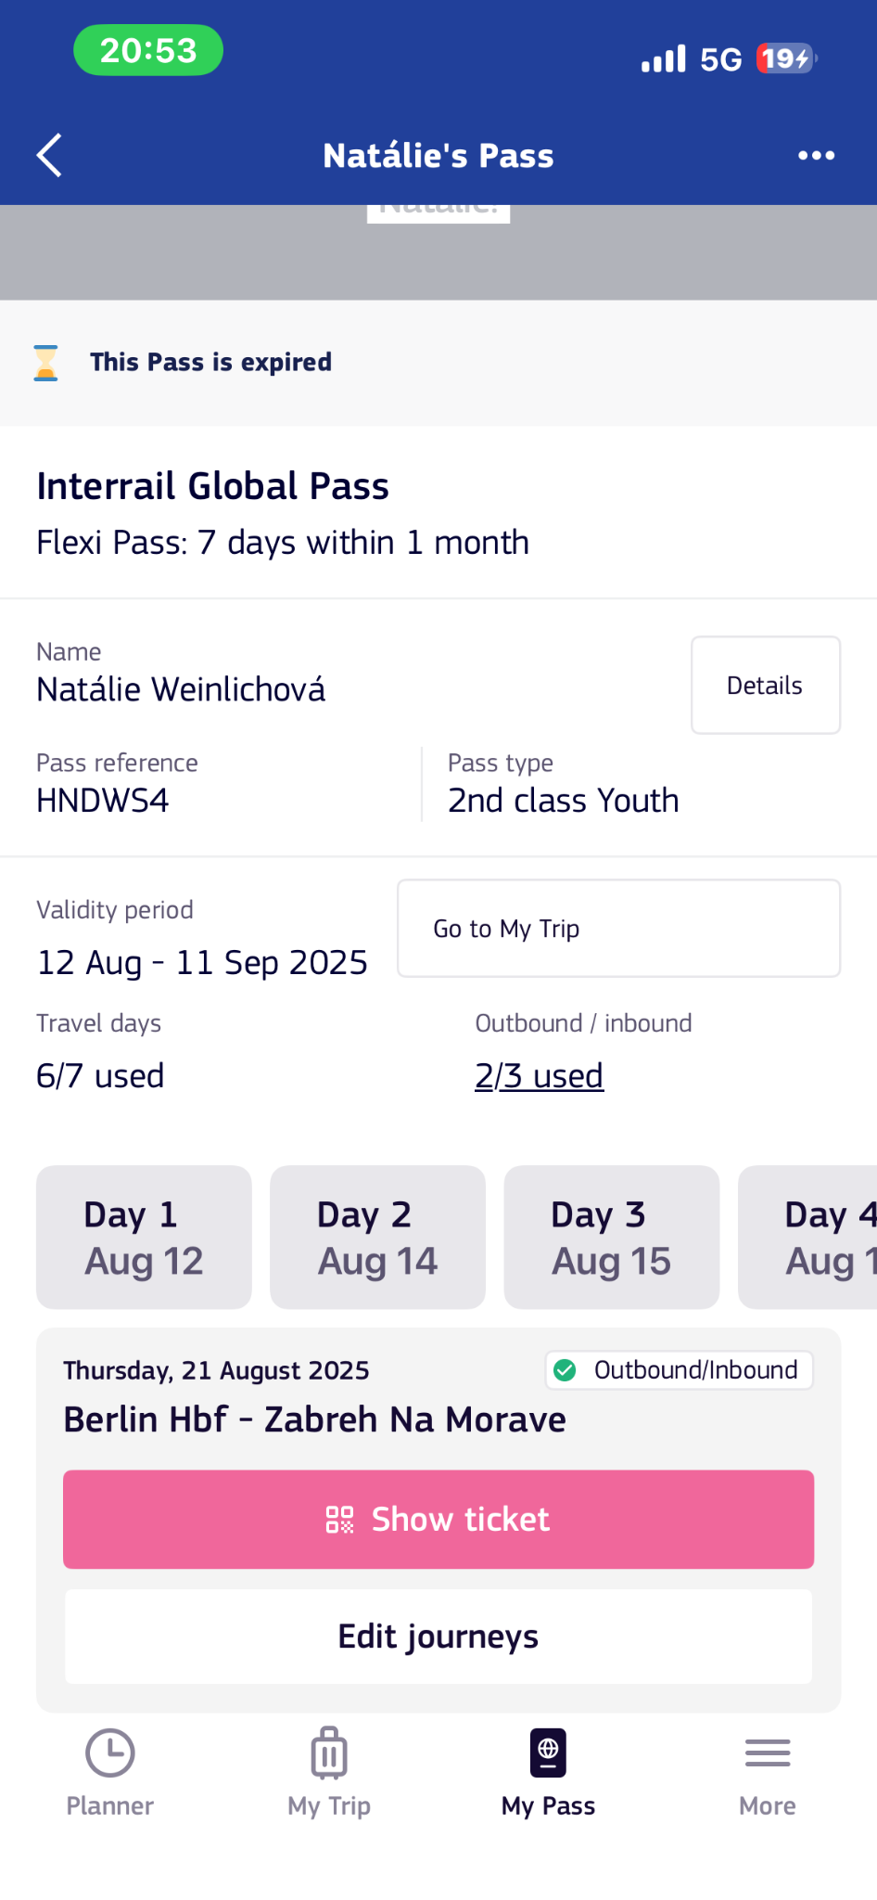

Slide 6

How to join the project?
first of all you must be 18 years old to even enter the project
you fill out the application
you write a motivation letter
you just wait if you get chosen
you have a small talk with the teachers about your expectations

Slide 7
What's next?
When you get chosen you can start planning your trip
While traveling you have to participate in a meet up of your choice
( meet up is a place where you meet with other participants from other projects)
When you choose your meet up you can start planning your whole trip
that includes finding places where you want to go and what you want to see, finding which trains you will take, also finding your acomodation

Slide 8
Our MeetUp
Our host for the meetup was Awesome People, a non-governmental organization based in Örebro, whose mission is to help people feel and be awesome
Through interactive learning activities, such as a treasure hunt and an educational escape game, we explored both locations and learned new things
Above all, the meetup allowed us to see and discover beautiful and diverse places in Sweden

Slide 9
Our activity program
Friday 15th August 2025 Örebro 11.00 Get to know each other Treasure Hunt Örebro 13.00 Lunch at Svampen 15.30 - Educational Escape rooms: Opportunities in Erasmus+ and ESC 18.00 Dinner at local restaurant 19.51 Train to Kopparberg
Saturday 16th August 2025 Kopparberg 10.00 Treasure Hunt Kopparberg 12.30 Lunch in the forest 15.00 Educational escape rooms: ESCAPE the phobia 18.00 Bowling 19.00 Dinner at the local pub 20.30 Board game evening
Sunday 17th August 2025 Kloten/Kopparberg 10.00 Kloten adventure park 19.00 Pizza-night 20.30 Storytelling
Monday 18th August 2025 Kopparberg 07.00 - 10.00 Departures

Slide 10
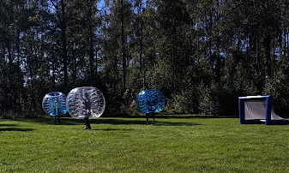
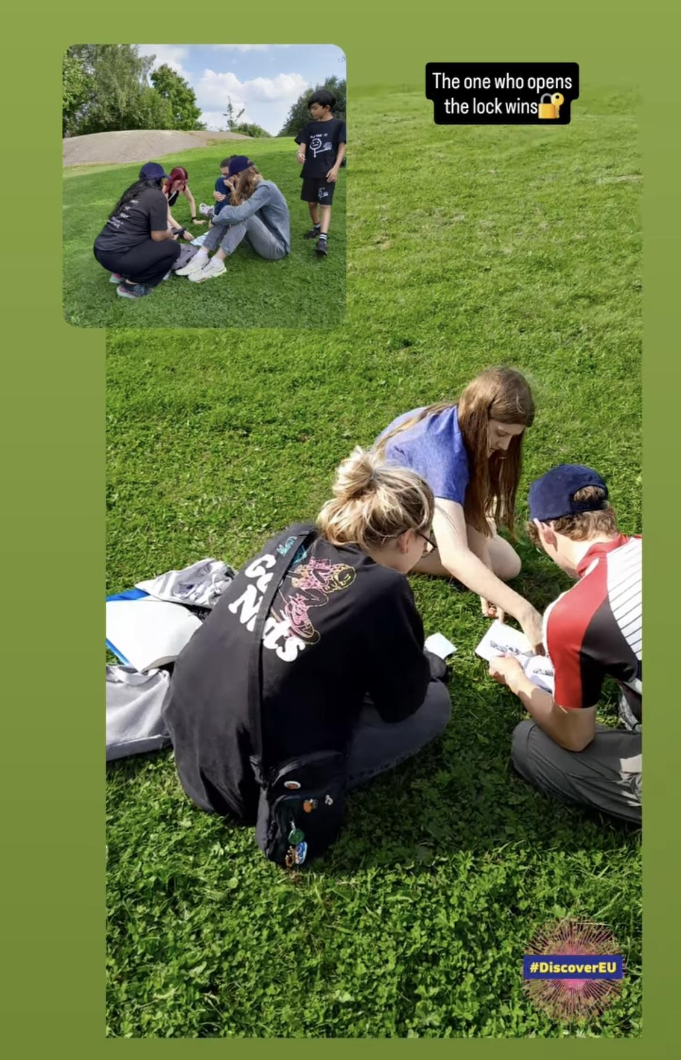
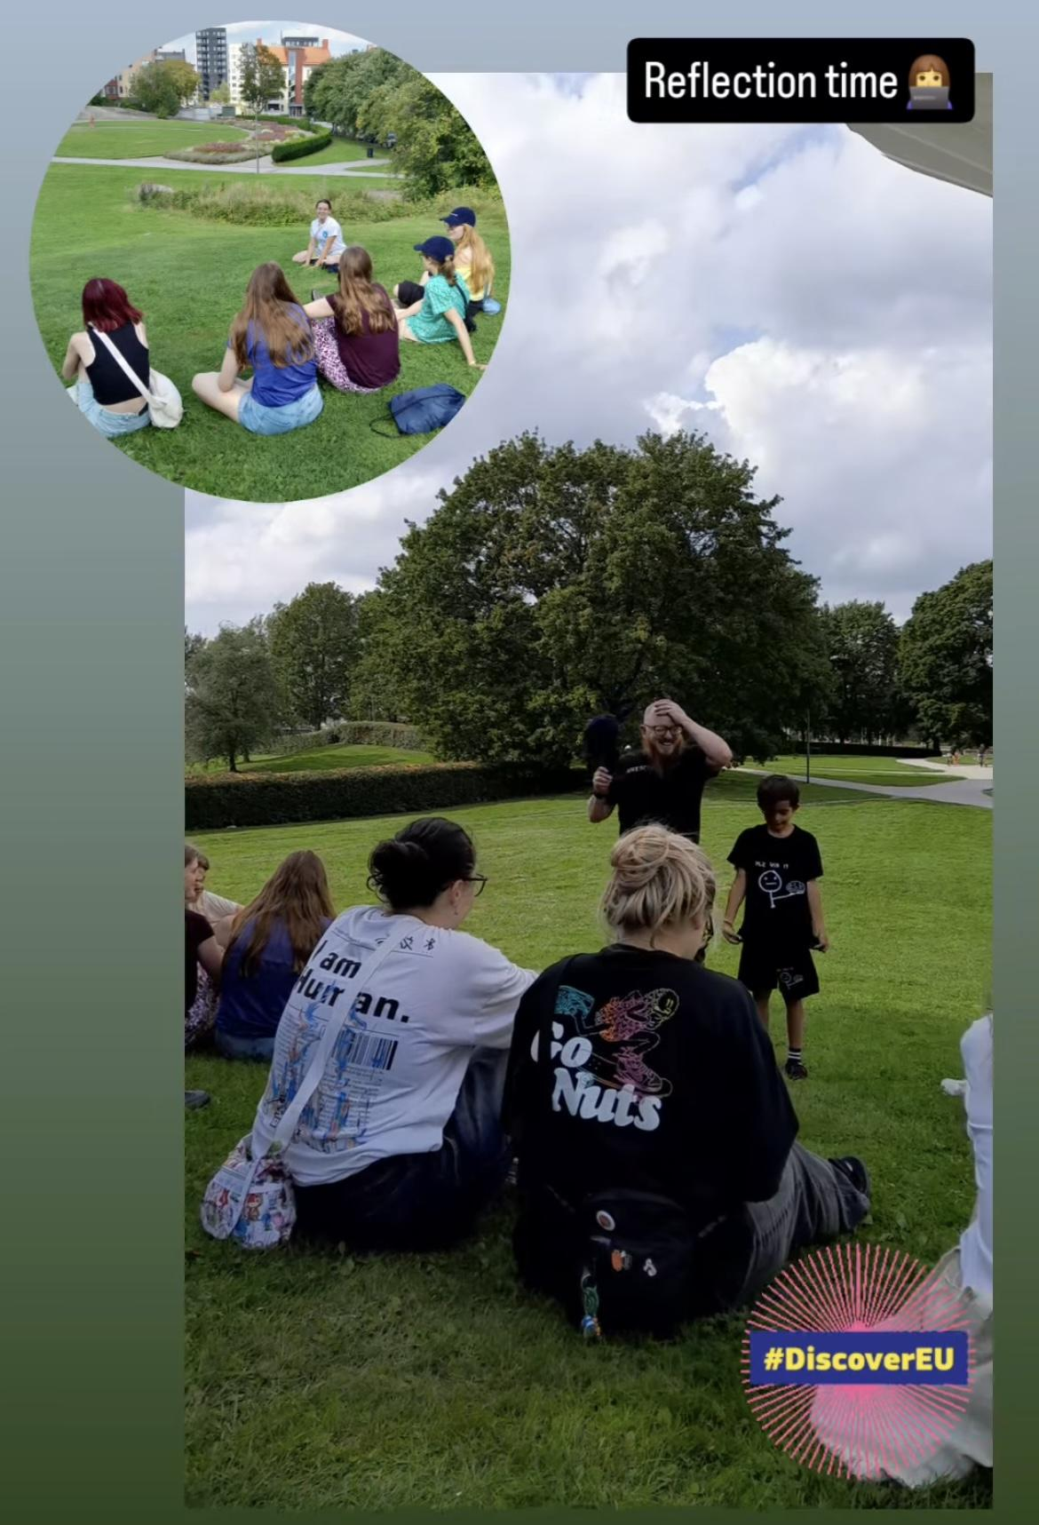
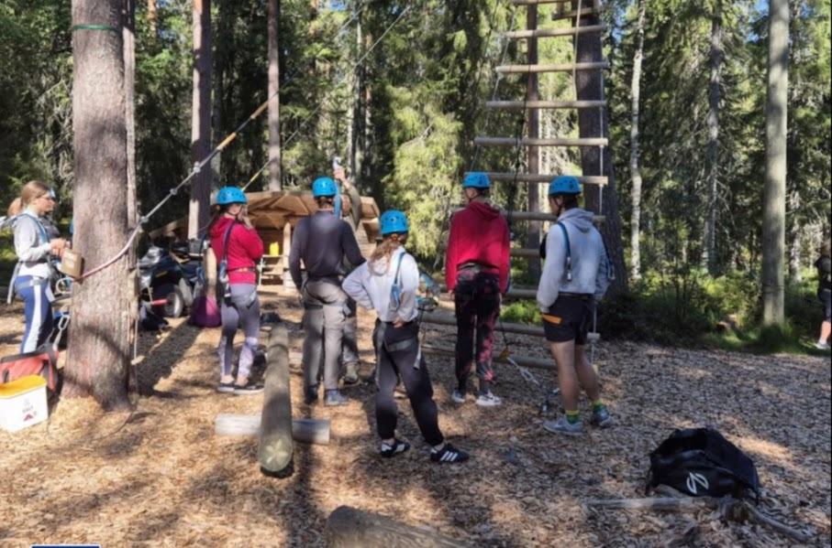

Slide 11
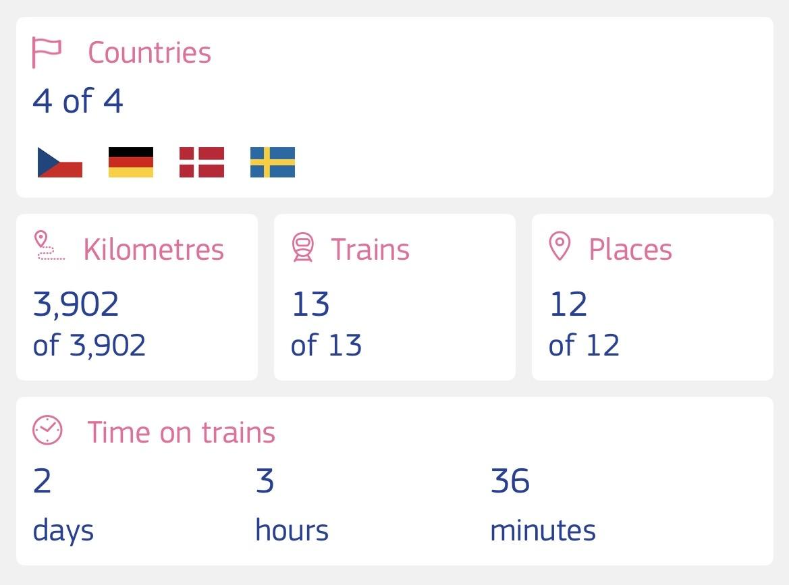
How long did we travel and how many countries did we visit ?
We traveled for 10 days and we visited 4 countries, also we spent 2 days 3 hours and 36 minutes in the train

Slide 12
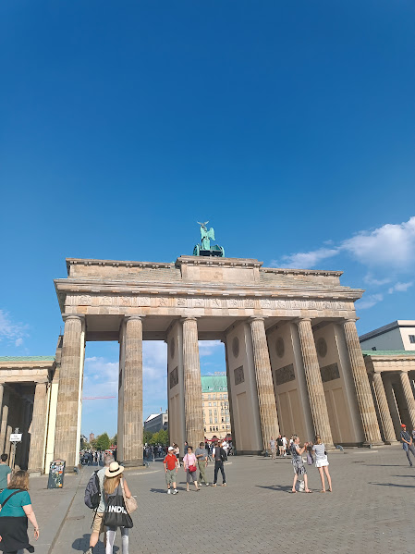
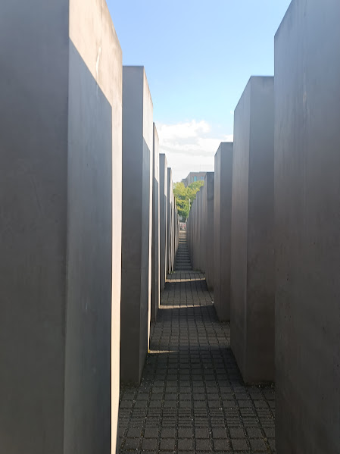
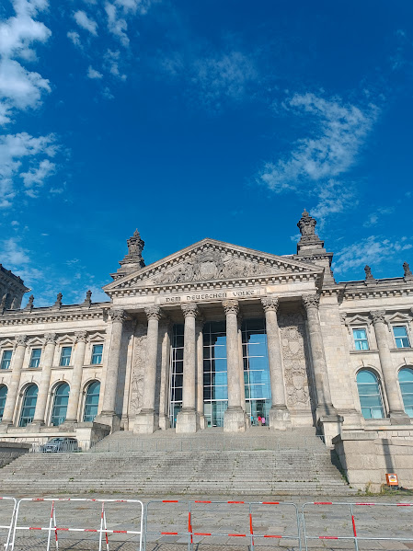
12.8.2025
Berlin
The Brandenburg Gate Holocaust Memorial Reichstag Building

Slide 13
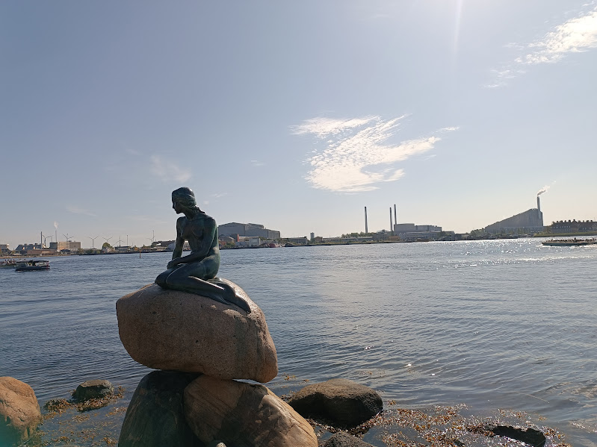
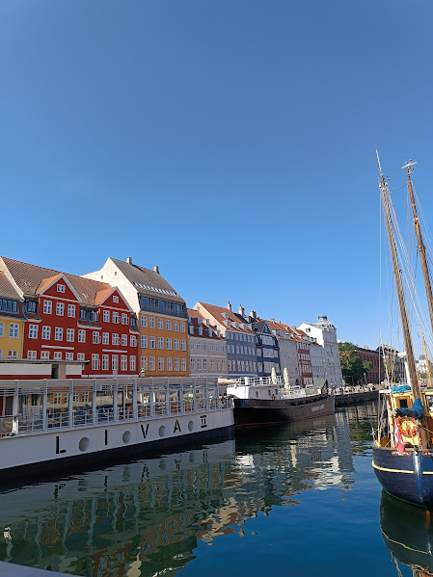
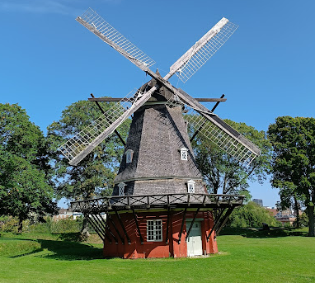
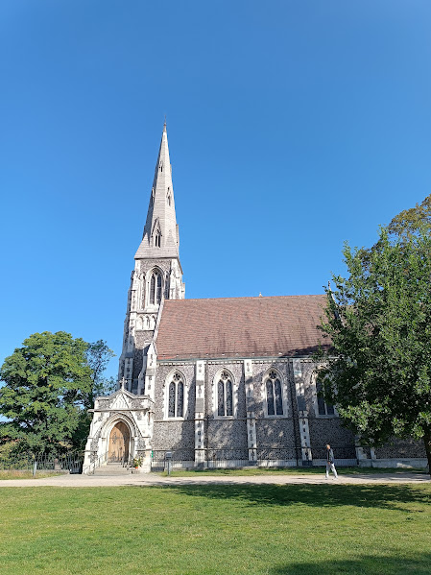
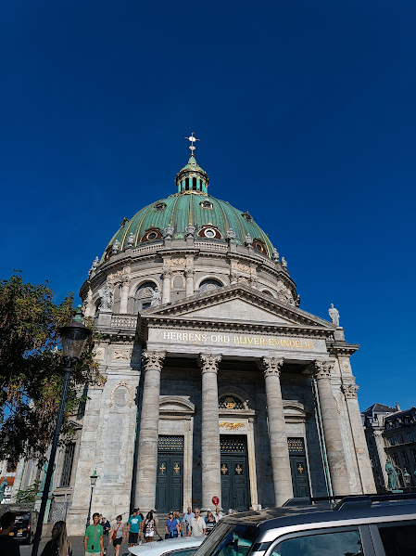
13.8.2025
Copenhagen
The Little Mermaid
Strøget
Windmill in Kastellet
St. Alban's Englisch Church Frederiks church

Slide 14
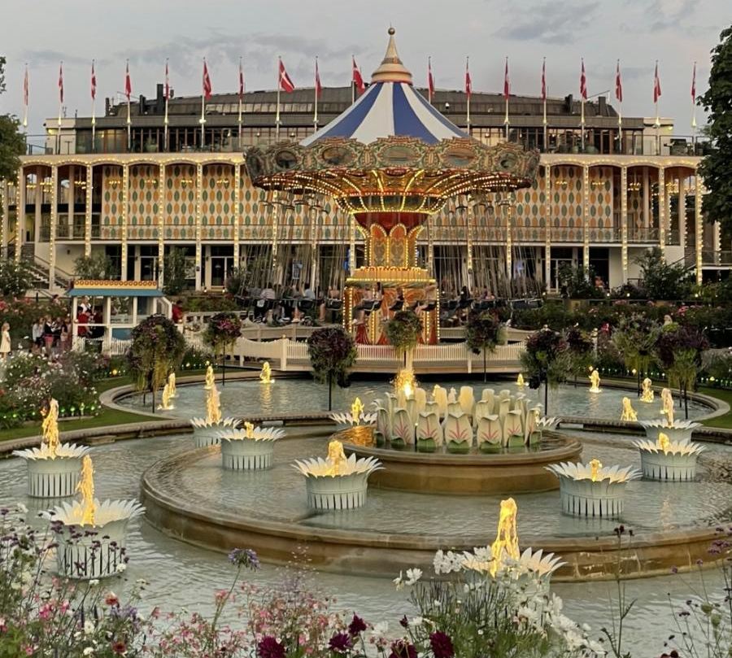
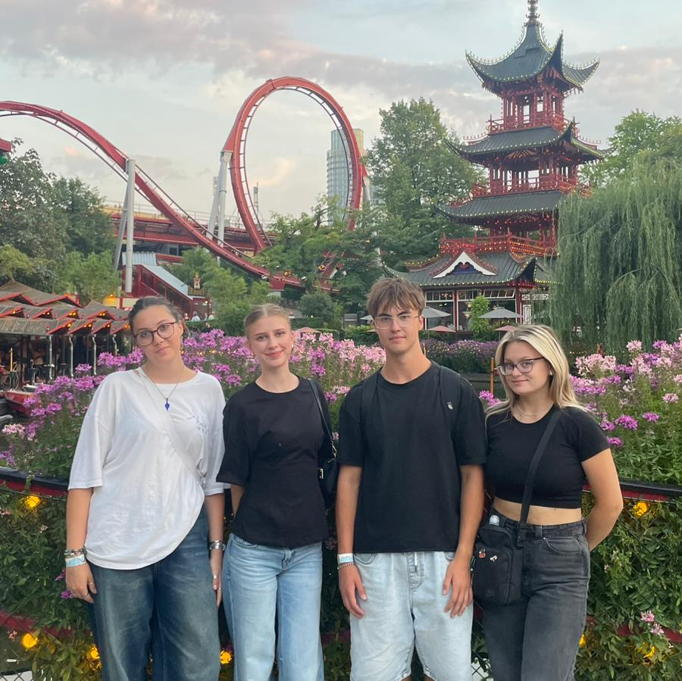
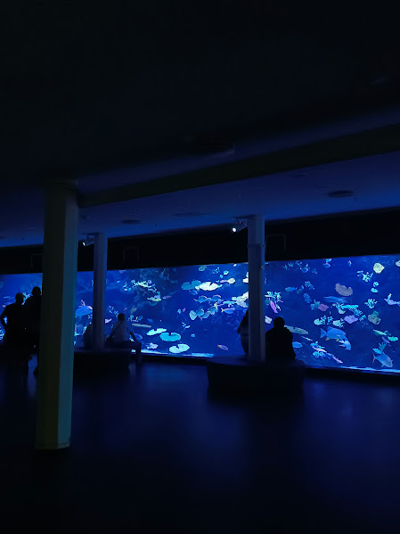
14.8.2025
Tivoli Gardens
The second oldest adventure park in the world
Tivoli Gardens have been open since 1843

Slide 15
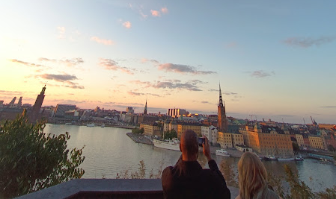
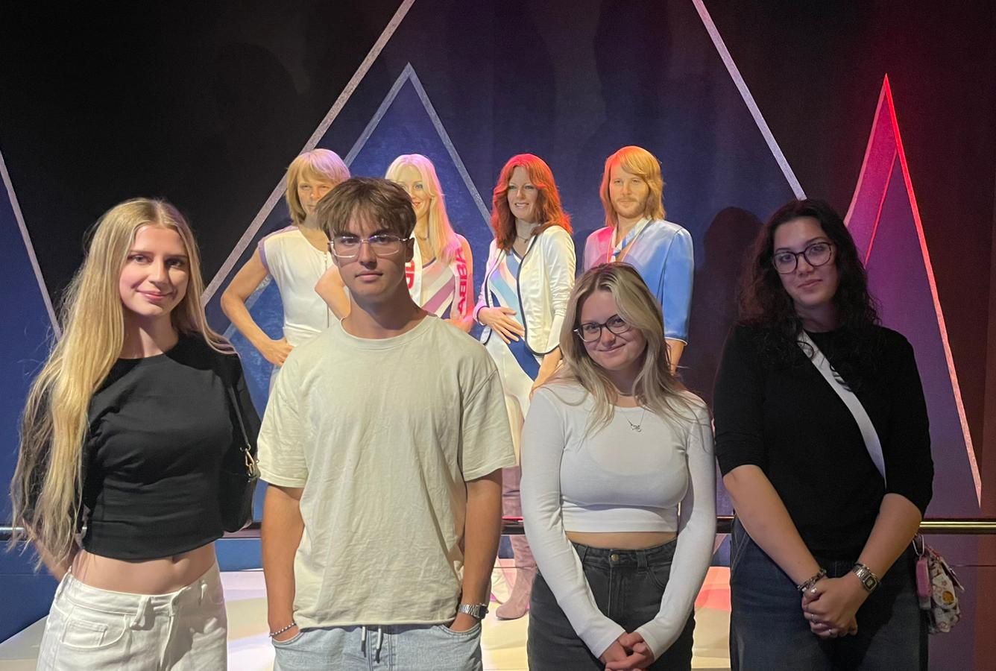
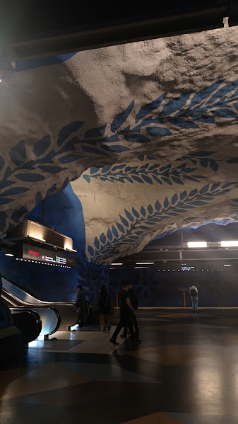
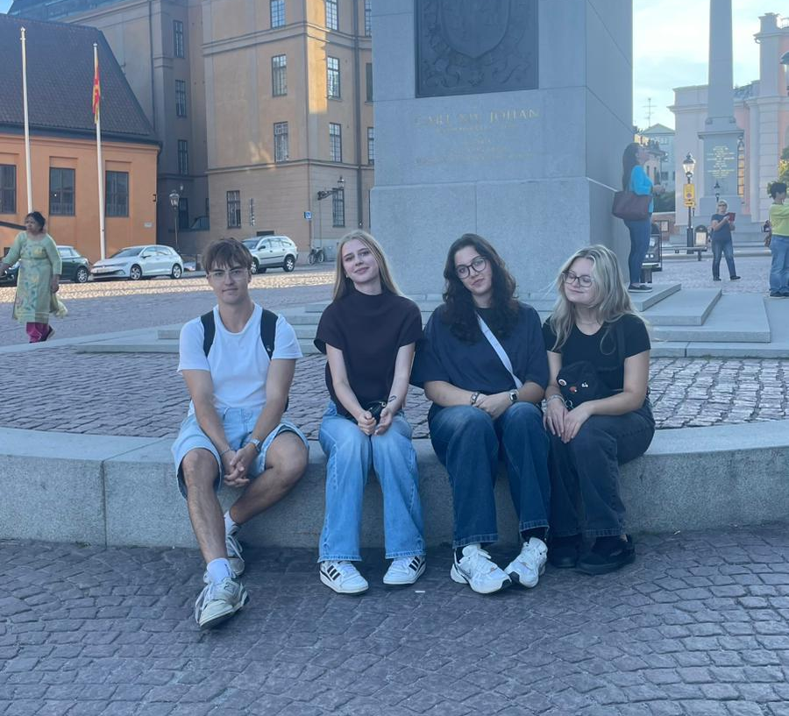
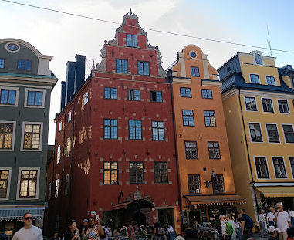
18.-20.8.2025
Stockholm
The ABBA muzeum
T-Centralen
Gamla Stan

Slide 16
The greatest advice:
don't be afraid to travel!

