Slide 1
Název | CANADA – The Territories
Předmět, ročník | Anglický jazyk, 1.- 4. roč. , kvinta - oktáva
Tematická oblast | Reálie – Česká republika, Olomoucký kraj, Spojené státy americké, Kanada
Anotace | Jedná se o prezentaci s výkladem, obrázky
Klíčová slova | The Yukon, gold rush, gold, snow, the Inuits, lakes, wildlife, Arctic tundra
AAArcticAutor | Mgr. Romana Jurášová
Datum | 21. 5. 2014
Škola | Gymnázium Jana Opletala, Litovel, Opletalova 189
Projekt | EU peníze středním školám, reg. č.: CZ.1.07/1.5.00/34.0221

Slide 2
THE TERRITORIES
The Northwest Territories
The Yukon Territory
The Nunavut

Slide 3
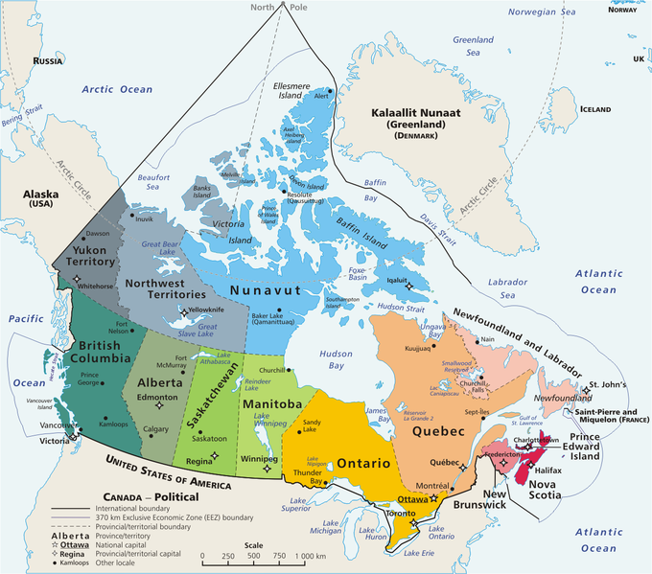
CANADA - PROVINCIES
Zdroj: [cit2014-05-21]. Dostupný pod licencí public domain
http://upload.wikimedia.org/wikipedia/commons/thumb/f/fe/Geopolitical_map_of_Canada.png/680px-Geopolitical_map_of_Canada.png

Slide 4
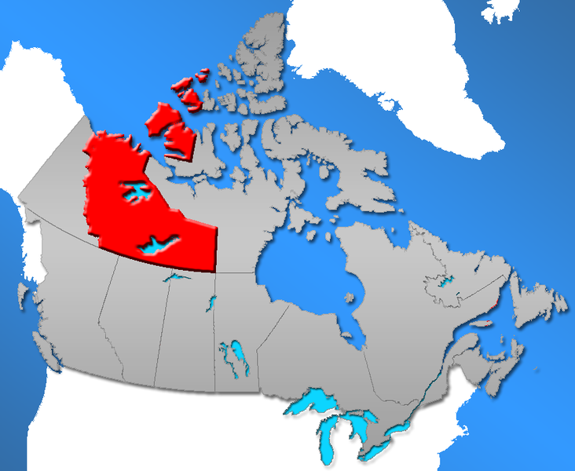
THE NORTHWEST TERRITORIES
Zdroj: [cit2014-05-21]. Dostupný pod licencí public domain
http://upload.wikimedia.org/wikipedia/commons/thumb/6/65/NWT-Canada-territory.png/732px-NWT-Canada-territory.png

Slide 5
1 The Northwest Territories
One of the largest unspoilt wilderness
Home to many animal species – wolf, moose, arctic fox
Northern Lights can be seen often
In 1906 Roald Amundsen found the ship route from the Atlantic to the Pacific north around North America continent
Large lakes – Great Slave Lake (the largest in Canada), Great Bear Lake

Slide 6
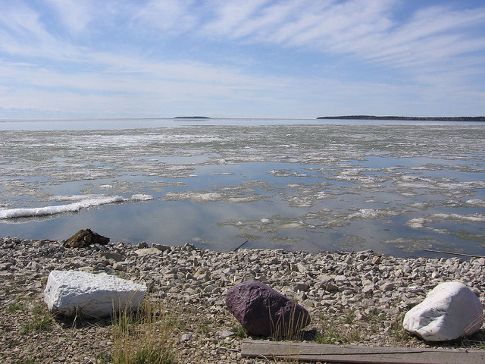
GREAT SLAVE LAKE
Zdroj: [cit2014-05-21]. Dostupný pod licencí Creative Commons
http://upload.wikimedia.org/wikipedia/commons/2/26/Spring_on_Great_Slave_Lake_near_Fort_Resolution.jpg

Slide 7
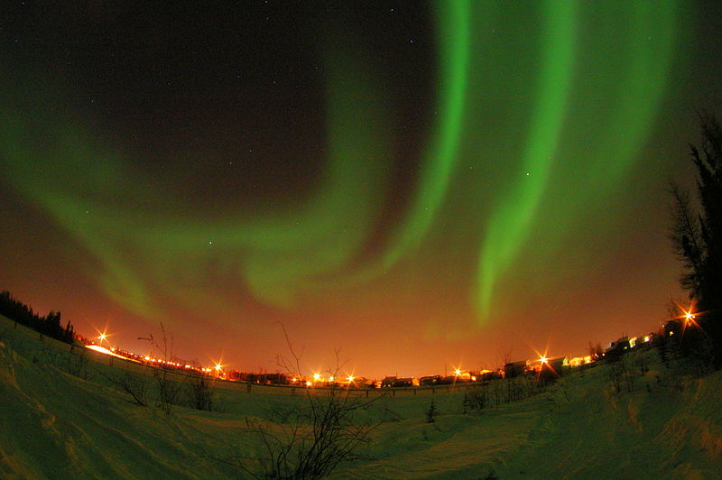
NORTHERN LIGHTS AT YELLOWKNIFE, NWT, CANADA
Zdroj: [cit2014-05-21]. Dostupný pod licencí Creative Commons
http://upload.wikimedia.org/wikipedia/commons/thumb/e/e8/Northern_Lights_at_Yellowknife.jpg/800px-Northern_Lights_at_Yellowknife.jpg

Slide 8
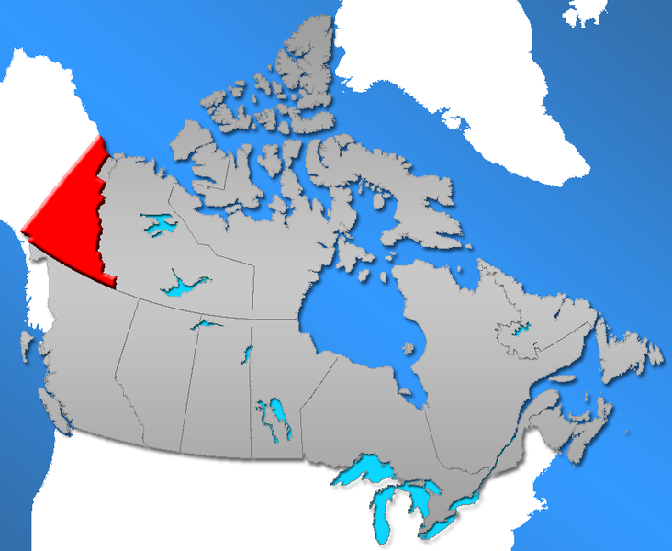
THE YUKON TERRITORY
Zdroj: [cit2014-05-21]. Dostupný pod licencí public domain
http://upload.wikimedia.org/wikipedia/commons/thumb/9/99/YU-Canada-territory.png/732px-YU-Canada-territory.png

Slide 9
2 The Yukon Territory
Named after the Yukon river
Whitehorse – the capital, the most of the Yukon Territory ´s population lives there
1890s - Klondike Gold Rush – thousands of gold seekers arrived to pan for gold
Dawson City – centre of the Gold Rush
Mt. Logan – Canada´s highest peak (5, 959 m)

Slide 10
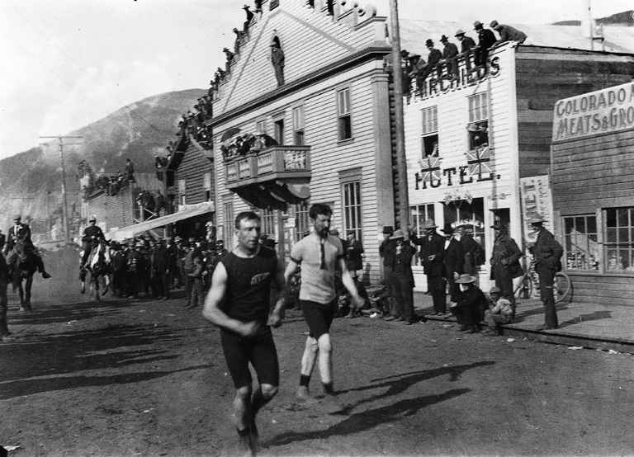
DAWSON CITY – GOLD RUSH
Zdroj: [cit2014-05-201. Dostupný pod licencí public domain
http://upload.wikimedia.org/wikipedia/commons/3/3e/Foot_race%2C_Dawson_City%2C_YT%2C_about_1900.jpg

Slide 11
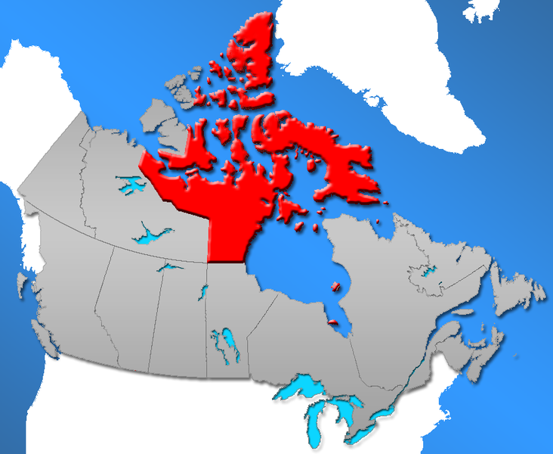
THE NUNAVUT
Zdroj: [cit2014-05-21]. Dostupný pod licencí public domain
http://upload.wikimedia.org/wikipedia/commons/thumb/4/49/NU-Canada-territory.png/732px-NU-Canada-territory.png

Slide 12
3 The Nunavut
The newest, the largest, the least poulated of all the provincies and territories
Established in 1999
83% of the population – the native Inuits
Most of the territory is covered with Arctic tundra
Iqaluit – the capital situated on Baffin Island (the largest island in Canada)

Slide 13
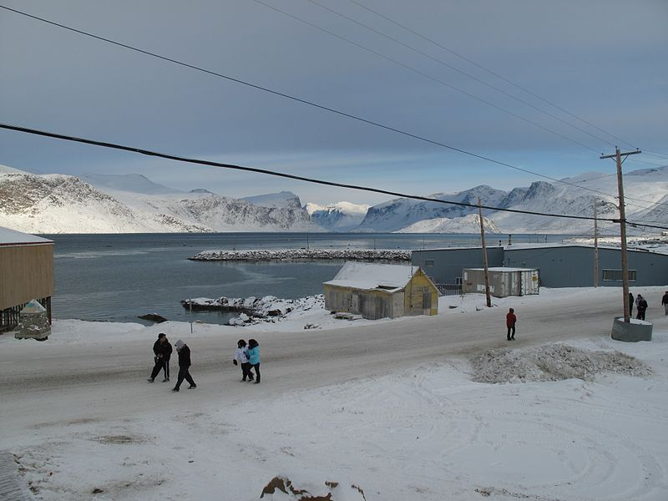
A NUNAVUT COMMUNITY
Zdroj: [cit2014-05-21]. Dostupný pod licencí public domain
http://upload.wikimedia.org/wikipedia/commons/thumb/f/fd/A_Nunavut_community_-a.jpg/800px-A_Nunavut_community_-a.jpg

Slide 14
SOURCES
EL-HMOUDOVÁ, Dagmar. Angličtina - Maturitní témata. Český Těšín: Petra Velanová, Třebíč, 2006, ISBN 9788086873046.
CHUDÝ, Tomáš ; CHUDÁ, Jana. Some Basic Facts (about the English speaking countries). 1.vydání. Havlíčkův Brod: FRAGMENT, 1995, ISBN 80-85768-96-8
Wikipedie [online]. 2011, [cit. 2014-05-20]. Dostupné z: http://www.aitc.sk.ca/saskschools/canada/facts/nf.html

