Slide 1
Název | CANADA – Prairie / Western Provinces
Předmět, ročník | Anglický jazyk, 1.- 4. roč. , kvinta - oktáva
Tematická oblast | Reálie – Česká republika, Olomoucký kraj, Spojené státy americké, Kanada
Anotace | Jedná se o prezentaci s výkladem, obrázky a úkoly
Klíčová slova | Provincies, urbanization, wildlife, prairies, wheat, oil, the Olympic games, boreal forests. coal
Autor | Mgr. Romana Jurášová
Datum | 21. 5. 2014
Škola | Gymnázium Jana Opletala, Litovel, Opletalova 189
Projekt | EU peníze středním školám, reg. č.: CZ.1.07/1.5.00/34.0221

Slide 2
PRAIRIE/WESTERN PROVINCIES
Manitoba
Saskatchewan
Alberta
British Columbia

Slide 3
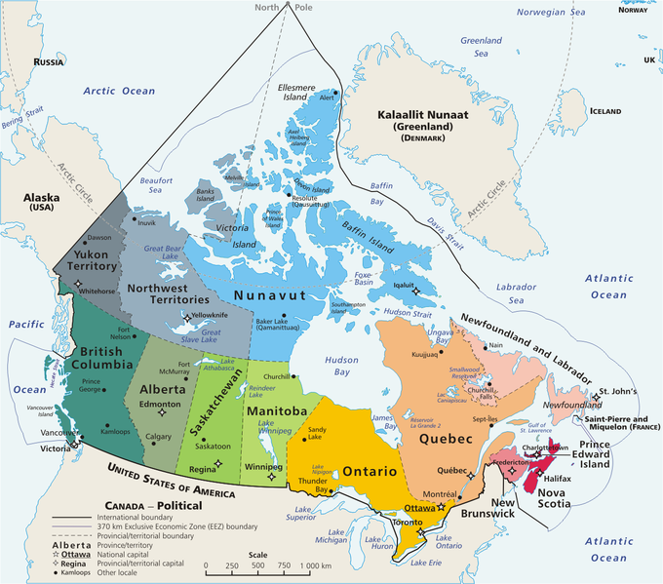
CANADA - PROVINCIES
Zdroj: [cit2014-05-21]. Dostupný pod licencí public domain
http://upload.wikimedia.org/wikipedia/commons/thumb/f/fe/Geopolitical_map_of_Canada.png/680px-Geopolitical_map_of_Canada.png

Slide 4
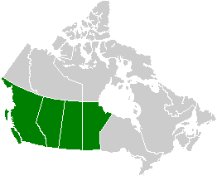
PRAIRIE/WESTERN PROVINCIES
Zdroj: [cit2014-05-21]. Dostupný pod licencí public domain
http://upload.wikimedia.org/wikipedia/commons/9/94/Canada_Western_provinces_map.png

Slide 5
1 Manitoba
Winnipeg – the capital city, commercial and distibutional centre for regional farming and mining production
Large population of Icelanders
2 Saskatchewan
Most inhabitants live in the southern part of the province
Large ares of Northern Saskatchewan - covered by boreal forest, except for the Lake Athabasca Sand Dunes - the largest active sand dunes in the world north of 58°
The most sunshine of all Canada
Canada´s Breadbasket – the large production of grains , especially wheat
Regina – Royal Canadian Mounted Police academy

Slide 6
3 Alberta
Named after Queen Victoria´s daughter, Princess Luise Caroline Alberta
the prairies and the Rocky Mountains begin there
The sunnies province
Rich in oil deposites - (NHL team Edmonton Oilers)
Highvale – the largest surface coal mine
Edmonton – the capital, founded in 1795 as a fur-trade post
Calgary – the largest city in the province, was home to the 1988 Winter Olympic games

Slide 7
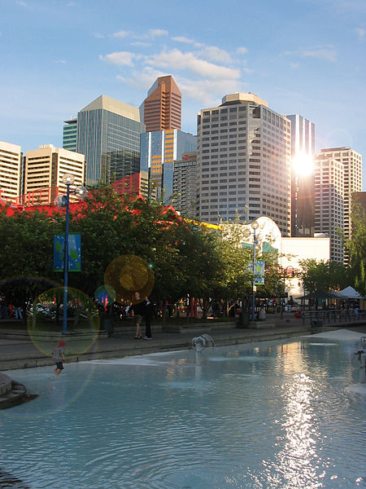
CALGARY DOWNTOWN
Zdroj: [cit2014-05-21]. Dostupný pod licencí public domain
http://upload.wikimedia.org/wikipedia/commons/thumb/8/83/CalgaryIsland.jpg/450px-CalgaryIsland.jpg

Slide 8
4 British Columbia
Columbia is the westernmost province in Canada
2/3 of BC id coverd with forests
Physically divided from the rest of Canada by the great Rocky Mountains
Victoria – the capital situated on Vancouver island, beautiful gardens
Vancouver – the largest city was home to the 2010 Winter Olympics
Okanagan Valley – situated in the south, one of the warmest fruit and wine regions

Slide 9
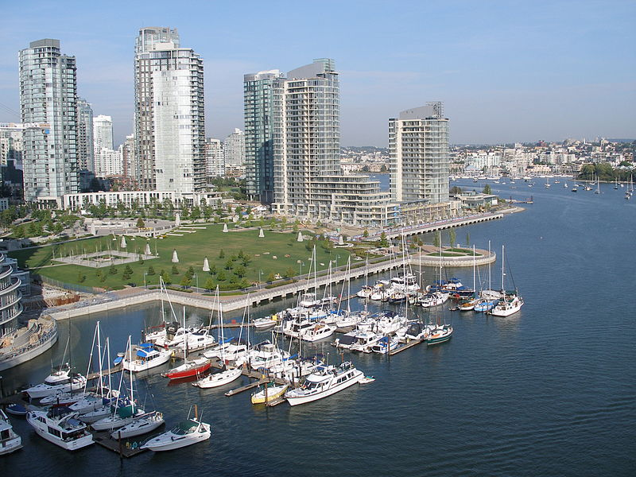
VANCOUVER
Zdroj: [cit2014-05-21]. Dostupný pod licencí Creative Commons
http://upload.wikimedia.org/wikipedia/commons/thumb/d/dc/Vancouver-bridge.jpg/800px-Vancouver-bridge.jpg

Slide 10
QUESTIONS
1 Which province is called „Canada´s Breadbasket?
a) Alberta
b) Saskatchewan
2 British Columbia is mainly covered with
a) forests
b) deserts
3 What is the „means of transport“ of the Royal Canadian Mounted Police?
4 Where were the 2010 Winter Olympics held?

Slide 11
ANSWER KEY
1 b)
2 a)
3 a horse
4 Vancouver

Slide 12
SOURCES
EL-HMOUDOVÁ, Dagmar. Angličtina - Maturitní témata. Český Těšín: Petra Velanová, Třebíč, 2006, ISBN 9788086873046.
CHUDÝ, Tomáš ; CHUDÁ, Jana. Some Basic Facts (about the English speaking countries). 1.vydání. Havlíčkův Brod: FRAGMENT, 1995, ISBN 80-85768-96-8
Wikipedie [online]. 2011, [cit. 2014-05-21]. Dostupné z: http://www.aitc.sk.ca/saskschools/canada/facts/nf.html
.

