Slide 1
Název | CANADA – Atlantic Provincies
Předmět, ročník | Anglický jazyk, 1.- 4. roč. , kvinta - oktáva
Tematická oblast | Reálie – Česká republika, Olomoucký kraj, Spojené státy americké, Kanada
Anotace | Jedná se o prezentaci s výkladem, obrázky
Klíčová slova | Provincies, urbanization, wildlife, Maritime Provinces, billingual, Scottish heritage, French - speaking
Autor | Mgr. Romana Jurášová
Datum | 20. 5. 2014
Škola | Gymnázium Jana Opletala, Litovel, Opletalova 189
Projekt | EU peníze středním školám, reg. č.: CZ.1.07/1.5.00/34.0221

Slide 2
ATLANTIC PROVINCIES
Newfoundland and Labrador
Prind Edward Island
Nova Scotia
New Brunswick
Quebeck
Ontario

Slide 3
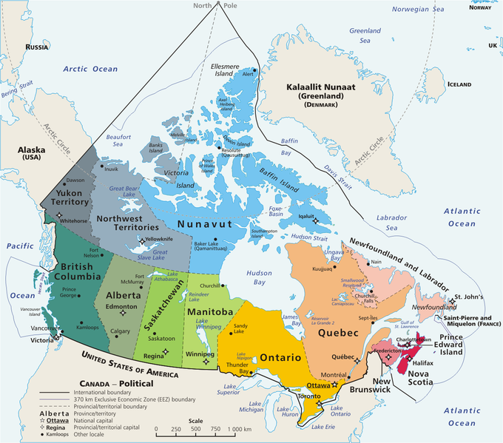
CANADA - PROVINCIES
Zdroj: [cit2014-05-20]. Dostupný pod licencí public domain
http://upload.wikimedia.org/wikipedia/commons/thumb/f/fe/Geopolitical_map_of_Canada.png/680px-Geopolitical_map_of_Canada.png

Slide 4
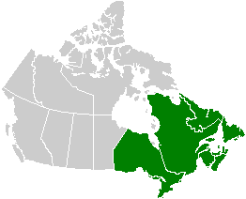
ATLANTIC PROVINCIES
Zdroj: [cit2014-05-20]. Dostupný pod licencí public domain
http://upload.wikimedia.org/wikipedia/commons/0/0b/Eastern_Canada_map.png

Slide 5
1 Newfoundland and Labrador
70 provincial parks and natural areas
Lots of ecological reserves
Viking village – from about AD 1000 (UNESCO site)
Moose are not native to Newfoundland, but today there are more than 100,000 on the island.
Signal Hill - a high cliff where Italian inventor Marconi received the first wireless signal (1901) from across the Atlantic Ocean.

Slide 6
2 Princ Edward Island
One of three Maritime Provincies
The smallest province
3 Nova Scotia
Maritime Province
Halifax – the capital city, sthe shipping, fishing and the tourist centre
Rich Scottish heritage
Scottish Highland festival – music festival with bagpipies, Scottish dancing and Scottish sports

Slide 7
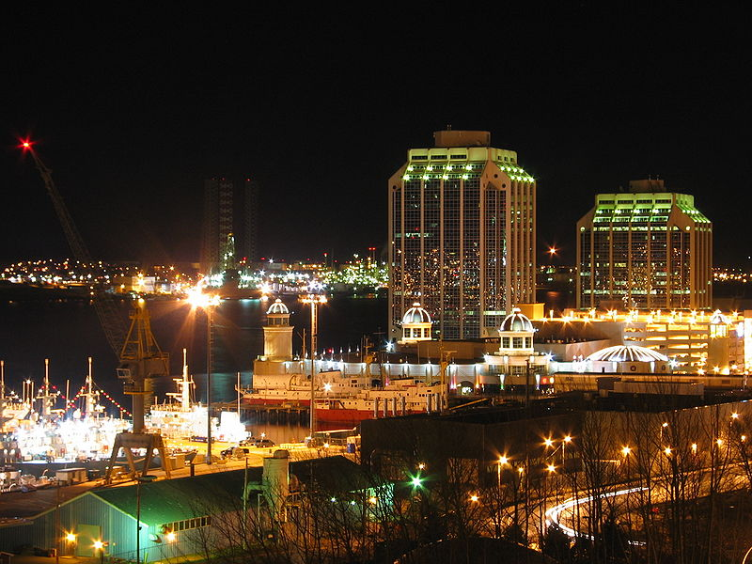
HALIFAX, NOVA SCOTIA
Zdroj: [cit2014-05-20]. Dostupný pod licencí Creative Commons
http://upload.wikimedia.org/wikipedia/commons/thumb/2/26/Halifax_at_night.jpg/800px-Halifax_at_night.jpg

Slide 8
4 New Brunswick
Maritime Province
The only officially bilingual (English-French) province
Thick forests
Rich wildlife – moose, black bear, deeer, beaver, mink, fox, Canada goose
5 Quebeck
Canada´s only French speaking province
Quebeck City – the oldest city in Canada
Historic French-style of architecture
The city of Montreal – major metropolitan area in Canada

Slide 9
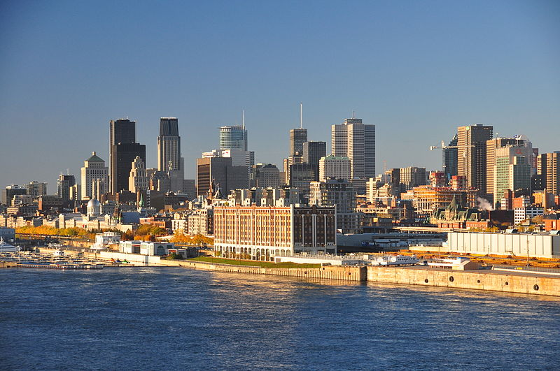
MONTREAL
Zdroj: [cit2014-05-20]. Dostupný pod licencí Creative Commons
http://upload.wikimedia.org/wikipedia/commons/thumb/1/15/Montreal_skyline_2011.jpg/800px-Montreal_skyline_2011.jpg

Slide 10
6 Ontario
is the original British province
The most urbanized Canadian province
The city of Ottawa – the capital of Canada, the seat of federal government
Toronto – the most poulous city in Ontario, leading manufacturing centre, CN Tower – the tallest freestanding object
The very south of Ontario, on the border with New York state, - Niagara Fall, also a major producer of hydro‑electricity for the country.

Slide 11
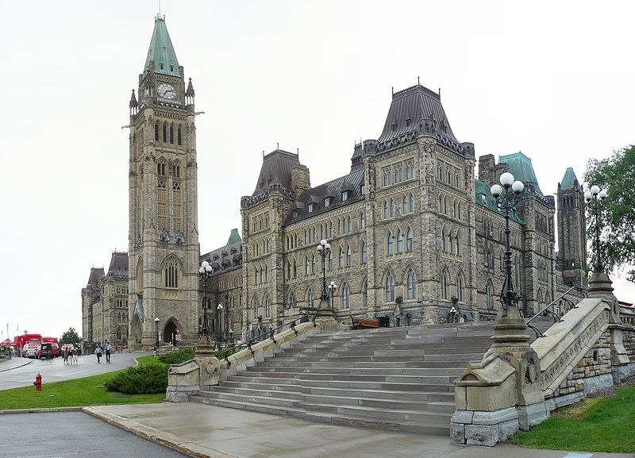
OTTAWA, THE PARLIAMENT
Zdroj: [cit2014-05-20]. Dostupný pod licencí Creative Commons
http://upload.wikimedia.org/wikipedia/commons/thumb/4/40/Parliament_Building_in_Ottawa.jpg/800px-Parliament_Building_in_Ottawa.jpg

Slide 12
SOURCES
EL-HMOUDOVÁ, Dagmar. Angličtina - Maturitní témata. Český Těšín: Petra Velanová, Třebíč, 2006, ISBN 9788086873046.
CHUDÝ, Tomáš ; CHUDÁ, Jana. Some Basic Facts (about the English speaking countries). 1.vydání. Havlíčkův Brod: FRAGMENT, 1995, ISBN 80-85768-96-8
Wikipedie [online]. 2014, [cit. 2014-05-20]. Dostupné z: http://en.wikipedia.org/wiki/Canadian_Prairies

