Slide 1
Název | The USA – Regions, Places of interest
Předmět, ročník | Anglický jazyk, 1.- 4. roč. , kvinta - oktáva
Tematická oblast | Reálie – Česká republika, Olomoucký kraj, Spojené státy americké, Kanada
Anotace | Jedná se o prezentaci s výkladem, obrázky
Klíčová slova | City, centre, the capital, institution, monument, museum, the White House, the Statue of Liberty, Manhattan
Autor | Mgr. Romana Jurášová
Datum | 14. 5. 2014
Škola | Gymnázium Jana Opletala, Litovel, Opletalova 189
Projekt | EU peníze středním školám, reg. č.: CZ.1.07/1.5.00/34.0221

Slide 2
REGIONS OF THE USA
New England
The Middle Atlantic Region
The South
The Midwest
The North West Region (The West)
The Southwest and Hawaii

Slide 3
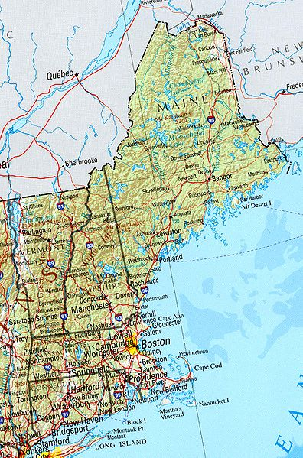
NEW ENGLAND
Zdroj: [cit2014-05-15]. Dostupný pod licencí public domain
http://upload.wikimedia.org/wikipedia/commons/thumb/7/7f/New_england_ref_2001.jpg/396px-New_england_ref_2001.jpg

Slide 4
NEW ENGLAND
Alnog the Atlantic Ocean
Boston – a commercial, cultural and educational centre – Harward University, MIT
Plymouth – first pilgrims settled here in 1620
Vermont – rural state with farms and settlements

Slide 5
THE MIDDLE ATLANTIC REGION
The natural features – The Great Valley, the Appalachians
NYC
Niagara Falls – 50 m high, over a km wide
Pennsylvania Dutch Country – a rural area settled by Amish people (since 1600s, descendants of Germans and Swiss)
Philadelphia – the first capital, Independence hall (the Declaration of Independence was signed here)

Slide 6
THE SOUTH
Traditionally farming region
Main crops: cotton, tobaco, soya
Washington, D.C. – the capital city
Memphis (Tennessee) – Graceland is home to Elvis Presley
Nashville – the capital of Tennessee, centre of music industry, festivals of country music
Miami (Florida) – recreation centre (Deytona Beach)
Cape Canaveral (Florida) – Kennedy Space Centre´s Spaceport
New Orleans (Louisiana) – French origion, on the Mississippi river, jazz music
Houston (Texas) – NASA base

Slide 7
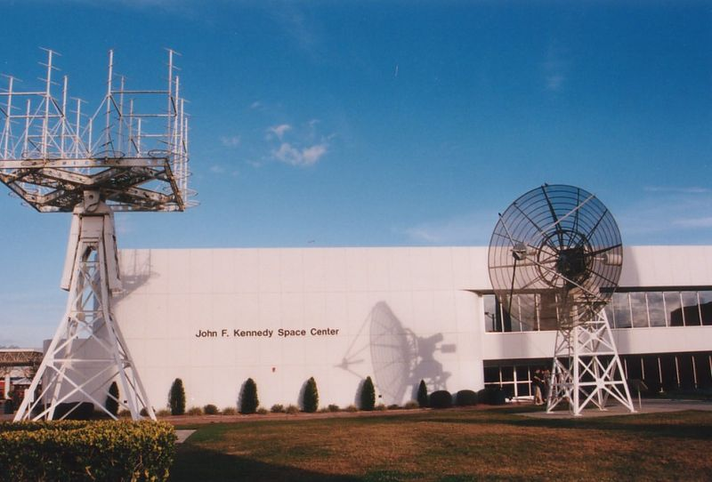
KENNEDY SPACE CENTRE, FLORIDA
Zdroj: [cit2014-05-15]. Dostupný pod licencí Creative Commons
http://upload.wikimedia.org/wikipedia/commons/thumb/3/3c/Kennedy-space-center.jpg/800px-Kennedy-space-center.jpg

Slide 8
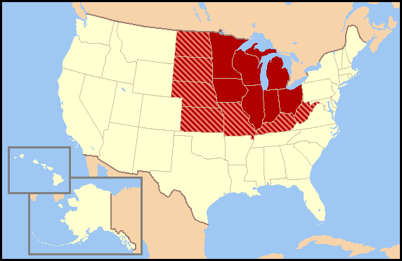
THE MIDWEST
Zdroj: [cit2014-05-15]. Dostupný pod licencí Creative Commons
http://upload.wikimedia.org/wikipedia/commons/2/28/US_map-Midwest.PNG

Slide 9
THE MIDWEST
Both agricultural and industrial region
3 main crops - corn belt, wheat belt, dairy belt
Natural feature – Great Lakes
Chicago – the 3rd largest city, foodstuff industry, Czech community
Detroit – famous for car production (Ford, Chrysler, Cadillac), Henry Ford Museum
Mt. Rushmore (South Dakota) – mountain monument with colossal portrait heads of US presidents – Washington, Jefferson, Lincoln, Roosevelt

Slide 10
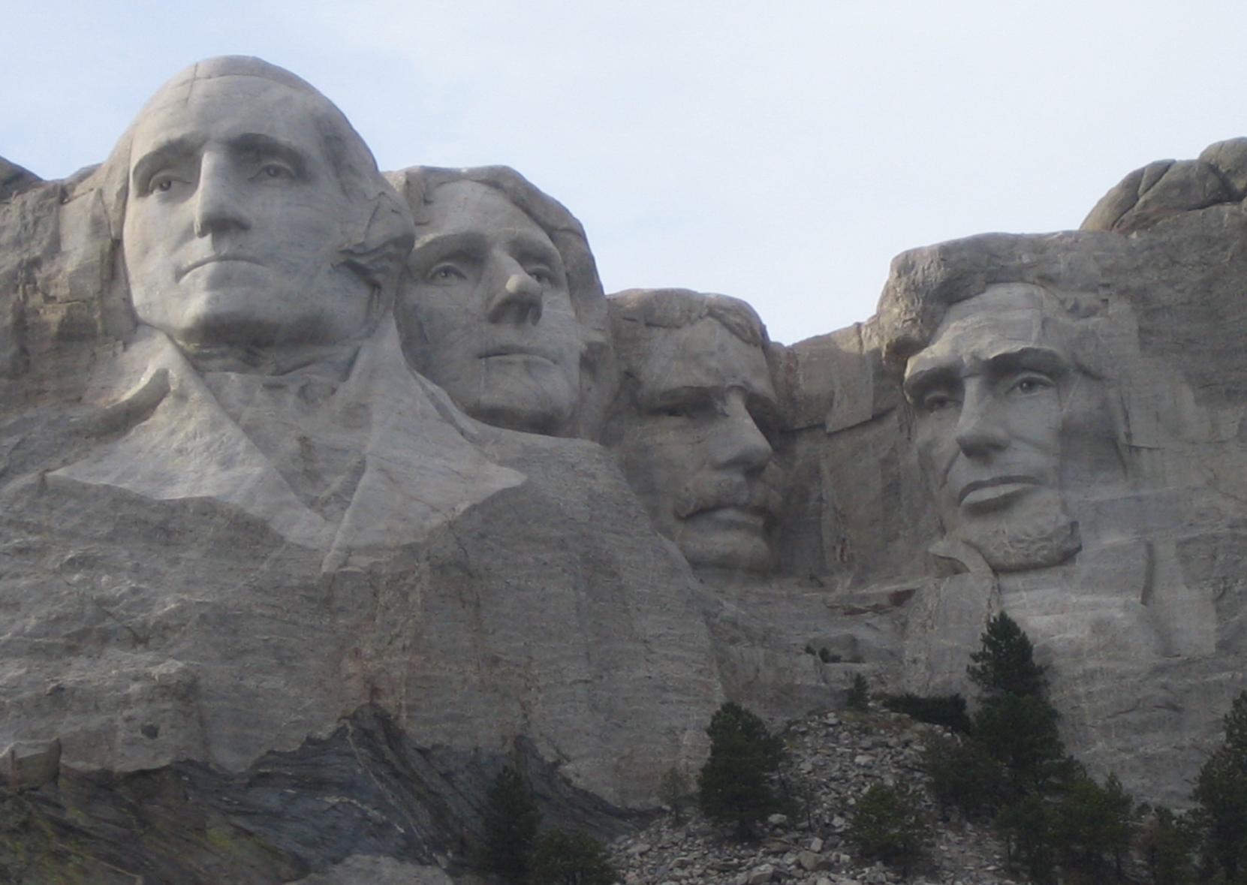
MT. RUSHMORE MONUMENT
Zdroj: [cit2014-05-15]. Dostupný pod licencí public domain
http://upload.wikimedia.org/wikipedia/commons/3/37/Mt_Rushmore.JPG?uselang=cs

Slide 11
THE NORTH WEST REGION
The Rocky Mountain States - Idaho, Montana, Wyoming, Colorado, Utah, New Mexico
The Pacific Northwest – Oregon, Washington, Alaska
Denver, Seattle, the Colorado Rockeis – ski resorts
Denver – aviatiothn, airplane industry
Salt Lake City – Mormons
Alaska – extreme north, permafrost, the Inuits
Natural beauty – Yellowstone Nation Park, Glacier National Park

Slide 12
SOUTHWEST AND HAWAII
States – California, Arizona, Nevada
Large Hispanic population (Spanish, Mexican)
The native Americans reservations – the Navajo, Shoshone people
San Francisco – cable cars, The Golden Gate Bridge, Alcatraz prison
Sillicon Valley – the largest centre of computing
Las Vegas – centre of gambling, casinos, hostels
Los Angeles – Spanish origin, Beverly Hills, Hollywood (film studios and film-making companies)
Nationa parks – The Grand Canyon (30 km wide and 1.6 km deep), Yosemite Valley Nation Park (giant sequoias, the highest waterfall in the USA), Sequoia National Park (the southern Sierra Nevada)

Slide 13
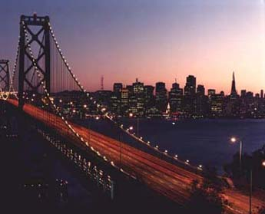
SAN FRANCISCO
GOLDEN GATE BRIDGE
Zdroj: [cit2014-05-15]. Dostupný pod licencí public domain
http://upload.wikimedia.org/wikipedia/commons/4/4b/Sfbaybridge_at_night.jpg
SAN FRANCISCO BAY
Zdroj: [cit2014-05-15]. Dostupný pod licencí public domain
http://upload.wikimedia.org/wikipedia/commons/e/e9/San_Francisco_by_night_skyline.jpg

Slide 14
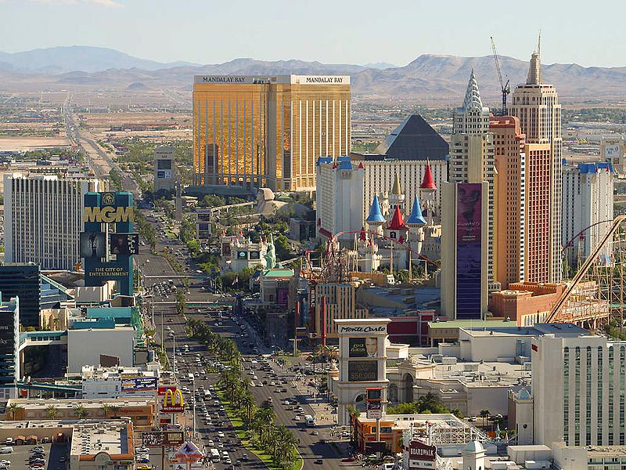
LAS VEGAS, NEVADA
Zdroj: [cit2014-05-15]. Dostupný pod licencí public domain
http://upload.wikimedia.org/wikipedia/commons/thumb/7/76/Las_Vegas_strip.jpg/800px-Las_Vegas_strip.jpg

Slide 15
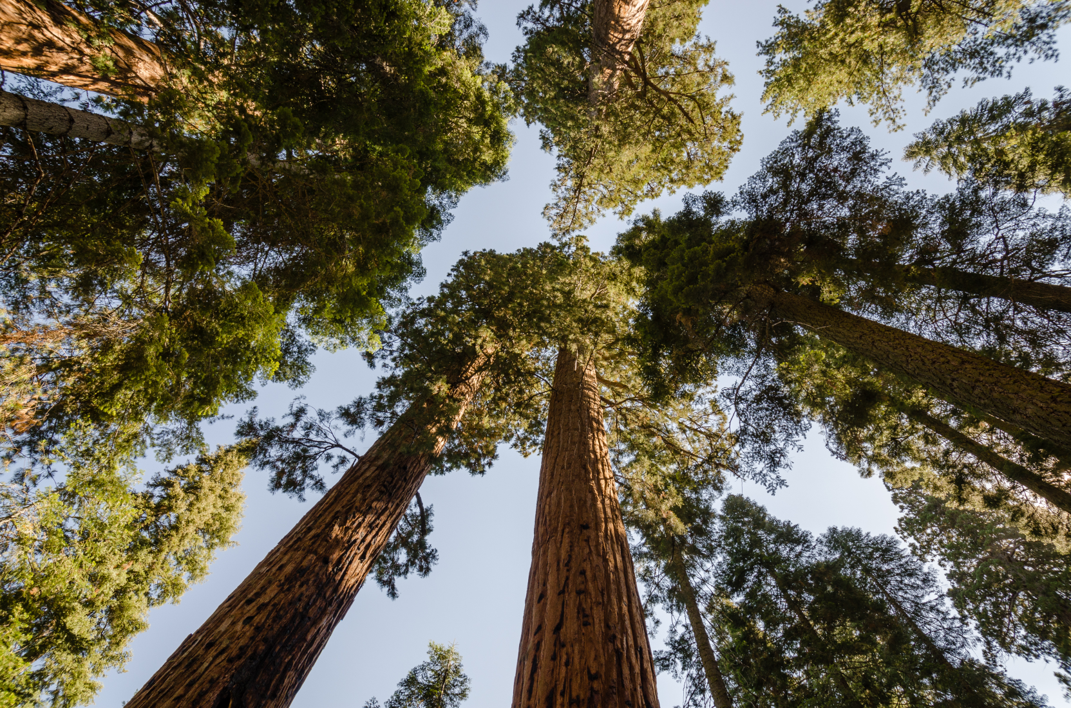
SEQUOIA NATIONAL PARK
Zdroj: [cit2014-05-15]. Dostupný pod licencí Creative Commons
http://upload.wikimedia.org/wikipedia/commons/thumb/7/7c/Giant_sequoias_in_Sequoia_National_Park_2013.jpg/800px-Giant_sequoias_in_Sequoia_National_Park_2013.jpg

Slide 16
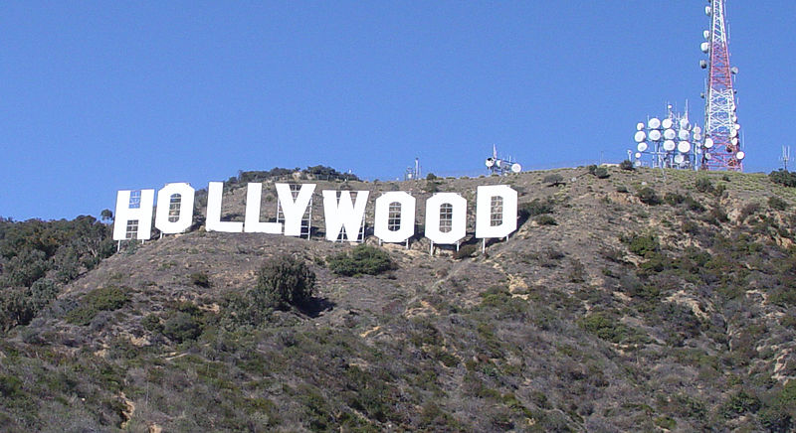
HOLLYWOOD
Zdroj: [cit2014-05-15]. Dostupný pod licencí Creative Commons
http://upload.wikimedia.org/wikipedia/commons/thumb/9/97/Hollywood-Sign-cropped.jpg/800px-Hollywood-Sign-cropped.jpg

Slide 17
SOURCES
EL-HMOUDOVÁ, Dagmar. Angličtina - Maturitní témata. Český Těšín: Petra Velanová, Třebíč, 2006, ISBN 9788086873046.
CHUDÝ, Tomáš ; CHUDÁ, Jana. Some Basic Facts (about the English speaking countries). 1.vydání. Havlíčkův Brod: FRAGMENT, 1995, ISBN 80-85768-96-8
.

