Slide 1
Název | The USA – New York, Washington, D.C.
Předmět, ročník | Anglický jazyk, 1.- 4. roč. , kvinta - oktáva
Tematická oblast | Reálie – Česká republika, Olomoucký kraj, Spojené státy americké, Kanada
Anotace | Jedná se o prezentaci s výkladem, obrázky a úkoly
Klíčová slova | City, centre, the capital, institution, monument, museum, the White House, the Statue of Liberty, Manhattan
Autor | Mgr. Romana Jurášová
Datum | 7. 5. 2014
Škola | Gymnázium Jana Opletala, Litovel, Opletalova 189
Projekt | EU peníze středním školám, reg. č.: CZ.1.07/1.5.00/34.0221

Slide 2
NEW YORK – general inforamtion
The largest city in the USA (aprox. 8 mil.inhabitants)
Area 780 sq km
Located on the east coast at the mouth of the Hudson and the East Rivers
Founded by the Dutch in 1626 ( who bought Manhattan from the Native Americans for 24 USD)
Former name – New Amsterdam
Divided into 5 boroughs: Manhattan, the Bronx, Queens, Brooklyn and Staten Island

Slide 3
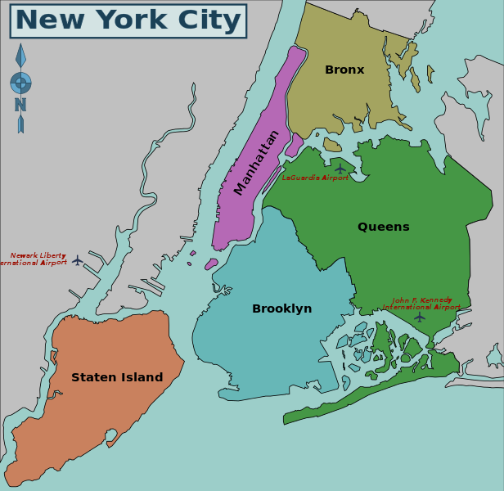
NEW YORK CITY
Zdroj: [cit2014-05 - 14]. Dostupný pod licencí Creative Commons
http://upload.wikimedia.org/wikipedia/commons/thumb/b/b5/New_York_City_District_Map.svg/616px-New_York_City_District_Map.svg.png

Slide 4
MANHATTAN
Skyscrapers skyline – the Empire State Building (381m high), the Chrysler Building (Art Deco style)
The rectangular city plan of 12 avenues (North – South direction) and 155 streets (West – East direction)
Financial centre – Wall Street (New York Stock Exchange, banks, international financial institutions)
Cultural centre – Broadway (cinemas, theatres), Greenwich Village, SoHo, Carnegie Hall (music hall), New York State Theatre, Metropolitan Opera House
Museums, galleries – the Guggenheim Museum, the Metropolitan Museum of Art, American Museum of Natural History
Other places of interest – Time Square, Rockefeller Centre (made up of 14 buildings)- restaurants, restaurants, theatres, luxury stores
Monuments – The Statue of Liberty (91.5m, gift from French,
Shopping – the 5th avenue

Slide 5
MANHATTAN
Zdroj: [cit2014-05-14]. Dostupný pod licencí: GNU Free Documentation License
http://upload.wikimedia.org/wikipedia/commons/thumb/5/5b/Panorama_Skyline_Manhattan_Empire_State_Building.jpg/800px-Panorama_Skyline_Manhattan_Empire_State_Building.jpg

Slide 6
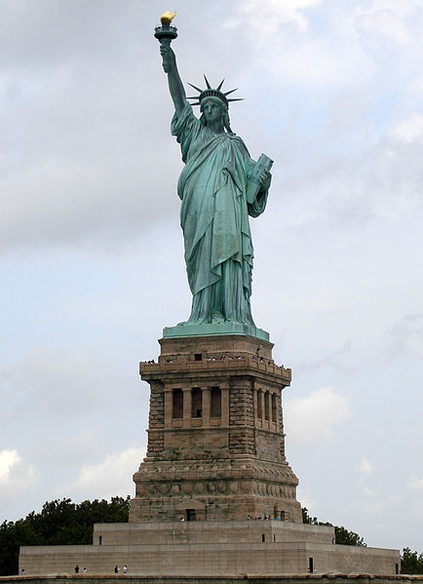
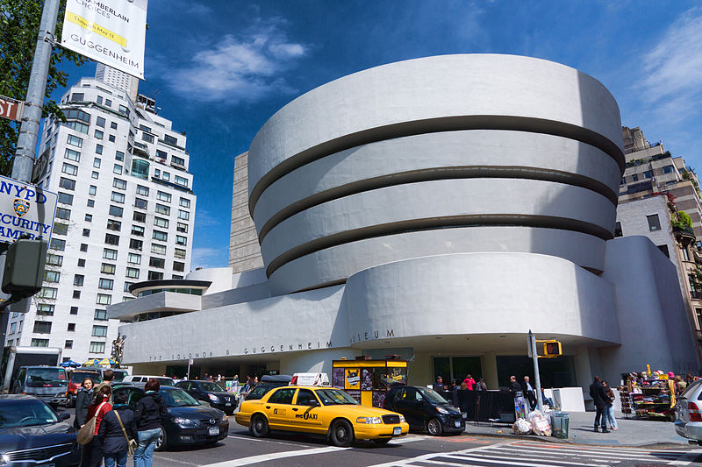
Guggenheim Museum/The Statue of Liberty
Zdroj: [cit2014-05-14]. Dostupný pod licencí: Creative Commons
http://upload.wikimedia.org/wikipedia/commons/thumb/6/6b/NYC_-_Guggenheim_Museum.jpg/800px-NYC_-_Guggenheim_Museum.jpg
Zdroj: [cit2014-05-14]. Dostupný pod licencí: Creative Commons
http://upload.wikimedia.org/wikipedia/commons/thumb/a/a1/Statue_of_Liberty_7.jpg/434px-Statue_of_Liberty_7.jpg

Slide 7
OTHER BOROUGHS
The Bronx – botanical gardens, zoo, home of hip-hop and rap
Queens – the largest borough, airports – La Gardia and J.F.K. International Airport
Brooklyn – prominent residential area (Brooklyn Heights), Academy, Brooklyn Bridge
Staten Island – the smallest borough,

Slide 8
WASHINGTON, D.C. - GOVERNMENT
The capital of the USA
Federal government, the President, the Congress and the Supreme Court
Most of the government buildings, monuments and museum stand in the westcentral part of the city:
White house (132 room, Oval Room)
The United States Capitol (the seat of Congress - the House of Representatives,Senate)

Slide 9
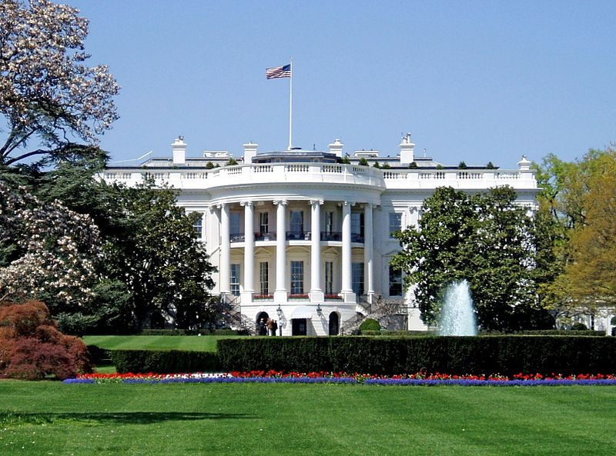
THE WHITE HOUSE
Zdroj: [cit2014-05 - 14]. Dostupný pod licencí Creative Commons
http://upload.wikimedia.org/wikipedia/commons/thumb/a/af/WhiteHouseSouthFacade.JPG/800px-WhiteHouseSouthFacade.JPG

Slide 10
WASHINGTON, D.C. – MONUMENTS, CULTURAL FACILITIES
The Lincoln Memorial (resembles Greek temple)
The Jefferson Memorial
The Washington Monument
The Library of Congress (98 million items)
Ford´s Theatre – Lincoln was assasssinated in 1865
Arlington National Cemetery
Smithonian Institution – complex of 14 museums
The National Gallery of Art

Slide 11
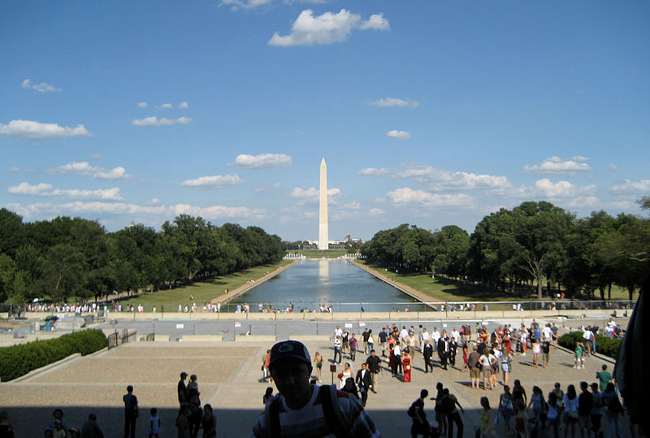
WASHINGTON MONUMENT
Zdroj: [cit2014-05 -14]. Dostupný pod licencí Creative Commons
http://upload.wikimedia.org/wikipedia/commons/thumb/5/5a/Monument_From_Lincoln_Memorial.jpg/800px-Monument_From_Lincoln_Memorial.jpg

Slide 12
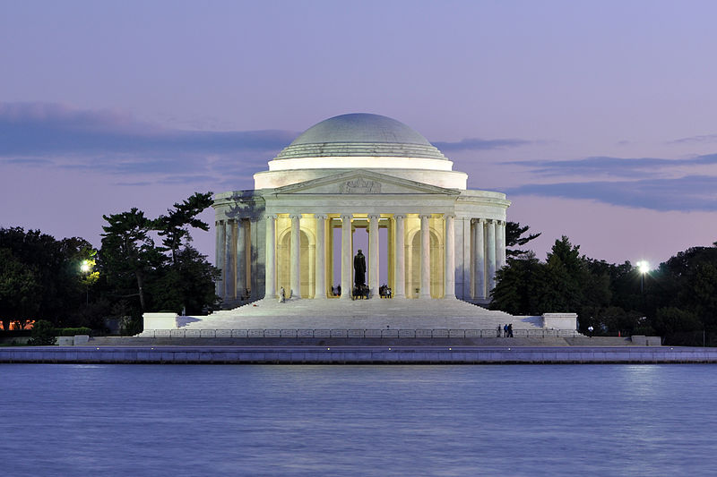
JEFFERSON MEMORIAL
Zdroj: [cit2014-05-14]. Dostupný pod licencí Creative Commons
http://upload.wikimedia.org/wikipedia/commons/thumb/1/13/Jefferson_Memorial_At_Dusk_1.jpg/800px-Jefferson_Memorial_At_Dusk_1.jpg

Slide 13
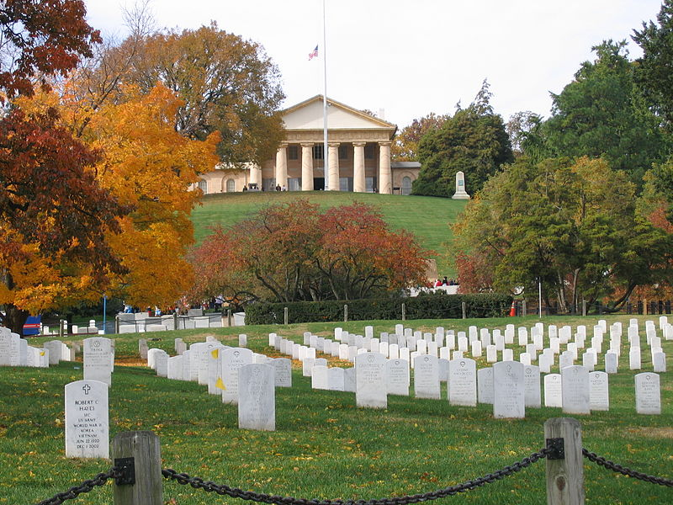
ARLINGTON NATIONAL CEMETERY
Zdroj: [cit2014-04-14]. Dostupný pod licencí public domain.
http://upload.wikimedia.org/wikipedia/commons/thumb/7/79/Arlington_House.jpg/800px-Arlington_House.jpg

Slide 14
QUESTIONS
1 When was New York (originally New Amsterdam) founded?
a) 17th. Century
b) 18th. Century
2 How many boroughs does NYC consist of?
3 Where do you find Lincoln Memorial?
a) New York
b) Washington, D. C.
4 What is the name of the building that houses the Congress of the USA?

Slide 15
ANSWER KEY
1 a)
2 5 boroughs
3 b)
4 Capitol

Slide 16
SOURCES
EL-HMOUDOVÁ, Dagmar. Angličtina - Maturitní témata. Český Těšín: Petra Velanová, Třebíč, 2006, ISBN 9788086873046.
CHUDÝ, Tomáš ; CHUDÁ, Jana. Some Basic Facts (about the English speaking countries). 1.vydání. Havlíčkův Brod: FRAGMENT, 1995, ISBN 80-85768-96-8
.

