Slide 1
Název | The USA – Economy
Předmět, ročník | Anglický jazyk, 1.- 4. roč. , kvinta - oktáva
Tematická oblast | Reálie – Česká republika, Olomoucký kraj, Spojené státy americké, Kanada
Anotace | Jedná se o prezentaci s výkladem, obrázky
Klíčová slova | Industry, agriculture, raw materials, G - 8, communication technologies, computing, crop belts, industrial belt, companies,
Autor | Mgr. Romana Jurášová
Datum | 7. 5. 2014
Škola | Gymnázium Jana Opletala, Litovel, Opletalova 189
Projekt | EU peníze středním školám, reg. č.: CZ.1.07/1.5.00/34.0221

Slide 2
THE USA - ECONOMY
Basic facts
Industry
Raw materials
Agriculture

Slide 3
ECONOMY – BASIC FACTS
The US economy is one of the biggest in the world
30% of the world´s industrial production
Member of G 8
It is focused on services and research (72%),advanced technologies and industries (25%), agriculture (3%)
The greatest concentration of industry
The North – East , Lower Lakes Region (in the Middle West), Pacific states (west)

Slide 4
LARGEST COMPANIES
Transportation, vehicles : General Motors, Ford a DaimlerChrysler
Chemicals/pertochemical ind. : Du Pont de Nemours, Union Carbide, Goodyear Tires, Exxon, Mobil, Texaco, Chevron
Electronics, communication technologies: IBM, Microsoft, General Electric, Hewlett-Packard, Compaq Computer
Foodstuff corporations: Coca-Cola, Pepsi-Cola, Conagra

Slide 5
THE NORTH - EAST + LOWER LAKES REGION= INDUSTRIAL BELT
Boston – Washington, D.C., Philadelphia- Ohio (Chicago, Detroit, Pittsburgh)
Vehicles – Detroit
Steel making industry – Pittsburgh
Foodstuff, meat processing – Chicago
Machine tools – Boston
Heavy industry - Baltimore

Slide 6
GM HEADQUARTERS, DETROIT
Zdroj: [cit2014-05-10]. Dostupný pod licencí public domain .
http://upload.wikimedia.org/wikipedia/commons/0/04/GM_headquarters_in_Detroit.JPG

Slide 7
PACIFIC STATES
California – between San Francisco and San Diego (San – San)
Silicon Valley – high technologies ( IBM, Microsoft, Apple, Google, Yahoo)
Los Angleles (Hollywood) – film industry
Washington – aviatics , astronautic technologies

Slide 8
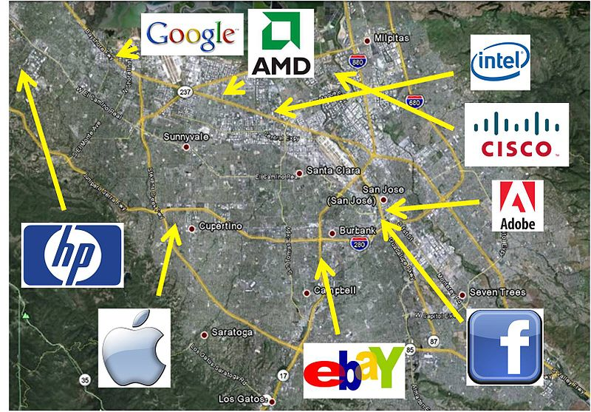
SILICON VALLEY, CALIFORNIA
Zdroj: [cit2014-05-10]. Dostupný pod licencí Creative Commons
http://upload.wikimedia.org/wikipedia/commons/thumb/2/23/Firmen_im_Silicon_Valley.jpg/800px-Firmen_im_Silicon_Valley.jpg

Slide 9
RAW MATERIALS
Coal – east, the north of the Appalachians
Iron ore – south of Lake Superior
Oil - Texas, the Gulf of Mexico
Lead (Pb) – Montana (north-west)
Zinc – the Appalachians, Montana
Uranium – Utah, Wyoming
Gold – Nevada
Silver – Utah, Arizona, Idaho

Slide 10
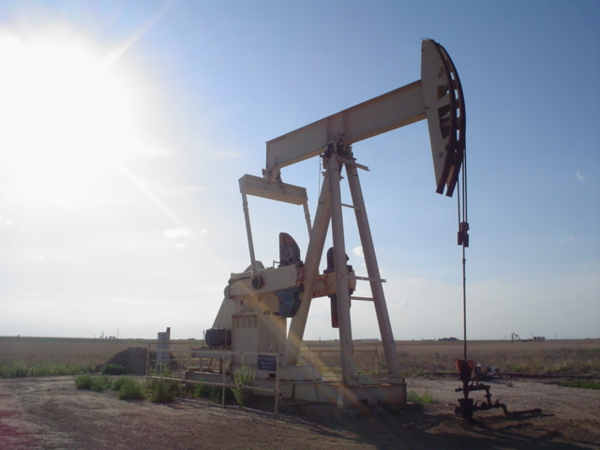
OIL PUMP IN TEXAS
Zdroj: [cit2014-05-21]. Dostupný pod licencí Creative Commons
http://upload.wikimedia.org/wikipedia/commons/c/ce/Oil_well.jpg

Slide 11
AGRICULTURE
3 % OF population
Domestic consumption + surplases for export
Livestock production: beef cattle, dairy cattle, sheep, pigs, poultry
Crops: corn, wheat, soya beans, oats, potatoes, cotton, tobacco
Horticulture: apples, pears, apricots, peaches, strawberries, citrus fruit, vegetables
Fishing: South, the Pacific Coast, East coast states

Slide 12
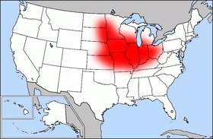
CORN BELT
Zdroj: [cit2014-05-10. Dostupný pod licencí public domain
http://upload.wikimedia.org/wikipedia/commons/3/3e/Map_of_USA_highlighting_Corn_Belt.png

Slide 13
OTHER FARMING AREAS
The Great Plains – beef cattle raising
The Cotton Belt – South
The Tobacco Belt – Kentucky, North Caroline, Virginia
California – fruit (oranges)

Slide 14
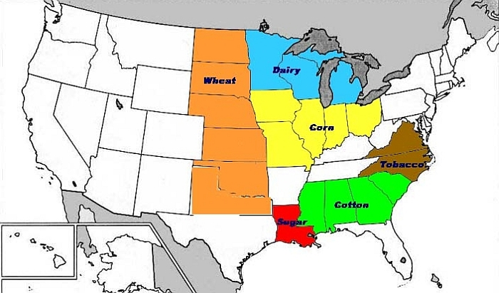
CROP BELTS
Zdroj: [cit2014-05-10]. Dostupný pod licencí public domain
https://www15.uta.fi/FAST/US2/NOTES/images/belts2.jpg

Slide 15
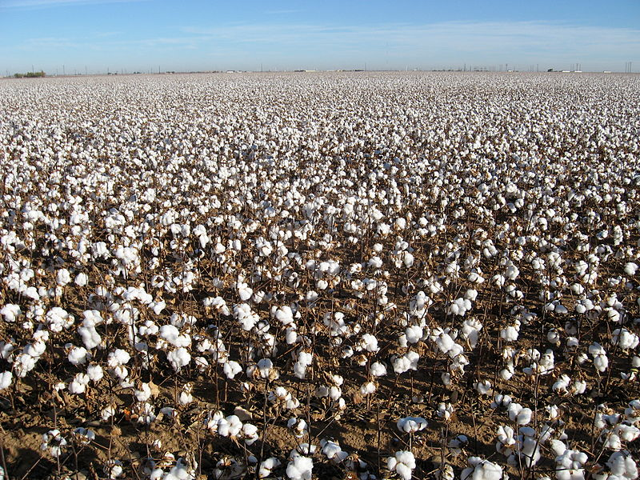
COTTON FIELDS, TEXAS
Zdroj: [cit2014-05-21]. Dostupný pod licencí Creative Commons
http://upload.wikimedia.org/wikipedia/commons/thumb/a/a4/Cotton_field_kv03.jpg/800px-Cotton_field_kv03.jpg

Slide 16
SOURCES
1 EL-HMOUDOVÁ, Dagmar. Angličtina - Maturitní témata. Český Těšín: Petra Velanová, Třebíč, 2006, ISBN 9788086873046.
CHUDÝ, Tomáš ; CHUDÁ, Jana. Some Basic Facts (about the English speaking countries). 1.vydání
Havlíčkův Brod: FRAGMENT, 1995, ISBN 80-85768- 96-8
VESELÝ, Karel. The English Speaking Countries. 1. vydání. Praha: Státní pedagogické nakladatelství, n. p., 1983, ISBN 14-484-83
Wikipedie [online]. 2014, [cit. 2014-07-05]. Dostupné z: http://en.wikipedia.org/wiki/Economy_of_the_United_States

