Slide 1
Název | The USA – Geography
Předmět, ročník | Anglický jazyk, 1.- 4. roč. , kvinta - oktáva
Tematická oblast | Reálie – Česká republika, Olomoucký kraj, Spojené státy americké, Kanada
Anotace | Jedná se o prezentaci s výkladem, obrázky a úkoly
Klíčová slova | Mountains, rivers, lakes, areas, regions, climate
Autor | Mgr. Romana Jurášová
Datum | 5. 5. 2014
Škola | Gymnázium Jana Opletala, Litovel, Opletalova 189
Projekt | EU peníze středním školám, reg. č.: CZ.1.07/1.5.00/34.0221

Slide 2
THE USA- geography
General characterstics - areas
Rivers
Lakes
Climate

Slide 3
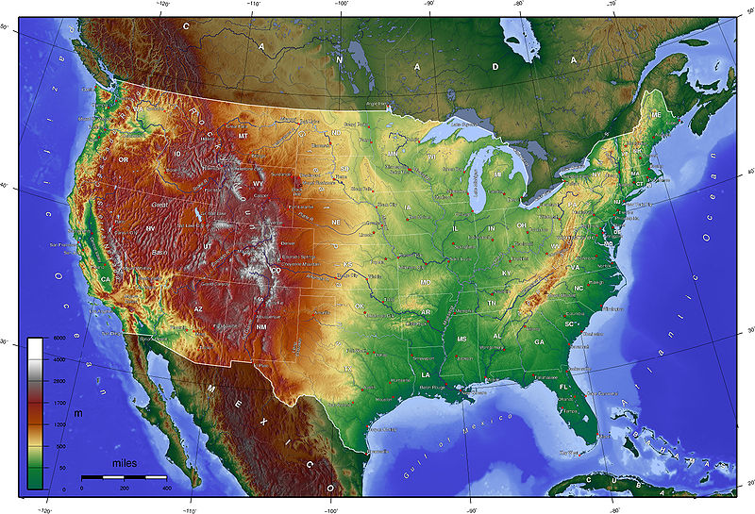
THE USA - GEOGRAPHY
Zdroj: [cit2014-05--14]. Dostupný pod licencí: Creative Commons
http://upload.wikimedia.org/wikipedia/commons/thumb/2/2d/USA_topo_en.jpg/800px-USA_topo_en.jpg

Slide 4
GENERAL CHARACTERISTICS – AREAS
Broadly,the continental United States consists of :
The Appalachian Highlands - an eastern highland
The Interior Plains
Western Highland

Slide 5
THE APPALACHIANS
eastern mountainous region
stretches from the Norht-East far south to Georgia
The Appalachian Mountains run roughly parallel to the Atlantic coast.
Main feature – hills and forests
The highest point – Mt.Mitchell (2,036 m)
The Appalachians are bordered by a coastal plain (the Atlantic Plain)

Slide 6
INTERIOR PLAINS
vast basin stretching from the Appalachians (east) to the Rocky Mountains (west)
half the area of the USA
drained mainly by the Mississippi system
1 – Central Lowlands - includes the Great Lakes section
2 – The Great Plains – endless, monotonous open space , formerly extensive grasslands (tallgrass prairie and shortgrass steppe), today mainly farmland
,

Slide 7
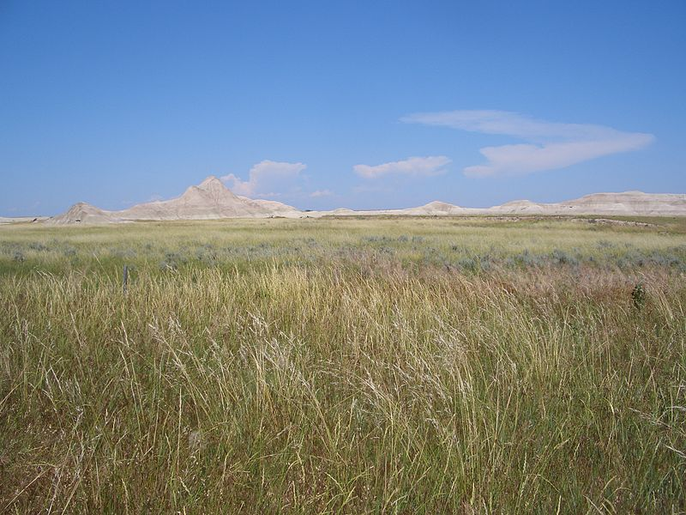
OGLALA NATIONAL GRASSLAND, NEBRASKA
Zdroj: [cit2014-05-14]. Dostupný pod licencí: public domain
http://upload.wikimedia.org/wikipedia/commons/thumb/5/5b/Oglala_National_Grassland.jpg/800px-Oglala_National_Grassland.jpg

Slide 8
THE WESTERN HIGHLAND
Covers the third of the country
Vast rugged area (part of the Cordilleras)
The highest peak – Mt. Whitney (4,418 m)
1 – the Rocky Mountains – eastern part
2 – the Intermontane Plateaus – central part
3 – the Pacific Mounain System – western part, stretching from Canada to California along the coast (the Sierra Nevada and the Cascade Mountains)

Slide 9
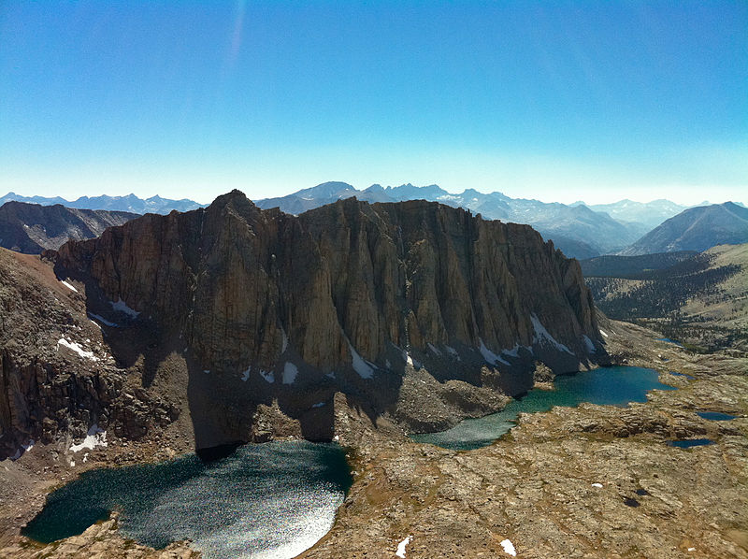
Mt. Whitney,the Rocky Mountains
Zdroj: [cit2014-05-14]. Dostupný pod licencí Creative Commons
http://upload.wikimedia.org/wikipedia/commons/thumb/a/ab/Views_from_Mt._Whitney_%284897099432%29.jpg/800px-Views_from_Mt._Whitney_%284897099432%29.jpg

Slide 10
Rivers flowing into the Atlantic
short rivers
little value to navigation
1 - the Delaware
2 - the Potomac
3 - the Hudson – the only navigable , the mouth forms the harbour in New York City

Slide 11
Rivers entering the Gulf of Mexico
1- the Mississippi (the „Old Man River“)
the biggest river
thousands of kilometers of navigable water
its estuary forms the port in New Orleans
The Mississippi – Missouri systém is over 6,000km long, one of the largest systems in the world
Its main tributaries are the following:
2 – the Missouri
3 – the Ohio
4 – the Red River
5 – the Arkansas
In the south west
6 – the Rio Grande
forms the boundary between the USA and Mexico

Slide 12
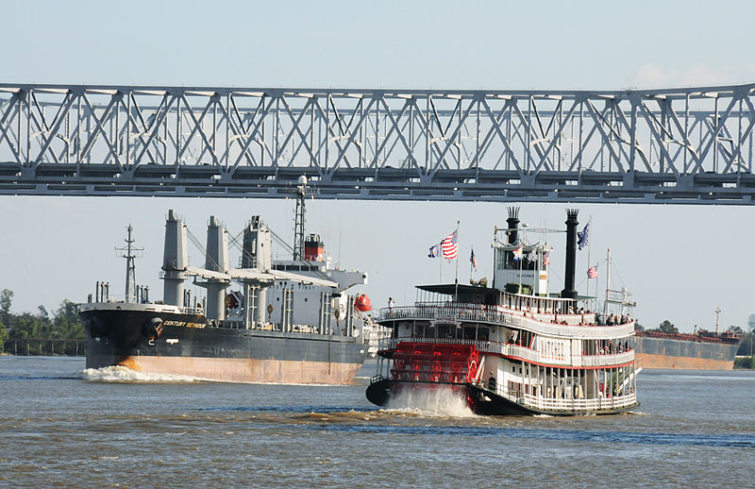
THE MISSISSIPPI
Zdroj: [cit2014-05-14]. Dostupný pod licencí Creative Commons
http://upload.wikimedia.org/wikipedia/commons/thumb/a/a0/Boats_on_the_Mississippi_%282965404740%29.jpg/800px-Boats_on_the_Mississippi_%282965404740%29.jpg

Slide 13
Rivers flowing into the Pacific
1 – the Snake – Columbia
In the north
2 – the Colorado
In the south
The Great Canyon
3 – the Sacramento

Slide 14
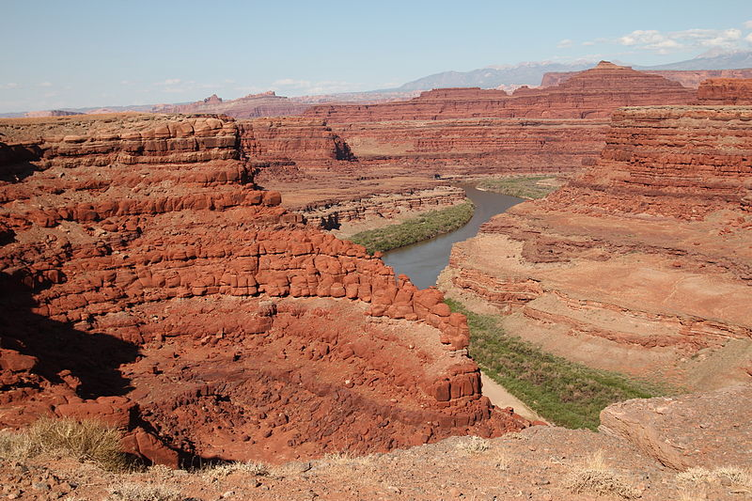
THE COLORADO RIVER
Zdroj: [cit2014-05-14]. Dostupný pod licencí Creative Commons http://upload.wikimedia.org/wikipedia/commons/thumb/2/25/Overlook_to_the_Colorado_River%2C_Moab.jpg/800px-Overlook_to_the_Colorado_River%2C_Moab.jpg

Slide 15
LAKES
5 Great lakes in the nort-east
All of them are navigable
Resources of fresh water
4 of them form the borderline with Canada
1- Lake Ontario
2 – Lake Erie
3 – Lake Superior
4 – Lake Huron
5 – Lake Michigan – an inland lake
the Niagara Falls on the Niagara river flowing from Lake erie to Lake Ontario

Slide 16
GREAT LAKES
Zdroj: [cit2014-05-14]. Dostupný pod licencí public domain.
http://upload.wikimedia.org/wikipedia/commons/thumb/7/73/Great_Lakes_3.PNG/793px-Great_Lakes_3.PNG

Slide 17
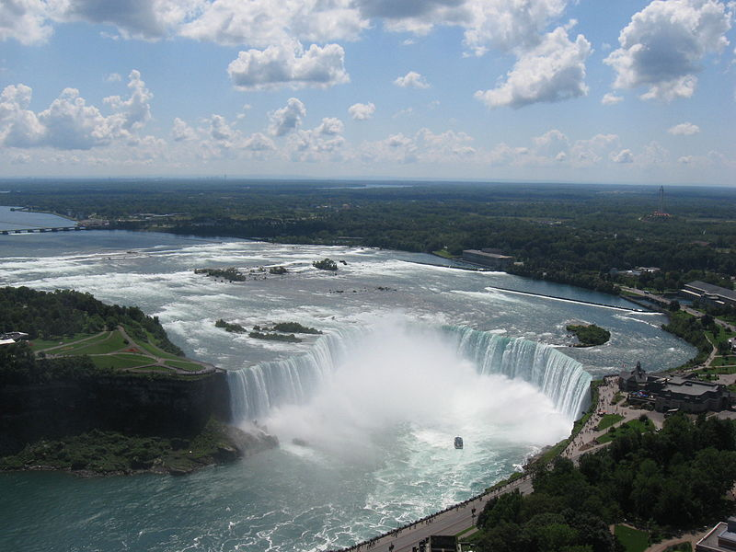
THE NIAGARA FALLS
Zdroj: [cit2014-04-14]. Dostupný pod licencí: Creative Commons
http://upload.wikimedia.org/wikipedia/commons/thumb/7/74/Niagara_Falls_006.JPG/800px-Niagara_Falls_006.JPG

Slide 18
CLIMATE
Different types of climatic zones
The Atlantic coast – relatively cold with occasional heavy snowfalls, hot and humid summers
the Middle-West – great contrasts, long and cold winters, hot and dry summers
The Gulf coast – mild humid climate
The Western Mountain system - a harsh, continentql climate, southern parts are the driest places in the USA (deserts in New Mexico, Nevada, Arizona)
The Pacific coast – milder climate than the Atlantic coast, pleasantly warm summers, mild winters

Slide 19
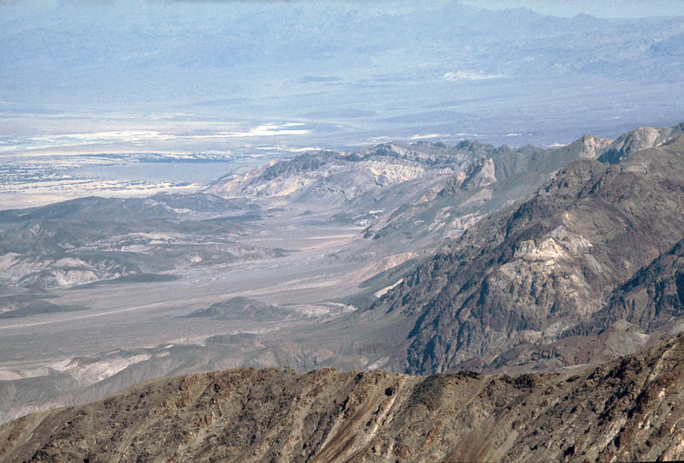
Death Valley
Zdroj: [cit2014-05-14]. Dostupný pod licencí: public domain.
http://upload.wikimedia.org/wikipedia/commons/thumb/f/f3/Death_Valley%2C19820817%2CDante%27s_View%2Cto_North.jpg/800px-Death_Valley%2C19820817%2CDante%27s_View%2Cto_North.jpg

Slide 20
QUESTIONS
1 What is the biggest mountain range in the east?
2 Which river is also known as the „Old Man River“?
a) Colorado
b) Mississippi
3 Where the tallgrass prairie can be found?
4 Which of Great Lakes does not form the Canadian-American border?

Slide 21
ANSWER KEY
1 The Appalachians
2 b)
3 in Interior Plains
4 Michigan

Slide 22
SOURCES
EL-HMOUDOVÁ, Dagmar. Angličtina - Maturitní témata. Český Těšín: Petra Velanová, Třebíč, 2006, ISBN 9788086873046.
CHUDÝ, Tomáš ; CHUDÁ, Jana. Some Basic Facts (about the English speaking countries). 1.vydání. Havlíčkův Brod: FRAGMENT, 1995, ISBN 80-85768-96-8
Wikipedie [online]. 2014, [cit. 2014-05-05]. Dostupné z: http://en.wikipedia.org/wiki/United_States

