Slide 1
Název | The United States of America – Basic facts
Předmět, ročník | Anglický jazyk, 1.- 4. roč. , kvinta - oktáva
Tematická oblast | Reálie – Česká republika, Olomoucký kraj, Spojené státy americké, Kanada
Anotace | Jedná se o prezentaci s výkladem, obrázky a úkoly
Klíčová slova | Official name, location, population, area, flag, emblem, currency, government,
Autor | Mgr. Romana Jurášová
Datum | 5. 5. 2014
Škola | Gymnázium Jana Opletala, Litovel, Opletalova 189
Projekt | EU peníze středním školám, reg. č.: CZ.1.07/1.5.00/34.0221

Slide 2
THE USA – basic facts
location
capital
population
area
currency
system of government

Slide 3
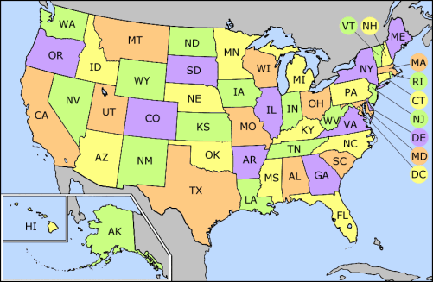
THE UNITED STATES OF AMERICA
Zdroj: [cit2014-05-05]. Dostupný pod licencí: Creative Commons
http://upload.wikimedia.org/wikipedia/commons/6/6c/US_state_abbrev_map.png

Slide 4
Official name
The United States of America
Location
North America
Neighbouring countries: Canada (in the north), Mexico (in the south)
Oceans: The Atlantic Ocean (in the east), The Pacific Ocean (in the west)
Population
318 million
density: 34. 2 sq km
Area
Approx. 9. 827 million sq km

Slide 5
The USA – the federal state consisting of 50 states and a federal district
Inland states: 48 + Washington, D.C. Separate: 2 – Alaska (extreme north), Hawaii (an archipelago in the mid-Pacific)
Capital
Washington, D. C.
Currency
United States Dollar
National language
English

Slide 6
SYMBOLS OF THE COUNTRY
The national flag
is known as Stars and Stripes
Consists of :13 horizontal red and white stripes (representing 13 former colonies) 50 white, five-pointed stars (representing 50 states) on blue background
The national anthem
The Star-Spangled Banner
Seal of the United States
The nationa bird
Bald Eagle
The national mottos
In God we Trust
E Pluribus Unum (One out of many)

Slide 7
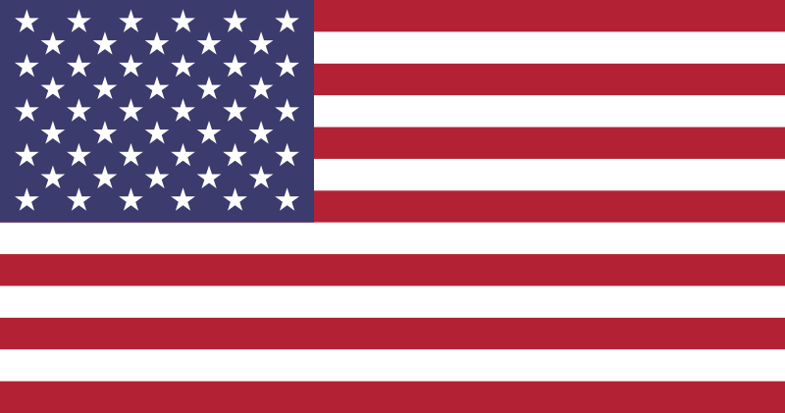
The national flag of the USA
Zdroj: [cit2014-05-05]. Dostupný pod licencí: Creative Commons
http://upload.wikimedia.org/wikipedia/en/thumb/a/a4/Flag_of_the_United_States.svg/800px-Flag_of_the_United_States.svg.png

Slide 8
The system of government
The system of federal government is composed of three branches:
1 Legislative
Two houses of Congress – the House of Representatives (435 members - Congressmen), the Senate (100 Senators)
2 Executive
the President – the head of the country, four-year term
the Executive office
3 Judical
the Supreme court
all other federal courts
Two main political parties
Democratic Party
Republican Party

Slide 9
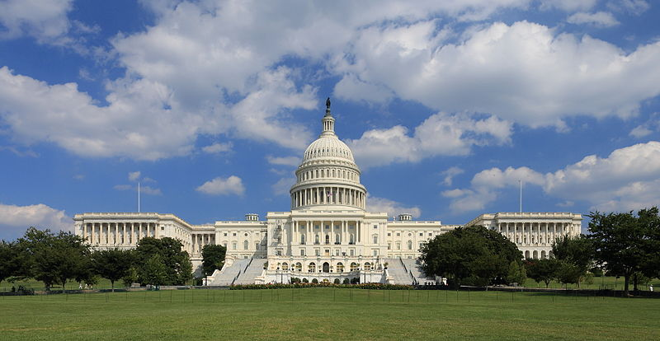
The Capitol, Washington, D.C.
Zdroj: [cit2014-05-05]. Dostupný pod licencí: Creative Commons
http://upload.wikimedia.org/wikipedia/commons/thumb/4/4f/US_Capitol_west_side.JPG/800px-US_Capitol_west_side.JPG

Slide 10
QUESTIONS
1How many state do The United States of America conssist of?
2 What do the stripes on the American flag represent?
3 What are 2 chambres of Congress?
4 Which state do the USA border on in the south?
a) Mexico
b) Panama

Slide 11
ANSWER KEY
1 50
2 13 former colonial states
3 The Senate and the House of Representatives
4 a)

Slide 12
SOURCES
EL-HMOUDOVÁ, Dagmar. Angličtina - Maturitní témata. Český Těšín: Petra Velanová, Třebíč, 2006, ISBN 9788086873046.
CHUDÝ, Tomáš ; CHUDÁ, Jana. Some Basic Facts (about the English speaking countries). 1.vydání. Havlíčkův Brod: FRAGMENT, 1995, ISBN 80-85768-96-8
Wikipedie [online]. 2014, [cit. 2014-05-05]. Dostupné z: http://en.wikipedia.org/wiki/United_States

