Slide 1
Název | Olomouc Region – Places of interest
Předmět, ročník | Anglický jazyk, 1.- 4. roč., kvinta - oktáva
Tematická oblast | Reálie – Česká republika, Olomoucký kraj, Spojené státy americké, Kanada
Anotace | Jedná se o prezentaci s výkladem a obrázky
Klíčová slova | historical, sights, monuments, tourists, castle, church, palace, chateaux
Autor | Mgr. Romana Jurášová
Datum | 22. 4. .2014
Škola | Gymnázium Jana Opletala, Litovel, Opletalova 189
Projekt | EU peníze středním školám, reg. č.: CZ.1.07/1.5.00/34.0221

Slide 2
MY REGION – places of interest
Historic cities, towns,
Castles, chateaux
Nature and landscape
Other tourist destinations

Slide 3
HISTORIC CITIES AND TOWNS
Olomouc – the second largest urban reserve (after Prague)- is exceptional in its concentration of churches, chapels, palaces and monasteries wirhin a walk-distance location. There are sights from all historic periods and architectural styles.

Slide 4
Litovel - royal town established in the 13th century by King Přemysl Otakar II
Šternberk – Šternberk castle with exhibition of clocks and time measuring devices
Uničov – medieval royal town
established round 1213
Baroque column of Virgin Mary
Town hall, originally from the 14th cent., rebuilt in Neo-Renaissance style
Hranice na Moravě – Renaissance Palace
Přerov – Jan Ámos Komenský Museum, prehistoric settlement in Předmostí

Slide 5
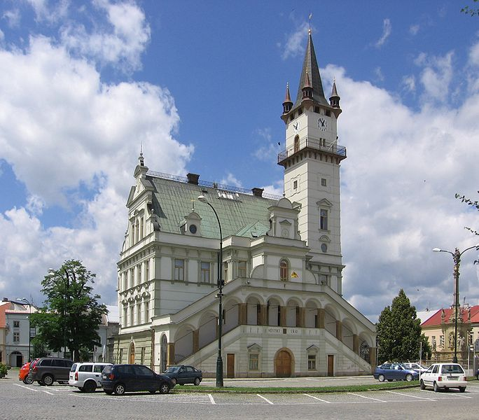
TOWN HALL, UNIČOV
Zdroj: [cit2014-04-22]. Dostupný pod licencí Creative Commons
http://upload.wikimedia.org/wikipedia/commons/thumb/6/65/Uni%C4%8Dov_-_Townhall.jpg/684px-Uni%C4%8Dov_-_Townhall.jpg

Slide 6
CASTLES, CHATEAUX
Bouzov castle –neo- romantic castle originlly from the 14th c.
Náměšť na Hané chateau – classical chateau with a formal garden and an exposition of carriages and coaches
Sovinec – the ruins of14th c. castle
Úsov – hunting manor with exposition of hunting trophes
Jewish cemetery

Slide 7
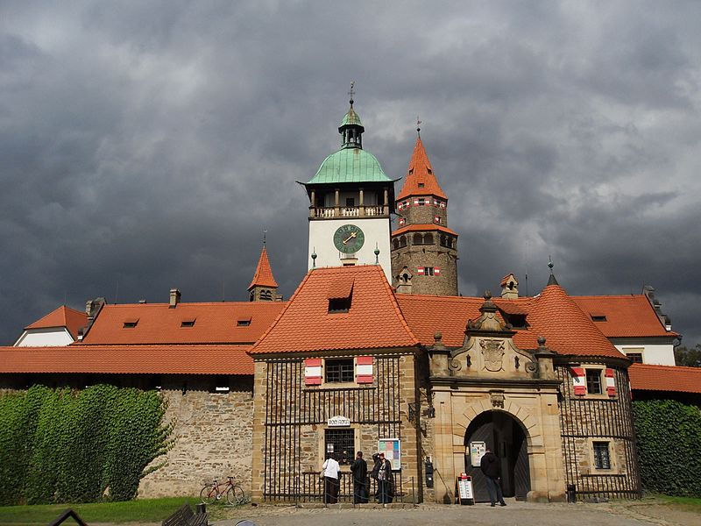
BOUZOV CASTLE
Zdroj: [cit2014-04-22]. Dostupný pod licencí: Creative Commons
http://upload.wikimedia.org/wikipedia/commons/thumb/c/c8/Bouzov%2C_hrad_%2803%29.jpg/800px-Bouzov%2C_hrad_%2803%29.jpg

Slide 8
NATURE AND LANDSCAPE
Protected landscape area Litovelské Pomoraví - many endangered kinds of plants and animals, many period river branches (protection against flooding water)
caves in the region: Javoříčko Caves , Mladeč Caves ,Zbrašov aragonite caves, Hranice Abbys – with the depth of 442.5m, the deepest abbys in the CR, the second deepest underwater abbys in the world
Landscape park of English style around Nové Zámky manor

Slide 9
OTHER TOURIST DESTINATIONS
The town of Jeseník – Priessnitz spa
Karlova Studánka – climatic spa
Svatý Kopeček village - well-known Pilgrimage Church of the Visitation of the Virgin Mary and the monastry (Baroque)
Scenic place: Dlouhé Stráně water reservoir on the top of the hill

Slide 10
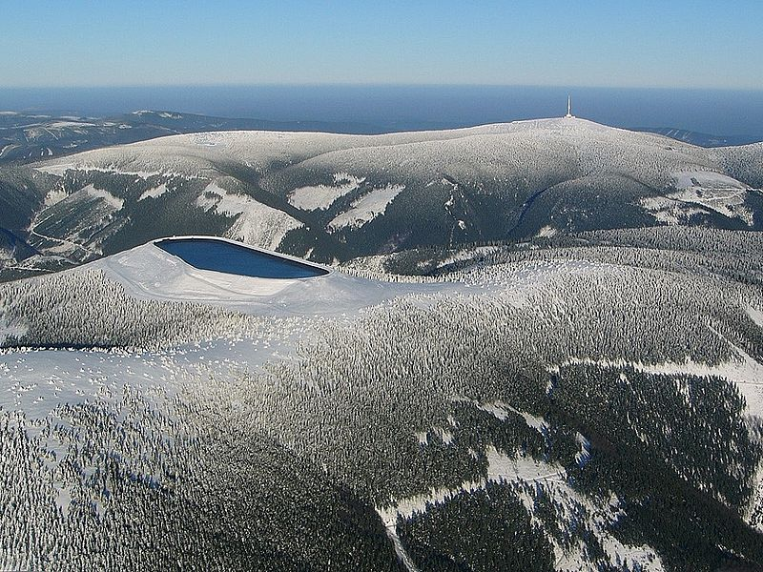
Dlouhé Stáně hydro-power plant and Praděd mountain
Zdroj: [cit2014-04-22]. Dostupný pod licencí: Creative Commons
http://upload.wikimedia.org/wikipedia/commons/thumb/3/33/Dlouhe_strane_horni_nadrz.jpg/800px-Dlouhe_strane_horni_nadrz.jpg

Slide 11
SOURCES
1 Wikipedie [online]. 2014, [cit. 2014-04-22]. Dostupné z:
http://en.wikipedia.org/wiki/Olomouc_Region
2 Wikipedie [online]. 2007, [cit. 2014-04-22]. Dostupné z:
http://www.unicov.cz/en/vismo/dokumenty2.asp?id_org=100381&id=1002&p1=55
3 Wikipedie [online]. 2014, [cit. 2014-04-22]. Dostupné z: http://cs.wikipedia.org/wiki/Olomouck%C3%BD_kraj

