Slide 1
Název | Olomouc Region – Olomouc, Litovel
Předmět, ročník | Anglický jazyk, 1.-4. roč., kvinta - oktáva
Tematická oblast | Reálie – Česká republika, Olomoucký kraj, Spojené státy americké, Kanada
Anotace | Jedná se o prezentaci s výkladem, obrázky a úkoly
Klíčová slova | historical, sights, monuments, tourists, castle, church, palace, chateaux
Autor | Mgr. Romana Jurášová
Datum | 22.4.2014
Škola | Gymnázium Jana Opletala, Litovel, Opletalova 189
Projekt | EU peníze středním školám, reg. č.: CZ.1.07/1.5.00/34.0221

Slide 2
OLOMOUC – CENTRE OF THE REGION
Administrative centre of the region
Located on the Morava River,
The sixth largest city in the Czech
102,000 residents
The ecclesiastical metropolis (the seat of the Archbishop)and historical capital city of Moravia.
Second largest urban reserve (after Prague)- is exceptional in its concentration of churches, chapels, palaces and monasteries wirhin a walk-distance location.

Slide 3
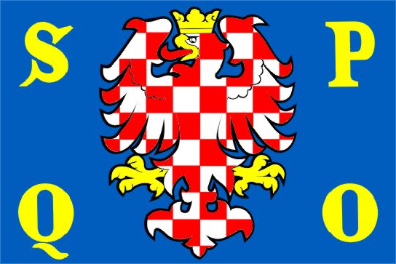
FLAG OF OLOMOUC SENATUS POPULUSQUE OLOMOUCIENSIS
Zdroj: [cit2014-04-22]. Dostupný pod licencí public domain
http://upload.wikimedia.org/wikipedia/commons/e/e1/Olomouc_flag.png

Slide 4
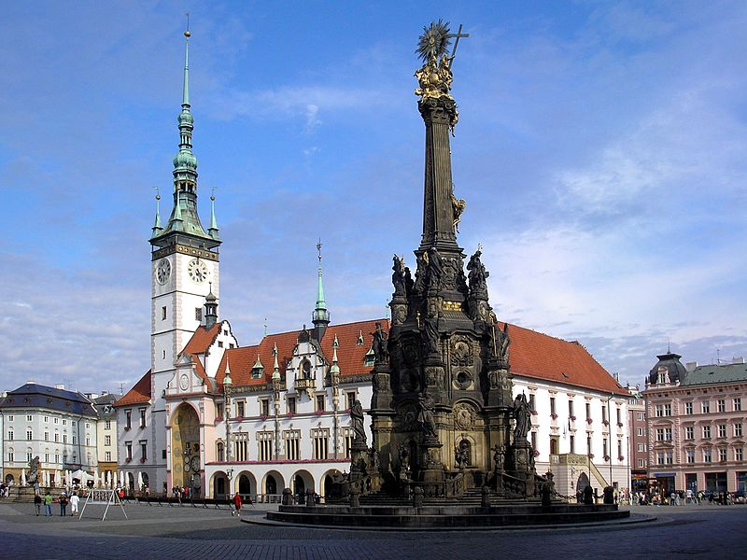
UPPER SQUARE, OLOMOUC
Zdroj: [cit2014-0-22]. Dostupný pod licencí public domain
http://upload.wikimedia.org/wikipedia/commons/thumb/9/9a/Olomouc-Horn%C3%AD_n%C3%A1m%C4%9Bst%C3%AD.JPG/800px-Olomouc-Horn%C3%AD_n%C3%A1m%C4%9Bst%C3%AD.JPG

Slide 5
SACRAL SIGHTS
There are sights from all historic periods and architectural styles.
St. Maurice Church (Gothic )– houses the second largest organ in Central Europe
St. Michael Church (Baroque st.),
St. Wenceslas Cathedral (Noe-Gothic) – the dominant of the city with the tallest church spire in Moravia,
Přemyslid /Bishop Palace – the oldest sight from Romanesque period
Jesuit church of St Mary of Snow (Baroque) with an adjacent convent

Slide 6
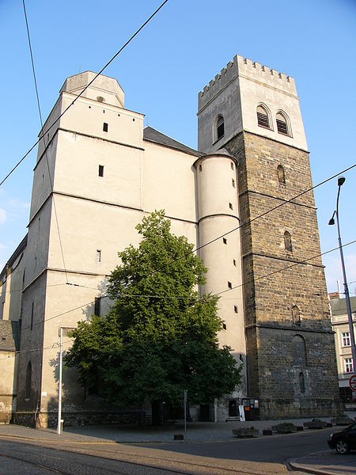
ST. MAURICE CHURCH
Zdroj: [cit2014-04-22]. Dostupný pod licencí Creative Commons
http://upload.wikimedia.org/wikipedia/commons/thumb/8/87/Chram_svateho_Morice_2.jpg/450px-Chram_svateho_Morice_2.jpg

Slide 7
BUILDINGS, PALACES, MONUMENTS
Baroque monuments
Holy Trinity Column (Baroque) – the UNESCO site
Baroque fountains (Caesar, the Tritons, Hercules, Mercury, Jupiter, Neptune)
Buildings and palaces:
Town hall (Renaissance) with the astronomical clock (modern Socialist period)
Edelmann´s Palace (Renaissance)
Archbishop Palace (Baroque)
The Přemyslid Palace (Romanesqu)
Villa Primavesi (Art Nouveau)

Slide 8
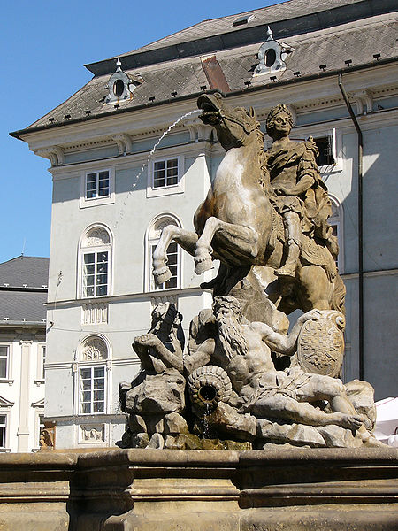
CAESAR FOUNTAIN, OLOMOUC
Zdroj: [cit2014-04-22]. Dostupný pod licencí Creative Commons
http://upload.wikimedia.org/wikipedia/commons/thumb/8/8c/Caesarova_kasna_detail.jpg/450px-Caesarova_kasna_detail.jpg

Slide 9
FACILITIES
Cultural facilities: Archbishop´s Museum, The Museum of Modern Art, Natural Science Museum, Moravian Theater, The Music Theater, galleries, concert halls, cinemas
Sport facilities: Ander ś football stadium, Lokomotiva stadium, Ice rink, sports hall, sports centres, tennis courts, swimming pool, opn-air pool and aqua centre
Education: Palacký University, secondary schools, elementary schools, Science library, University library, Municipal library

Slide 10
LITOVEL
This royal town established in the 13th century by King Přemysl Otakar II
Located in the north-western part of the area called Haná.
Due to the seven branches of Morava river flowing through the town, sometimes called Venice of Haná (Hanácké Benátky).
Population - approx. 10 000

Slide 11
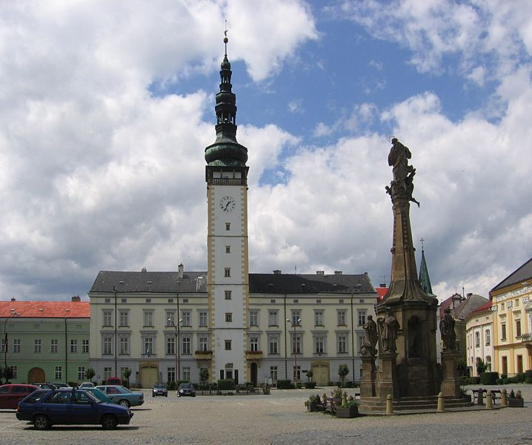
TOWN HALL + PLAGUE COLUMN LITOVEL
Zdroj: [cit2014-04-22]. Dostupný pod licencí Creative Commons
http://upload.wikimedia.org/wikipedia/commons/thumb/f/fc/Litovel_-_Square_of_P%C5%99emysl_Otakar_II.jpg/718px-Litovel_-_Square_of_P%C5%99emysl_Otakar_II.jpg

Slide 12
PLACES TO SEE
Town Hall - Rennaisance style building,
originally the house of the town mayor
since 16th cent.- town hall
the tower is 72m high
Plague column – built in 1724
Reminds the 1714 „black death“ victims
St. John of Nepomuk Bridge (Svatojánský most)
The oldest bridge (in use) in Moravia (the 3rd in the Czech Republic)
Buil around 1590
The baroque statue of St.John of Nepomuk in the middle of the bridge

Slide 13
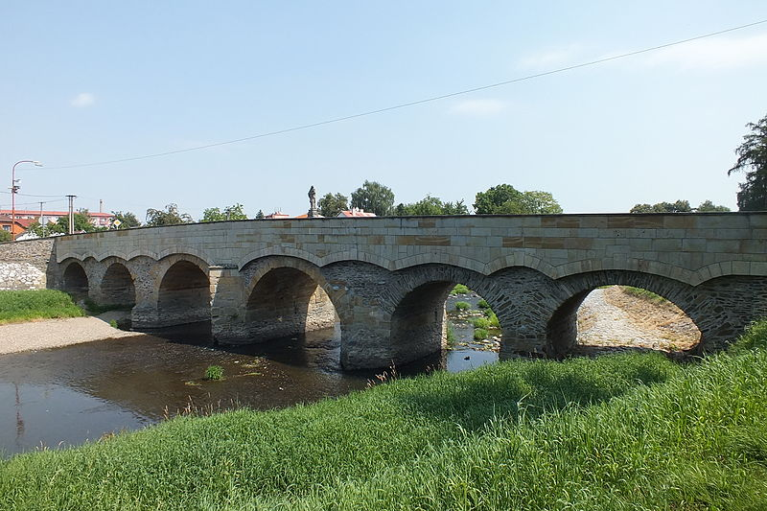
ST. JOHN BRIDGE, LITOVEL
Zdroj: [cit2014-04-22]. Dostupný pod licencí Creative Commons
http://upload.wikimedia.org/wikipedia/commons/thumb/3/35/Svatoj%C3%A1nsk%C3%BD_most_in_Litovel_01.jpg/800px-Svatoj%C3%A1nsk%C3%BD_most_in_Litovel_01.jpg

Slide 14
Swedish plaque – built in 1652
reminds the seize of the town by the Swedish army during the Thirty Years´ War
The Secondary School (gymnázium) building – finished in 1904
built in Neo-Renaissance style
decorated with mosaics commemorating the important historical events and prominent personalities
St.George chapel – the oldest preserved building in Litovel and its surroundings.
dated back to the end of the 15th century.
an outstanding example of small but superior late Gothic religious building

Slide 15
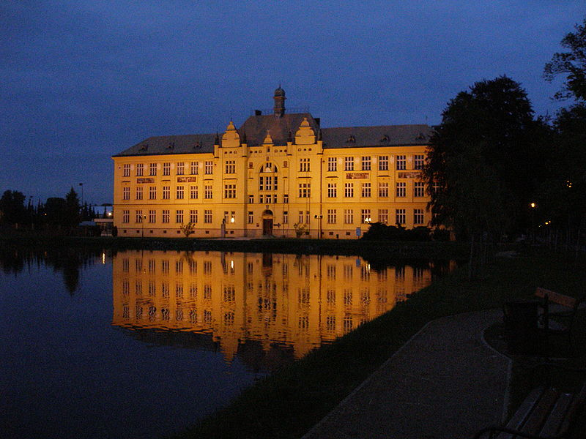
GYMNÁZIUM BUILDING, LITOVEL
Zdroj: [cit2014-04-22]. Dostupný pod licencí public domain
http://upload.wikimedia.org/wikipedia/commons/thumb/0/00/Litovel-2008-05-23-Gymnazium.JPG/800px-Litovel-2008-05-23-Gymnazium.JPG

Slide 16
SACRAL SIGHTS
St.George chapel - the oldest preserved building in Litovel and its surroundings.
dated back to the end of the 15th century.
an outstanding example of small but superior late Gothic religious building
St.Mark Church – dated back to the 15th century
Rebuilt in Renaissance and Baroque styles
The current look dates back to the 18th cent.

Slide 17
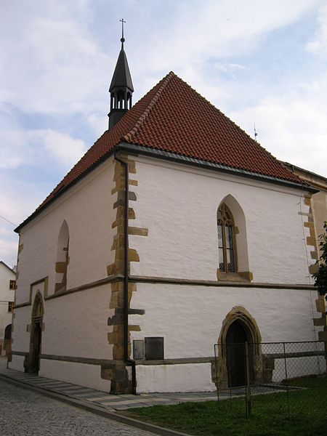
ST. GEORGE CHAPEL, LITOVEL
Zdroj: [cit2014-04-22]. Dostupný pod licencí Creative Commons
http://upload.wikimedia.org/wikipedia/commons/thumb/9/92/Kaple_sv._Ji%C5%99%C3%AD_%28Litovel%29.JPG/450px-Kaple_sv._Ji%C5%99%C3%AD_%28Litovel%29.JPG

Slide 18
QUESTIONS
1What is the oldest sight in Olomouc?
2 How many Baroque fountains can you find in Olomouc?
a) five
b) six
3 What UNESCO sight is located on the Upper Square in Olomouc?
4 What does the Plague column in Litovel remind of ?

Slide 19
ANSWER KEY
1 Přemyslid Palace
2 b)
3 The Holy Trinity Column
4 the victims of plague (in 1714)

Slide 20
SOURCES
Wikipedie [online]. 2014, [cit. 2014-04-22]. Dostupné z:
http://en.wikipedia.org/wiki/Olomouc_Region
Wikipedie [online]. 2014, [cit. 2014-04-22]. Dostupné z: http://en.wikipedia.org/wiki/Olomouc
Wikipedie [online]. 2014, [cit. 2014-04-22]. Dostupné z: http://cs.wikipedia.org/wiki/Litovel

