Slide 1
Název | Olomouc Region - Economy
Předmět, ročník | Anglický jazyk, 1.-4. roč., kvinta - oktáva
Tematická oblast | Reálie – Česká republika, Olomoucká kraj, Spojené státy americké, Kanada
Anotace | Jedná se o prezentaci s výkladem a obrázky
Klíčová slova | Industry, engineering, natural deposits, raw materials, agriculture, crops, livestock, transport
Autor | Mgr. Romana Jurášová
Datum | 20.4.2014
Škola | Gymnázium Jana Opletala, Litovel, Opletalova 189
Projekt | EU peníze středním školám, reg. č.: CZ.1.07/1.5.00/34.0221

Slide 2
MY REGION - economy
Economy of the region
farming, products
Industries, products
transport

Slide 3
AGRICULTURE
Olomouc region is predominantly a farming region due to suitable climatic conditions, fertile soil , water sufficiency and low-country relief
Main crops are: wheat, corn, hops, sugar beet, barley, oat, rape
Vegetables: garlic, onoin, potatos, peas, cabbage, carrots
Fruit: apples, cherries, stawberries, pears, plums
Livestock: pigs, dairy/beef cattle, poultry
Traditional products: dairy products, Olomoucké syrečky (mature soft cheese produced in Loštice)

Slide 4
INDUSTRIAL PRODUCTION
Industrial production is mainly based on foodstuff and processing industries
Dairy products – Olma diary in Olomouc, local farms, Orero Tři Dvory, Tvarůžky Loštice
Pasta making – Adriana Tři Dvory
Oil and fat making – MILO Olomouc
Breweries – Litovel , Hanušovice
Sweets – Orion (Zora) Olomouc
Sugar rafineries – Litovel, Vrbátky
Malt making factories – Litovel, Olomouc

Slide 5
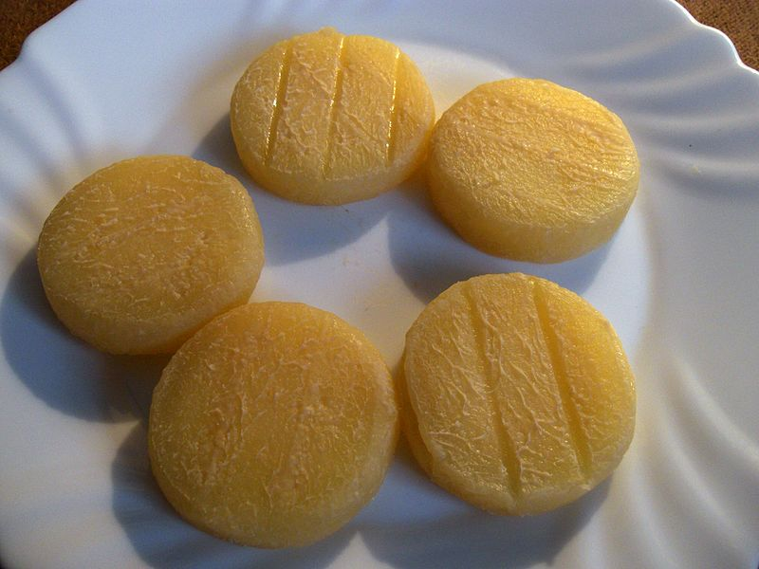
TVARŮŽKY CHEESE, LOŠTICE
Zdroj: [cit2014-04-20]. Dostupný pod licencí Creative Commons
http://upload.wikimedia.org/wikipedia/commons/thumb/8/82/Olomouck%C3%A9_tvar%C5%AF%C5%BEky_%283%29.jpg/800px-Olomouck%C3%A9_tvar%C5%AF%C5%BEky_%283%29.jpg

Slide 6
Fruit and vegetable preserves – Alibona Litovel
Other industries:
Heavy machinery – PAPCEL Litovel, UNEX Uničov, Moravian steel making factory in Olomouc, ISH Olomouc, SIGMA Lutín, TOS Olomouc
Chemical - Farmak Olomouc, PRECHEZA Přerov
Electronics – Miele Uničov, Siemens Mohelnice, HELLA Mohelnice,

Slide 7
TRANSPORT
Transport accessibility of the region is provided by
3,582 km of roads, of which only 12.3% are first class roads.
The motorways with two lanes connect Olomouc with Brno (I/46), Ostrava (I/35 followed by D1) and the Pardubice Region (I/35) . Road network is denser in the southern flat part of the region
There is 601 km of railways in the region. Important rail junctions are in Olomouc and Přerov. The railway network is spread all over the region´s territory.
Near to the city of Olomouc there is an airport for small airliners

Slide 8
SOURCES
Wikipedie [online]. 2014, [cit. 2014-04-20]. Dostupné z: http://en.wikipedia.org/wiki/Olomouc_Region

