Slide 1
Název | Olomouc Region – Basic facts
Předmět, ročník | Anglický jazyk, 1.- 4. roč. , kvinta - oktáva
Tematická oblast | Reálie - Česká republika, Olomoucký kraj, Spojené státy americké, Kanada
Anotace | Jedná se o prezentaci s výkladem, obrázky a úkoly
Klíčová slova | Mountains, location, population, Moravia, town, rivers, areas, regions
Autor | Mgr. Romana Jurášová
Datum | 20. 4. 2014
Škola | Gymnázium Jana Opletala, Litovel, Opletalova 189
Projekt | EU peníze středním školám, reg. č.: CZ.1.07/1.5.00/34.0221

Slide 2
MY REGION – basic facts
Name and location
Population
Geography
Municipalities – towns , villages, settlements

Slide 3
NAME AND LOCATION
Official name – Olomouc region – one of 14 regions in the CR
Occupies the central part of a district called Morava - an area of Uppermoravian Lowlands (Hornomoravský úval)
Spanns between the Jeseníky mountains in the north and lowlands of South Bohemian region in the south and Zlín region in the south – east
Stratches along the banks of the river Morava

Slide 4
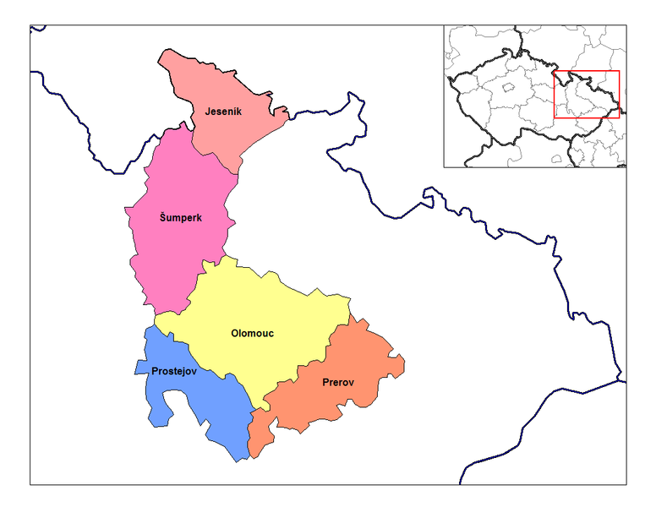
OLOMOUC REGION - MAP
Zdroj: [cit2014-04-20]. Dostupný pod licencí: public domain.
Http://upload.wikimedia.org/wikipedia/commons/thumb/7/7f/Olomouc_districts.png/776px-Olomouc_districts.png

Slide 5
POPULATION
Approx 636.5 thousand people
56.6% of the population live in towns or cities
Average population density – 121.3 inhabitants per sq km
The most populated city – the capital city of Olomouc Region with more than 100 thousand residents

Slide 6
GEOGRAPHY
Total area of the region – 5,226.5 sq km
The northern part – mountainous landscape ( the Jeseníky mts.)
The highest peak – Praděd mt. (1492m)
He southern part – Hanakian lowland
The Morava river flows through the region and forms the basin of arable land

Slide 7
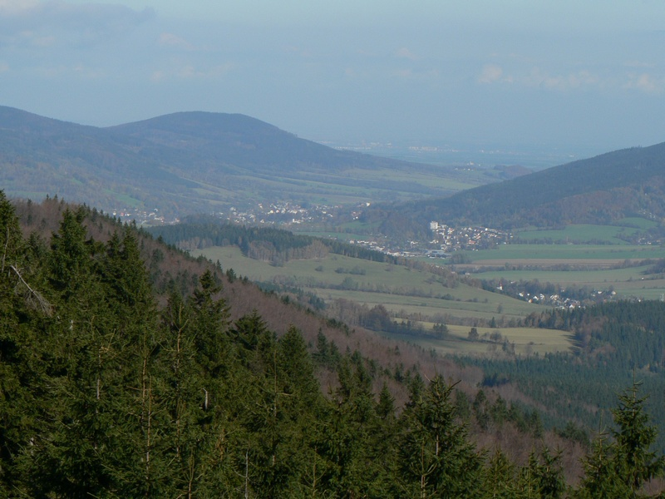
THE JESENÍKY MOUNTAINS
Zdroj: [cit2014-04-20]. Dostupný pod licencí: public domain.
http://upload.wikimedia.org/wikipedia/commons/f/f4/Jesenik.jpg

Slide 8
MUNICIPALITIES
The most important cities and towns
Olomouc
administrative centre of the region
the largest city in the region
historical city – monuments, sights
educational centre – Palacký University (7 colleges)
Cultural and sport facilities
Modern residential areas
Shopping opportunitie

Slide 9
Přerov
Centre of Přerov district
Prostějov
Šternberk
Jeseník
In the north of the region
Hranice na Moravě
Uničov
Litovel
Mohelnice

Slide 10
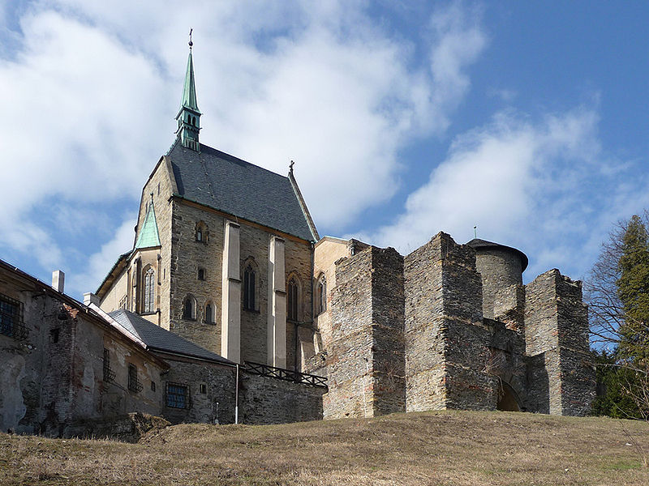
ŠTERNBERK CASTLE
Zdroj: [cit2014-04-20]. Dostupný pod licencí: Creative Commons
http://upload.wikimedia.org/wikipedia/commons/thumb/1/1b/Sternberk_hrad_1.jpg/800px-Sternberk_hrad_1.jpg

Slide 11
QUESTIONS
1 Where is Olomouc Region situated?
2 What is the administrative centre of the region?
3 How high is the highest point in the region?
a) 1602
b) 1492
4 What is the longest river in the area?

Slide 12
ANSWER KEY
1 Central part of Moravia
2 Olomouc city
3 b)
4 The Morava river

Slide 13
SOURCES
Wikipedie [online]. 2014, [cit. 2014-04-20]. Dostupné z: http://en.wikipedia.org/wiki/Olomouc_Region

