Slide 1
Název | The Czech Republic – Natural attractions
Předmět, ročník | Anglický jazyk, 1.- 4. roč. , kvinta - oktáva
Tematická oblast | Reálie – Česká republika, Olomoucký kraj, Spojené státy americké, Kanada
Anotace | Jedná se o prezentaci s výkladem, obrázky
Klíčová slova | National parks, protected area, mountains, rivers, lakes, areas, regions, climate,
Autor | Mgr. Romana Jurášová
Datum | 14. 4. 2014
Škola | Gymnázium Jana Opletala, Litovel, Opletalova 189
Projekt | EU peníze středním školám, reg. č.: CZ.1.07/1.5.00/34.0221

Slide 2
THE CZECH REPUBLIC – natural attractions
Mountain resorts
National parks
Nature reserves

Slide 3
MOUNTAIN RESORT
The Krkonoše Mts.
Pec pod Sněžkou – ski, tourist resort, Labská bouda hotel, funicular
Špindlerův Mlýn – fashionable ski and tourist resort, many hotels and boarding houses, 25 km of ski slopes, 14 ski lifts and funiculars
Harrachov – 1908 Association of winter sports was founded, ski jumps, since 1954 Internationsl ski jump competitions

Slide 4
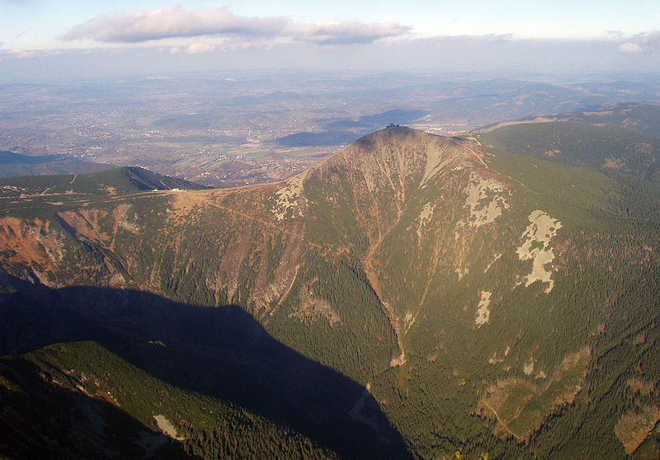
SNĚŽKA MT., THE KRKONOŠE MTS
Zdroj: [cit2014-04-14]. Dostupný pod licencí: Creative Commons
http://upload.wikimedia.org/wikipedia/commons/thumb/1/11/Sn%C4%9B%C5%BEka_a_Ob%C5%99%C3%AD_d%C5%AFl.jpg/800px-Sn%C4%9B%C5%BEka_a_Ob%C5%99%C3%AD_d%C5%AFl.jpg

Slide 5
The Beskydy Mts.
Pustevny resort – ski lifts, unique folk architecture of hotels and restaurants by archtect Dušan Jurkovič, statue of Radegast – pagan god) on Radhošť mountain
Lysá hora mt. – the highest mountain in the Beskydy mts., cross-country ski tracks, tourist paths
The Jeseníky Mts.
Praděd – the highest mt. In Moravia (1492 m), ski resrt, nature reserve
Karlova Studánka Spa

Slide 6
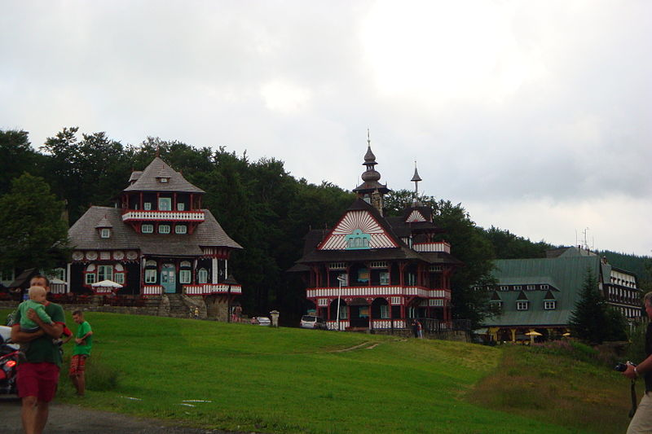
PUSTEVNY, THE BESKYDY MTS.
Zdroj: [cit2014-04-14]. Dostupný pod licencí: Creative Commons
http://upload.wikimedia.org/wikipedia/commons/thumb/f/f0/Pustevny-budovy.JPG/800px-Pustevny-budovy.JPG

Slide 7
NATIONAL PARKS
Šumava National Park
covered by the most extensive forest in Central Europe
Numerous large plateaux with peat bogs, glacial lakes and remnants of primeval forests (e.g. Boubín) create unque nature habitats which are little disturbed by human
Declared a NP in 1991
The Krkonoše Mountains National Park
Area of 425 sq km
Founded in1986
10 million visitors a year
Leafy and mixed forests, grasslands, meadows

Slide 8
Podyjí National Park
The Dyje river forms the border with Austria
Well-preserved forest valley
rocky amphitheatres, cliffs, meanders, detritus fields, impervious ravines, several types of heatland
Bohemian Switzerland
Declared NP on January 1st 2000, the youngest NP
Area of 80 sq km
a unique sandstone rock town with the occurance of rare plant and animal species and islands of well-preserved woods.

Slide 9
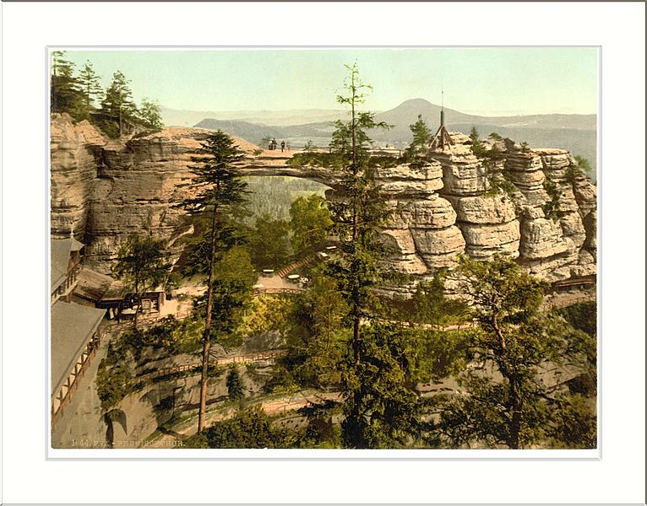
Bohemain Switzerland Natioanl Park
Zdroj: [cit2014-04-14]. Dostupný pod licencí: Creative Commons
http://upload.wikimedia.org/wikipedia/commons/thumb/5/5b/Prebischtor_with_Rosenberg_Bohemian_Switzerland_Bohemia_Austro-Hungary.jpg/766px-Prebischtor_with_Rosenberg_Bohemian_Switzerland_Bohemia_Austro-Hungary.jpg

Slide 10
SOURCES
EL-HMOUDOVÁ, Dagmar. Angličtina - Maturitní témata. Český Těšín: Petra Velanová, Třebíč, 2006, ISBN 9788086873046.
Wikipedie [online]. 2013, [cit. 2014-04-15]. Dostupné z: http://en.wikipedia.org/wiki/List_of_national_parks_of_the_Czech_Republic

