Slide 1
Název | The Czech Republic – Places of interest
Předmět, ročník | Anglický jazyk, 1.- 4. roč. , kvinta - oktáva
Tematická oblast | Reálie – Česká republika, Olomoucký kraj, Spojené státy americké, Kanada
Anotace | Jedná se o prezentaci s výkladem, obrázky a úkoly
Klíčová slova | Historical, UNESCO sites, castle, spa, monument, old town, Renaissance, Baroque, Gothic style
Autor | Mgr. Romana Jurášová
Datum | 14. 4. 2014
Škola | Gymnázium Jana Opletala, Litovel, Opletalova 189
Projekt | EU peníze středním školám, reg. č.: CZ.1.07/1.5.00/34.0221

Slide 2
THE CZECH REPUBLIC – places of interest
UNESCO sites
Historical places and monuments
Spas

Slide 3
UNESCO SITES
Prague
Historical centre of Prague and Hradčany Castle
Kutná Hora: Historical Town Centre with the Church of St Barbara and the Cathedral of Our Lady at Sedlec
in the 14th century royal city, centre of silver mining
Gothic church of St Barbara – saint patron of miners
The Cathedral of Our Lady at Sedlec – masterpiece of early baroque architecture
Historic Centre of Český Krumlov
Perfect example of a small historical medieval town with 13th –century castle and monuments and buildings with Gothic, Renaissance and Baroque features.
Situated on the banks of the Vltava river

Slide 4
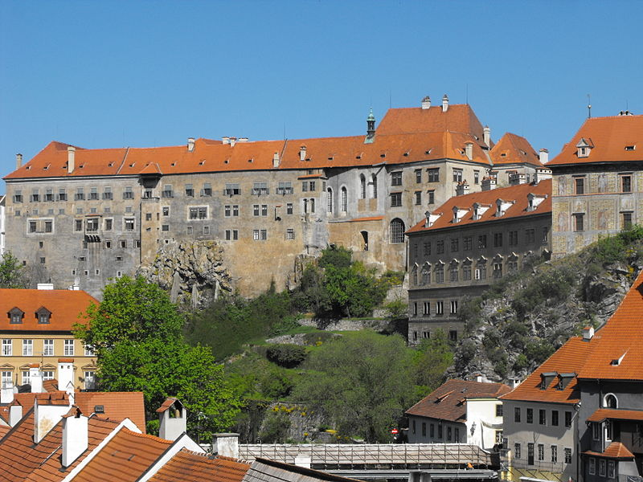
Český Krumlov Castle
Zdroj: [cit2014-04-14]. Dostupný pod licencí: Creative Commons CC0 1.0 Universal Public Domain Dedication na WWW
http://upload.wikimedia.org/wikipedia/commons/thumb/f/f9/Castle_in_%C4%8Cesk%C3%BD_Krumlov%2C_Czech_Republic.jpg/800px-Castle_in_%C4%8Cesk%C3%BD_Krumlov%2C_Czech_Republic.jpg

Slide 5
Holašovice Historical Village Reservation
complete and well-preserved example of a traditional central European village with 18th- and 19th-century buildings in a style known as 'South Bohemian folk Baroque
Historic Centre of Telč
The Renaissance houses in Telc ( originally built in the 14th cent.) surrounded by walls and the town's Gothic castle reconstructed in High Gothic style in the late 15th century.
Litomyšl Castle
an outstanding example of the arcade castle (aristocratic residence) in Renaissance style, a type of building first developed in Italy

Slide 6
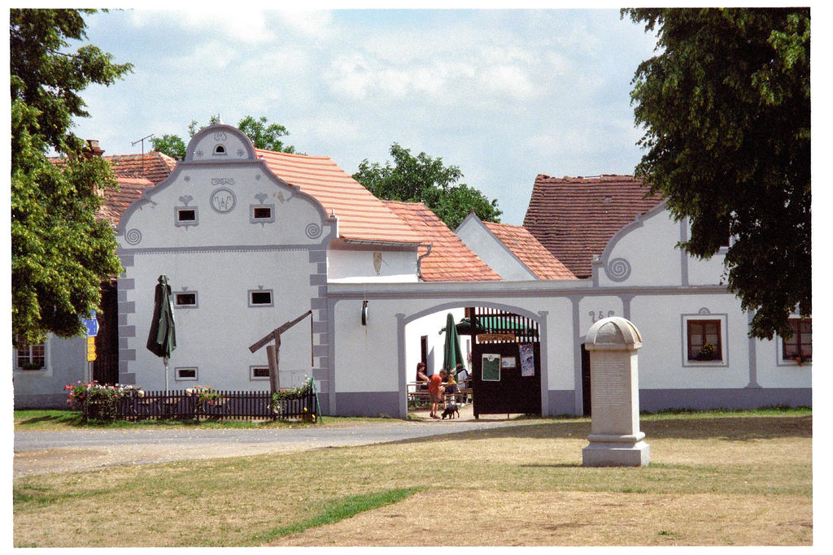
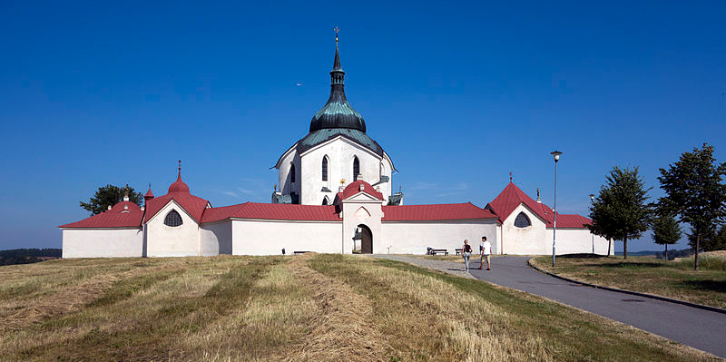
Holašovice / Zelená Hora
Zdroj: [cit2014-04-14]. Dostupný pod licencí: Creative Commons Uveďte autora-Zachovejte licenci 3.0 Unporte
http://upload.wikimedia.org/wikipedia/commons/thumb/c/cb/Pilgrimage_Church-Zelena_Hora%28js%29.jpg/800px-Pilgrimage_Church-Zelena_Hora%28j
Zdroj: [cit2014-04-14]. Dostupný pod licencí: Creative Commons Uveďte autora-Zachovejte licenci 2.0 Generic
http://upload.wikimedia.org/wikipedia/commons/7/79/Hola%C5%A1ovice.jpg?uselang=cs

Slide 7
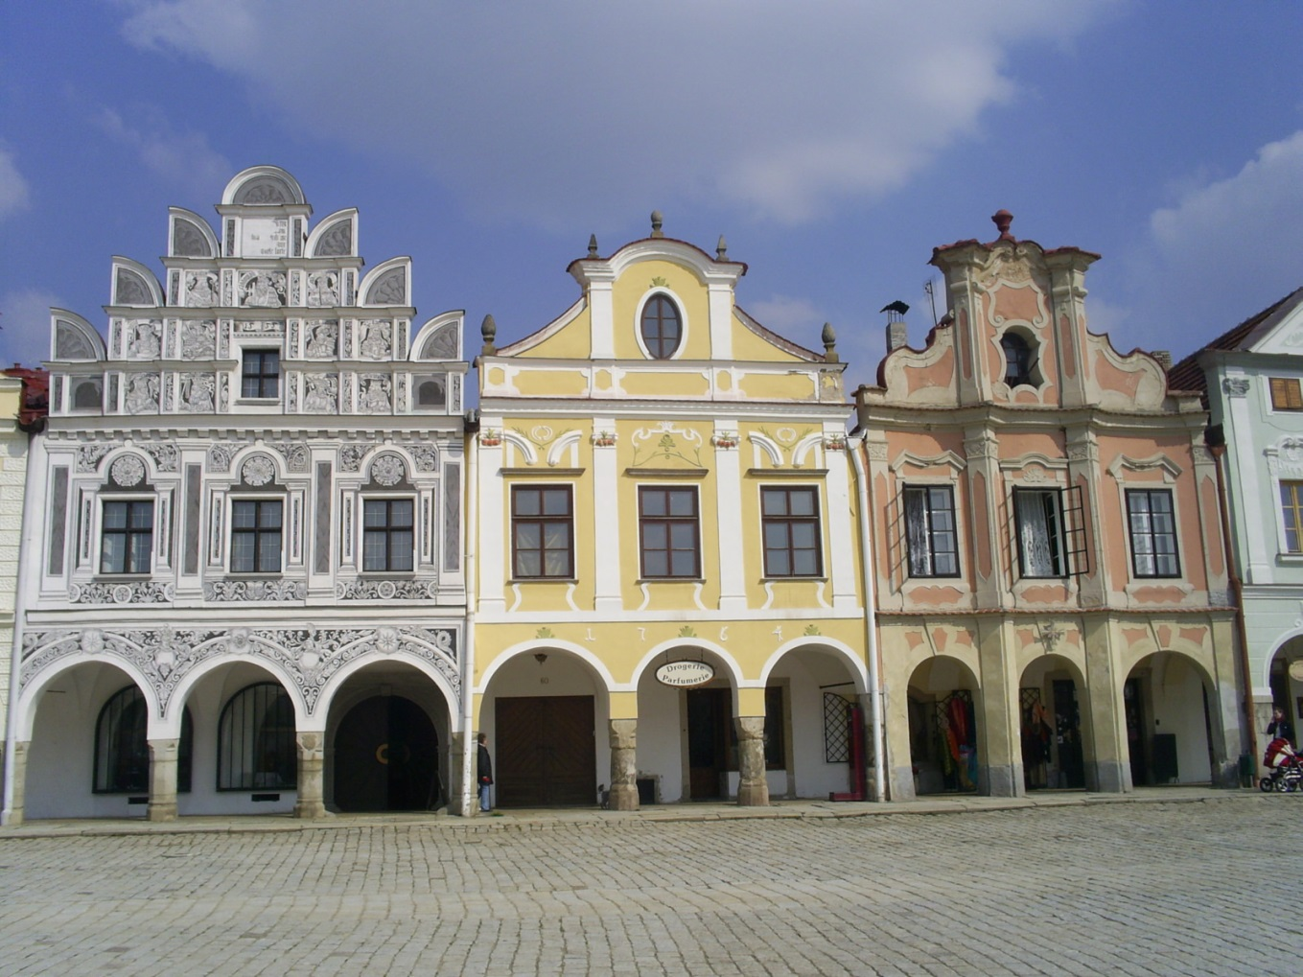
Telč houses
Zdroj: [cit2014-04-14]. Dostupný pod licencí: Creative Commons
http://upload.wikimedia.org/wikipedia/commons/5/5d/Houses_in_Tel%C4%8D.jpg?uselang=cs

Slide 8
Pilgrimage Church of St John of Nepomuk at Zelená Hora
built in honour of St John of Nepomuk, stands at Zelená Hora, constructed at the beginning of the 18th century on a star-shaped plan
the most unusual work by the great architect Jan Blazej Santini in neo-Gothic and Baroque style
Jewish Quarter and St Procopius' Basilica in Třebíč
complex of the Jewish Quarter, the old Jewish cemetery and the Basilica of St Procopius (built 13th c.) in Trebíc are reminders of the co-existence of Jewish and Christian cultures from the Middle Ages to the 20th century
Holy Trinity Column in Olomouc
Consturcted and erected in the early years of the 18th century by Olomouc stonemason Václav Render
is the most outstanding example of a type of monument specific to central Europe. style known as Olomouc Baroque
35 m hig
decorated with many fine religious sculptures, the work of the distinguished Moravian artist Ondrej Zahner.

Slide 9
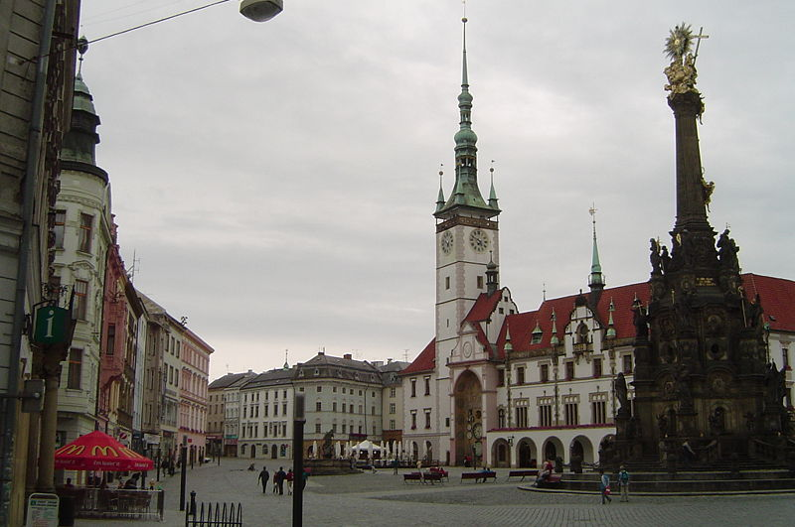
Olomouc – Holy Trinity Column
Tento soubor podléhá licenci Creative Commons
http://upload.wikimedia.org/wikipedia/commons/thumb/f/f5/Olomouc_square.jpg/800px-Olomouc_square.jpg

Slide 10
Lednice-Valtice Cultural Landscape
complex of classical and neo-Gothic style of the castles of Lednice and Valtice and countryside fashioned according to English romantic principles of landscape architecture
Gardens and Castle at Kroměříž
exceptionally complete and well-preserved example of a European Baroque royal and archepiscopal residence and its gardens.
Tugendhat Villa in Brno
designed by the architect Mies van der Rohe, is an outstanding example of the international Modern Movement style in Europe in the 1920s.

Slide 11
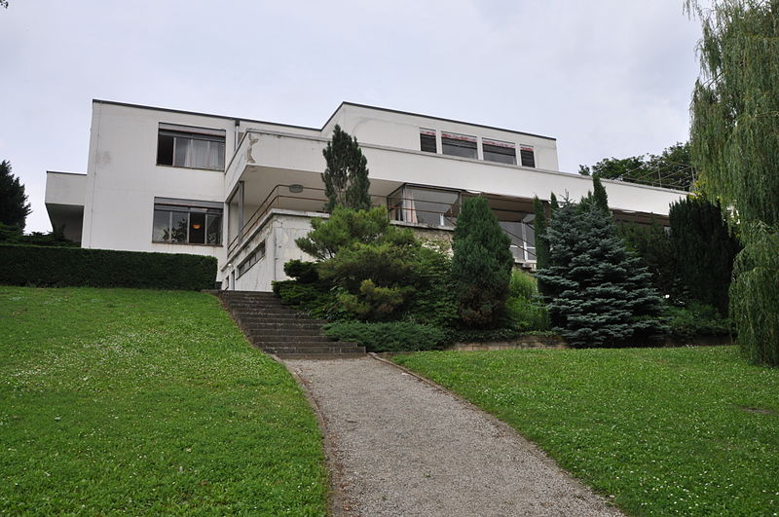
Tugendhat villa, Brno
Zdroj: [cit2014-04-14]. Dostupný pod licencí: Creative Commons
http://upload.wikimedia.org/wikipedia/commons/thumb/f/fc/Villa-Tugendhat-Brno2009o.jpg/800px-Villa-Tugendhat-Brno2009o.jpg

Slide 12
Castles and palaces
Karlštejn Castle
14th cent., ordered by the Holy Emperor Charles IV
Designed for safekeeping of the Crown Jewels and relics
Holy Rood chapel – lavishly decorated by gems and semi-precious stones
14th-century collection of 129 panel paintings by Master Theodoric
Hluboká Castle
rebuilt in the romantic neo-Gothic style in the years 1840 – 1871, including a re-arrangement of the park and the surrounding countryside
influenced by the royal castle of Windsor
Bouzov Castle
founded in the 14th cent.
romantic appearance after massive Neo-gothic reconstruction between 1895 and 1910 under the owner of the Order of the Teutonic Knights

Slide 13
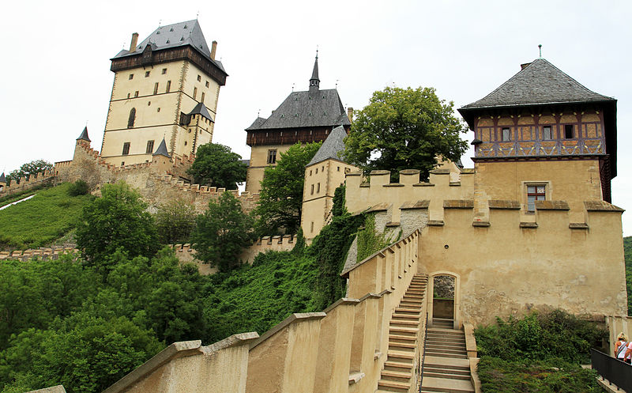
Karlštejn Castle
Zdroj: [cit2014-04-14]. Dostupný pod licencí: Creative Commons
http://upload.wikimedia.org/wikipedia/commons/e/e1/Karl%C5%A1tejn.jpg?uselang=cs

Slide 14
Spas
Karlovy Vary Spa
Founded in the 14th centrury by Holy Roman Emperor Charles IV
13 mineral springs
Cures digestive system, metabolic disorders, motor aparatus and problems connented with cancer
Františkovy Lázně Spa
Founded in the 18th cent. by Austrian Emperor Franz I
20 cold mineral springs, mineral mud and gas
Treatment of muscular-sceletal systém, cardiovascular diseases and gynaecological problems, including infertility
Karlova Studánka Spa
Founded in th late 18th cent.
Climatic spa in the Jeseníky Mts.
Treatment of diseases of the air passges and breathing disorders

Slide 15
QUESTIONS
1 Which castle was built to keep relics and crown jewels?
2 What architectonic style was the Holy Trinity Column in Olomouc built in?
3 What is the only modern UNESCO site in the CR?
4 Which spa in Bohemia were founded by the Holy Emperor Charles IV?

Slide 16
ANSWER KEY
1 Karlštejn castle
2 Baroque style
3 Tugendhat villa in Brno
4 Karlovy Vary spa

Slide 17
SOURCES
EL-HMOUDOVÁ, Dagmar. Angličtina - Maturitní témata. Český Těšín: Petra Velanová, Třebíč, 2006, ISBN 9788086873046.
Wikipedie [online]. 2014, [cit. 2014-04-14]. Dostupné z: http://whc.unesco.org/en/statesparties/CZ/

