Slide 1
Název | The Czech Republic - Prague
Předmět, ročník | Anglický jazyk, 1.-4. roč., kvinta - oktáva
Tematická oblast | Reálie – Česká republika, Olomoucký kraj, Spojené státy americké, Kanada
Anotace | Jedná se o prezentaci s výkladem, obrázky a úkoly
Klíčová slova | administrative centre, attraction, history, baroque, gothic, renaissnce, institution, gallery, palace,
Autor | Mgr. Romana Jurášová
Datum | 15.4.2014
Škola | Gymnázium Jana Opletala, Litovel, Opletalova 189
Projekt | EU peníze středním školám, reg. č.: CZ.1.07/1.5.00/34.0221

Slide 2
PRAGUE
Basic facts
Tourists attractions – sights, monuments
Institutions

Slide 3
PRAGUE – basic facts
Mother of cities or Hundred Spired - nicknames
The capital city of the Czech Republic
Situated in Central Bohemia on the Vltava river
One of the administrative divisions
Population: 1.3 million
Area: 496 sq km – the largest city in the CR
The seat of the President, Government, Parliament, Senate
Administrative, cultural, educational, economical and tourist centre of the CR

Slide 4
TOURISTIC ATTRACTIONS
Hradčany and Lesser Town (Malá Strana)
Prague Castle with the St. Vitus Cathedral – Old Royal Palace (Vladislav hall - Renaissance origine), St. Vitus Cathedral (started by the Holy Emperor Charles IV, took 600 years to built, gothic architecture), St. George´s Basilica and Convent (founded in 10th.c., Romanesque origin)
The Baroque Saint Nicholas Church
Charles Bridge (2nd oldest in the CR, built in 14th cent.,gothic structure, 17th-18th cent. 30 baroque statues and sculptures)
Petřín hill (maze, funicular)
Lennon wall

Slide 5
Old Town and Jewish Quarter (Josefov)
Old Town Square (gothic, renaissance, baroque buildings)
The Old Town City Hall (renaissance, Astronomical Clock)
The Church of Our Lady before Týn (gothic, 14th cent., 80 metres high tower)
Pařížská street (art nouveau buildings, ornaments)
Old Jewish Cemetery (medieval)
Old New Synagogue (13th cent.)
Spanish Synagogue (moresque style)
Powder Tower – gothic tower of old city walls
The Municipal House (art nouveau, concert hall)

Slide 6
Prague Castle and Charles Bridge
Zdroj: [cit2014-04-15]. Dostupný pod licencí Creative Commons Attribution-Share Alike 3.0 Unported http://upload.wikimedia.org/wikipedia/commons/thumb/2/21/Hradcany_karol_bridge_beentree.jpg/800px-Hradcany_karol_bridge_beentree.jpg

Slide 7
New Town
Wenceslas Square (1 km long, riding statue of St.Wenceslas on the upper end, night life, shops, hotels, restaurants
The National Theatre (neo-renaissance structure, 19th cent., golden roof, rich decorations )
Charles Square (the largest square in Prague)
Dancing House /Fred and Ginger Building, modern architecture

Slide 8
The Old Town City Hall and the Astonomical Clock
Zdroj: [cit2014-04-15]. Dostupný pod licencí Creative Commons Attribution-Share Alike 3.0
http://upload.wikimedia.org/wikipedia/commons/thumb/f/f4/Prague_Clock_Tower.jpg/450px-Prague_Clock_Tower.jpg

Slide 9
Othe places of interest
Vyšehrad Castle and Vyšehrad Cemetery (one of the oldest buildings, 10th cent., orig. royal residence of 1st. Czech king )
Prague Zoo in Troja
Industrial Palace and Křižík´s Light Fountain (Holešovice)
Strahov Monastery (abbey founded in 12th cent.,monastic library, the Monument of Czech Literature)
Carolinum (historical seat of Charles University, the oldest building of Charles University – Collegium Caroli, founded in14th cent. by Charles IV, assembly hall, graduation ceremonies)
Clementinum – (formerly Jesuit convent, 17-18th cent., Fardinand University, later part of Charles University, seat of the National Library)

Slide 10
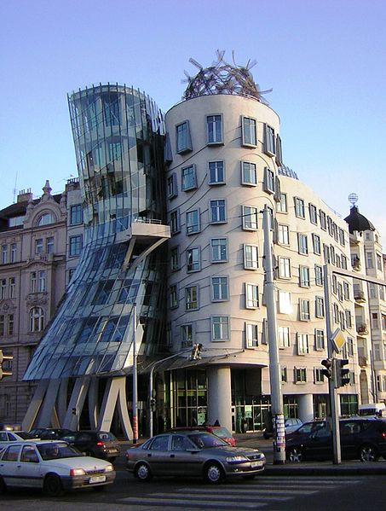
Dancing House
Zdroj: [cit. 2014-04-15]. Dostupný pod licencí creative commons na WWW:
http://upload.wikimedia.org/wikipedia/commons/thumb/b/b8/Praha_Dancing_House_from_N_DSCN1185.JPG/453px-Praha_Dancing_House_from_N_DSCN1185.JPG

Slide 11
INSTITUTIONS
Cultural institutions
The National Theatre
The National Museum (located on the upper end of Wenceslas Square, large scientific and artistic collections)
The National Gallery (collections are housed in different buildings: Schwarzenberg palace,the Convent of St. Agnes, Šternberk Palace , Kinsky Palace, Trade Fair Palace

Slide 12
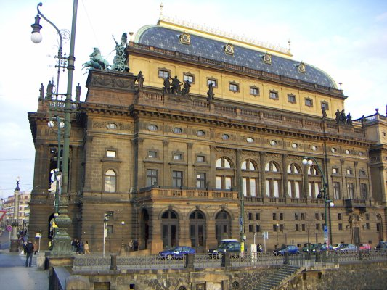
THE NATIONAL THEATRE
Zdroj: [cit. 2013-03-05]. Dostupný pod licencí Creative Commons Attribution-Share Alike 2.0 Germany
http://upload.wikimedia.org/wikipedia/commons/d/d0/Nationaltheater_2005-03-26_00.jpeg

Slide 13
Administrative institutions:
Presidenstial residence – Prague Castle
Ministries
Governmental Offices (Straka´s Academy)
The Senate (Valdštejn Palace)
The Parliament (complex of buildings in Lesser Town)
Educational centre
Charles University (founded in 1378 by the Holy Emperor Charles IV)
Czech Technical University
The University of Economics
Academy of Fine Art
Academy of Performing Arts
Academy of Music

Slide 14
Economical and financial institutions
The Nationa Bank
The Board of Industry
The Board of Agriculture
Board of Trade
Headquarters of both national and international banks and financial institutions
Headquarters of international companies
Centre of shopping
Shopping malls, centres and galleries
Designer boutiques (Pařížská st.)

Slide 15
Transport
The International Airport of Václav Havel
Prague Metro/underground
Railways – Prague mains station, Masaryk station
Buses/Coaches –Florenc station
Tams
Taxi cars
Boats
Cycling paths

Slide 16
QUESTIONS
1 What is the second oldest stone bridge?
2 Which architectural style is St. Vitus Cathedral built in?
3 What are four historical Prague quarters/towns?
4 When was Charles Universtiy founded?

Slide 17
ANSWER KEY
1 Charles bridge
2 Gothic style
3 Hradčany, the Lesser Town, Old Town, New Town
4 1378

Slide 18
SOURCES
EL-HMOUDOVÁ, Dagmar. Angličtina - Maturitní témata. Český Těšín: Petra Velanová, Třebíč, 2006, ISBN 9788086873046.
Wikipedie [online]. 2014, [cit. 2014-04-15]. Dostupné z: http://en.wikipedia.org/wiki/Prague

