Slide 1

Název | The Czech Republic - Economy
Předmět, ročník | Anglický jazyk, 1.-4. roč., kvinta - oktáva
Tematická oblast | Reálie – Česká republika, Olomoucká kraj, Spojené státy americké, Kanada
Anotace | Jedná se o prezentaci s výkladem a obrázky
Klíčová slova | Industry, engineering, natural deposits, raw materials, agriculture, crops, livestock, transport
Autor | Mgr. Romana Jurášová
Datum | 15.4.2014
Škola | Gymnázium Jana Opletala, Litovel, Opletalova 189
Projekt | EU peníze středním školám, reg. č.: CZ.1.07/1.5.00/34.0221

Slide 2
THE CZECH REPUBLIC – ECONOMY
Industries
Raw materials
Products
Areas
Agriculture/farming
Crops
Areas
Transport

Slide 3
INDUSTRIES
Since the 19th century the Czech Republic has been an industrial country.
The main industries are:
Engineering
Steel industry
Mining
Chemical industry
Wood processing
Textile industry
Foodstuff industry
Traditional products

Slide 4
Engineering – belongs to the most traditional industrial branches.
Vehicles – Škoda Auto in Mladá Boleslav (cars), Tatra Kopřivnice (trucks and lorries), Hyundai Nošovice (cars)
Heavy machinery – Škoda holding in Plzeň,
ČKD Blansko
Iron and steel industry – is concentrated near or within the mining areas as it is closely conected with deposits of iron ore or coal .
Steel - Arcelor Mittal Ostrava, Evraz Vítkovice Steel in Ostrava
Metallurgy – Třinecké železárny, ŽDB Bohumín

Slide 5
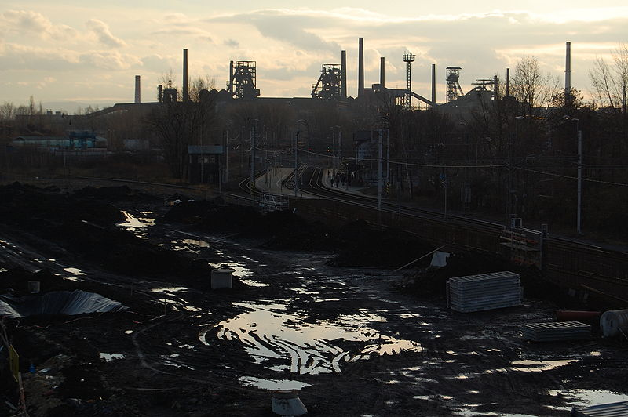
THE CITY OF OSTRAVA
Zdroj: [cit2014-04-15]. Dostupný pod licencí Creative Commons
http://upload.wikimedia.org/wikipedia/commons/thumb/0/0c/Nova_Karolina_Ostrava_Czech_republic_15.jpg/800px-Nova_Karolina_Ostrava_Czech_republic_15.jpg

Slide 6
Mining – mines and pits are located in areas with metal and non-metal deposits in the north of Moravia and in the north of Bohemia
Black and brown coal – OKD mines, Severočeské doly mines, Mostecká uhelná mines
Silver – Kutná Hora
Uranium – Stráž pod Ralskem in Northern Bohemia
Oil - the south of Moravia
Clay – Western Bohemia
Chemical industry – the third biggest industry in the CR, requires highly qualified labour and sufficient raw materials + electricity + water sources. Most chemical factories are located near rivers – the Elbe river (the north of Bohemia).
Synthesia Pardubice
Explosia Semtín (Semtex)
Spolana Neratovice
Synthos /Kaučuk Kralupy nad Vltavou - rubber
Zentiva Praha – pharmaceutics
Unipetrol - petrochemistry

Slide 7
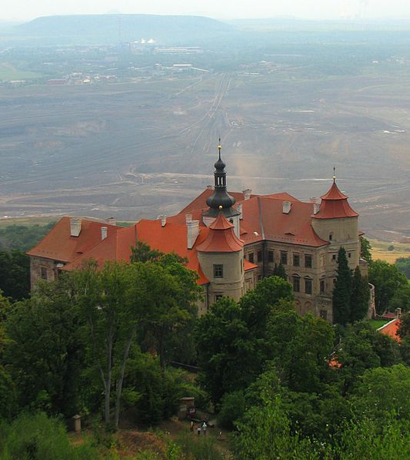
JEZEŘÍ, COAL MINING IN NOTHERN BOHEMIA
Zdroj: [cit2014-04-15]. Dostupný pod licencí Creative Commons
http://upload.wikimedia.org/wikipedia/commons/thumb/a/a4/Jezeri_Chateau.jpg/533px-Jezeri_Chateau.jpg

Slide 8
Textile and clothing industry – traditional industry processing and weaving cotton and wool and other natural or man-made fibres
Prostějov –OP
Jitex Písek
Velveta Vansdorf
Veba Broumov (bed linen, table linen)

Slide 9
Foodstuff industry – supplies the inhabitants with food and beverages, the basic resources are domestic agriculture products. The factories are located within the farming areas.
Dairy products –Olma (Olomouc), Madeta (České Budějovice), Pragolaktos
Meat processing and slaughter houses- Masokombinát Olomouc, Krahulík – Masozávod Krahulčí, Váhala
Fruit and vegetables processing – Alibona (Litovel), Hamé (Babice), Seliko (Opava)
Breweries – beer is brewed traditionaly in Plzeň – Pilsner, České Budějovice – Budvar, Litovel brewery, Hanušovice brewery
Spirits and liqueur – Stock (Plzeń-Božkov), Jan Becher (Karlovy Vary), Rudolf Jelínek (Vizovice)

Slide 10
Traditional products:
Glass and cut glass – in the north and the nort-west of Bohemia : Dubí, Nová Role, Nový Bor
Jewellery – Jablonec nad Nisou
China and Pottery – Thun (Karlovy Vary)
Musical instruments – Petrof pianos (Hradec Králové)
Shoes – Baťa (Zlín)
Cars (see pg 3)

Slide 11
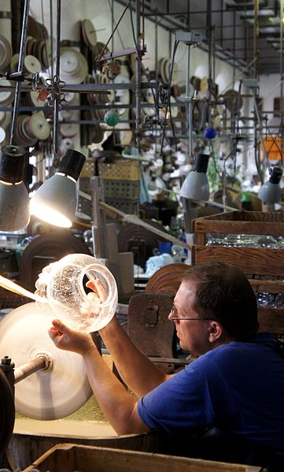
GLASS WORKER, HARRACHOV
Zdroj: [cit2014-04-15]. Dostupný pod licencí Free Art License
http://upload.wikimedia.org/wikipedia/commons/thumb/5/56/Skl%C3%A1rna_Harrachov.JPG/361px-Skl%C3%A1rna_Harrachov.JPG

Slide 12
AGRICULTURE
Farming and agriculture is located in suitable areas of lowlands and basins, usually along rivers.
Bohemia – the Elbe basin, the Vysočina highlands, the Central and Western Bohemia
Crops are grown: wheat, corn, barley, sugar beet, hops (Žatec , Louny), grapes, fruit, vegetables, potatoes (the Vysočina hghl.)
Livestock is raised: beef cattle, pigs, poultry, fish farming (Southern Bohemia)

Slide 13
Moravia – lowlands along the Morava river, the Dyje basin
Crops: vegetables, fruit, wheat, oat, barley, hops (Olomouc region), sugar beet, corn, grapes (Southern Moravia)
Livestock : poultry, pigs, dairy cattle, sheep (hillsides of the Jeseníky mts. And the Beskydy mts.)

Slide 14
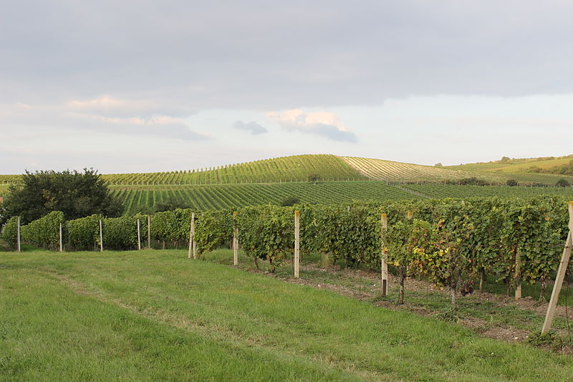
VINEYARDS, PÁLAVA HILLS
Zdroj: [cit2014-04-15]. Dostupný pod licencí Creative Commons
http://upload.wikimedia.org/wikipedia/commons/thumb/8/8d/Vineyeards_under_P%C3%A1lava_hills%2C_Moravia.JPG/800px-Vineyeards_under_P%C3%A1lava_hills%2C_Moravia.JPG

Slide 15
TRANSPORT
Railway - total network length is 9, 470 km
Main railway runs in the north-east direction connecting Prague and Ostrava
Trains and carriages have been modernized
Pendolino, recently introduced, is the fastest and the most comfortable train
Privat companies: RegioJet, Leo
Road network – is being enlarged
D 1 - the oldest motorway D1, connects Prague with Brno and Bratislava (in Slovakia)
Many othe motorways

Slide 16
SOURCES
EL-HMOUDOVÁ, Dagmar. Angličtina - Maturitní témata. Český Těšín: Petra Velanová, Třebíč, 2006, ISBN 9788086873046.
Wikipedie [online]. 2010, [cit. 2014-04-15]. Dostupné z: http://www.czech.cz/en/Discover-CZ/Facts-about-the-Czech-Republic/Economic-facts/Traditional-Czech-products

