Slide 1
Název | The Czech Republic – Geography
Předmět, ročník | Anglický jazyk, 1.- 4. roč. , kvinta - oktáva
Tematická oblast | Reálie – Česká republika, Olomoucký kraj, Spojené státy americké, Kanada
Anotace | Jedná se o prezentaci s výkladem, obrázky a úkoly
Klíčová slova | Mountains, rivers, lakes, areas, regions, climate
Autor | Mgr. Romana Jurášová
Datum | 14. 4. 2014
Škola | Gymnázium Jana Opletala, Litovel, Opletalova 189
Projekt | EU peníze středním školám, reg. č.: CZ.1.07/1.5.00/34.0221

Slide 2
THE CZECH REPUBLIC - geography
Areas
Mountains
Lowlands
Rivers, lakes
Climate

Slide 3
AREAS AND REGIONS
Traditional historical lands
Bohemia – lies in the west
Moravia – occupies the east
Silesia – situated in the north-east
Current adminisrative areas – 13 regions: Central Bohemian, South Bohemian, Plzeň, Karlovy Vary, Ústní nad Labem, Liberec, Hradec Králové, Pardubice, Vysočina, Olomouc, Moravian-Silesian, Zlín, South Moravian and the capital city of Prague

Slide 4
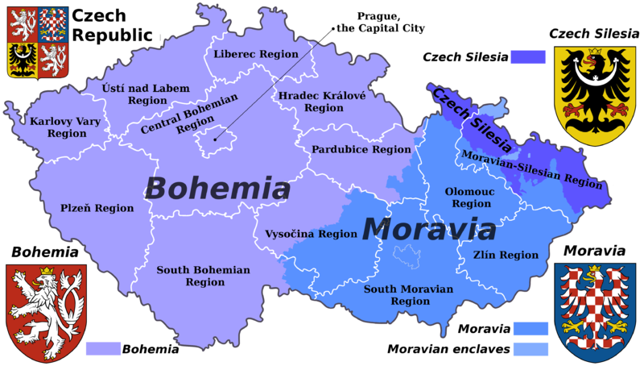
The areas and addministrative divisions
Zdroj: [cit2014-04-14]. Dostupný pod licencí Creative Commons Attribution-Share Alike 3.0 Unported
http://upload.wikimedia.org/wikipedia/commons/thumb/2/23/Czech_Rep._-_Bohemia%2C_Moravia_and_Silesia_III_%28en%29.png/800px-Czech_Rep._-_Bohemia%2C_Moravia_and_Silesia_III_%28en%29.png

Slide 5
MOUNTAINS AND HIGHLANDS
Bohemian mountains surround the whole area:
The Krkonoše range (in the north)
The Šumava range (in the south)
The Krušné hory mountains (in the west)
The Jizerské hory mountains (in the north)
The Orlické hory mountains (in the north)
The Vysočina highlands (central east)
The highest mounatain of Bohemia – Sněžka (1603m)

Slide 6
MOUNTAINS AND HIGHLANDS II
Moravia is covered with mountains and hills:
The Moravian-Silesian Beskydy range (in the east)
The Jeseníky range (in the north)
The Rychlebské hory (in the north)
The Drahanská vrchovina highlands (central Moravia)
The highest Moravian summit – Praděd Mt. (1492 m)

Slide 7
LOWLANDS
Lowlands and basins are found both in Bohemia and Moravia.
Bohemia:
The Elbe basin – drained by the river Elbe (central Bohemia)
Moravia:
The Hornomoravský Úval lowlands (central Moravia)
The Dolnomoravský Úval lowlands (southern Moravia)

Slide 8
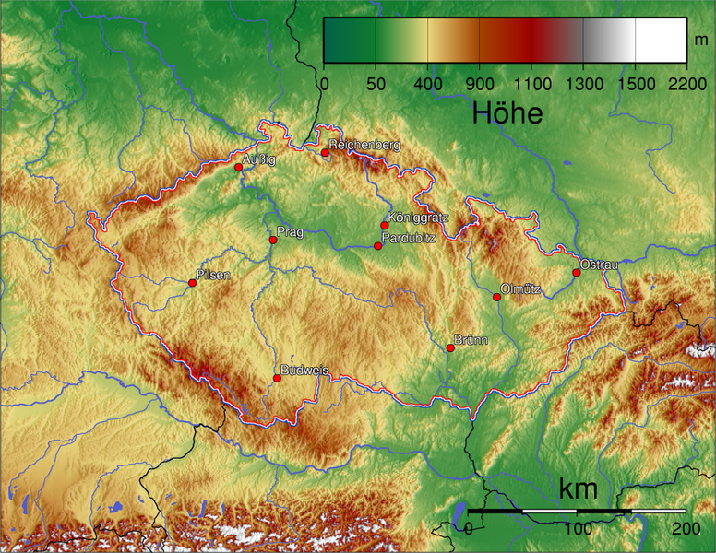
The relief of the Czech Republic
Zdroj: [cit2014-04-14]. Dostupný pod licencí Creative Commons Uveďte autora-Zachovejte licenci 3.0 Unported
http://upload.wikimedia.org/wikipedia/commons/thumb/0/08/Tschechien_topo.png/776px-Tschechien_topo.png

Slide 9
RIVERS, LAKES, PONDS
The Czech Republic abounds many sources of fresh water – rivers, lakes, ponds and dams.
The water from the landlocked country flows into 3 differnt seas – the North Sea
- the Baltic Sea
-the Black Sea

Slide 10
Rivers
Bohemia is drained mainly by the Vltava river (the Moldau), the Labe river (The Elbe) and their inflows and tributories.
The Vltava river - starts in The Šumava range,
-flows from the south to the north of Bohemia,
- is 430 km long
- tributories are: the Otava river, the Malše river, the Berounka river, the Sázava river

Slide 11
The Labe river
- starts in the Krkonoše mts.
- flows into the North Sea in Germany
- is 1554 km long (359km in the CR)
- tributories: the Metuje river, the Orlice river, the Ohře river, the Bílina river
Moravia is drained by the Morava river, the Odra river and others.
The Morava river
- springs in the Kralický Sněžník mountains
- flows from the north to the south of the area into the Danube riveris
- is 354 km long ( 284 km in Moravia)
- tributories: The Bečva river, the Dyje river

Slide 12
Lakes
There are not many natural lakes,they are mainly tarns in the Šumava range – the largest is the Black Lake.
Characteristic feature of the Czech landscape is the large number of man-made lakes created for fish-farming. There are 21,800 fishponds and cover about 41,000 hectares. The largest of them are Lake Rozmberk and Lake Bezdrev in southern Bohemia.

Slide 13
The Vltava-Labe confluence near Mělník
Zdroj: [cit2014-04-14]. Dostupný pod licencí Creative CommonsAktron / Wikimedia Commons. Attribution-Share Alike 3.0 Unported
http://upload.wikimedia.org/wikipedia/commons/thumb/a/a7/M%C4%9Bln%C3%ADk%2C_Vltava_a_later%C3%A1ln%C3%AD_kan%C3%A1l_%C3%BAst%C3%AD_v_Labi.JPG/800px-M%C4%9Bln%C3%ADk%2C_Vltava_a_later%C3%A1ln%C3%AD_kan%C3%A1l_%C3%BAst%C3%AD_v_Labi.JPG

Slide 14
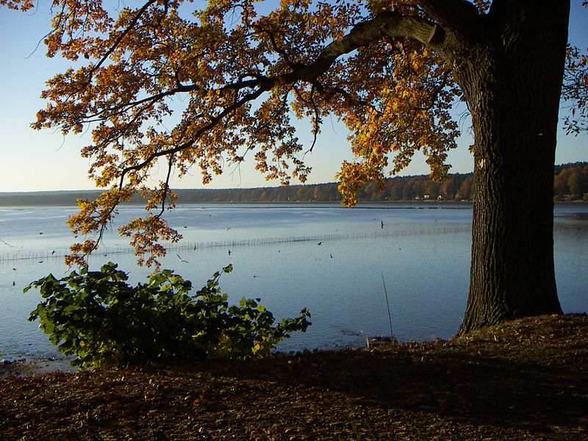
Bezdrev fishpond, Southern Bohemia
Zdroj: [cit2014-04-14]. Dostupný pod licencí public domain na WWW:
http://upload.wikimedia.org/wikipedia/commons/thumb/1/12/Bezdrev_in_October.jpg/800px-Bezdrev_in_October.jpg

Slide 15
Climate
Continental climate – hot summers, could,cloudy snowy winters
The coldest month – January
Average winter temperature – 0 degrees
The hottest month – July
Average summer temperature – 20 degrees
Average annual temerature – 5 – 9 degrees
The dries month – January
The wettest months – June, July

Slide 16
QUESTIONS
1 How many administrative areas is the CR devided into?
2 What is the highest peak in the CR?
a) Sněžka Mt.
b) Praděd Mt.
3 Name the longest river in the CR
4 Which area of the country is known for the fish-farming?

Slide 17
ANSWER KEY
1 – 14
2 – a)
3 – the Vlatava river
4 – Southern Bohemia

Slide 18
SOURCES
EL-HMOUDOVÁ, Dagmar. Angličtina - Maturitní témata. Český Těšín: Petra Velanová, Třebíč, 2006, ISBN 9788086873046.
Wikipedie [online]. 2014, [cit. 2014-04-14]. Dostupné z: http://en.wikipedia.org/wiki/Geography_of_the_Czech_Republic

