Slide 1
Název | Australia – Culture, Literature, Holidays
Předmět, ročník | Seminář z anglického jazyka, septima
Tematická oblast | Reálie anglicky mluvících zemí I.
Anotace | Jedná se o prezentaci s výkladem, obrázky a úkoly.
Klíčová slova | Aboriginal art, boomerang, language, literature, holidays.
Autor | Mgr. Lucie Babišová
Datum | 6. 5. 2013
Škola | Gymnázium Jana Opletala, Litovel, Opletalova 189
Projekt | EU peníze středním školám, reg. č.: CZ.1.07/1.5.00/34.0221

Slide 2
Aboriginal Culture
Aboriginals - the original inhabitants of the Australian continent and nearby islands
more than 250 languages spoken by Indigenous Australians prior to the arrival of Europeans, most of these are now extinct, with only about fifteen languages still being spoken
unique musical instruments and folk styles (the didgeridoo, the clapping sticks)
a tradition of Aboriginal art which is thousands of years old, the best known forms being rock art and bark painting
thraditional tools and weapones: the boomerang

Slide 3
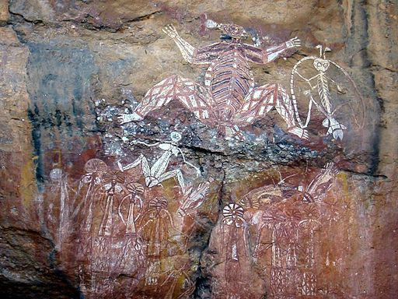
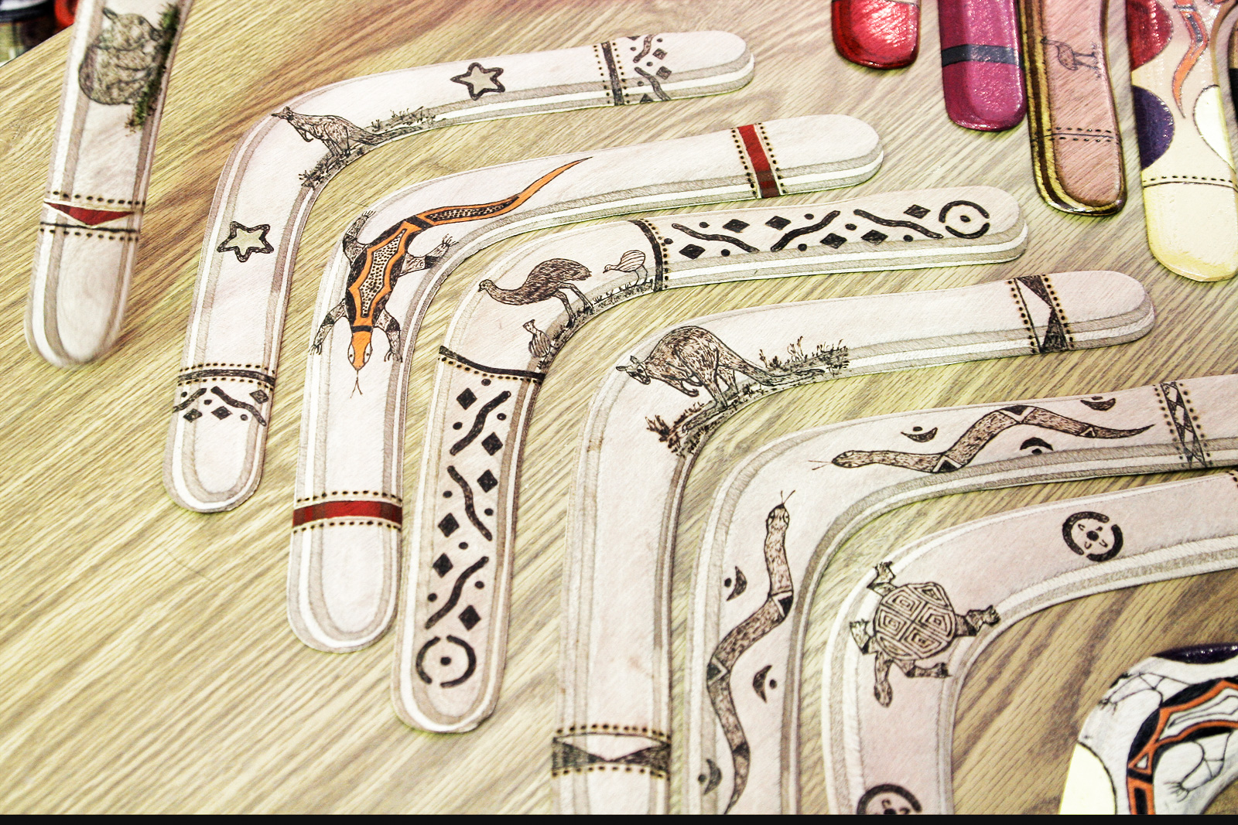
Aboriginal Culture
Zdroj: [cit. 2013-05-06]. Dostupný pod licencí Creative Commons na WWW:
http://commons.wikimedia.org/wiki/File:Aboriginal_Art_Australia(2).jpg?uselang=cs
Zdroj: [cit. 2013-05-06]. Dostupný pod licencí Creative Commons na WWW:
http://commons.wikimedia.org/wiki/File:Boomerangs_-_melbourne_show_2005.jpg?uselang=cs

Slide 4
Literature
the narrative art of Australian writers has, since 1788, introduced the character of a new continent into literature - exploring such themes as Aboriginality, democracy, national identity, migration, etc.
notable Australian writers have included the novelists Patrick White (Nobel Prize in Literature in 1973), Colleen McCullough (The Thorn Birds), etc., bush poets and playwrights as well

Slide 5
Holidays
Australia Day (26th January)
celebrated to remember the day the first British ships came to the country in 1788
Anzac Day (the end of April)
to rememeber Australian soldiers killed in WWI and WWII

Slide 6
Questions
What is the traditional Aboriginal musical instrument called?
What id the name of the weapon used by Aboriginal warriors?
Why is Australia Day celebrated?

Slide 7
Answer Key
The didgeridoo.
The Boomerang.
To celebrate the arrival of the forst British ships to Australia.

Slide 8
Source
BELÁN, Juraj. Odmaturuj! z anglického jazyka. Vyd. 1. Brno: Didaktis, 2005, 256 s. Odmaturuj!. ISBN 80-735-8024-1.
BRENDLOVÁ, Světla. Reálie anglicky mluvících zemí. 2., dopl. vyd. Plzeň: Fraus, c1996, 79 s. ISBN 80-857-8487-4.
EL-HMOUDOVÁ, Dagmar. Angličtina pro střední školy. 1. vyd. Třebíč: Petra Velanová, 2006. ISBN 80-868-7302-1.
KEMPTON, Grant. New opportunities UK/US: workbook. Vyd. 1. Harlow: Pearson Education Limited, 2006, 256 s. Odmaturuj!. ISBN 978-140-5829-441.
KEMPTON, Grant. New opportunities UK/US: workbook. Vyd. 1. Harlow: Pearson Education Limited, 2006, 256 s. Odmaturuj!. ISBN 978-0-582-84791-0.

