Slide 1
Název | Australia - History
Předmět, ročník | Seminář z anglického jazyka, septima
Tematická oblast | Reálie anglicky mluvících zemí I.
Anotace | Jedná se o prezentaci s výkladem, obrázky a úkoly.
Klíčová slova | Aboriginals, Commonwealth, settlers, explore, penal colony.
Autor | Mgr. Lucie Babišová
Datum | 5. 5. 2013
Škola | Gymnázium Jana Opletala, Litovel, Opletalova 189
Projekt | EU peníze středním školám, reg. č.: CZ.1.07/1.5.00/34.0221

Slide 2
Australia – Early History
the first settlers came from Eastern Polynesia in AD 800 (the ancestors of Aborigines and Torres Straight Islanders – the natives with different cultures and languages)
discovered by the Dutch in the 17th century – Abel Tasman (as well as NZ) – later Captain James Cook explored the islands close to the continent and in 1770 landed in Botany Bay near Sydney, who claimed the country for Britain
the new settlers disrupted the lifestyle of the indigenous (native) people and many died of new illnesses

Slide 3
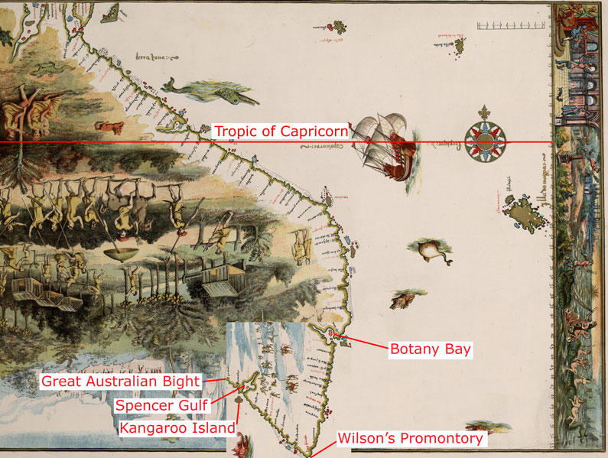
Botany Bay
Zdroj: [cit. 2013-05-05]. Dostupný pod licencí public domain na WWW:
http://commons.wikimedia.org/wiki/File:Vallard_map_rotated.jpg

Slide 4
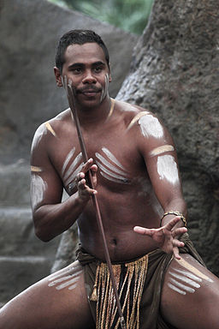
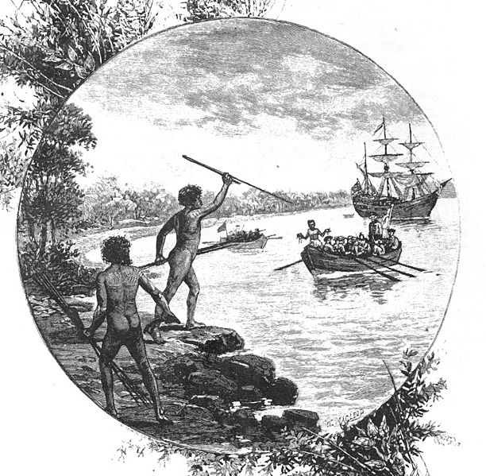
Aboriginals
Zdroj: [cit. 2013-05-05]. Dostupný pod licencí Creative Commons na WWW:
http://commons.wikimedia.org/wiki/File:Boomerangs_-_melbourne_show_2005.jpg?uselang=cs
Zdroj: [cit. 2013-05-05]. Dostupný pod licencí Creative Commons na WWW:
http://commons.wikimedia.org/wiki/File:Indig2.jpg?uselang=cs

Slide 5
The British in Australia
the settlement of Australia began on 26th January (Australia Day) 1788, with the arrival of about 1,000 colonists from Britain (750 of them were convicts)
the British decided to use the new country as a penal colony (they wouold keep prisoners there)
thousands of men and women were brought to Australia as prisoners until 1868
in 1901, the Commonwealth of Australia was founded and the six colonies federated as sovereign states (it is still a member of the British Commonwealth of Nations – a free association of formal British colonies under one monarch)

Slide 6
Questions
The native people of NZ are called:
Aborans b) Ankoraginals c) Aboriginals
Who was the first European to discover New Zealand?
.............. claimed Australia as British territory.
Abel Cook b) James Cook c) Thomas Cook
4. Australia declared its independence in ....... .

Slide 7
Answer Key
c).
The Dutch – Abel Tasman
b).
1901.

Slide 8
Source
BELÁN, Juraj. Odmaturuj! z anglického jazyka. Vyd. 1. Brno: Didaktis, 2005, 256 s. Odmaturuj!. ISBN 80-735-8024-1.
BRENDLOVÁ, Světla. Reálie anglicky mluvících zemí. 2., dopl. vyd. Plzeň: Fraus, c1996, 79 s. ISBN 80-857-8487-4.
EL-HMOUDOVÁ, Dagmar. Angličtina pro střední školy. 1. vyd. Třebíč: Petra Velanová, 2006. ISBN 80-868-7302-1.
KEMPTON, Grant. New opportunities UK/US: workbook. Vyd. 1. Harlow: Pearson Education Limited, 2006, 256 s. Odmaturuj!. ISBN 978-140-5829-441.
KEMPTON, Grant. New opportunities UK/US: workbook. Vyd. 1. Harlow: Pearson Education Limited, 2006, 256 s. Odmaturuj!. ISBN 978-0-582-84791-0.

