Slide 1
Název | Australia – Geography, Economy
Předmět, ročník | Seminář z anglického jazyka, septima
Tematická oblast | Reálie anglicky mluvících zemí I.
Anotace | Jedná se o prezentaci s výkladem, obrázky a úkoly.
Klíčová slova | Location, climate, mountain, river, desert, animal, export.
Autor | Mgr. Lucie Babišová
Datum | 4. 5. 2013
Škola | Gymnázium Jana Opletala, Litovel, Opletalova 189
Projekt | EU peníze středním školám, reg. č.: CZ.1.07/1.5.00/34.0221

Slide 2
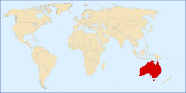
Geography - Location
located between the Indian and the Southern Pacific Ocean
the smalles continent in the world, but the biggest island in the world and the sixth largest state
Zdroj: [cit. 2013-05-04]. Dostupný pod licencí Creative Commons na WWW:
http://commons.wikimedia.org/wiki/File%3ALocationAU.svg

Slide 3
Climate
it is quite different from the rest of the world
because of it size it has many different climates
the climate in the north is tropical (there are only two seasons: rainy and dry)
the south is cooler with regular seasons
the winter is mild compared to Europe
it is the driest inhabited continent – the centre of the country has the lowest reinfall rates in the world
70 % of the population live in the south in large cities

Slide 4
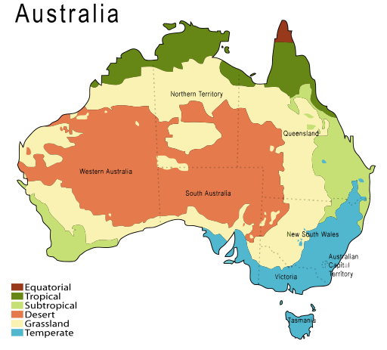
Climate Map
Zdroj: [cit. 2013-05-04]. Dostupný pod licencí Creative Commons na WWW:
http://commons.wikimedia.org/wiki/File%3AAustralia-climate-map_MJC01_1.svg

Slide 5
Basic geographical facts
The longest river: the Murray
The highest mountain: Mount Kosciusko (2,228 m) – discovered by a Polish scientist
Deserts: The Great Sandy Desert and the Great Victoria Desert – red, orange and brown and strange rocks can be found there: Ayers Rock/Uluru – the largest piece of rock in the world
Mountain ranges: the Australian Alps

Slide 6
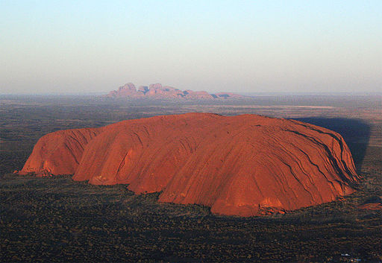
Ayers Rock/Uluru
Zdroj: [cit. 2013-05-04]. Dostupný pod licencí public domain na WWW:
http://commons.wikimedia.org/wiki/File%3AUluruClip3ArtC1941.jpg

Slide 7
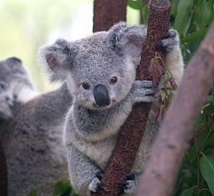
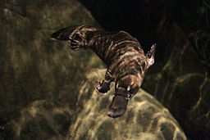
Unusual Animals
isolation and distance give Australia ist special character, including the unique animal species: the kangaroo, the koala bear, the emu, the platypus, the wombat
Zdroj koala: [cit. 2013-05-04]. Dostupný pod licencí Creative Commons na WWW:
http://commons.wikimedia.org/wiki/File%3ACutest_Koala.jpg
Zdroj platypus: [cit. 2013-05-04]. Dostupný pod licencí Creative Commons na WWW:
http://commons.wikimedia.org/wiki/File%3A%E6%B0%B4%E4%B8%AD%E3%81%A7%E6%B3%B3%E3%81%90%E3%82%AB%E3%83%A2%E3%83%8E%E3%83%8F%E3%82%B7.JPG

Slide 8
Economy
a rich counry in iron ore, oil, natural gass and coal
rich also in gold, silver and other precious metals
the greatest producer of wool in the world
other exports: wheat, beef and vine

Slide 9
Questions
Australia is:
a continent b) an island c) both
What is the largest piece of rock in the world called?
What is the weather like in the north of Australia?
Wombat is an Australia:
a) aboriginal b) animal c) kind of boat d) holy place

Slide 10
Answer Key
c).
The Ayers Rock/Uluru
Its climate is tropical, the weather is hot, there are no regular seasons of the year.
b).

Slide 11
Source
BELÁN, Juraj. Odmaturuj! z anglického jazyka. Vyd. 1. Brno: Didaktis, 2005, 256 s. Odmaturuj!. ISBN 80-735-8024-1.
BRENDLOVÁ, Světla. Reálie anglicky mluvících zemí. 2., dopl. vyd. Plzeň: Fraus, c1996, 79 s. ISBN 80-857-8487-4.
EL-HMOUDOVÁ, Dagmar. Angličtina pro střední školy. 1. vyd. Třebíč: Petra Velanová, 2006. ISBN 80-868-7302-1.
KEMPTON, Grant. New opportunities UK/US: workbook. Vyd. 1. Harlow: Pearson Education Limited, 2006, 256 s. Odmaturuj!. ISBN 978-140-5829-441.
KEMPTON, Grant. New opportunities UK/US: workbook. Vyd. 1. Harlow: Pearson Education Limited, 2006, 256 s. Odmaturuj!. ISBN 978-0-582-84791-0.

