Slide 1
Název | Australia – Basic facts
Předmět, ročník | Seminář z anglického jazyka, septima
Tematická oblast | Reálie anglicky mluvících zemí I.
Anotace | Jedná se o prezentaci s výkladem, obrázky a úkoly.
Klíčová slova | Area, population, capital, political system, population, flag.
Autor | Mgr. Lucie Babišová
Datum | 2. 5. 2013
Škola | Gymnázium Jana Opletala, Litovel, Opletalova 189
Projekt | EU peníze středním školám, reg. č.: CZ.1.07/1.5.00/34.0221

Slide 2
Australia – Basic facts
The official name: The Commonwealth of Australia
Total area: 7,686,850 sq km
Population: 20 million
Capital: Canberra
Major cities: Sydney, Melbourne, Brisbane, Perth
Nickname: Oz (Aussie is a nickname for an Australian)
Flag: dark blue, with the Union Jack (the flag of the UK) in the upper left hand corner and a seven pointed star known as the Commonwealth Star, which represents the federation of colonoie of Australia in 1901 in the lower lef hand corner. The rest of the flag is the Souther Cross constelation (can only be seen in the southern hemisphere)

Slide 3
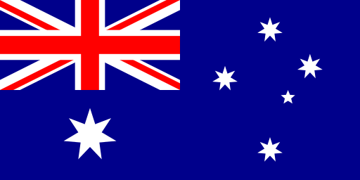
The Flag
Zdroj: [cit. 2013-05-02]. Dostupný pod licencí public domain na WWW:
http://commons.wikimedia.org/wiki/File%3AFlag_of_Australia.svg

Slide 4
Government
constitutional monarchy – Britsih monarch is still the official head of the country
in practice: the head of the country is the governor-general
a federal state consisting of six states and two territories: Western Australia, Queensland, New South Wales, Victoria, South Australia, Tasmania, Northern Territory and Australian Capital Territory
each state has its own government and its own capital city

Slide 5
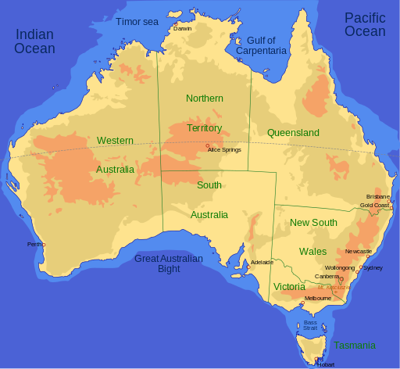
Map
Zdroj: [cit. 2013-05-02]. Dostupný pod licencí creative commons na WWW
http://commons.wikimedia.org/wiki/File%3AAustralia_map_(English).svg

Slide 6
Questions
The full name of the country known as Austalia is:
a) The Australian Union b) The Republic of Australia c) The United States of Australia d) The Commonwealth of Australia
What is the capital of Australia?
What is the nickname of Australi?
Which of the following is not an Australian state?
a) New South Wales b) Nova Scotia c) Queensland d) Tasmania

Slide 7
Answer Key
d.
Canberra
Oz
b.

Slide 8
Source
BELÁN, Juraj. Odmaturuj! z anglického jazyka. Vyd. 1. Brno: Didaktis, 2005, 256 s. Odmaturuj!. ISBN 80-735-8024-1.
BRENDLOVÁ, Světla. Reálie anglicky mluvících zemí. 2., dopl. vyd. Plzeň: Fraus, c1996, 79 s. ISBN 80-857-8487-4.
EL-HMOUDOVÁ, Dagmar. Angličtina pro střední školy. 1. vyd. Třebíč: Petra Velanová, 2006. ISBN 80-868-7302-1.
KEMPTON, Grant. New opportunities UK/US: workbook. Vyd. 1. Harlow: Pearson Education Limited, 2006, 256 s. Odmaturuj!. ISBN 978-140-5829-441.
KEMPTON, Grant. New opportunities UK/US: workbook. Vyd. 1. Harlow: Pearson Education Limited, 2006, 256 s. Odmaturuj!. ISBN 978-0-582-84791-0.

