Slide 1
Název | New Zealand
Předmět, ročník | Seminář z anglického jazyka, septima
Tematická oblast | Reálie anglicky mluvících zemí I.
Anotace | Jedná se o prezentaci s výkladem, obrázky a úkoly.
Klíčová slova | Basic facts, population, political system, holidays, capital, location, flag, history.
Autor | Mgr. Lucie Babišová
Datum | 17. 4. 2013
Škola | Gymnázium Jana Opletala, Litovel, Opletalova 189
Projekt | EU peníze středním školám, reg. č.: CZ.1.07/1.5.00/34.0221

Slide 2
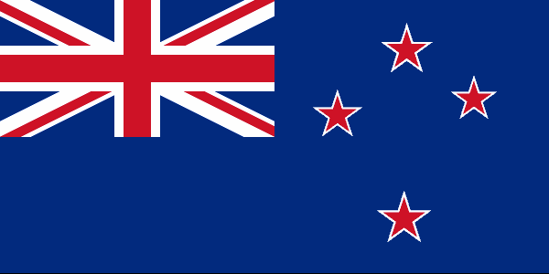
New Zealand -Basic Facts
Total area: 268,680 sq km
Population: 4 million
Capital: Welligton
Major cities: Aukland, Hamilton, Christchurch
Flag: dark blue with the Union Jack (flag of the UK) and the Southern Cross
Zdroj: [cit. 2013-04-17]. Dostupný pod licencí Creative Commons na WWW:
http://commons.wikimedia.org/wiki/File%3ANew_zealand_flag_300.png

Slide 3
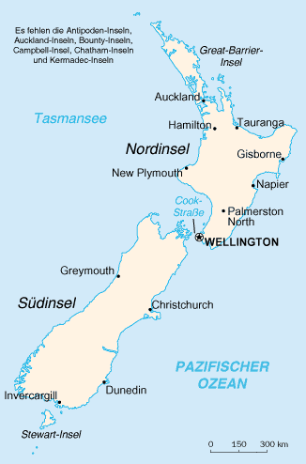
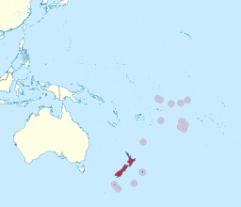
Location
New Zealand consists of two large islands (the North Island and the South Island) and numerous small islands
situated in the South Pacific Ocean, south-east of Australia
Zdroj south pacific: [cit. 2013-04-17]. Dostupný pod licencí creative commons na WWW:
http://commons.wikimedia.org/wiki/File%3ANew_Zealand_in_Oceania_(%2Ball_territories_%2Bhighlighted)_(-mini_map_-rivers).svg
Zdroj New Zealand: [cit. 2013-04-17]. Dostupný pod licencí public domain na WWW:
http://commons.wikimedia.org/wiki/File%3ANew_zealand_map.png

Slide 4
Geography
both island are famous for beautiful sceneries
the majority of people live in the North Island because of its mild climate
the North Island – volcanic areas, many lakes
the South Island – the Souther Alps with the hisghest montain Mount Cook (3,764m), glaciers

Slide 5
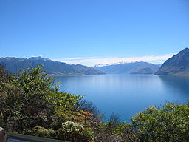
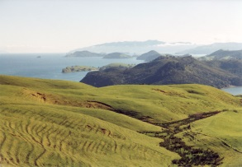
NZ: Nature
Zdroj Lake Hawea: [cit. 2013-04-17]. Dostupný pod licencí public domain na WWW:
http://commons.wikimedia.org/wiki/File%3ALake_Hawea%2C_New_Zealand.jpg
Zdroj peninsula : [cit. 2013-04-17]. Dostupný pod licencí Creative Commons na WWW:
http://commons.wikimedia.org/wiki/File:Coromandel_Peninsula.jpg

Slide 6
Political System
constitutional monarchy – Britsih monarch is still the official head of the country
in practice: the head of the country is the governor-general
legislative power – the single-chamber House of Representatices (parliament)

Slide 7
History
the first settlers came from Eastern Polynesia in AD 800 (the ancestors of Maori population – the natives)
the firts European : a Dutch sailor, Abel Tasman, in 1642 (but it was James Cook who explored the islands)
Great Britain took control of the islands by the right of discovery, the Maori were promised protection (→war between the Maori and the British – the resistance crushed by 1870)
New Zealand became formally independent from Britain in 1947 (it is still a member of the Commonwealth)

Slide 8
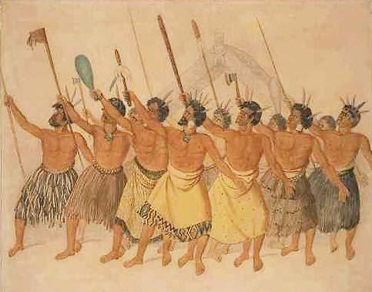
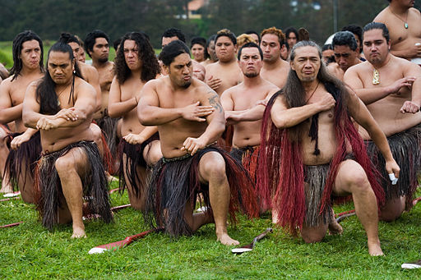
The Maori
Zdroj Maori painting: [cit. 2013-04-17]. Dostupný pod licencí public domain na WWW:
http://commons.wikimedia.org/wiki/File%3ADanceMaori.jpg
Zdroj Maori dancers: [cit. 2013-04-17]. Dostupný pod licencí Creative Commons na WWW:
http://commons.wikimedia.org/wiki/File%3ANew_Zealand_-_Maori_rowing_-_8452.jpg

Slide 9
Holidays
Anzac Day (25 April)
a holiday to honour those New Zealanders who were killed in the two world wars
values such as courage, self-sacrifice and loyality are celebrated

Slide 10
Questions
What is the capital of New Zealand?
Who is the official head of the state?
The native people of NZ are called:
Mamburi b) Menori c) Maori
4. Who was the first European to discover New Zealand?

Slide 11
Answer Key
Wellington
the British monarch
c)
a Dutch sailor, Abel Tasman

Slide 12
Source
BELÁN, Juraj. Odmaturuj! z anglického jazyka. Vyd. 1. Brno: Didaktis, 2005, 256 s. Odmaturuj!. ISBN 80-735-8024-1.
BRENDLOVÁ, Světla. Reálie anglicky mluvících zemí. 2., dopl. vyd. Plzeň: Fraus, c1996, 79 s. ISBN 80-857-8487-4.
EL-HMOUDOVÁ, Dagmar. Angličtina pro střední školy. 1. vyd. Třebíč: Petra Velanová, 2006. ISBN 80-868-7302-1.
KEMPTON, Grant. New opportunities UK/US: workbook. Vyd. 1. Harlow: Pearson Education Limited, 2006, 256 s. Odmaturuj!. ISBN 978-140-5829-441.
KEMPTON, Grant. New opportunities UK/US: workbook. Vyd. 1. Harlow: Pearson Education Limited, 2006, 256 s. Odmaturuj!. ISBN 978-0-582-84791-0.

