Slide 1
Název | The Republic of Ireland – Places of Interest
Předmět, ročník | Seminář z anglického jazyka, septima
Tematická oblast | Reálie anglicky mluvících zemí I.
Anotace | Jedná se o prezentaci s výkladem, obrázky a úkoly.
Klíčová slova | Place of interest, monuments, castle, weather, catherdral, spire.
Autor | Mgr. Lucie Babišová
Datum | 12. 4. 2013
Škola | Gymnázium Jana Opletala, Litovel, Opletalova 189
Projekt | EU peníze středním školám, reg. č.: CZ.1.07/1.5.00/34.0221

Slide 2
Emerald Isle
Ireland is often called the Emerald Isle
emeralds are beautiful green jewels
isle is a poetic word for island
→ thus Ireland is the Beautiful Green Island
one of the greenest places in the world (green grass all year round)
the weather is affected by the Gulf Stream – a lot of rain, mild winters (palm trees)

Slide 3
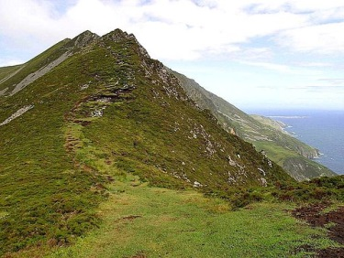
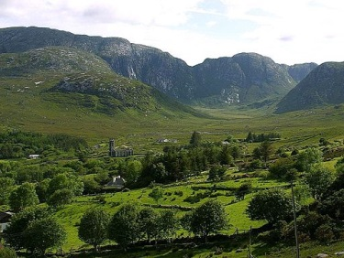
Landscape
Zdroj cliff: [cit. 2013-04-12]. Dostupný pod licencí public domain na WWW:
http://commons.wikimedia.org/wiki/File%3AGreen_cliffs_in_Ireland.jpg
Zdroj mountain: [cit. 2013-04-12]. Dostupný pod licencí public domain na WWW:
http://commons.wikimedia.org/wiki/File%3ADunlewy_mountains_Ireland.jpg

Slide 4
Places of Interest
Dublin
the capital (0,5 million citizens)
the name means „Dark Pool“
famous for its castle, Christ Church Cathedral and St Patrick's Cathedral
Trinity College - the Book of Kells in its library (an illustrated manuscript created by Irish monks around 800 AD)
modern architecture - Spire of Dublin, or officially titled "Monument of Light„ (a 121.2 metres conical spire made of stainless steel)

Slide 5
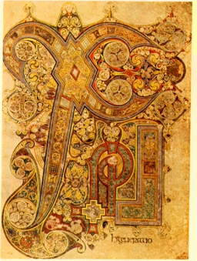
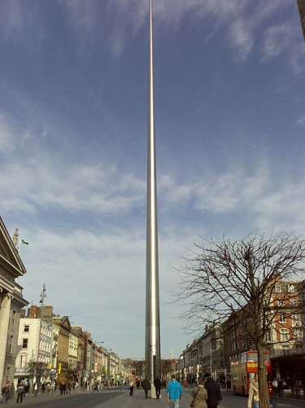
The Book of Kells/Spire of Dublin
Zdroj the book of kells: [cit. 2013-04-12]. Dostupný pod licencí public domain na WWW:
http://commons.wikimedia.org/wiki/File%3ABook_of_Kells_ChiRho_Folio_34R.png
Zdroj spire of Dublin: [cit. 2013-04-12]. Dostupný pod licencí Creative Commons na WWW:
http://commons.wikimedia.org/wiki/File%3ASpire_of_Dublin_in_the_morning.jpg

Slide 6
Places of Interest
Cork
the symbol of the city - the church tower of Shandon
Limerick
cultural city
famous for King John's Castle (1212) and St Mary's Cathedral

Slide 7
Questions
What is the nickname of the Irish Island?
Why is the weather in Ireland hot and rainy?
What is the name of the famous modern architecture piece in Dublin?
What are other places in Ireland or places you can vist?

Slide 8
Answer Key
Ireland is often called the Emeral Isle.
The weather is affected by the Gulf Stream.
The Spire of Dublin.
Other places that are popular among tourists are Cork, Limerick and mountains.

Slide 9
Source
BELÁN, Juraj. Odmaturuj! z anglického jazyka. Vyd. 1. Brno: Didaktis, 2005, 256 s. Odmaturuj!. ISBN 80-735-8024-1.
BRENDLOVÁ, Světla. Reálie anglicky mluvících zemí. 2., dopl. vyd. Plzeň: Fraus, c1996, 79 s. ISBN 80-857-8487-4.
EL-HMOUDOVÁ, Dagmar. Angličtina pro střední školy. 1. vyd. Třebíč: Petra Velanová, 2006. ISBN 80-868-7302-1.
KEMPTON, Grant. New opportunities UK/US: workbook. Vyd. 1. Harlow: Pearson Education Limited, 2006, 256 s. Odmaturuj!. ISBN 978-140-5829-441.
KEMPTON, Grant. New opportunities UK/US: workbook. Vyd. 1. Harlow: Pearson Education Limited, 2006, 256 s. Odmaturuj!. ISBN 978-0-582-84791-0.

