Slide 1
Název | The Republic of Ireland
Předmět, ročník | Seminář z anglického jazyka, septima
Tematická oblast | Reálie anglicky mluvících zemí I.
Anotace | Jedná se o prezentaci s výkladem, obrázky a úkoly.
Klíčová slova | Basic fatcts, population, officila name/language, popitical structure, economy, history, flag, national symbol.
Autor | Mgr. Lucie Babišová
Datum | 10. 4. 2013
Škola | Gymnázium Jana Opletala, Litovel, Opletalova 189
Projekt | EU peníze středním školám, reg. č.: CZ.1.07/1.5.00/34.0221

Slide 2
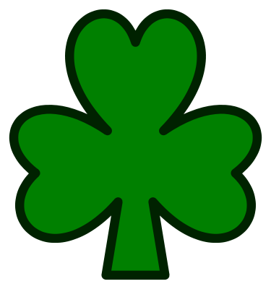
Ireland – Basic Facts
The official name: The Republic of Ireland
Area: 70,280 sq km
Capital: Dublin
Major cities: Cork, Limerick, Galway
Population: 4 million
Official language: Irish and English
Political structure: Parlimentary republic
The Heas of the State: president
National symbols: the harph and the shamrock
Zdroj: [cit. 2013-04-10]. Dostupný pod licencí Creative Commons na WWW:
http://commons.wikimedia.org/wiki/File:Shamrock.svg

Slide 3
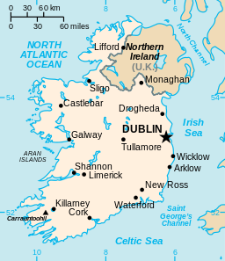
Location
an island lying west of Britain, separated from Britain by the Irish Sea
politicaly devided into the Republic of Ireland (a sovereign state) and Northern Ireland (a part of the UK)
Zdroj: [cit. 2013-04-10]. Dostupný pod licencí public domain na WWW:
http://commons.wikimedia.org/wiki/File%3AEi-map.svg

Slide 4
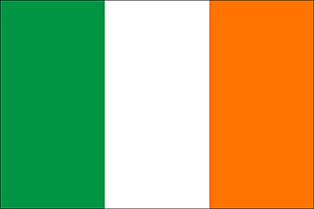
The Flag
consists of three equal stripes representing the Irish Catholics (green stripe), the Irish Protestants (orange stripe), and peace between them (white stripe)
the orange colour is associated with the king William of Orange whose victory in the 17th century secured Protestant dominance over the island
green symbolizes the mostly green landscape of Ireland, but also Irish nationalism
Zdroj: [cit. 2013-04-10]. Dostupný pod licencí Creative Commons na WWW:
http://commons.wikimedia.org/wiki/File%3AIreland_flag.gif

Slide 5
History
Ireland was originally inhabited by the Celts. St. Patrick brought them Christianity in the 5th cent. (patron saint of Ireland)
Normans from England moved to Ireland, in the 12th cent., imposing English law on Ireland – a long series of revolts were crushed
in the Early Rising n April 1916, the nationalists proclaimed independence, but the revolt was suppressed by the British army
an independent Irish state was established in 1921 but the six nothern countries remained a part of the UK – the struggles between the Catholics and the pro-British Protestants continued untill the Good Friday Agreement was signed in 1998

Slide 6
Economy
since joining the EU in 1973 – growth in economy, transformation from a largely agricultural society into a technology-based economy
the economy grew up rapidly in the 1990's so that the state was called the Celtic Tiger

Slide 7
Questions
Decide if the statement below are true (T) or false (F):
The island of Northern Ireland is occupied by the Repulbic of Ireland only.
Dublin is the capital city of the Northern Ireland.
The Catholics and the Protestants lived in peace in one state together.
What are the symbols of the Republic of Ireland.
In what was is the Irish flag symbolic?
Who is the patron saint of Ireland?

Slide 8
Answer Key
a) F, b) F, c) F.
The symbols are the harph and the shamrock.
The flag consists of three equal stripes representing the Irish Catholics (green stripe), the Irish Protestants (orange stripe), and peace between them (white stripe).
St. Patrick (brought Cristianity to Ireland)

Slide 9
Source
BELÁN, Juraj. Odmaturuj! z anglického jazyka. Vyd. 1. Brno: Didaktis, 2005, 256 s. Odmaturuj!. ISBN 80-735-8024-1.
BRENDLOVÁ, Světla. Reálie anglicky mluvících zemí. 2., dopl. vyd. Plzeň: Fraus, c1996, 79 s. ISBN 80-857-8487-4.
EL-HMOUDOVÁ, Dagmar. Angličtina pro střední školy. 1. vyd. Třebíč: Petra Velanová, 2006. ISBN 80-868-7302-1.
KEMPTON, Grant. New opportunities UK/US: workbook. Vyd. 1. Harlow: Pearson Education Limited, 2006, 256 s. Odmaturuj!. ISBN 978-140-5829-441.
KEMPTON, Grant. New opportunities UK/US: workbook. Vyd. 1. Harlow: Pearson Education Limited, 2006, 256 s. Odmaturuj!. ISBN 978-0-582-84791-0.

