Slide 1
Název | The United Kingdom – Holidays and special days
Předmět, ročník | Seminář z anglického jazyka, septima
Tematická oblast | Reálie anglicky mluvících zemí I.
Anotace | Jedná se o prezentaci s výkladem, obrázky a úkoly.
Klíčová slova | Bank holidays, custom, celebration, commemoration, tradition, festival, carols, family.
Autor | Mgr. Lucie Babišová
Datum | 28. 3. 2013
Škola | Gymnázium Jana Opletala, Litovel, Opletalova 189
Projekt | EU peníze středním školám, reg. č.: CZ.1.07/1.5.00/34.0221

Slide 2
The UK – Bank Holidays
in the UK, official days off are called bank holidays – the banks close for a day and so do most bussinesses, offices and services (New Year's Day, Easter, May Day, Christmas Day, Boxing Day)
besides the holidays celebrated in the USA and most countries of the world (New Year's Eve, Easter, St. Valentine's Day, Christmas, etc.), there are some typically „Britsih Holidays“: Guy Fawkes Night, Remebrance Sunday. etc.

Slide 3
The Beginning of the Year
New Year's Day (1 January)
people have parties to see the old year out
in London people go to Trafalgar Square – there is some singing and dancing
in Scotland, celebration of New Year's Eve is called Hogmanay (31 December)
St Valentine's Day (14 January)
people send a card to the one they love

Slide 4
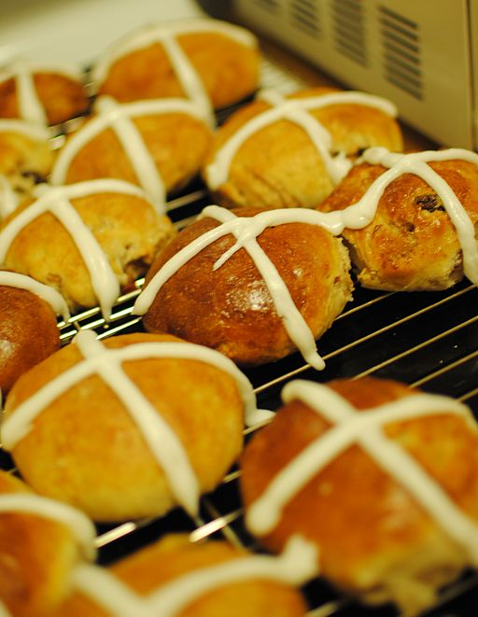
Easter
a movable feast
the British celebrate the idea of new birth giving each other chocolate Easter eggs
Easter Monday is a bank holiday and many people travel to the seaside
on Good Friday, bakes sell hot cross buns, which are toasted and eaten with butter
egg hunts are organised for children
Zdroj: [cit. 2013-03-28]. Dostupný pod licencí Creative Commons na WWW:
http://commons.wikimedia.org/wiki/File%3AHomemade_Hot_Cross_Buns.jpg

Slide 5
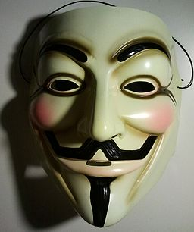
Important Days
May Day (the first Monady in May)
currently celebrated as a festival for children, they dance around the Maypole (in villages)
celebrated also in many European countries
Guy Fawkes Night (Bonfire Night – 5 Nov.)
fireworks and bonfires are burned to celebrate Fawkes' failure in his attempt to blow up the Houses of Parliament on 4 Nov. 1605
Remembrance Day (2nd Sun in November)
honours veterans, red paper poppies are sold
Zdroj guy fawkes mask: [cit. 2013-03-28]. Dostupný pod licencí Creative Commons na WWW:
http://commons.wikimedia.org/wiki/File%3AGuyFawkesMask.jpg

Slide 6
Halloween
means the eve of All Saints' Day or All Hallows Day and takes place on 31st October
more celebrated and important in the USA
people dress up in strange costumes of witches and ghosts and they cut horrible faces into pumpkins (Jack-o'-lantern)
children go around houses and say „trick or treat“ – if you give them a treat they go away, if you don't, they play a trick on you

Slide 7
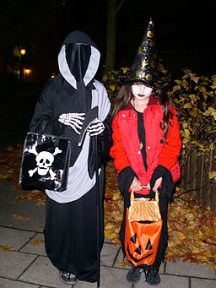
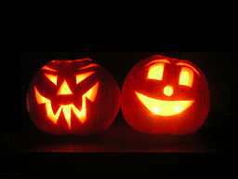
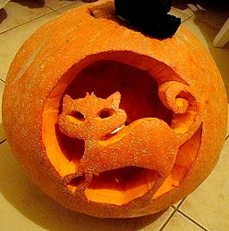
Halloween
Zdroj lanterns: [cit. 2013-03-28]. Dostupný pod licencí Creative Commons na WWW:
http://commons.wikimedia.org/wiki/File%3AJack-o-lantern-FR.JPG
Zdroj cat lantern: [cit. 2013-03-28]. Dostupný pod licencí Creative Commons na WWW:
http://commons.wikimedia.org/wiki/File%3AJack-o'-lantern_in_Sanok.JPG
Zdroj carolers: [cit. 2013-03-28]. Dostupný pod licencí public domainna WWW:
http://commons.wikimedia.org/wiki/File%3ATrick_or_treat_in_sweden.jpeg

Slide 8
Christmas
combines the Christian celebration of the birth of Christ with the traditional festivities of winter
Christmas Eve (24th Dec.) – Father Christmas comes down the chimney and brings the presents (stockings)
Christmas Day (25th Dec.) – families open their presents in the morning and have Christmas dinner (roast turkey, potatoes, vegetables, Christmas pudding, minced pies)
Boxing Day (26 Dec.) – it is still the custom to give some money to the tradesmen – milkmen and dustmen – years ago the money was put into a box
people sing carols (Silent Night, Jingle Bells, etc.) and go to a pantomime

Slide 9
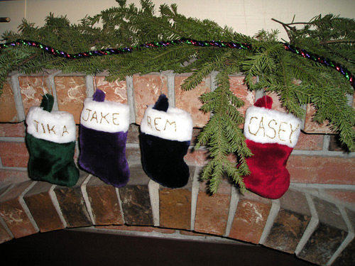
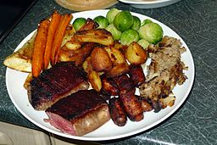
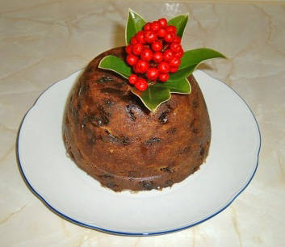
Christmas
Zdroj stockings: [cit. 2013-03-28]. Dostupný pod licencí Creative Commons na WWW:
http://commons.wikimedia.org/wiki/File:ChristmasStockingsHung_wb.jpg
Zdroj dinner: [cit. 2013-03-28]. Dostupný pod licencí Creative Commons na WWW:
http://commons.wikimedia.org/wiki/File%3AChristmas_Lunch_(4213358626).jpg
Zdroj pudding: [cit. 2013-03-28]. Dostupný pod licencí Creative Commons na WWW:
http://commons.wikimedia.org/wiki/File%3AChristmas_pudding.JPG

Slide 10
Other Special Days
Twelfth Night – 6 January
April Fool's Day – 1 April
Mother's Day – 2nd Sun in May
Father's Day – 3rd Sun in June

Slide 11
Questions
The official days off are , in the UK, called ............... (fill the gap).
What is the Scottish name for the New Year's Eve?
Why is Remembrance Day celebrated?
What is the special Halloween pumpkin lantern called?
When do the British open their Christmas presents (what day)?
What do the British eat for Christmas lunch/dinner?

Slide 12
Answer Key
Bank holidays.
Hogmanay.
It is celebrated to honour veterans.
Jack-o'-lantern.
On the 25th of December (Christmas Day).
They have roast turkey, potatoes, vegetables, Christmas pudding, minced pies, etc.

Slide 13
Source
BELÁN, Juraj. Odmaturuj! z anglického jazyka. Vyd. 1. Brno: Didaktis, 2005, 256 s. Odmaturuj!. ISBN 80-735-8024-1.
BRENDLOVÁ, Světla. Reálie anglicky mluvících zemí. 2., dopl. vyd. Plzeň: Fraus, c1996, 79 s. ISBN 80-857-8487-4.
EL-HMOUDOVÁ, Dagmar. Angličtina pro střední školy. 1. vyd. Třebíč: Petra Velanová, 2006. ISBN 80-868-7302-1.
KEMPTON, Grant. New opportunities UK/US: workbook. Vyd. 1. Harlow: Pearson Education Limited, 2006, 256 s. Odmaturuj!. ISBN 978-140-5829-441.
KEMPTON, Grant. New opportunities UK/US: workbook. Vyd. 1. Harlow: Pearson Education Limited, 2006, 256 s. Odmaturuj!. ISBN 978-0-582-84791-0.

