Slide 1
Název | The United Kingdom – Literature
Předmět, ročník | Seminář z anglického jazyka, septima
Tematická oblast | Reálie anglicky mluvících zemí I.
Anotace | Jedná se o prezentaci s výkladem, obrázky a úkoly.
Klíčová slova | Novel, writer, poet, poem, prose, drama, play.
Autor | Mgr. Lucie Babišová
Datum | 27. 3. 2013
Škola | Gymnázium Jana Opletala, Litovel, Opletalova 189
Projekt | EU peníze středním školám, reg. č.: CZ.1.07/1.5.00/34.0221

Slide 2
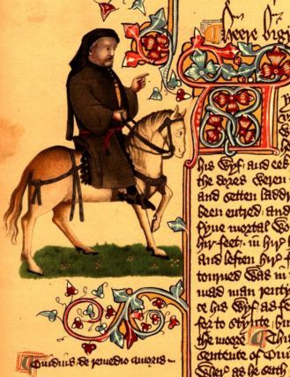
Medieval Literature
Geoffrey Chaucer (1340 – 1400)
considered to be the father of English poetry
Canterbury Tales - conversations of pilgrims on their journey from London to Canterbury
Zdroj: [cit. 2013-03-27]. Dostupný pod licencí public domain na WWW:
http://commons.wikimedia.org/wiki/File:Chaucer_ellesmere.jpg

Slide 3
Renaissance
William Shakespeare (1564 – 1616)
the reign of Queen Elizabeth I. (the Golden Age)
the world's greatest playwright
historical plays – Richard II., Henry V.
comedies – Twelfth Night, As You Like It
traagedies – Romeo and Juliet, Hamlet, Othelo, King Lear, Macbeth
sonnets

Slide 4
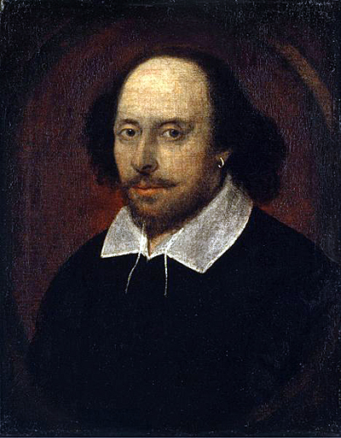
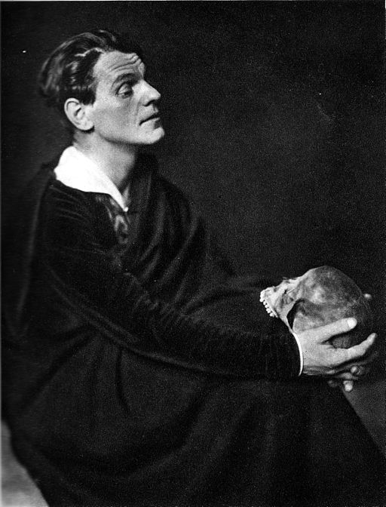
William Shakespeare
Zdroj Shakespeare: [cit. 2013-03-27]. Dostupný pod licencí public domain na WWW:
http://commons.wikimedia.org/wiki/File:William_Shakespeare_Chandos_Portrait.jpg
Zdroj Hamlet: [cit. 2013-03-27]. Dostupný pod licencí public domain na WWW:
http://commons.wikimedia.org/wiki/File%3AAlexander_Moissi_als_Hamlet%2C_Wien_1925%2C_Aufnahme_Kolliner.JPG

Slide 5
The English Revolution and Restoration/18th Literature
John Milton (1608 – 1674)
a famous poet – Paradise Lost - an epic poem
Jonath Swift (1667 – 1745)
Gulliver's Travels – a satire on British society
Daneiel Defoe (1660 – 1731)
Robinson Crusoe – one of the most popular books
Moll Flanders – a realistic picture of a life of a prostitute in London

Slide 6
Romantic Literature
George Gordon Byron (1788 – 1824)
represents „Revolutionary Romantics“
Childe Harold's Pilgrimage
Walter Scott (1771 – 1832)
novels with themes from British history (historical novels)
Wawerly, Ivanhoe, Rob Roy
Mary Shelly (1797 – 1851)
Frankenstein – a well-known Gothic novel

Slide 7
Victorian Novels
Chatlotte Brönte (1816 – 1855)
Jane Eyre
Emily Brönte (1818 – 1848)
Wuthering Heights
Charles Dickens (1812 – 1870)
heroes taken from the hustle and bustle of Victorian London
Oliver Twist, David Copperfield, The Great Expectations

Slide 8
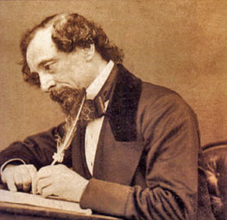
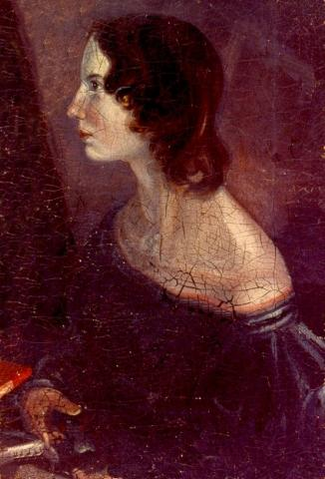
Charles Dickens/Emily Brönte
Zdroj Dickens: [cit. 2013-03-27]. Dostupný pod licencí Creative Commons na WWW:
http://commons.wikimedia.org/wiki/File%3ACharles_Dickens_3.jpg
Zdroj Bronte: [cit. 2013-03-27]. Dostupný pod licencí Creative Commons na WWW:
http://commons.wikimedia.org/wiki/File:Emilybronte_retouche.jpg

Slide 9
Questions
Who is considered to be the father of British poetry?
Name at least two tragedies writen by Shakespeare.
What is the time of Shekespeare called?
Who is the author of novels Moll Flanders and Robinsone Crusoe?
Who is the writer of historical novels?

Slide 10
Answer Key
Geoffrey Chaucer
Hamlet, Othelo, King Lear, Megbeth. etc.
The Golden Age.
Danie Defoe.
Walter Scott.

Slide 11
Source
BELÁN, Juraj. Odmaturuj! z anglického jazyka. Vyd. 1. Brno: Didaktis, 2005, 256 s. Odmaturuj!. ISBN 80-735-8024-1.
BRENDLOVÁ, Světla. Reálie anglicky mluvících zemí. 2., dopl. vyd. Plzeň: Fraus, c1996, 79 s. ISBN 80-857-8487-4.
EL-HMOUDOVÁ, Dagmar. Angličtina pro střední školy. 1. vyd. Třebíč: Petra Velanová, 2006. ISBN 80-868-7302-1.
KEMPTON, Grant. New opportunities UK/US: workbook. Vyd. 1. Harlow: Pearson Education Limited, 2006, 256 s. Odmaturuj!. ISBN 978-140-5829-441.
KEMPTON, Grant. New opportunities UK/US: workbook. Vyd. 1. Harlow: Pearson Education Limited, 2006, 256 s. Odmaturuj!. ISBN 978-0-582-84791-0.

