Slide 1
Název | The United Kingdom – Culture and Art
Předmět, ročník | Seminář z anglického jazyka, septima
Tematická oblast | Reálie anglicky mluvících zemí I.
Anotace | Jedná se o prezentaci s výkladem, obrázky a úkoly.
Klíčová slova | Art, architecture, gallery, festivals, painting, music, sculpture, theatre.
Autor | Mgr. Lucie Babišová
Datum | 29. 3. 2013
Škola | Gymnázium Jana Opletala, Litovel, Opletalova 189
Projekt | EU peníze středním školám, reg. č.: CZ.1.07/1.5.00/34.0221

Slide 2
Cultural Festivals
Edinburgh Festival and the Fringe (May to September)
music, drama (street theatre) and cultural festivals
Glyndebourne Opera Festival (May to August)
in East Sussex
you can have a picnic in the gardens of Glyndebourne during the intervals
Glastonbury Festival (June)
a major contemporary music festival
many musicians and group have played there (Coldplay, Paul McCartney, etc.)

Slide 3
Cultural Festivals in London
The BBC Proms at the Royal Albert Hall (July to September)
one of the world's largest festivals of classical music
'the proms‚ is a colloguial abbreviation for Promenade Concerts
over than 70 concerts
Notting Hill Carnival (the end of August)
bands and parades competitions bring music, rhythm and the colour of the Caribbean and Brail to London

Slide 4
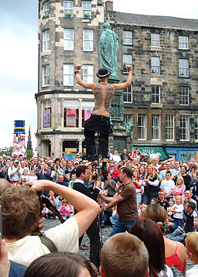
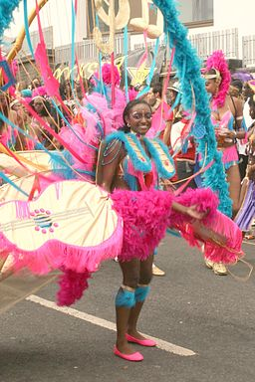
The Fringe/Notting Hill Festival
Zdroj Fringe: [cit. 2013-03-29]. Dostupný pod licencí Creative Commons na WWW:
http://commons.wikimedia.org/wiki/File:Edinburgh_Festival_Fringe_Street_Performer.jpg?uselang=cs
Zdroj Notting Hill Carnival: [cit. 2013-03-29]. Dostupný pod licencí Creative Commons na WWW:
http://commons.wikimedia.org/wiki/File%3ANotting_Hill_Carnival_2008_010.jpg

Slide 5
The UK - Theatres
London's West End
a part of London with more than 50 theatres: The Royal National Theatre, The Royal Court Theatre, The Globe, etc.
musical venues (Cats – the longest running musical – Andrew Lloyd Weber)
Theatre Genedlaethol Cymru
the Welsh language national theatre of Wales
National Theatre of Scotland
has no theatre building, tours to venues (a theatre company)

Slide 6
Art Galleries
National Gallery in London
the gratest collections of in the world, showcasting paintings from Early Renaissance to the Post-impressionists
National Portrait Gallery in London
housing a collection of portraits of historically important and famous British people
Tate Modern in London
a moder art gallery
originally a power station, opened as a gallery in 2000
popul among tourists

Slide 7
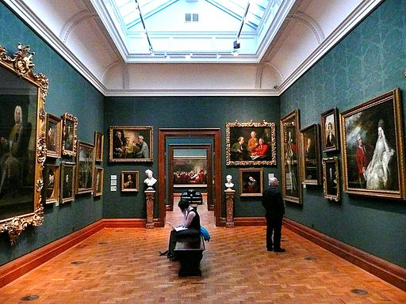
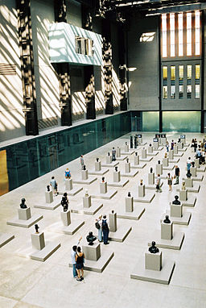
The National Portrait Gallery/Tate Modern
Zdroj: [cit. 2013-03-29]. Dostupný pod licencí Creative Commons na WWW:
http://commons.wikimedia.org/wiki/File:2008_inside_the_National_Portrait_Gallery,_London.jpg?uselang=cs
Zdroj: [cit. 2013-03-29]. Dostupný pod licencí Creative Commons na WWW:
http://commons.wikimedia.org/wiki/File%3ATate_Modern_-_interi%C3%A9r_I._(3._10._2004).JPG

Slide 8
Questions
What is the name of one of the world's largest festivals of classical music held in the UK?
Where can you go to enjoy a contemporary music festival?
What is the name of the part of London with lots of theatres?
East End b) West End c) North End
What is the name of the gallery in London that is placed in a power station?

Slide 9
Answer Key
The BBC Proms at the Royal Albert Hall
In Galstonbury.
b).
Tate Modern

Slide 10
Source
BELÁN, Juraj. Odmaturuj! z anglického jazyka. Vyd. 1. Brno: Didaktis, 2005, 256 s. Odmaturuj!. ISBN 80-735-8024-1.
BRENDLOVÁ, Světla. Reálie anglicky mluvících zemí. 2., dopl. vyd. Plzeň: Fraus, c1996, 79 s. ISBN 80-857-8487-4.
EL-HMOUDOVÁ, Dagmar. Angličtina pro střední školy. 1. vyd. Třebíč: Petra Velanová, 2006. ISBN 80-868-7302-1.
KEMPTON, Grant. New opportunities UK/US: workbook. Vyd. 1. Harlow: Pearson Education Limited, 2006, 256 s. Odmaturuj!. ISBN 978-140-5829-441.
KEMPTON, Grant. New opportunities UK/US: workbook. Vyd. 1. Harlow: Pearson Education Limited, 2006, 256 s. Odmaturuj!. ISBN 978-0-582-84791-0.

