Slide 1
Název | The United Kingdom – Scotland
Předmět, ročník | Seminář z anglického jazyka, septima
Tematická oblast | Reálie anglicky mluvících zemí I.
Anotace | Jedná se o prezentaci s výkladem, obrázky a úkoly.
Klíčová slova | Capital, places of interest, castle, festival, games, symbol, lake.
Autor | Mgr. Lucie Babišová
Datum | 20. 3. 2013
Škola | Gymnázium Jana Opletala, Litovel, Opletalova 189
Projekt | EU peníze středním školám, reg. č.: CZ.1.07/1.5.00/34.0221

Slide 2
Scotland – Basic Facts
a part of the UK to the north of England (but has its own parliament, legal system, education system and its own international football team)
the capital is Edinburgh
the symbol of the country is the thistle
famous for its festivals and music (Edinburgh Festival)
culture: Scottish men wear (on special occasions) kilts – traditional skirts made of tartan

Slide 3
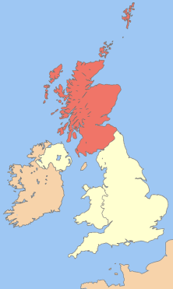
Scotland - Map
Zdroj: [cit. 2013-03-20]. Dostupný pod licencí Creative Commons na WWW:
http://commons.wikimedia.org/wiki/File%3AUk_map_scotland.png

Slide 4
Places of Interest
Edinburgh
a hilly city, dating from mediaval times
famous for its castle and the annual Edinburgh International Festival
Aberdeen
a chief city of northern Scotland, a university city
Glasgow
an industrial city and seaport, the largest city in Scotland
Loch Ness
a sea monster called Nessie is said to live in this lake (loch)

Slide 5
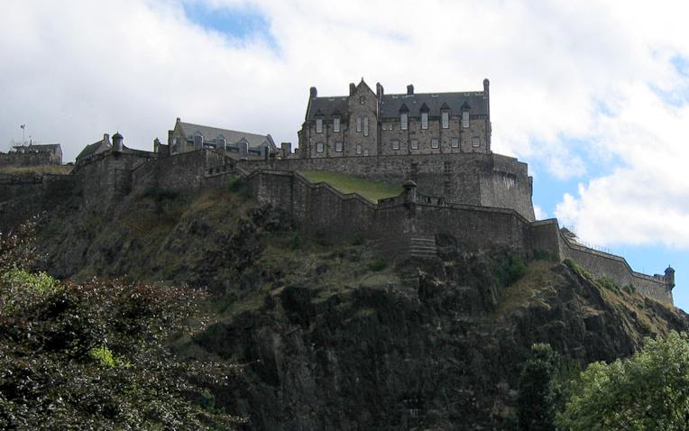
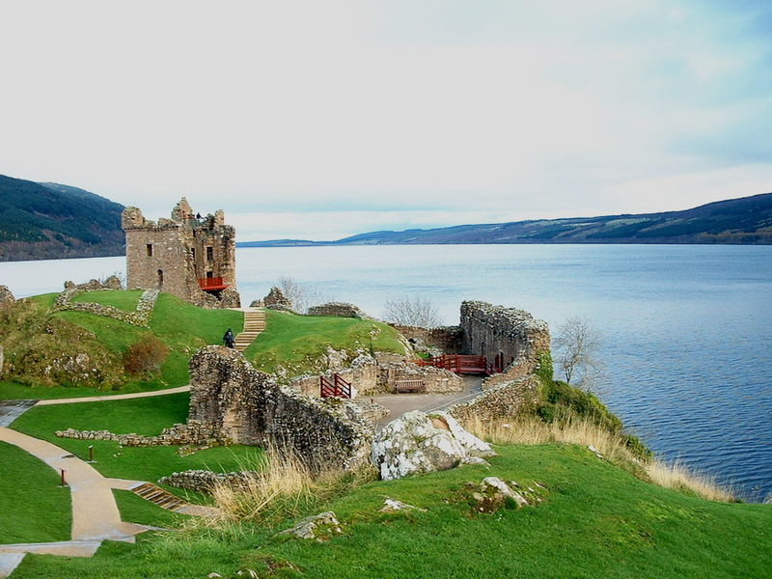
Edinburgh/Loch Ness
Zdroj Edinburgh: [cit. 2013-03-20]. Dostupný pod licencí Creative Commons na WWW:
http://commons.wikimedia.org/wiki/File:Edinburgh-castle.jpg
Zdroj Loch Ness: [cit. 2013-03-20]. Dostupný pod licencí Creative Commons na WWW:
http://commons.wikimedia.org/wiki/File:LochNess2.jpg

Slide 6
Highland Games
held every year from May to September
all round Scotland – the biggest are held in Cowal
bagpipers and drummers performances
dancing competitions
traditional games – throwing the hammer and tossing the caber (a large tree-trunk)
the athletes wear traditional skirts - kilts (with a sporran – a kind of purse)

Slide 7
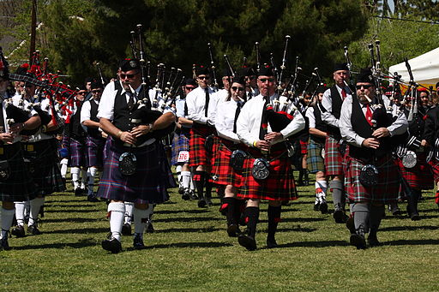
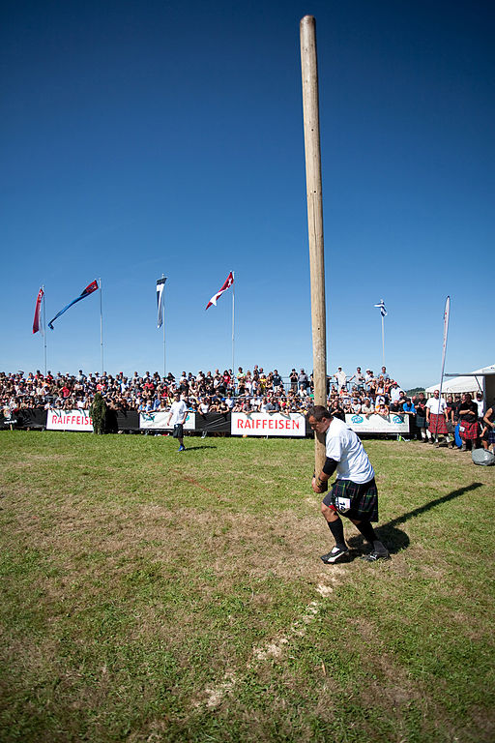
Highland Games
Zdroj caber tossing: [cit. 2013-03-20]. Dostupný pod licencí Creative Commons na WWW:
http://commons.wikimedia.org/wiki/File%3A2009_baumstammwerfen.jpg
Zdroj bagpipers: [cit. 2013-03-20]. Dostupný pod licencí Creative Commons na WWW:
http://commons.wikimedia.org/wiki/File%3ABagpipers_(3414062968).jpg

Slide 8
Questions
The capital of Scotland is:
Aberdeen b) Edinburgh c) Glasgow
What is the traditional Scottish skirt called?
The Scots word LOCH means:
a hole b) a lake c) a mountain
4. What are the traditional disciplines at Highland Games?

Slide 9
Answer Key
b).
It is called a kilt.
b).
The traditional disciplines are tossing the caber or throwing the hammer.

Slide 10
Source
BELÁN, Juraj. Odmaturuj! z anglického jazyka. Vyd. 1. Brno: Didaktis, 2005, 256 s. Odmaturuj!. ISBN 80-735-8024-1.
BRENDLOVÁ, Světla. Reálie anglicky mluvících zemí. 2., dopl. vyd. Plzeň: Fraus, c1996, 79 s. ISBN 80-857-8487-4.
EL-HMOUDOVÁ, Dagmar. Angličtina pro střední školy. 1. vyd. Třebíč: Petra Velanová, 2006. ISBN 80-868-7302-1.
KEMPTON, Grant. New opportunities UK/US: workbook. Vyd. 1. Harlow: Pearson Education Limited, 2006, 256 s. Odmaturuj!. ISBN 978-140-5829-441.
KEMPTON, Grant. New opportunities UK/US: workbook. Vyd. 1. Harlow: Pearson Education Limited, 2006, 256 s. Odmaturuj!. ISBN 978-0-582-84791-0.

