Slide 1
Název | The United Kingdom – Northern Ireland
Předmět, ročník | Seminář z anglického jazyka, septima
Tematická oblast | Reálie anglicky mluvících zemí I.
Anotace | Jedná se o prezentaci s výkladem, obrázky a úkoly.
Klíčová slova | Capital, places of interest, conflict, discrimination.
Autor | Mgr. Lucie Babišová
Datum | 22. 3. 2013
Škola | Gymnázium Jana Opletala, Litovel, Opletalova 189
Projekt | EU peníze středním školám, reg. č.: CZ.1.07/1.5.00/34.0221

Slide 2
Northern Ireland – Basic Facts
a part of the UK in the north-east of the island of Ireland, the symbol of the country is the shamrock
created in 1921, when Ireland was partitioned between Northern Ireland and Southern Ireland (unlike Southern Ireland, which would become the Irish Free State in 1922, the majority of the population of Northern Ireland wanted to remain within the UK)
largely self-governing, some areas are reserved for the Government of the UK
the capital is Belfast

Slide 3
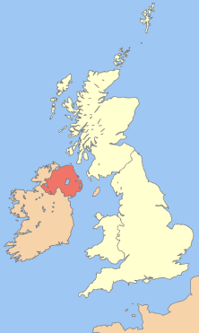
Northern Ireland - Map
Zdroj: [cit. 2013-03-22]. Dostupný pod licencí Creative Commons na WWW:
http://commons.wikimedia.org/wiki/File%3AUk_map_northern_ireland.png

Slide 4
Places of Interest
Belfast
the capital city
an industrial port and university city
the Ulster Museum and Botanical Gardens
Giant's Causeway
a natural wonder along the north coast
formed of hexagonal columns of basalt rock

Slide 5
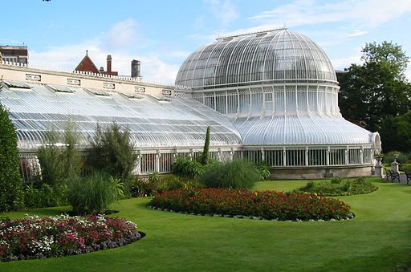
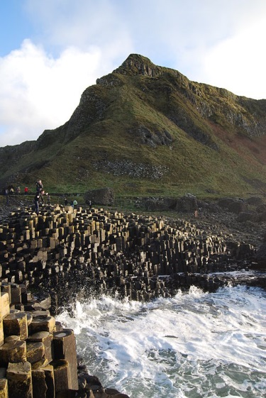
Belfast/Giant's Causeway
Zdroj: [cit. 2013-03-22]. Dostupný pod licencí public domain na WWW:
http://commons.wikimedia.org/wiki/File%3APalm_House_Botanic_Garden_Belfast.jpg
Zdroj: [cit. 2013-03-22]. Dostupný pod licencí creative commons na WWW:
http://commons.wikimedia.org/wiki/File%3AGiant's_Causeway_(17).JPG

Slide 6
The Troubles
starting in the late 1960s, consisted of about thirty years of violence between elements of Northern Ireland's nationalist community (principally Roman Catholic) and unionist community (principally Protestant) during which 3,254 people were killed
the conflict was caused by the disputed status of Northern Ireland within the UK and the discrimination against the nationalist minority by the dominant unionist majority
in 1973, Northern Ireland held a referendum to determine if it should remain in the UK, or be part of a united Ireland - the vote went heavily in favour (98.9%) of maintaining the status quo

Slide 7
Questions
What is the capital of the Northern Ireland?
What are the places of interest that are popular among tourists?
When did the Northern Ireland become a part of the UK?
Who is the head of the Northern Ireland?
What is the symbol of the country?

Slide 8
Answer Key
Belfast.
Belfast, Giant's Causeway.
In 1921.
The British monarch – the Queen.
It is the shamrock.

Slide 9
Source
BELÁN, Juraj. Odmaturuj! z anglického jazyka. Vyd. 1. Brno: Didaktis, 2005, 256 s. Odmaturuj!. ISBN 80-735-8024-1.
BRENDLOVÁ, Světla. Reálie anglicky mluvících zemí. 2., dopl. vyd. Plzeň: Fraus, c1996, 79 s. ISBN 80-857-8487-4.
EL-HMOUDOVÁ, Dagmar. Angličtina pro střední školy. 1. vyd. Třebíč: Petra Velanová, 2006. ISBN 80-868-7302-1.
KEMPTON, Grant. New opportunities UK/US: workbook. Vyd. 1. Harlow: Pearson Education Limited, 2006, 256 s. Odmaturuj!. ISBN 978-140-5829-441.
KEMPTON, Grant. New opportunities UK/US: workbook. Vyd. 1. Harlow: Pearson Education Limited, 2006, 256 s. Odmaturuj!. ISBN 978-0-582-84791-0.

