Slide 1
Název | The United Kingdom – London
Předmět, ročník | Seminář z anglického jazyka, septima
Tematická oblast | Reálie anglicky mluvících zemí I.
Anotace | Jedná se o prezentaci s výkladem, obrázky a úkoly.
Klíčová slova | Population, transportation system, tower, bridge, palace, gallery, column, sguare, monument, church, cathedral.
Autor | Mgr. Lucie Babišová
Datum | 20. 3. 2013
Škola | Gymnázium Jana Opletala, Litovel, Opletalova 189
Projekt | EU peníze středním školám, reg. č.: CZ.1.07/1.5.00/34.0221

Slide 2
London – Basic Facts
one of the most densely populated and biggest cities in Europe
the capital and the largest city in the UK
with a population of about 7 million
the seat of the central government
commercial and cultural centre of the country
famous for its tranportation system – London Underground (the Tube) – the world's oldest underground and red double-decker buses

Slide 3
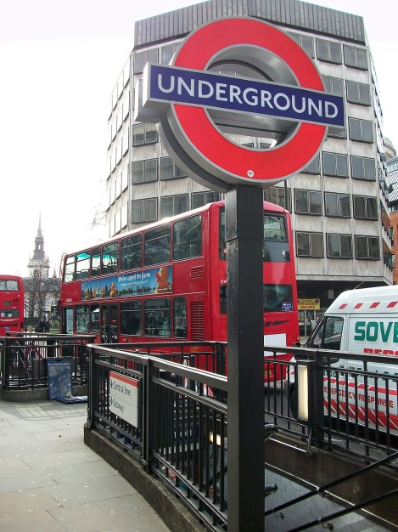
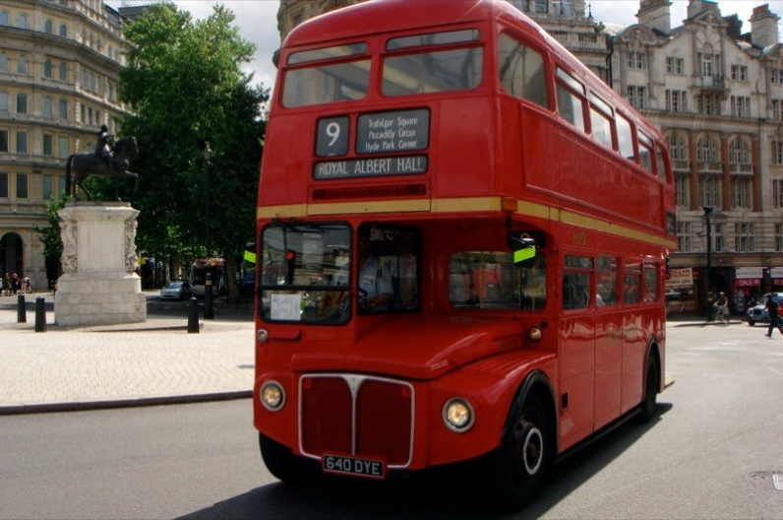
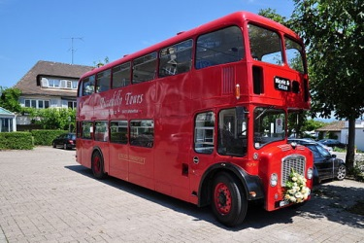
Transportation in London
Zdroj: [cit. 2013-03-20]. Dostupný pod licencí public domain na WWW:
http://commons.wikimedia.org/wiki/File%3ALondon_Underground_sign_02.jpg
Zdroj: [cit. 2013-03-20]. Dostupný pod licencí public domain na WWW:
http://commons.wikimedia.org/wiki/File%3ARed_double_decker_bus_in_London.jpg
Zdroj: [cit. 2013-03-20]. Dostupný pod licencí public domain na WWW:
http://commons.wikimedia.org/wiki/File%3AHurden_-_Bristol-Doppeldeckerbus_2011-07-09_13-43-40_ShiftN.jpg

Slide 4
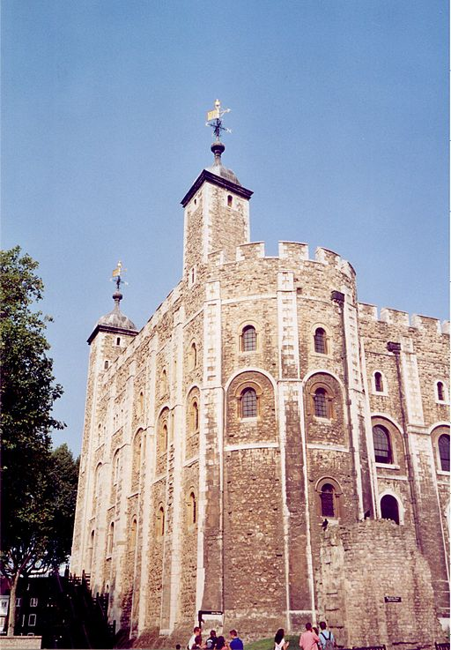
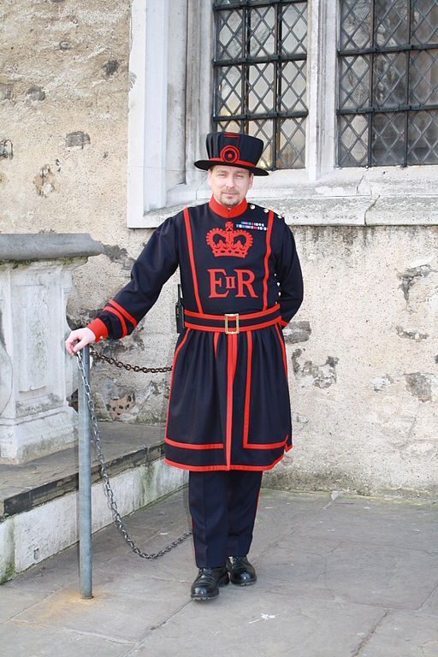
The City of London
The Tower of London
once a royal palce
then a prison (Anne
Boleyn, Sir T. More)
a museum now
(the crown jewels)
Yeoman Warders
callled Beefeaters
Zdroj Beefeater: [cit. 2013-03-20]. Dostupný pod licencí Creative Commons na WWW:
http://commons.wikimedia.org/wiki/File%3AYeoman_Warder_-_Beefeater.JPG
Zdroj Tower: [cit. 2013-03-20]. Dostupný pod licencí Creative Commons na WWW:
http://commons.wikimedia.org/wiki/File%3ALondon_-_White_Tower.jpg

Slide 5
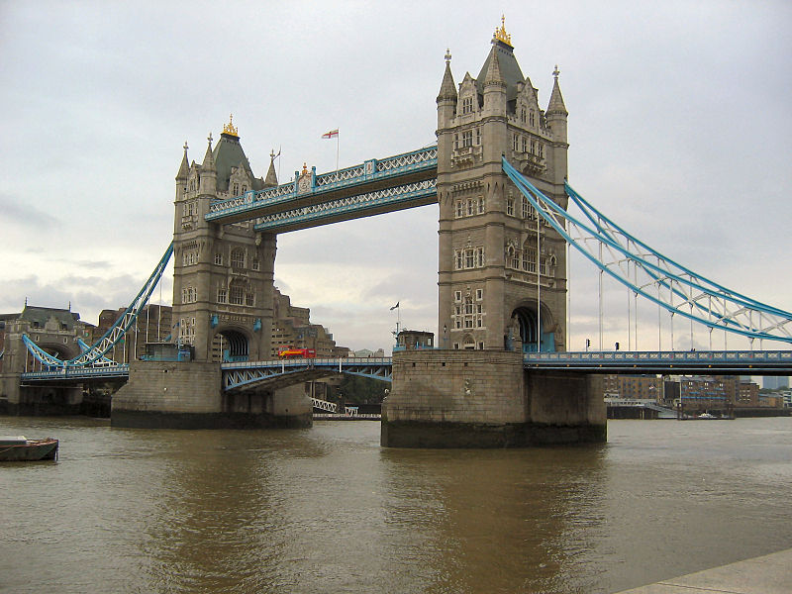
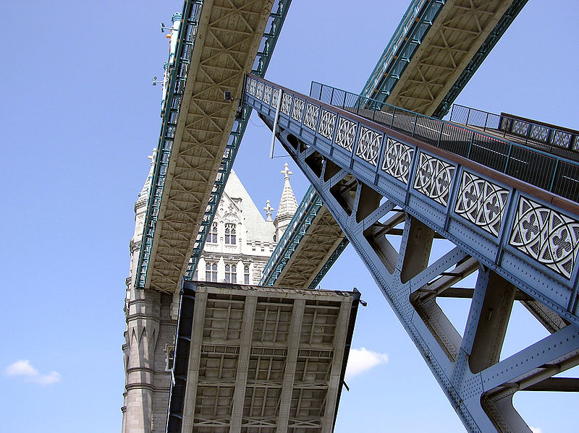
The City of London
Tower Bridge
a characteristic landmark of London
named after the Tower of London
a hydraulic mechanism can raise and lower the bridge in less tahn two minutes to permit the passage of high ships
Zdroj: [cit. 2013-03-20]. Dostupný pod licencí Creative Commons na WWW:
http://commons.wikimedia.org/wiki/File:Towerbridge2.jpg
Zdroj: [cit. 2013-03-20]. Dostupný pod licencí public domain WWW:
http://commons.wikimedia.org/wiki/File:Tower.bridge.7.basculecloseup.london.arp.jpg

Slide 6
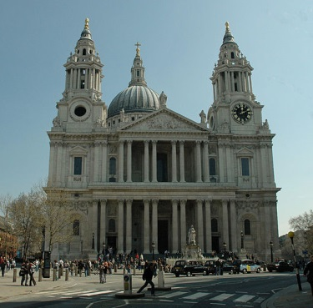
The City of London
St Paul's Cathedral
a catherdral built after the Great Fire of London in 1666
architect: Christopher Wren
the setting for the wedding of Charles and Diana in 1981
Zdroj: [cit. 2013-03-20]. Dostupný pod licencí Creative Commons na WWW:
http://commons.wikimedia.org/wiki/File%3ASt_Paul's_Cathedral_London_cropped_perspective_adjusted.jpg

Slide 7
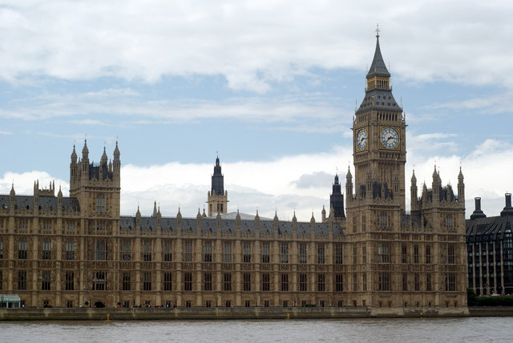
The City of Westminster
The Houses of Parliament
rebuilt in the Gothic style (1840-1857) after the fire in 1834
consists of two houses: the House of Lords and the House of Commons
Big Ben is the bell of the clock tower, called after Benjamin Hall (an engineer responsible for the construction)
Zdroj: [cit. 2013-03-20]. Dostupný pod licencí Creative Commons na WWW:
http://commons.wikimedia.org/wiki/File%3AThe_Houses_of_Parliament%2C_London_-_geograph.org.uk_-_1412018.jpg

Slide 8
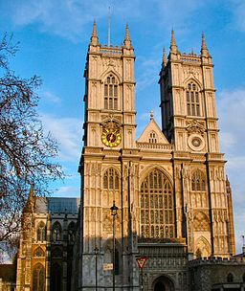
The City of Westminster
Westminster Abbey
English kings and queens have been crowned and buried here since Willeam the Conqueror in 1066
famous British writers, scholars, poets and scientists are buried here (Geoffrey Cahucer, Isaac Newton, etc.)
Zdroj: [cit. 2013-03-20]. Dostupný pod licencí Creative Commons na WWW:
http://commons.wikimedia.org/wiki/File%3AWestminster_Abbey_West_Door.jpg

Slide 9
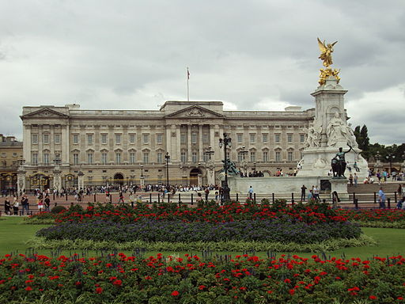
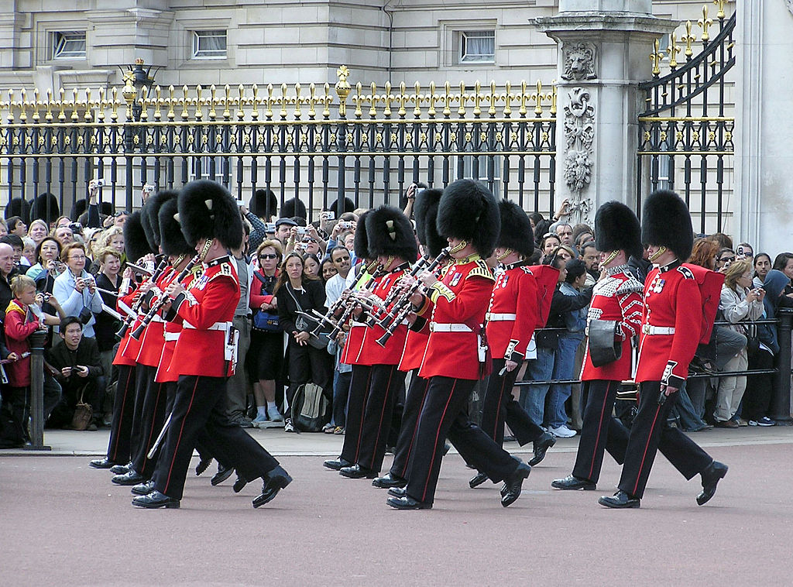
The City of Westminster
Buckingham Palace
the London home of the Qeen
the Royal Standard is flown from the flagstaff in her presence
the changing of the guard is a popular event
Queen Victoria Monument – in front of the palace
Zdroj Palace: [cit. 2013-03-20]. Dostupný pod licencí Creative Commons na WWW:
http://commons.wikimedia.org/wiki/File%3ABenkid77_Buckingham_Palace_1_100809.JPG
Zdroj Guard: [cit. 2013-03-20]. Dostupný pod licencí public domain na WWW:
http://commons.wikimedia.org/wiki/File%3AGuard.mounting.buck.palace.arp.jpg

Slide 10
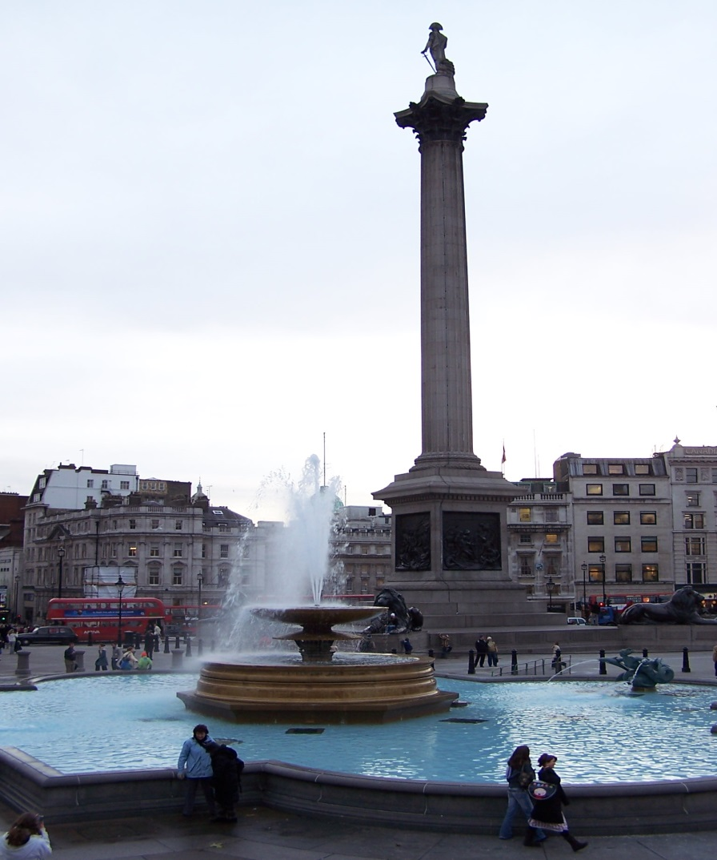
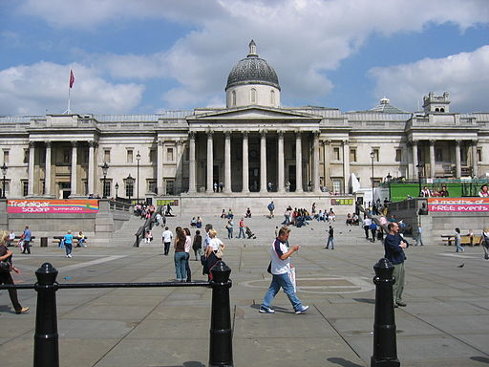
The City of Westminster
Tarafalgar Square
the bussiest part of London
large crowds gather there
Nelson's Column – named after Lord Nelson's victory over Napoleon at the Battle of Trafalgr in 1805
the National Gallery – one of the geratest collections of paintings in the world
Zdroj Column: [cit. 2013-03-20]. Dostupný pod licencí Creative Commons na WWW:
http://commons.wikimedia.org/wiki/File:London_TrafalgarSquareColumn01.JPG
Zdroj National Gallery: [cit. 2013-03-20]. Dostupný pod licencí Creative Commons na WWW:
http://commons.wikimedia.org/wiki/File%3ANational_Gallery_2004.jpg

Slide 11
Questions
What is the population of Londn?
What is the nickname of the London Underfround?
Where can you see the British crown jewels?
What is the name of the architect of St Paul's Cathedral?
Why is Big Ben called Big Ben (not big Tom)?
What is the name of the monument which is situated in front of the Buckingham Palacer?
Whose column is erected on Trafalgar Square?

Slide 12
Answer Key
7 million
The Tube
The Tower of London
Sir Christopher Wren
It is named after Benjamin hall, the engineer.
Queen Victoria Monument
Nelson's Column

Slide 13
Source
BELÁN, Juraj. Odmaturuj! z anglického jazyka. Vyd. 1. Brno: Didaktis, 2005, 256 s. Odmaturuj!. ISBN 80-735-8024-1.
BRENDLOVÁ, Světla. Reálie anglicky mluvících zemí. 2., dopl. vyd. Plzeň: Fraus, c1996, 79 s. ISBN 80-857-8487-4.
EL-HMOUDOVÁ, Dagmar. Angličtina pro střední školy. 1. vyd. Třebíč: Petra Velanová, 2006. ISBN 80-868-7302-1.
KEMPTON, Grant. New opportunities UK/US: workbook. Vyd. 1. Harlow: Pearson Education Limited, 2006, 256 s. Odmaturuj!. ISBN 978-140-5829-441.
KEMPTON, Grant. New opportunities UK/US: workbook. Vyd. 1. Harlow: Pearson Education Limited, 2006, 256 s. Odmaturuj!. ISBN 978-0-582-84791-0.

