Slide 1
Název | The United Kingdom – History
Předmět, ročník | Seminář z anglického jazyka, septima
Tematická oblast | Reálie anglicky mluvících zemí I.
Anotace | Jedná se o prezentaci s výkladem, obrázky a úkoly.
Klíčová slova | Battle, middle ages, moder times, qeen, king, dynasty, empire.
Autor | Mgr. Lucie Babišová
Datum | 6. 3. 2013
Škola | Gymnázium Jana Opletala, Litovel, Opletalova 189
Projekt | EU peníze středním školám, reg. č.: CZ.1.07/1.5.00/34.0221

Slide 2
The UK – History
Early History
the first inhabitants arrived from Europe between 3,500 B.C. and 3,000 B.C. (Stonehenge)
the Celts (Britons) started to invade Britain from the 10th century B.C
the Romans occupied Britain from 55 B.C. to the 5th century A.D.
the Angles and Saxons came from Germany and Denmark in the 5th century A.D.
the Vikings arrived from Scandinavia in the 9th cent.

Slide 3
Middle Ages
1066 - the Battle of Hastings – the English (King Harold) were defeated by the French army led by William the Conqueror, Duke of Normandy and became King William I. (French influence is still seen today)
1485 – a new dynasty, the Tudors, gained the throne – Henry VIII. established Church of England (1534)- Elizabeth I. (the Golden Age, the first English colonies in North America)

Slide 4
Modern Times
1649 – 1660 – the English Revolution – the monarchy was temporalily replaced with a series of republics and protectorates (led by Oliver Cromwell)
19th century – the long reign of Queen Victoria (ruled 1837 -1901) – the greates expansion and economic growth (the British Empire)
1926 – the British Commonwealth of Nations was declared – the countries that used to be or still are a part of the British Empire
1952 – Queen Elizabeth II. of the House of Windsor bacame qeen and the head of the royal family

Slide 5
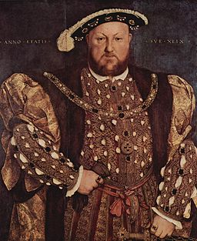
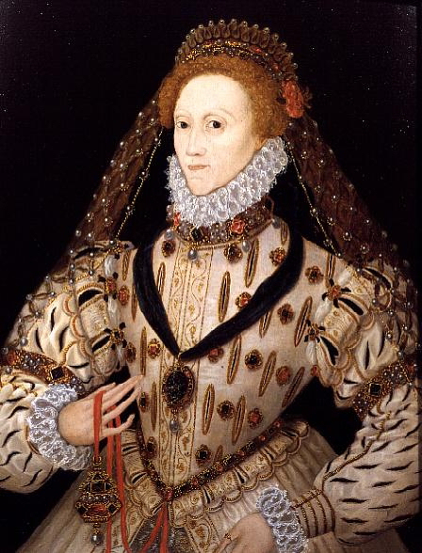
The Tudors - pictures
Zdroj Henry VIII.: [cit. 2013-03-06]. Dostupný pod licencí public domain na WWW:
http://commons.wikimedia.org/wiki/File%3AHans_Holbein_d._J._074.jpg
Zdroj Elizabeth I.: [cit. 2013-03-06]. Dostupný pod licencí public domain na WWW:
http://commons.wikimedia.org/wiki/File%3AElizabeth_I_c_1600.jpg

Slide 6
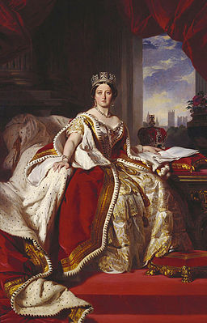
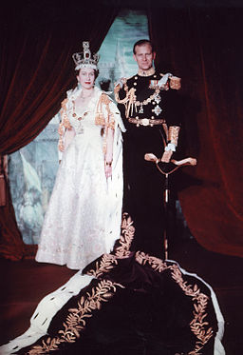
Queen Victoria and Elizabeth II.
Zdroj Queen Victoria: [cit. 2013-03-06]. Dostupný pod licencí public domain na WWW:
http://commons.wikimedia.org/wiki/File%3AVictoria_in_her_Coronation.jpg
Zdroj Elizabeth II.: [cit. 2013-03-06]. Dostupný pod licencí public domain na WWW:
http://commons.wikimedia.org/wiki/File%3AElizabeth_and_Philip_1953.jpg

Slide 7
Questions
When did the Normans conquered England?
What dynasty gained the throne in 1485?
What is the name of the association of states under the British sovereign?
Match the historical event with an explanantion (year):
a) The English Church 1. monarchy replaced with other forrms of government
b) The Golden Age 2. Henry VIII., quarrel with the Pope (1534)
c) The English Revolution 3. Elizabeth I., cultural era

Slide 8
Answer Key
1066
The Tudors
the British Commonwealth of Nations
a) 2, b) 3, c) 1.

Slide 9
Source
BELÁN, Juraj. Odmaturuj! z anglického jazyka. Vyd. 1. Brno: Didaktis, 2005, 256 s. Odmaturuj!. ISBN 80-735-8024-1.
BRENDLOVÁ, Světla. Reálie anglicky mluvících zemí. 2., dopl. vyd. Plzeň: Fraus, c1996, 79 s. ISBN 80-857-8487-4.
EL-HMOUDOVÁ, Dagmar. Angličtina pro střední školy. 1. vyd. Třebíč: Petra Velanová, 2006. ISBN 80-868-7302-1.
KEMPTON, Grant. New opportunities UK/US: workbook. Vyd. 1. Harlow: Pearson Education Limited, 2006, 256 s. Odmaturuj!. ISBN 978-140-5829-441.
KEMPTON, Grant. New opportunities UK/US: workbook. Vyd. 1. Harlow: Pearson Education Limited, 2006, 256 s. Odmaturuj!. ISBN 978-0-582-84791-0.

