Slide 1
Název | The United Kingdom – Geography
Předmět, ročník | Seminář z anglického jazyka, septima
Tematická oblast | Reálie anglicky mluvících zemí I.
Anotace | Jedná se o prezentaci s výkladem, obrázky a úkoly.
Klíčová slova | Land, mountain, river, lake, climate, area.
Autor | Mgr. Lucie Babišová
Datum | 6. 3. 2013
Škola | Gymnázium Jana Opletala, Litovel, Opletalova 189
Projekt | EU peníze středním školám, reg. č.: CZ.1.07/1.5.00/34.0221

Slide 2
The UK – Geography
Land: an island country located off the north-western coast of mainland Europe
Area: 244,755 sq km
The UK: comprises four geographic and historical parts: England (London), Scotland (Edinburgh), Wales (Cardiff) and Northern Ireland (Belfast)
The highest mountain: Ben Nevis (1,343m) in Scotland
The avarage temperature: ranges from 4˚C in winter to 16 ˚C in summer (the climate is modified by the warm Gulf Stream)

Slide 3
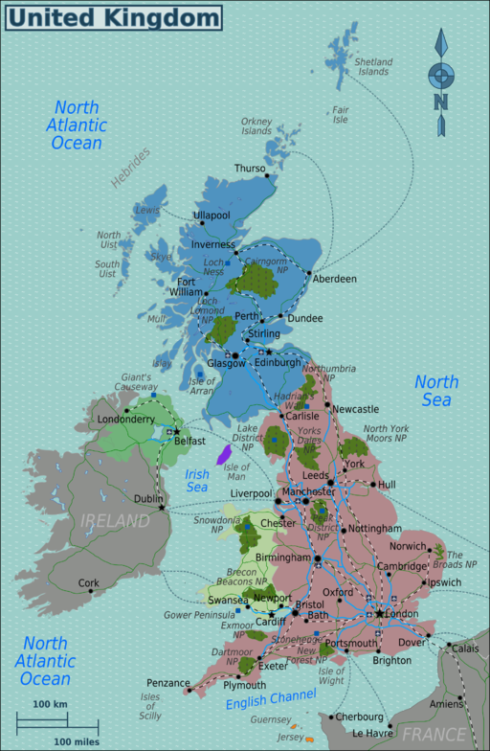
The UK - Map
Zdroj: [cit. 2013-03-06]. Dostupný pod licencí Creative Commons na WWW:
http://commons.wikimedia.org/wiki/File%3AUnited_Kingdom_map.png

Slide 4
Isles, rivers and lakes
The UK is surrounded by sea: the English Channel, the North Sea, the Irish Sea, the Atlantic Ocean
Islands: the Isla of Wigh, the Isles of Scilly, the Isle of Man, the Hebrides, the Orkneys, the Shetllands and the Channel Islands
Rivers: the Thames, the Severn, the Trent
Lakes: Loch Lomond and Loch Ness (the Highlands), Lough Neagh (in the Northern Ireland)

Slide 5
Mountain ranges
The highest mountais: the Highlands in Scotland (with Ben Nevis)
Mountain ranges: the Cumbrian Mountains (Lake District), the Pennine Chain (called the backbone of the country)

Slide 6
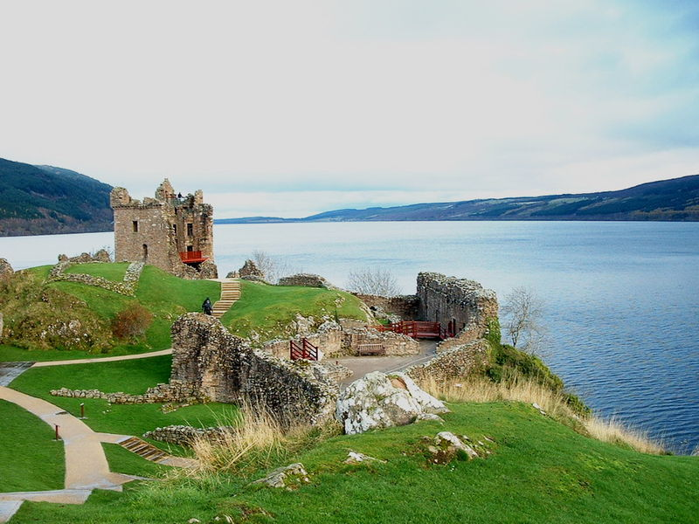
Loch Ness
Zdroj: [cit. 2013-03-06]. Dostupný pod licencí Creative Commons na WWW:
http://commons.wikimedia.org/wiki/File:LochNess2.jpg

Slide 7
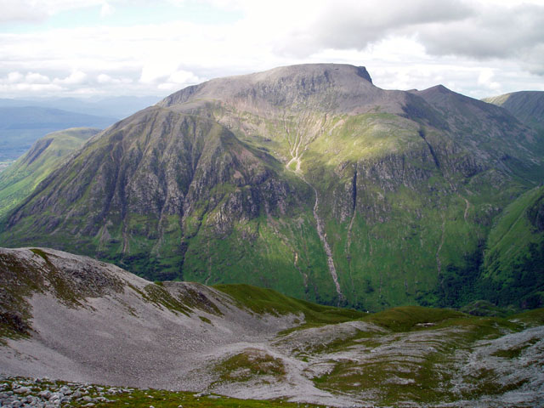
Ben Nevis
Zdroj: [cit. 2013-03-06]. Dostupný pod licencí Creative Commons na WWW:
http://commons.wikimedia.org/wiki/File:Ben_Nevis_south_face.jpg

Slide 8
Questions
What is the name of the highest mountain in the UK?
Name two rivers in the UK.
The back bone of the country is the nickname of ............ (fill the gap)
Match the cities with the parts of the country:
Wales 1. Belfast
Scotland 2. Cardiff
England 3. Edinburgh
Northern Ireland 4. London

Slide 9
Answer Key
Ben Nevis
The Thames, the Severn
The Pennine Chain
a) 2, b) 3, c) 4, d) 1

Slide 10
Source
BELÁN, Juraj. Odmaturuj! z anglického jazyka. Vyd. 1. Brno: Didaktis, 2005, 256 s. Odmaturuj!. ISBN 80-735-8024-1.
BRENDLOVÁ, Světla. Reálie anglicky mluvících zemí. 2., dopl. vyd. Plzeň: Fraus, c1996, 79 s. ISBN 80-857-8487-4.
EL-HMOUDOVÁ, Dagmar. Angličtina pro střední školy. 1. vyd. Třebíč: Petra Velanová, 2006. ISBN 80-868-7302-1.
KEMPTON, Grant. New opportunities UK/US: workbook. Vyd. 1. Harlow: Pearson Education Limited, 2006, 256 s. Odmaturuj!. ISBN 978-140-5829-441.
KEMPTON, Grant. New opportunities UK/US: workbook. Vyd. 1. Harlow: Pearson Education Limited, 2006, 256 s. Odmaturuj!. ISBN 978-0-582-84791-0.

