Slide 1
Název | The United Kingdom – Basic Facts
Předmět, ročník | Seminář z anglického jazyka, septima
Tematická oblast | Reálie anglicky mluvících zemí I.
Anotace | Jedná se o prezentaci s výkladem, obrázky a úkoly.
Klíčová slova | Official name, population, area, division, flag, symbol, country, government, parliament.
Autor | Mgr. Lucie Babišová
Datum | 5. 3. 2013
Škola | Gymnázium Jana Opletala, Litovel, Opletalova 189
Projekt | EU peníze středním školám, reg. č.: CZ.1.07/1.5.00/34.0221

Slide 2
The UK – Basic Facts
The official name:
the United Kingdom of Great Britain and Northern Ireland
Capital:
London
Polulation:
60,4 million (2003 estimate)
Official language: English (some nations speak their own language – people in Wales speak Welsh, Gaelic is spoken in Scotland)
Area:
244,820 sq km
Division:
England (London), Scotland (Edinburgh), Wales (Cardiff), Northern Ireland (Belfast) – united under one government

Slide 3
Symbols of the country
The Flag
is known as the Union Jack (officially adopted in 1801)
made up of three crosses: St George of England, St Andrew of Scotland and St Patrick of Ireland
the crosses are on a blue background
it is flown on Buckingham Palace when the monarch is at home

Slide 4
The Flag
Zdroj: [cit. 2013-03-05]. Dostupný pod licencí public domain na WWW:
http://commons.wikimedia.org/wiki/File%3AFlag_of_the_United_Kingdom.svg

Slide 5
Government
Form of government:
constitutional monarchy (in practice a parliamentary democracy)
Head of state:
monarch (qeen or king) – formally the head of the executive and judiciary, commander-in-chief of all the armed forces, and temporal governor of the Church of England
Head of government:
the prime minister

Slide 6
Parliament
consists of two houses:
The House of Commons
with 650 members
is the law making body
presided over by the Speaker
The House of Lords
with about 1,170 members
presided over by the Lord Chancellor

Slide 7
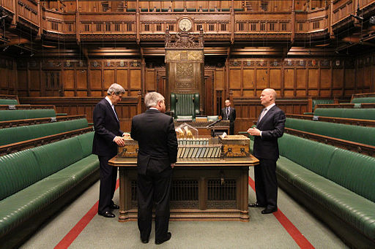
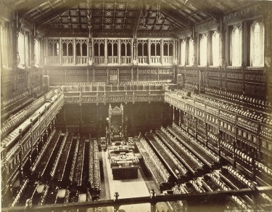
The House of Commons
Zdroj: [cit. 2013-03-05]. Dostupný pod licencí United States Department of State na WWW:
http://commons.wikimedia.org/wiki/File%3ASecretary_Kerry_in_House_of_Commons_Chamber.jpg
Zdroj: [cit. 2013-03-05]. Dostupný pod licencí public domain na WWW:
http://commons.wikimedia.org/wiki/File%3AOld_House_of_Commons_chamber%2C_F._G._O._Stuart.jpg

Slide 8
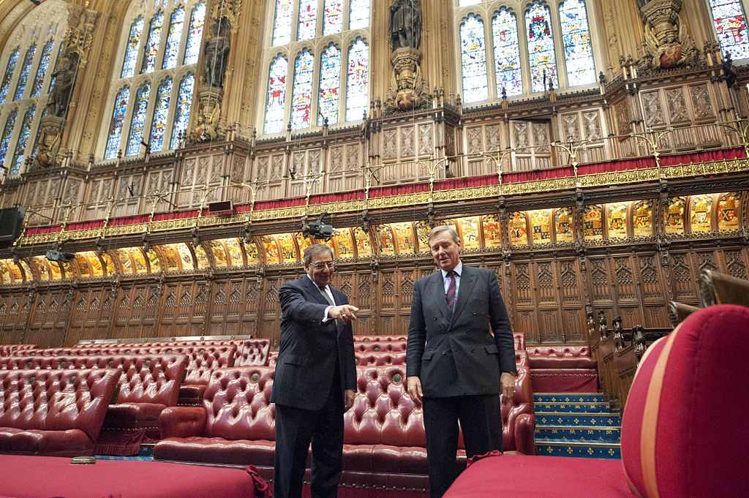
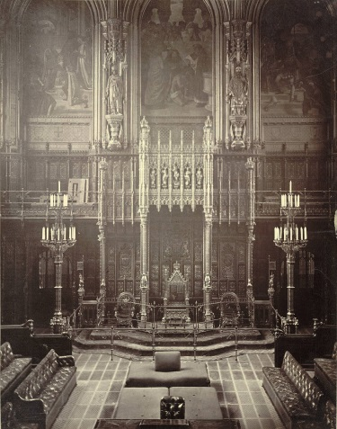
The House of Lords
Zdroj: [cit. 2013-03-05]. Dostupný pod licencí public domain na WWW:
http://commons.wikimedia.org/wiki/File%3AHouse_of_Lords%2C_throne.jpg
Zdroj: [cit. 2013-03-05]. Dostupný pod licencí Creative Commons Attribution 2.0 Generic na WWW:
http://commons.wikimedia.org/wiki/File%3ALeon_Panetta_given_tour_of_the_House_of_Lords_(2).jpg

Slide 9
Questions
The UK consists of :
England, Scotland, Wales, Northern Ireland.
England, Scotland, Wales, Eire.
England and Scotland.
What is the nickname of the British flag?
Who is the head of the country:
the monarch (queen or king)
the prime minister
4. The British parliament consists of two houses, what are their names?

Slide 10
Answer Key
a).
The Union Jack
a).
The House of Lords and the House of Commons.

Slide 11
Source
BELÁN, Juraj. Odmaturuj! z anglického jazyka. Vyd. 1. Brno: Didaktis, 2005, 256 s. Odmaturuj!. ISBN 80-735-8024-1.
BRENDLOVÁ, Světla. Reálie anglicky mluvících zemí. 2., dopl. vyd. Plzeň: Fraus, c1996, 79 s. ISBN 80-857-8487-4.
EL-HMOUDOVÁ, Dagmar. Angličtina pro střední školy. 1. vyd. Třebíč: Petra Velanová, 2006. ISBN 80-868-7302-1.
KEMPTON, Grant. New opportunities UK/US: workbook. Vyd. 1. Harlow: Pearson Education Limited, 2006, 256 s. Odmaturuj!. ISBN 978-140-5829-441.
KEMPTON, Grant. New opportunities UK/US: workbook. Vyd. 1. Harlow: Pearson Education Limited, 2006, 256 s. Odmaturuj!. ISBN 978-0-582-84791-0.

